Slide 1

Donor Prediction Challenge
Who is likely to donate to charity?

Slide 2
Introduction
The challenge here is to draw insights from previous donor history and make predictions based on that to identify the most likely donors to reach out to.
Being able to identify the individuals with the highest potential to donate will save the charity organization time, money and efforts

Slide 3
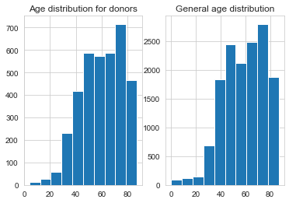
Insights
Age
Most of the people who donated in the past were between the ages of 70 and 80. Promotional efforts should be targeted at this age group

Slide 4
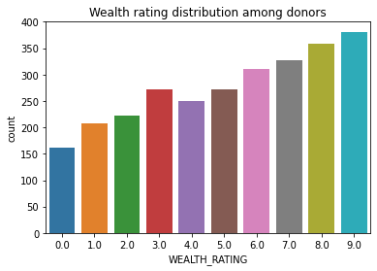
Insights(contd.)
Wealth Rating
As expected, people with higher wealth rating are more likely to give. Therefore, promotional efforts should be targeted at the more wealthy people

Slide 5
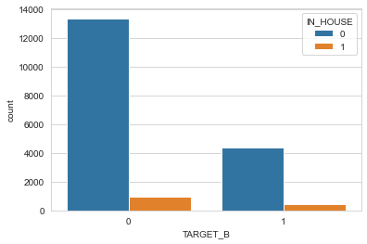
Insights(contd.)
Inhouse donations
It appears, there’s little contribution among workers within the charity. There should be a focus on donation among staff as this with set a precedent for other people.

Slide 6
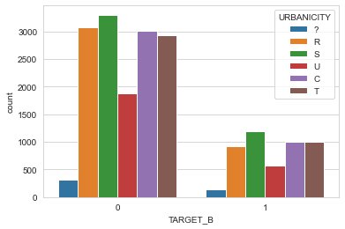
Insights (contd.)
Location
It appears from the data graph that there’s comparatively little data about people in Urban area. There is a good chance that urban dwellers will be willing to donate, so more efforts should be made to reach out to people in these areas

Slide 7
Prospects to Contact
1,198 individuals are predicted to be likely to donate to the charity and they are identified by their controlled number as given by the list_of_likely_donors series in the prediction python notebook file.

Slide 8
Reasoning Process For The Code
Data Cleaning
There were null values in the Donor Age, Income Group, and Wealth Rating columns. Rather than dropping them, they were filled with the mean, mode, and median values of the columns respectively. This was to prevent information loss.
The Gender column contained an additional class in the training data than in the prospective donors data, so the column was dropped to avoid training issues. The target_d column had about 75% null values. It was also dropped

Slide 9
Feature selection, Undersampling and model training
A baseline logistic regression model trained on the cleaned donor data showed that the data had a high skew towards selecting negative outcomes as there were mostly negative target variables in the training data. This led to a high precision on the 0 target value implying a biased dataset.
To tackle this, undersampling was carried out (both on the training set and the whole dataset) to randomly reduce the negative target values in the training set.
Various algorithms were also trained (logistic regression, random forest, decision tree, and XGB classifier) with feature selection to pick the most statistically important features.

Slide 10
Evaluation
Since we are concerned with identifying positive outcomes, the metric used to select the best model was the positive recall given by the formula True positives/(True positives+false negatives)
The XGB classifier with features selected and undersampling on the training set alone gave a marginally better performance than others and was used for the prediction (0.56 which is not good, but was the best I could find while training)

Slide 11
Further work
I plan to carry out more research on ways to improve the recall and accuracy and also train a neural network for this problem

