Slide 1
Dual-Stage EV Fast-Charging System
Design, simulation and automatic parameter calculation
Ayman Hazem ElShazly · R&D Internship, MIT Manipal
Supervisor: Dr. Anjan N Padmasali
Notes:
Introduce the project: a two-stage charger (AFE rectifier plus buck-boost) simulated in MATLAB/Simulink, with an automatic design script.

Slide 2
Objective: one script from inputs to results
1
2
3
Design
Automate
Verify
AFE rectifier with LCL filter plus synchronous buck-boost, feeding a 100 kWh, 400 V battery at up to 2C
Enter grid voltage, power, initial SOC and run time; all components and gains are calculated
CC then CV charging, rising SOC, regulated DC link, power factor and efficiency
Notes:
Three goals: design, automate, verify.

Slide 3
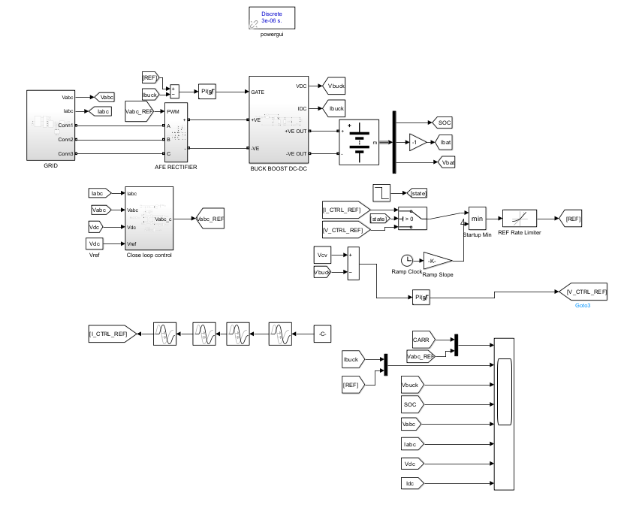
The simulated system
Grid: 400 V or 220 V, 50 Hz, LCL filter
AFE rectifier: IGBT bridge, 10 kHz PWM, DC link
Buck-boost: 100 kHz, current-controlled
Battery: 100 kWh, 400 V, 250 Ah (2C = 500 A), so power is limited to 200 kW
Reference ramp and rate limiter smooth the current steps
Notes:
Top level of the Simulink model: grid, AFE rectifier, buck-boost, battery, and the control subsystems.

Slide 4
How the design is automated
Inputs
Calculate
Simulate
Report
Grid voltage, power, initial SOC, run time
DC link, filter, inductor, capacitor, gains; printed with formulas
Model reads the workspace variables and runs
Power, efficiency, power factor, SOC, plot
One MATLAB script (charger_design_RAMP_v3.m) replaces all hard-coded numbers in the model.
Notes:
The user enters four inputs. The script prints every calculation with its formula in the Command Window and writes the variables to the workspace.

Slide 5
Component values for the two designs
Quantity | 400 V / 200 kW | 220 V / 60 kW
DC-link voltage | 700 V | 400 V
DC-link capacitor | 1031 µF | 984 µF
L / Lf / Cf | 107 µH / 27 µH / 199 µF | 112 µH / 27 µH / 197 µF
Resonant frequency | 2.43 kHz | 2.42 kHz
Maximum charging current | 500 A | 150 A
Buck-boost L / Co | 36 µH / 500 µF | 66 µH / 200 µF
Peak inductor current | 900 A | 354 A
Modulation index | 0.93 | 0.90
Notes:
Main component values. Complete formulas and parameter tables are in the report.

Slide 6
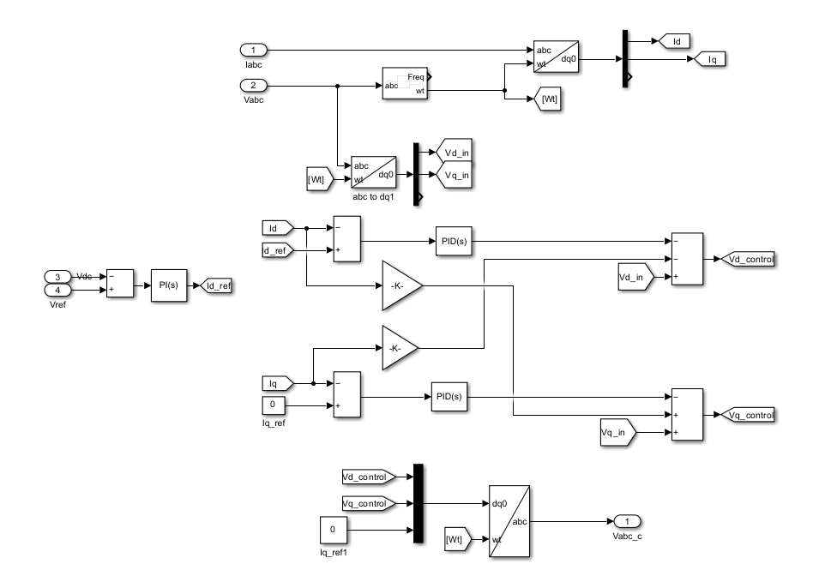
Control strategy
AFE: voltage-oriented control
dq frame, Iq = 0 for unity power factor; current loop about 970 Hz, DC-link loop 150 Hz
Charging: CC then CV
Staircase of 40-100 % of Io,max, then a time-based switch at 0.4 s to a 447 V constant-voltage loop
Notes:
AFE uses voltage-oriented control. The DC/DC stage runs CC then CV; the switch is at a fixed 0.4 s.

Slide 7
Four simulated cases
Case | Grid / power | Initial SOC | Run time
1 | 400 V / 200 kW | 80 % | 5 s
2 | 400 V / 200 kW | 70 % | 10 s
3 | 400 V / 200 kW | 90 % | 3 s
4 (additional) | 220 V / 60 kW | 70 % | 0.5 s
Cases 1 to 3 are the cases requested by the supervisor. Case 4 shows that the same script and model adapt to a different grid voltage and power.
Notes:
Cases 1-3 as requested; Case 4 added to show the design adapts.

Slide 8
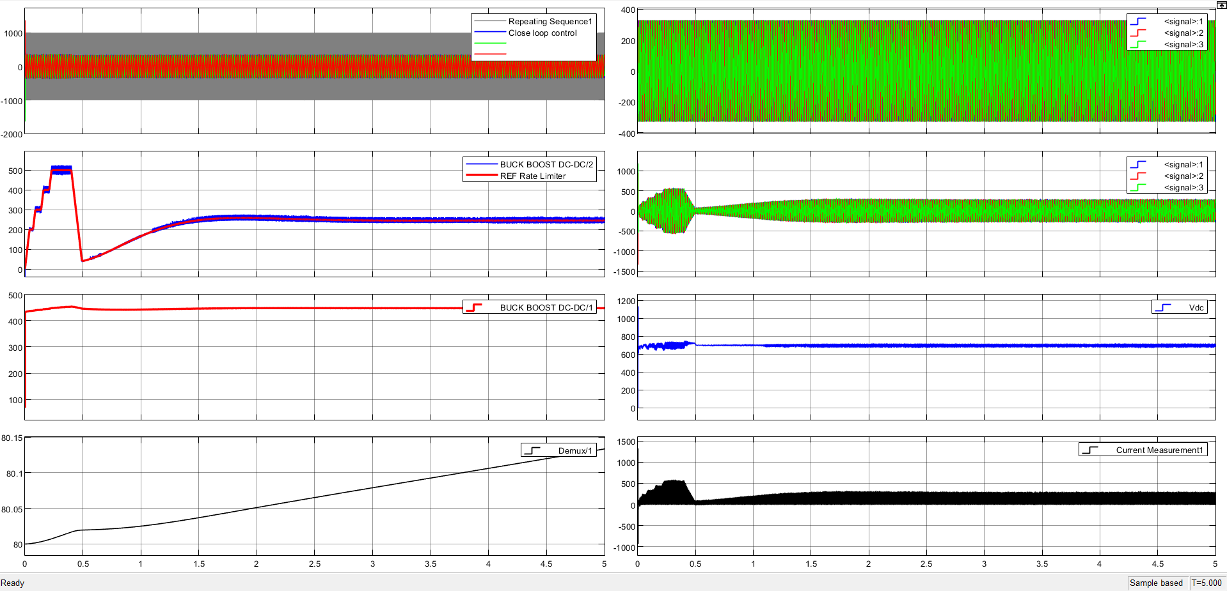
Case 1: 80 % SOC, 5 s
+0.134 %
SOC rise (80 to 80.134 %)
225 kW
battery power, CC stage
90.0 %
overall efficiency
CV current settles near 250 A at 447 V.
Notes:
Case 1: 80 % SOC, 5 s. CV current settles near 250 A at 447 V.

Slide 9
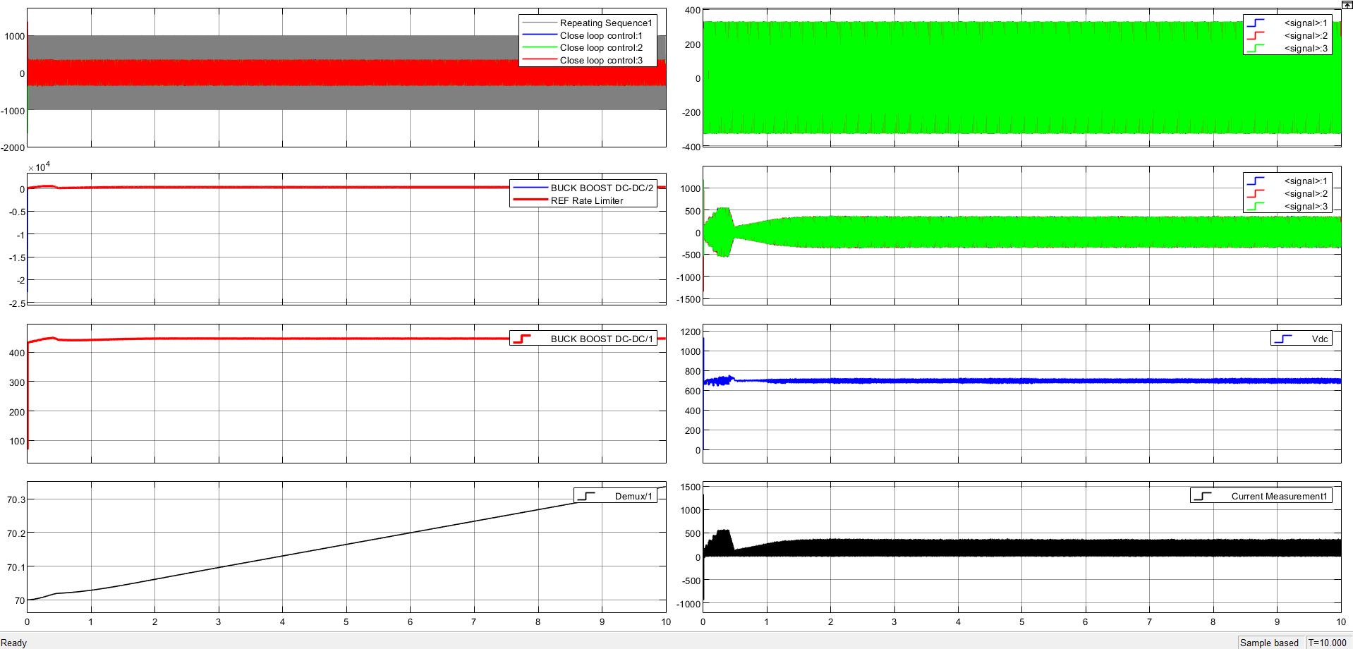
Case 2: 70 % SOC, 10 s
+0.337 %
SOC rise (70 to 70.337 %)
224 kW
battery power, CC stage
90.0 %
overall efficiency
CV current is about 310 A: a lower SOC means more current.
Notes:
Case 2: 70 % SOC, 10 s. CV current is about 310 A: a lower SOC means more current.

Slide 10
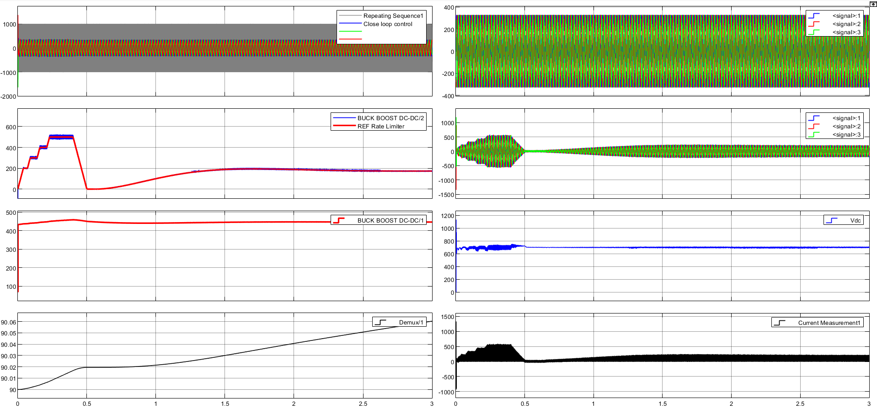
Case 3: 90 % SOC, 3 s
+0.060 %
SOC rise (90 to 90.060 %)
228 kW
battery power, CC stage
90.0 %
overall efficiency
The battery reached 460 V before the fixed-time CV switch, so the current fell to almost zero for 0.15 s.
Notes:
Case 3: 90 % SOC, 3 s. The battery reached 460 V before the fixed-time CV switch, so the current fell to almost zero for 0.15 s.

Slide 11
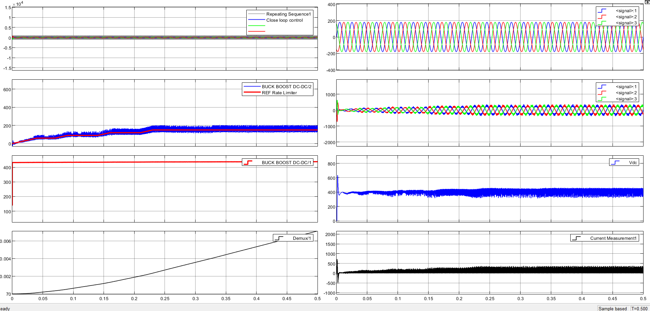
Case 4: 220 V, 60 kW, 70 % SOC, 0.5 s
+0.007 %
SOC rise (70 to 70.007 %)
69 kW
battery power, CC stage
92.7 %
overall efficiency
True power factor 0.988; DC-link ripple about 25 % peak-to-peak.
Notes:
Case 4: 220 V, 60 kW, 70 % SOC, 0.5 s. True power factor 0.988; DC-link ripple about 25 % peak-to-peak.

Slide 12
Efficiency by stage and case
The AFE and filter are about 99 % efficient
The buck-boost stage causes almost all of the loss at 400 V (about 90.5 %)
Case 4 is more efficient because its currents are lower
Notes:
Efficiency over the window 0.25 to 0.38 s. Buck-boost loss is probably dominated by IGBT switching loss at 100 kHz.

Slide 13
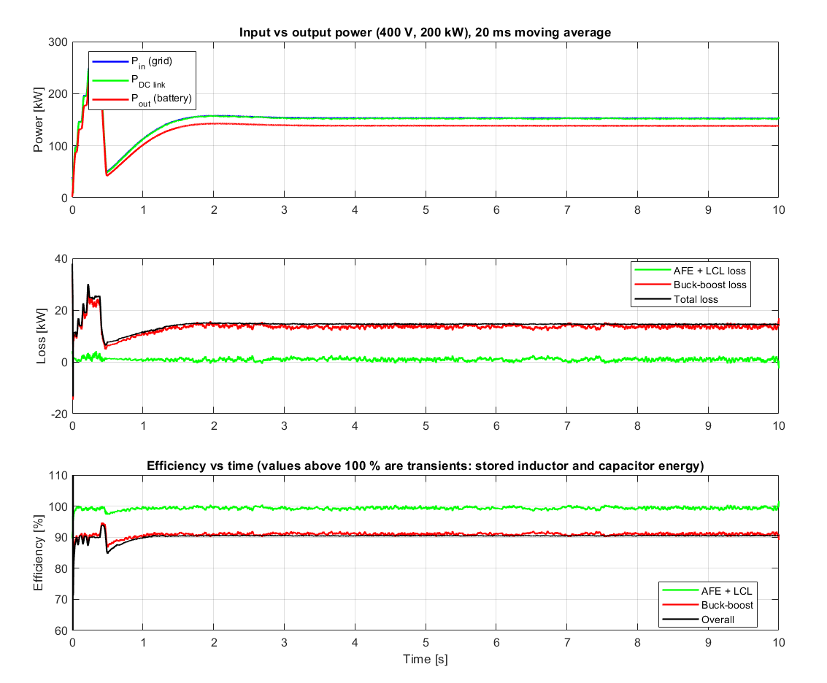
Where the power goes (Case 2)
Grid power, DC-link power and battery power are logged and averaged over 20 ms
The gap between grid and battery power is the loss
In the CC stage the battery gets 224 kW against 200 kW requested; the current limit uses the nominal 400 V, but the battery is at about 450 V
In CV the power settles near 138 kW (about 310 A)
Notes:
Explain Pin, Pdc, Pout, and why output power exceeds the request.

Slide 14
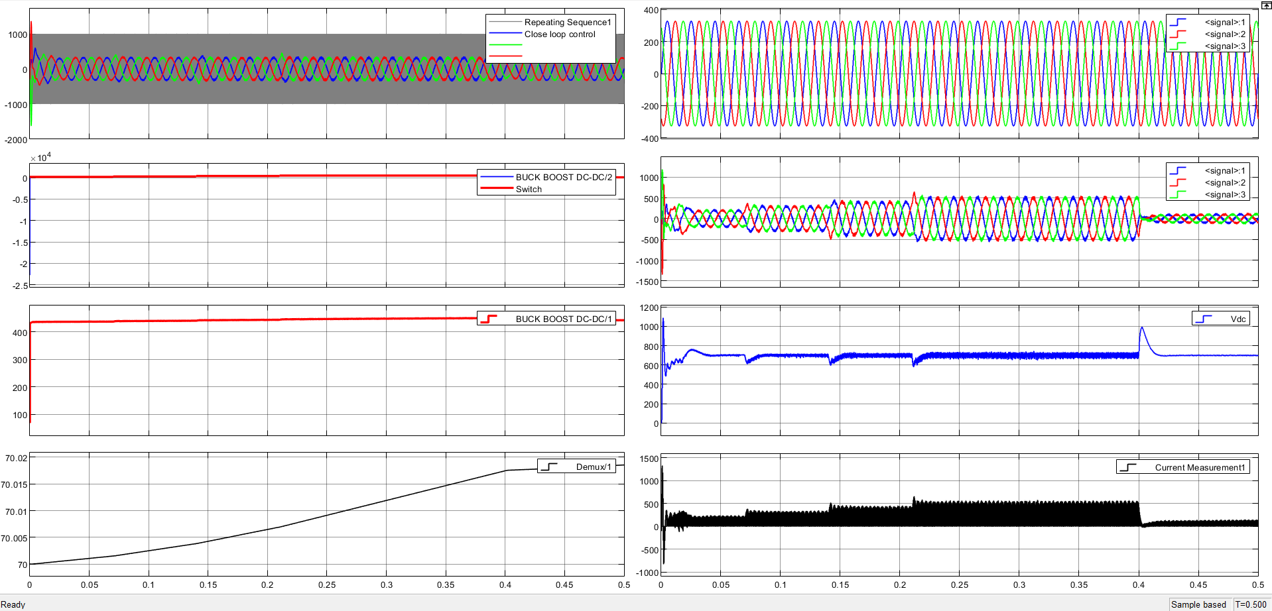
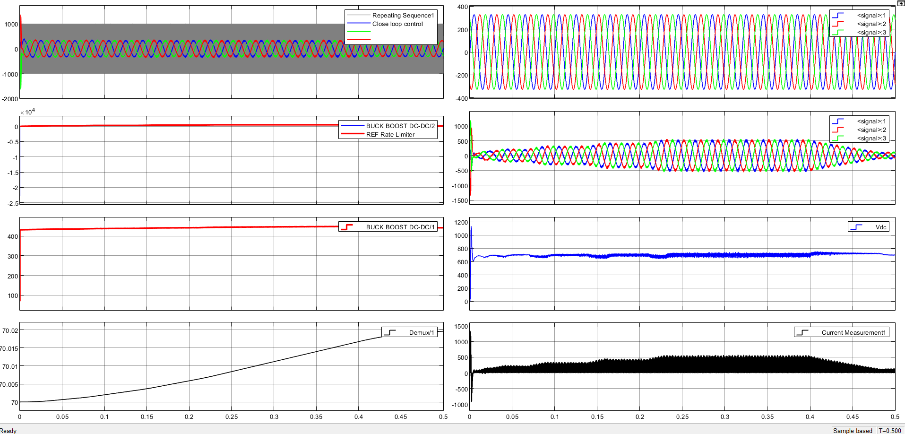
Effect of the current-reference ramp
Without ramp
With ramp and rate limiter
DC link overshoots to about 1000 V at the CC to CV switch
Currents change smoothly; DC link stays at 700-750 V
Notes:
Both runs: 400 V, 200 kW, first 0.5 s.

Slide 15
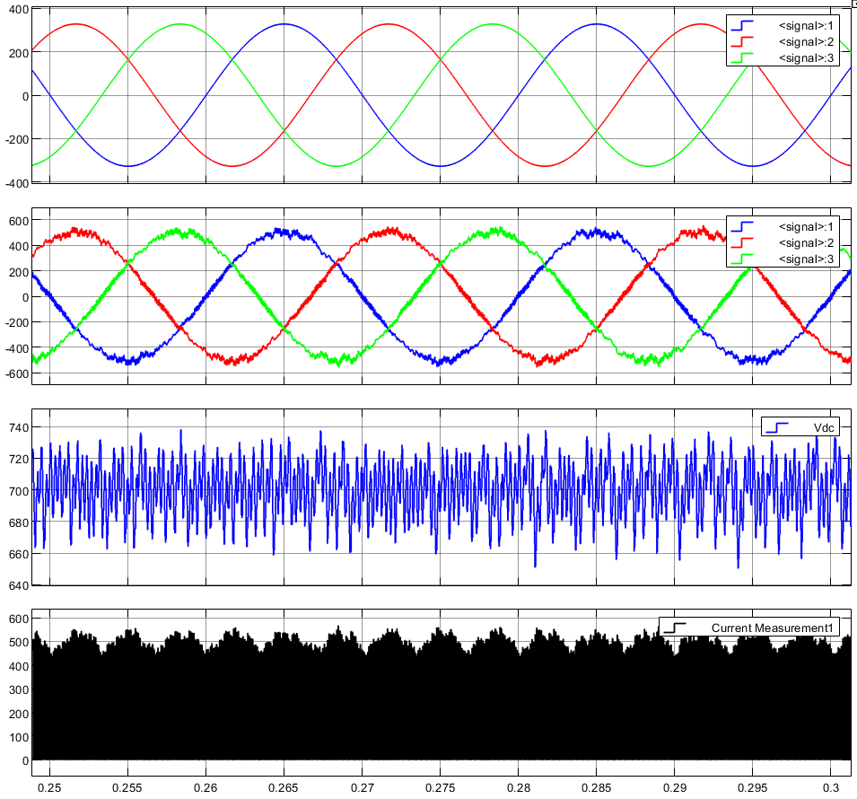
Unity power factor at the grid
1.000
0.999
displacement power factor
true power factor, 400 V
4.3 %
0.988
current distortion (THD), 400 V
true power factor, 220 V (THD 15.5 %)
Voltage and current of each phase peak at the same instant, so the AFE draws sinusoidal current in phase with the grid voltage.
Notes:
True power factor is below 1 only because of switching ripple in the current, not because of a phase shift.

Slide 16
Limitations and next steps
Power above request
Buck-boost efficiency
Battery gets 12-15 % more than requested. Size the current limit with 447 V instead of 400 V.
About 90.5 % at 400 V, likely IGBT switching loss at 100 kHz. A SiC module would suit better.
Time-based CV switch
Start-up and low voltage
At 90 % SOC the voltage passed 447 V before the switch. Trigger the switch on voltage.
Short start-up spike; larger ripple at 220 V. Retune the gains and delay the PWM until the PLL locks.
Notes:
Be open about the limitations; each has a concrete fix.

Slide 17
Conclusion
A dual-stage EV charger was designed and simulated, with all values calculated from four inputs
The DC link is regulated, charging runs CC then CV, and the SOC increases in all four cases
Displacement power factor 1.000; overall efficiency about 90 % at 400 V and 93 % at 220 V
Main limits: power above request, a time-based CC to CV switch, and IGBT losses at 100 kHz
Notes:
Summarise and invite questions.

