Slide 1
Human Activity Recognition Using Wavelet Transform: Data Visualisation

Slide 2
Introduction to UCI Human Activity Dataset
The Standard Human Activity Recognition Dataset is presented by UCI and can be downloaded from:
https://archive.ics.uci.edu/ml/datasets/human+activity+recognition+using+smartphones
The dataset provided by XXX is a public domain dataset and was made available in 2013.
The data was collected by volunteer subjects of age bracket of 19 to 48 years old while they perform ‘ Six Daily Human Activities’ while waist mounted smartphone records data using embedded accelerometer and gyroscope.
The 6 different Activities were:
Sitting
Standing
Laying
Walking Upstairs
Walking Downstairs
Walking
The movement data was recorded using Samsung Galaxy S II (smartphone).
The Data is recorded for manual annotation.

Slide 3
How Data is recorded
Tri-axial accelerometer and gyroscope data were recorded at 50 Hz (i.e. 50 datapoints per second)
The data available is pre-processed using following steps:
Pre-processing Accelerometer and Gyroscope data using noise filters
Splitting data into fixed size of 128 datapoints, i.e. fixed window size of 2.56 seconds for each activity.
Accelerometer data is divided into Body and Gravity acceleration signals, using low pass filter with corner frequency of 0.3 Hz.
The signals time varying signals obtained are as followed:
Total body acceleration signal-x,y,z
Acceleration signal-x,y,z
Gyro scope signal-x,y,z
Thus, the data available are only numerical values and fortunately with no missing values.

Slide 4
Data Distribution:
30 volunteer subjects activity recorded signal data is randomly split into ‘Train(70%)’ and ‘Test’(30%) data files.
The training data is comprised of 7352 rows for each axis sensor signal or window data, where each window has 128 observation.
Each of the datapoints corresponds to one of the activities.
The activities are encoded as followed:
WALKING– 1
WALKING_UPSTAIRS– 2
WALKING_DOWNSTAIRS– 3
SITTING– 4
STANDING– 5
LAYING– 6

Slide 5
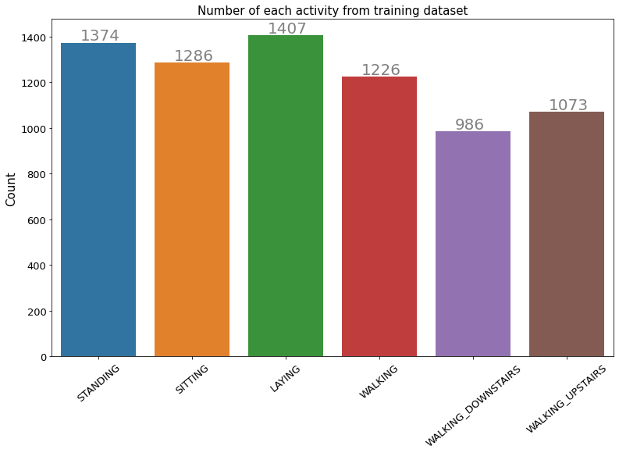
Figure [1] : Count of each activity by subject
As show in figure [1], there fluctuations in label counts, the dataset is fairly distributed.

Slide 6
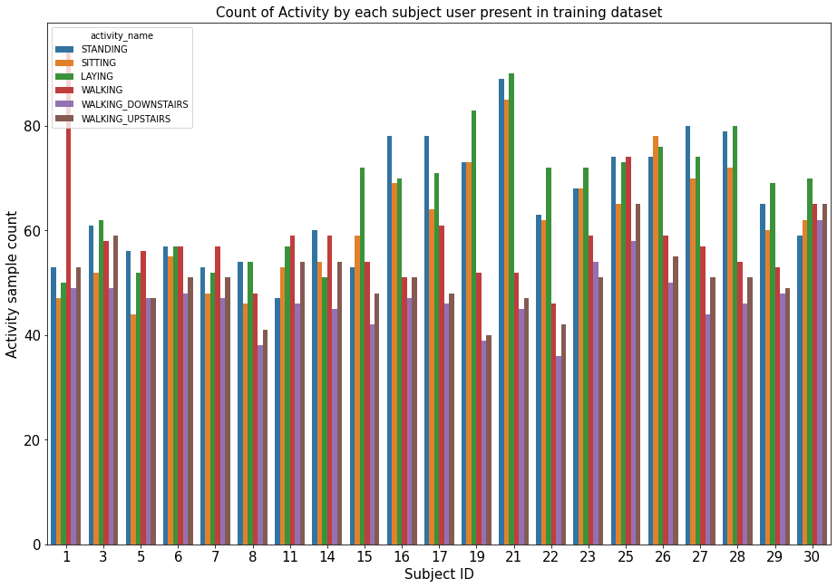
Data Distribution [Contd…]:
Figure [2] reveals, personal information of the participant.
Each participating subject has variations in time samples measured by sensors.
The samples available for each activity for each subject is available.
Figure [2]: Sample count of each subject for each six activity

Slide 7
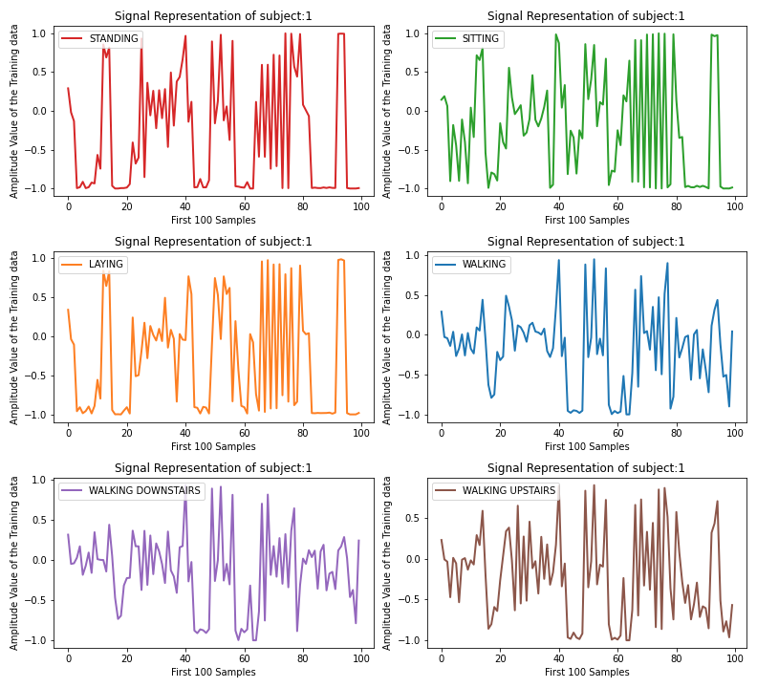
Activity Exploration :
Figure [4] : Signal representation of subject 1 for all activity

Slide 8
Activity Exploration [Contd..] :
The figure [3], shows the activity performed by subject:1.
A close look on signal activity for Static activities shows some what similar variations for first 100 time domain properties present inside the ‘training.txt’ file.
The dynamic signals are :
Sitting
Laying
Standing
On the other hand, dynamic activities shows similar variations for the first 100 time domain properties of same subject:1 in ‘training.txt’ file.
The dynamic signals are :
Walking
Walking Downstairs
Walking Upstairs
The time domain properties in ‘training.txt’ file of dataset contains statistical data for each sensor signal pre-processed using Fourier transformation.

Slide 9
Sensor Signal Visualisation: Acceleration Sensor-X
How good are each subject activities Separable and how each activity of each subject is Separable?
In order to asses this question, time series sensor signal data is visualised for each subject and for similar activity between subjects.
At first, Accelerometer Sensor- X axis signal is explored.
The figure [5], shows first 100 sensor reading samples for subject: 1, performing 6 activities for Acceleration- X axis:
It is clearly visible that, there are reasonable variations for each activity.
Adding to this, there is no similar variations between subjects:1,3,5, and 6, performing same activity when recorded using same set of sensor data.
The activity selected is ‘Standing’

Slide 10
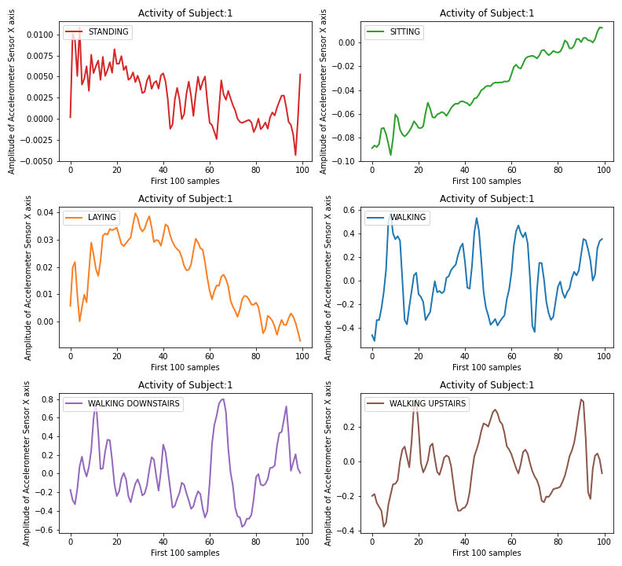
Acceleration Sensor-X
Figure [5 a]: Accelerometer Sensor X axis data of subject:1

Slide 11
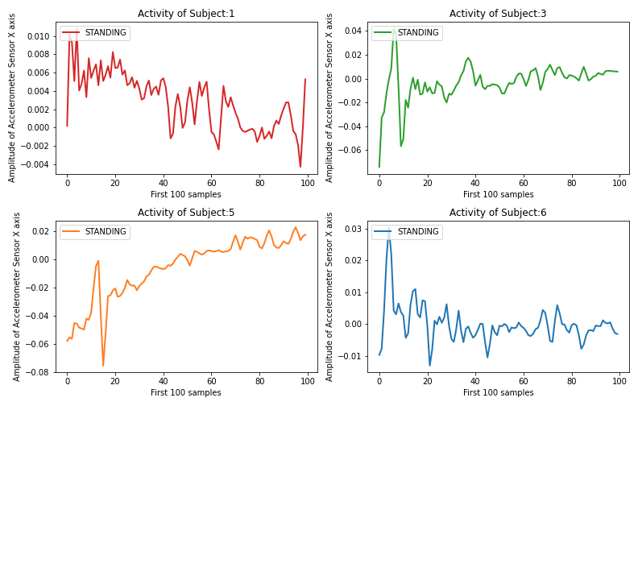
Acceleration Sensor-X [Contd..]
Figure [5 b]: “Standing” Activity by subject:1,3,5,6 of accelerometer X axis

Slide 12
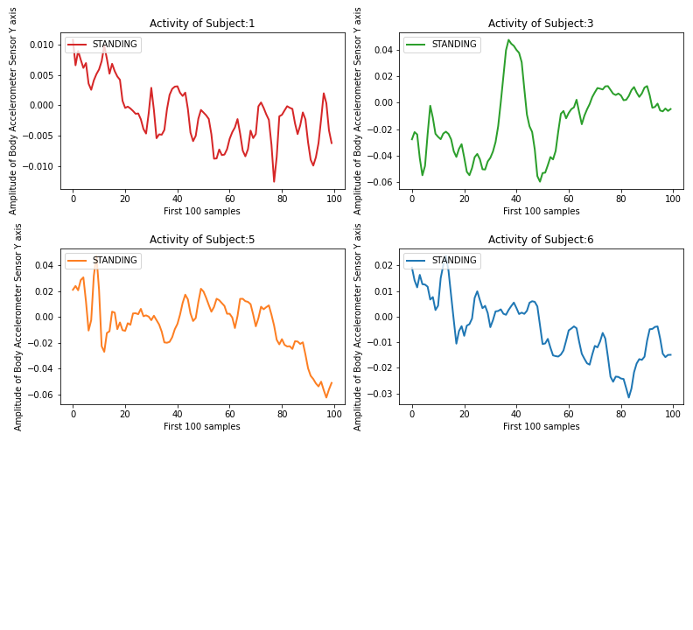
Sensor Signal Visualisation: Acceleration Sensor-Y
In order to make activity classification problem more clear, all the 3 axial data available for acceleration and gyroscope sensor signal is visualised, between different subjects performing same activity and for same subjects performing different activity.
Different activity for ‘subject :1’ and same activity ‘Standing’ for subject:1,3,5, and 6.
Figure [6a]: Accelerometer Sensor Y axis data of subject:1

Slide 13
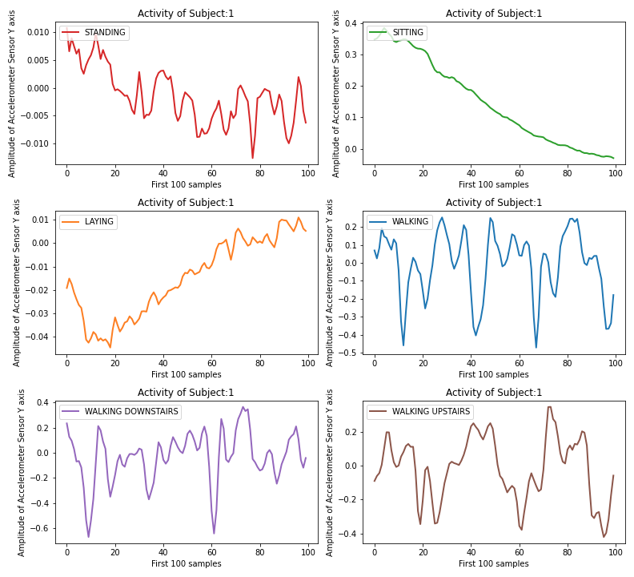
Acceleration Sensor-Y [Contd..]
Figure [6b]: “Standing” Activity by subject:1,3,5,6 of accelerometer Y axis

Slide 14
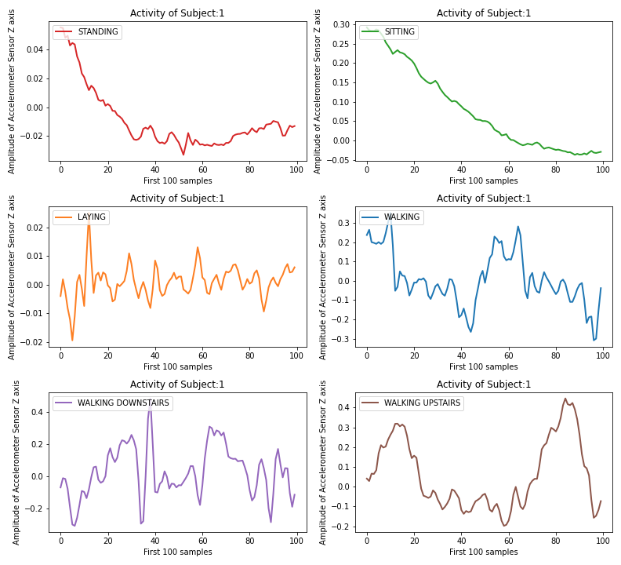
Acceleration Sensor-Z
Figure [7 a]: Accelerometer Sensor Z axis data of subject:1

Slide 15
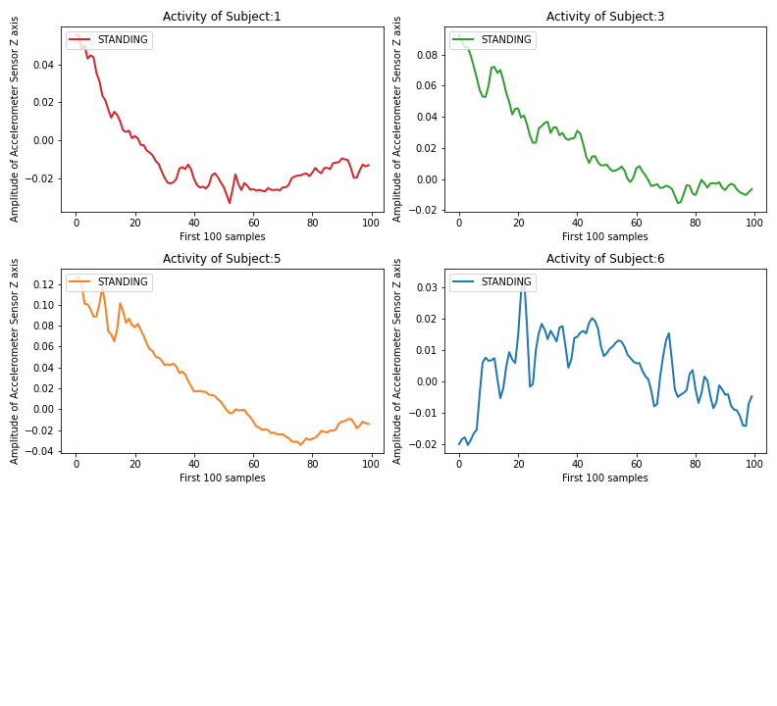
Acceleration Sensor-Z[Contd..]
Figure [7 b]: “Standing” Activity by subject:1,3,5,6 of accelerometer Z axis

Slide 16
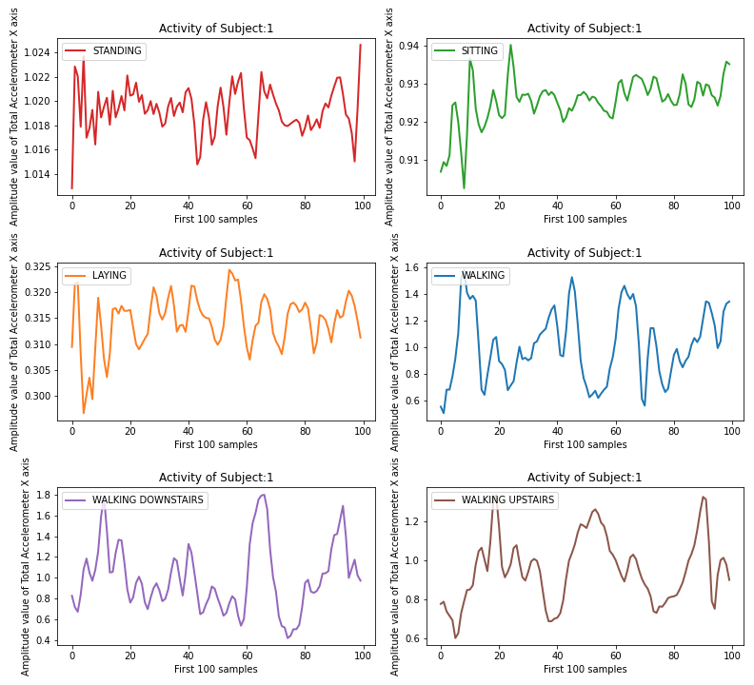
Total Acceleration Sensor-X
Figure [8 a]: Total Accelerometer Sensor X axis data of subject:1

Slide 17
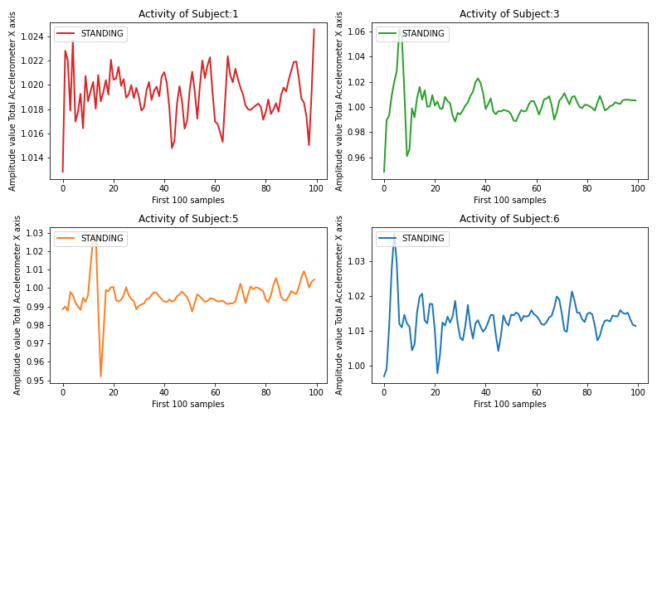
Total Acceleration Sensor-X[Contd..]
Figure [8 b]: “Standing” Activity by subject:1,3,5,6 of total accelerometer X axis

Slide 18
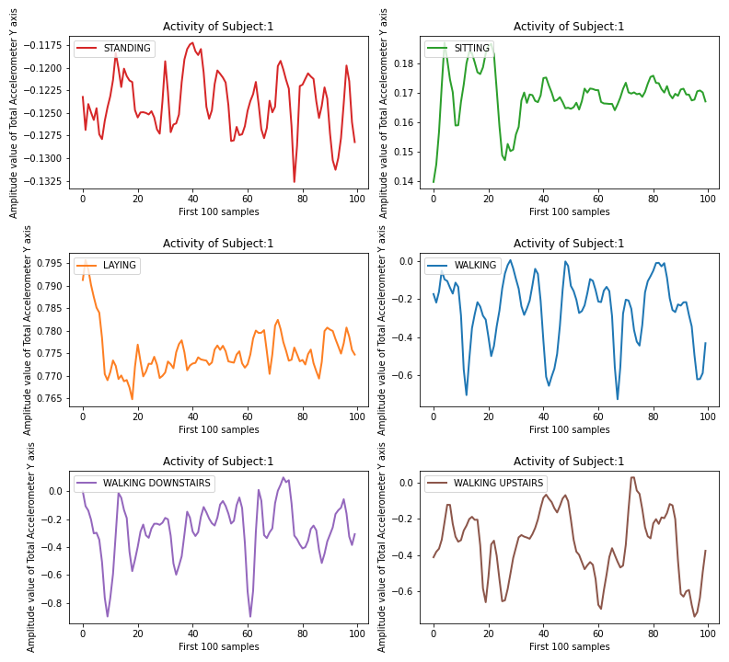
Total Acceleration Sensor-Y
Figure [9 a]: Total Accelerometer Sensor Y axis data of subject:1

Slide 19
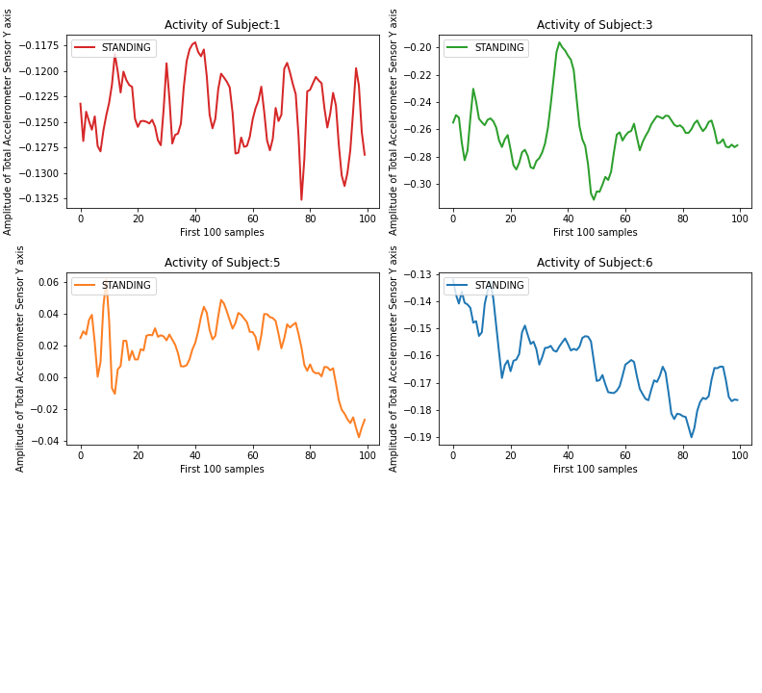
Total Acceleration Sensor-Y [Contd…]
Figure [9 b]: “Standing” Activity by subject:1,3,5,6 of total accelerometer Y axis

Slide 20
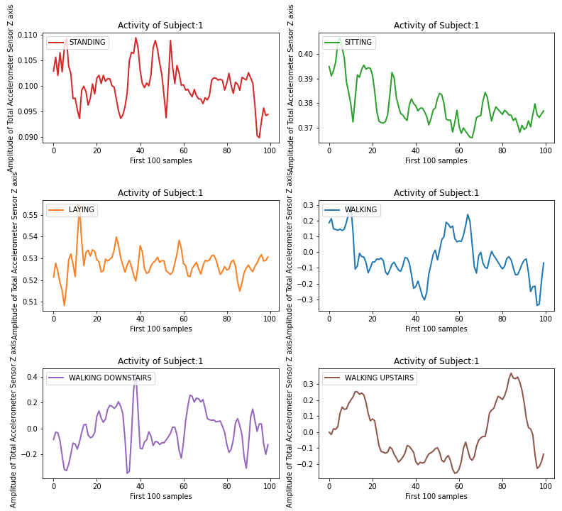
Total Acceleration Sensor-Z
Figure [10 a]: Total Accelerometer Sensor Z axis data of subject:1

Slide 21
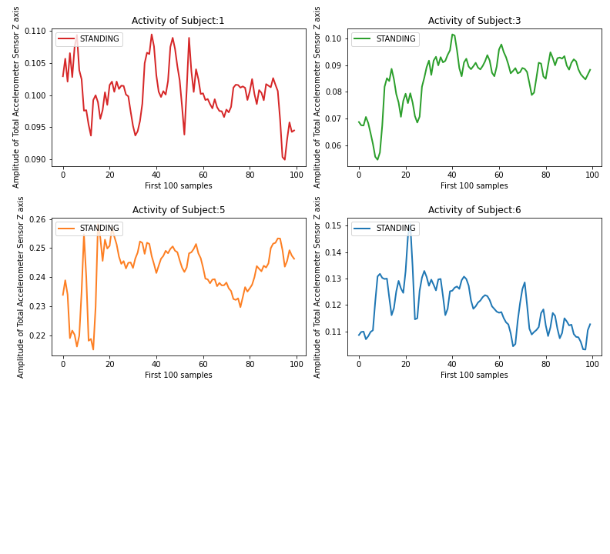
Total Acceleration Sensor-Z [Contd..]
Figure [10 b]: “Standing” Activity by subject:1,3,5,6 of total accelerometer Z axis

Slide 22
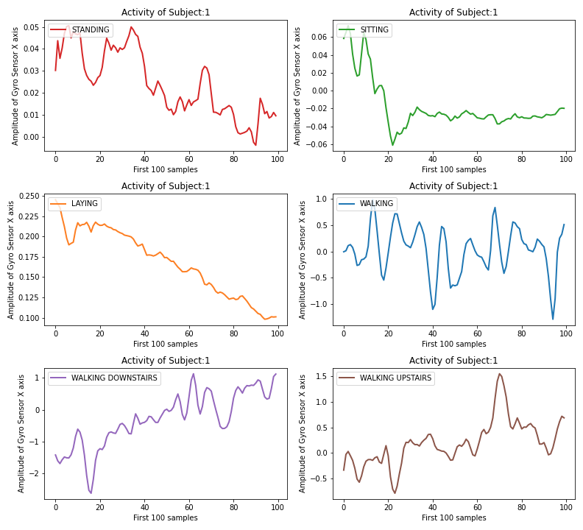
Gyro Sensor-X
Figure [11 a]: Gyro Sensor X axis data of subject:1

Slide 23
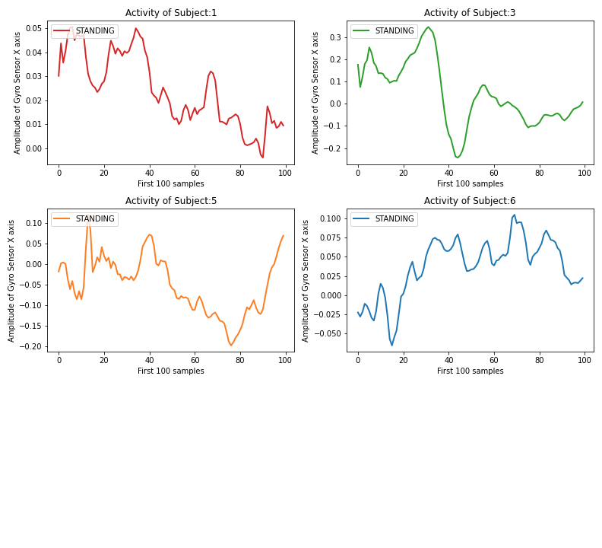
Gyro Sensor-X[Contd..]
Figure [11 b]: “Standing” Activity by subject:1,3,5,6 of Gyro X axis

Slide 24
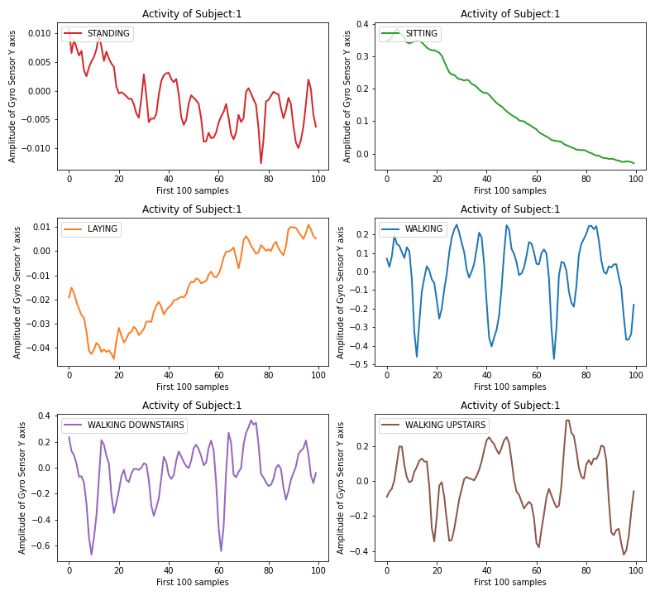
Gyro Sensor-Y
Figure [12 a]: Gyro Sensor Y axis data of subject:1

Slide 25
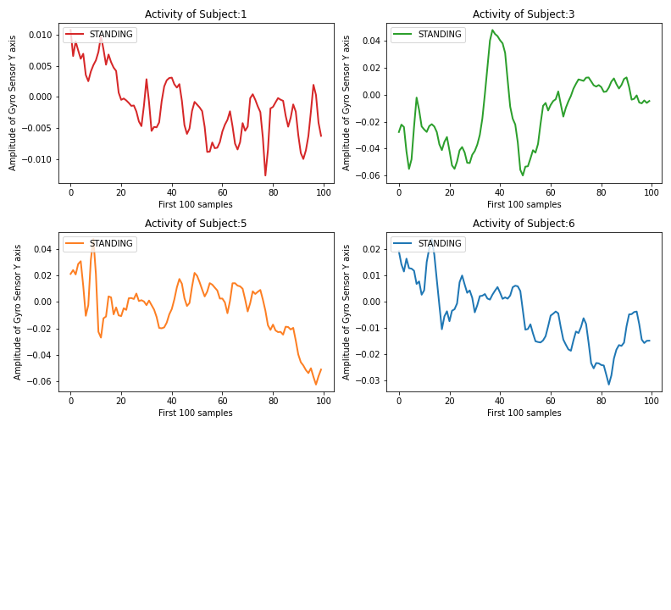
Gyro Sensor-Y [Contd..]
Figure [12 b]: “Standing” Activity by subject:1,3,5,6 of Gyro Y axis

Slide 26
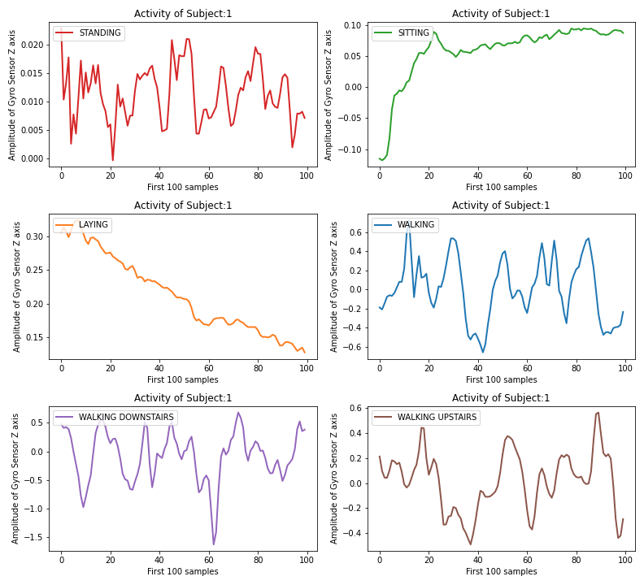
Gyro Sensor-Z
Figure [13 a]: Gyro Sensor Z axis data of subject:1

Slide 27
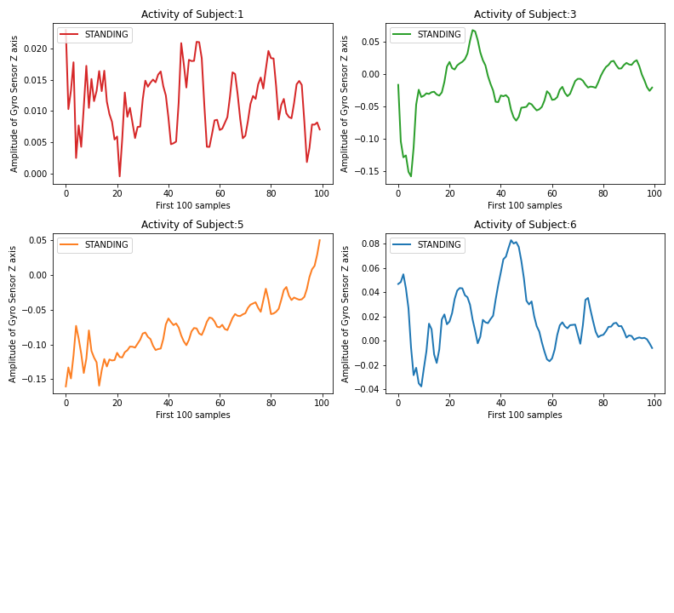
Gyro Sensor-Z [Contd…]
Figure [13 b]: “Standing” Activity by subject:1,3,5,6 of Gyro Z axis

Slide 28
Conclusion:
The signal plots as shown can be applied to Continuous Wavelet Transform (CWT), so that scaleogram obtained can be used to train deep neural network such as Continuous Neural Network (CNN) for classification of activity task.
Moreover, Discrete Wavelet Transform (DWT) can be applied to time variant sensor signal plots for each activity of each subject to extract statistical data to train Machine Learning algorithm such as Support Vector Machine for classification of activity.

