Slide 1


Face Matching
Biware solution
work produced by Daoud Aymen
work supervised by : Nadia Jmour PHD specialist in AI

Slide 2


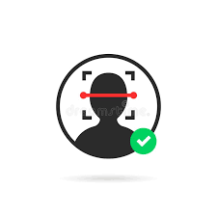


Recap
Liveness detection
Face matching
OCR
Voice identification and recognition
Stage ouvrier

Slide 3
What is the difference between Face matching and Liveness Detection?
What is the difference between Facial Recognition and Face Detection?
As we can see, there are some fairly significant differences between Face matching and Liveness Detection, however, the two are inextricably interlinked. The main difference and the one to be aware of if you are unsure of which term to use is that Liveness Detection refers to a system that can simply detect the presence of a human face. Face matching on the other hand takes this to the next level and is able to recognise and identify the detected face based on a match stored in a database.

Slide 4

Face matching
Libraries
import cv2
import uuid
import os
import time
from deepface import DeepFace
import matplotlib.pyplot as plt
Graphs (EBGM, Active Shape Models)
Appropriate distance are defined
http://pralab.diee.unica.it

Slide 5
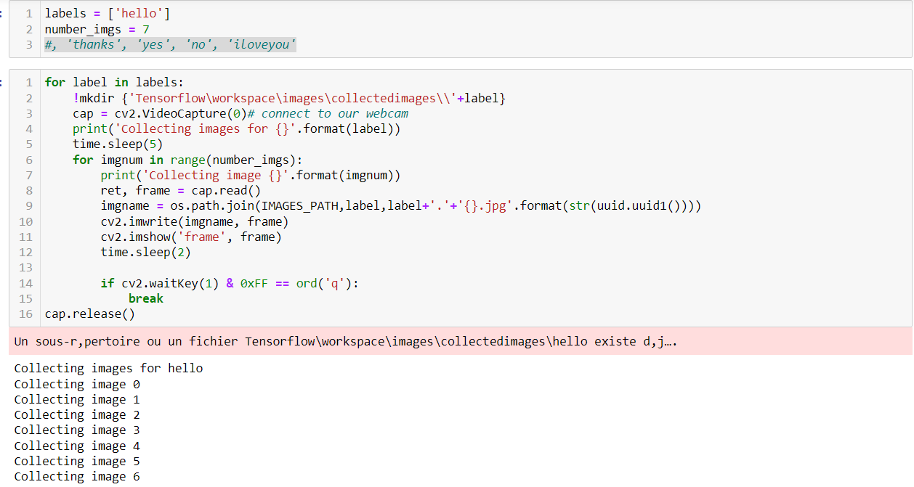
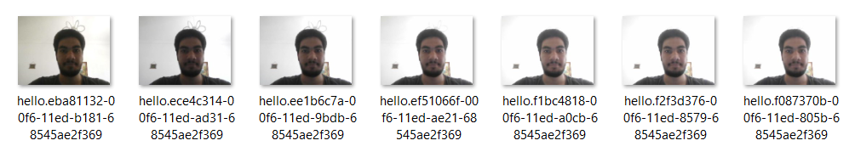
Face matching
Collecting Images
http://pralab.diee.unica.it

Slide 6
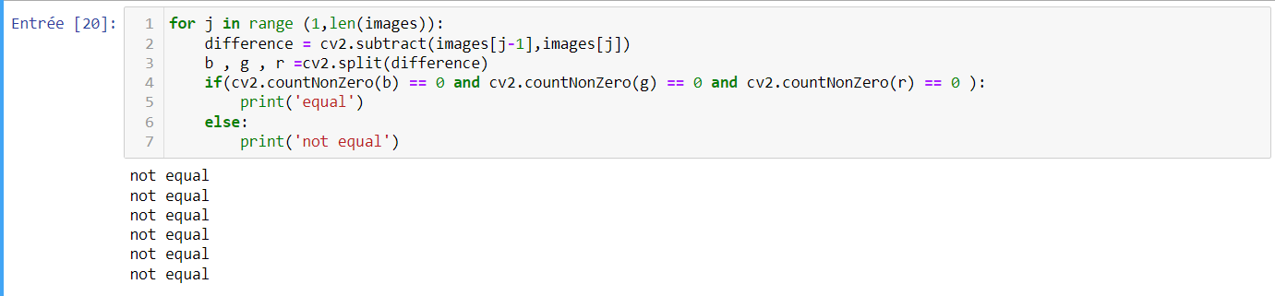
Face matching
Display the images and verify if all are the same
-We loaded the two images we can start making the comparison. -First we check if they have the same size and channels.
-If they have the same sizes and channels, we proceed by subtracting them. The operation cv2.subtract(image1, image2) simply subtract from each pixel of the first image, the value of the corresponding pixel in the second image.
***for example the value of the pixel of the first image in the position (0, 0) is 255 and the value of the pixel in the corresponding position of the second image is also 255, it will be a simple subtraction: 255 – 255 which is equal to 0.
That’s why if the images are equal, the result will be a black image (which means each pixel will have a value of 0).
A colored image has 3 channels (blue, green, and red), so the cv2.subtract() operation makes the subtraction for every single channel and we need to check if all the three channels are black.

Slide 7
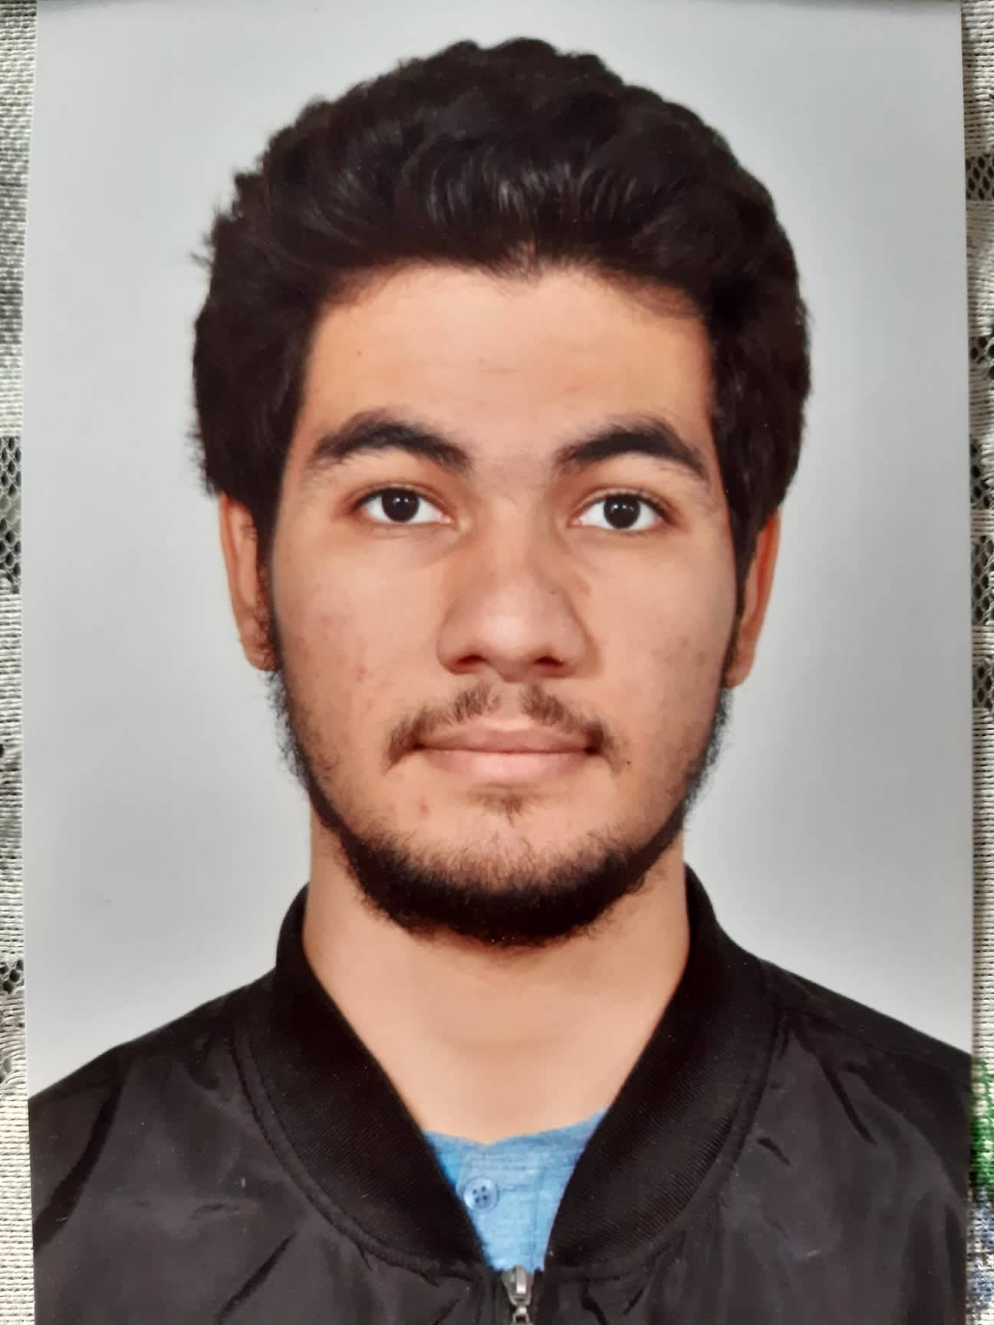
Face matching
Comparision with the original image using deep learning model
Result
http://pralab.diee.unica.it

Slide 8

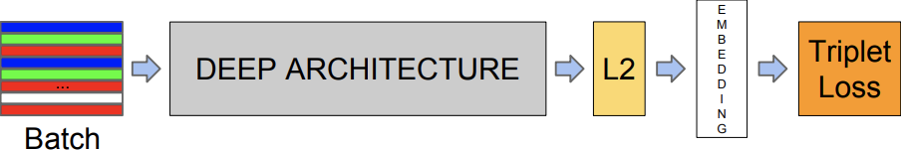
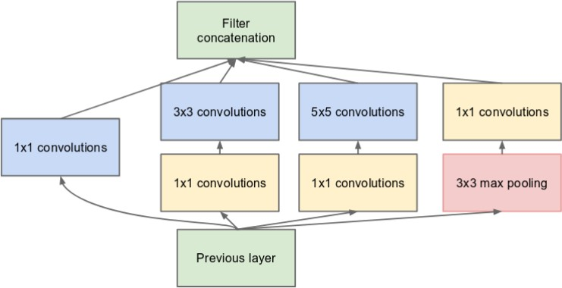
Deep learning-based approaches: FaceNet
http://pralab.diee.unica.it

Slide 9
