Slide 1
Deep Reinforcement Learning: Rainbow in Atari Simulator
Deep Learning Seminar WS 19/20
Aylin Haskioglu

Slide 2
Agenda
Rainbow Agent
DQN + Variants/Extensions
Results
Experiments
Frameworks
Results

Slide 3
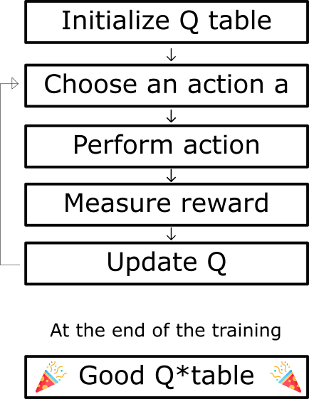

Q-learning
Learning action-value function
Determines how good a action at a particular state is
Bellman equation:
https://medium.com/@SmartLabAI/reinforcement-learning-algorithms-an-intuitive-overview-904e2dff5bbc
15. Januar 2020
Aylin Haskioglu
3
Notes:
Q-learning -> td-learning, model-free. Tries to find best policy for action taking; -> tries to get max rewards; takes current reward from step and adds estimated discounted max future rewards -> get Q-value for action-state pair (Quality) ; Current q-value + max – q-value of future action
1. → stable learning; TD error(loss) difference between TD target(Q target) and current Q-value (estimation of Q) → same parameters(weights) for estimating target and Q values → big correlation
Use separate network with fixed parameters

Slide 4
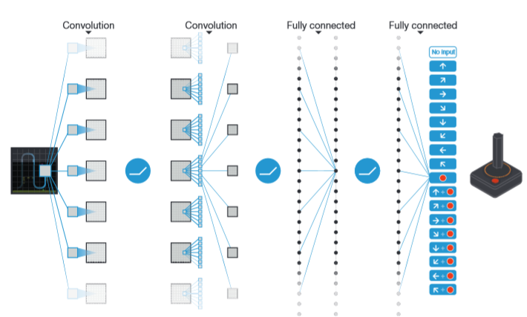
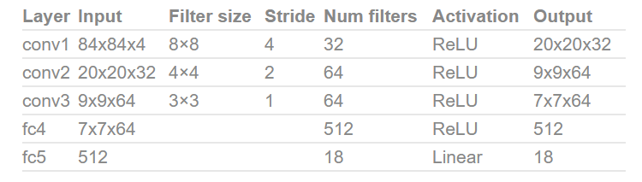
DQN – Deep Q-learning Network
https://neuro.cs.ut.ee/demystifying-deep-reinforcement-learning/
https://web.stanford.edu/class/psych209/Readings/MnihEtAlHassibis15NatureControlDeepRL.pdf
Notes:
Represents Q-Function with neural network
Q-learning -> td-learning, model-free. Tries to find best policy for action taking; -> tries to get max rewards; takes current reward from step and adds estimated discounted max future rewards -> get Q-value for action-state pair (Quality) ; Current q-value + max – q-value of future action
Takes state ( 4 game screens) and action as input and outputs corresponding Q-values
Has 3 convolution layers and 2 fully connected layers to estimate Q values directly from images
4

Slide 5
DQN - Variants/Extensions
Double DQN (DDQN)
Countermeasurment for overestimation bias
Decouples action selection from its evaluation
Multi-Step Q-learning
Calculate Q-values with N-step Return
Notes:
Q-learning -> td-learning, model-free. Tries to find best policy for action taking; -> tries to get max rewards; takes current reward from step and adds estimated discounted max future rewards -> get Q-value for action-state pair (Quality)
Double
→ accuracy depends on actions tried and neighboring states explored
→ beginning not enough info → false positves when chosing actions with max q-values
→ use 2 networks for choosing action and calculating q-value
→ normalerweise nimmt man den wert selbst aber bei ddqn nimmt man die action die zum wert führt
Mutli → faster and more accurate

Slide 6
DQN - Variants/Extensions
Prioritized Experience Replay
Selectes samples with most probability to learn from
Learning potential -> Q-Loss
Dueling Network Architecture
One stream to calculate value of being at specific state
One stream to calculate advantage of action over other actions at specific state
Combines at the end to get a state action value
Notes:
1. Bias towards recent transistions
Dueling
→ 1 value of being at that sate
→ 2 advantage of actions over other actions at that state
→ can learn which state is valuable without learning effect of each action at each state
→ determine states where their actions not affect environment → unnecessary to calculate value of each action

Slide 7
DQN - Variants/Extensions
Distributional Q-learning
Normally using average estimated Q-value as target
-> average Q-values not accurate
Learn distribution of Q-Values instead of average
KL divergence as loss
Noisy Nets
Combining final output linear layer of Q-Network with noisy stream
Network can learn to ignore noisy stream during training
Notes:
1. Q-values van be diverse in different situations
Using distributional Bellman equation
(Kullback-Leibler-Divergenz)
2.Changes exploration rates automatically
7

Slide 8
Rainbow
Replace 1-step distributional loss with multi-step variant
Combine with DDQN
Proportional prioritized replay → prioritizes transistions by the KL loss
Dueling network adapted for use with return distributions
Replace all linear layers with noisy equivalent
Notes:
1. target distribution by contracting the value distribution

Slide 9
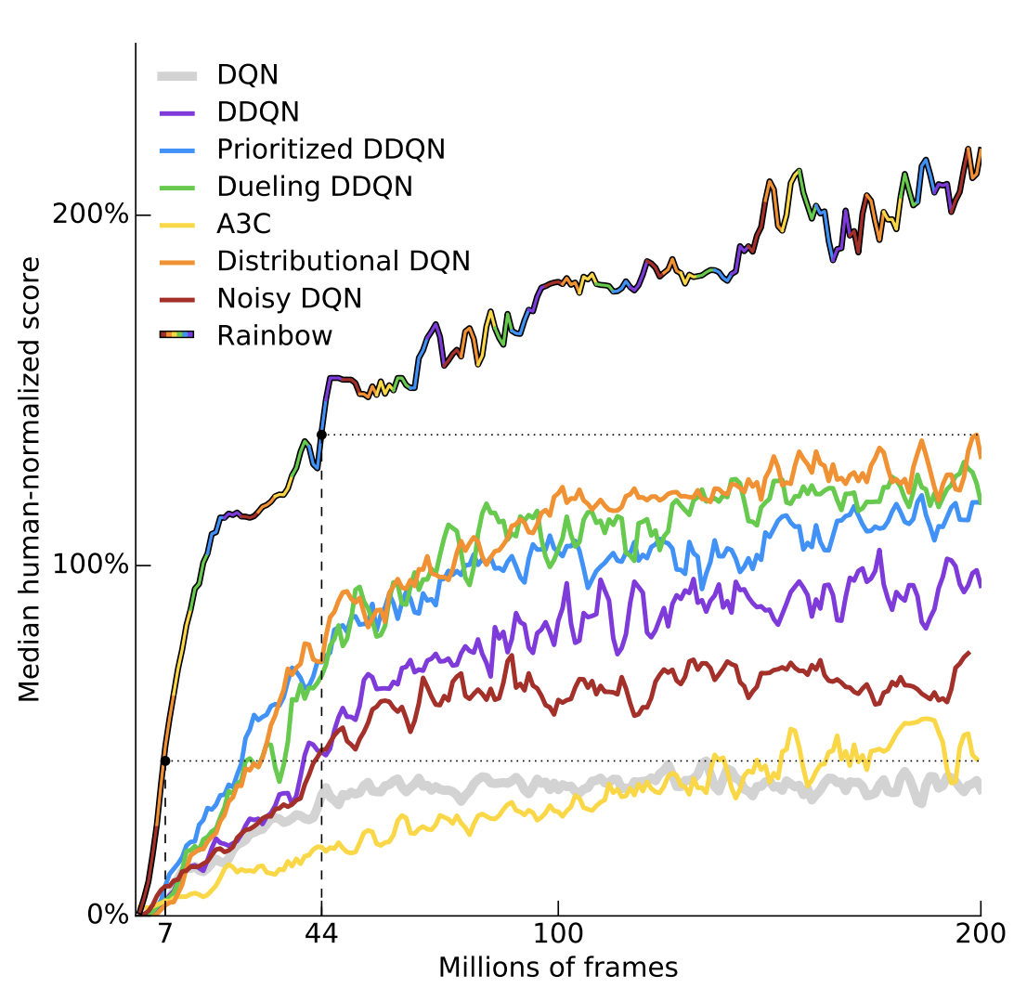
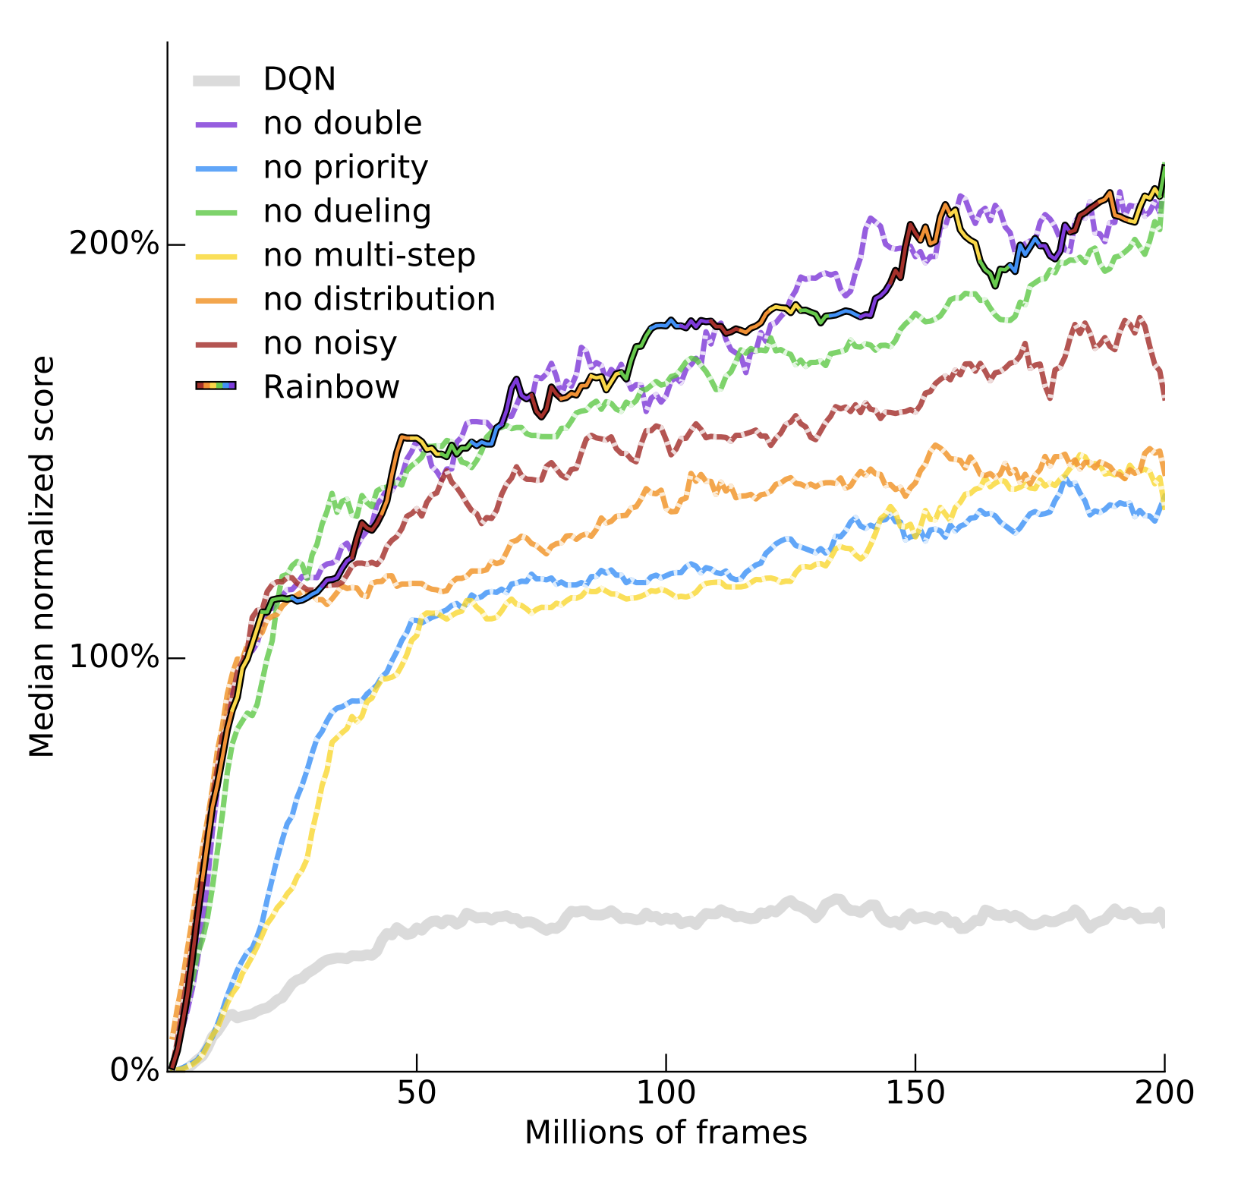
Rainbow

Slide 10
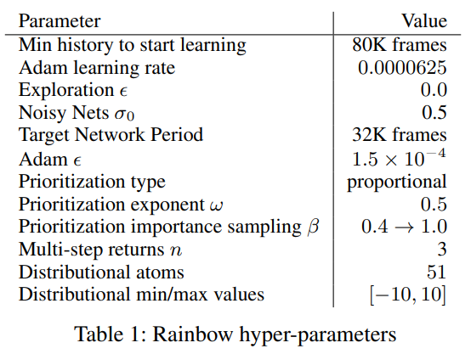
Experiments
Different frameworks, different implementations
Colab
Anyrl-py
Used by OpenAI Baseline Retro Contest
Dopamine
Only using 3 variants not all
15. Januar 2020
Aylin Haskioglu
10

Slide 11
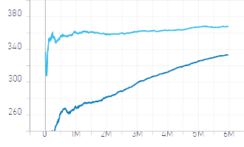
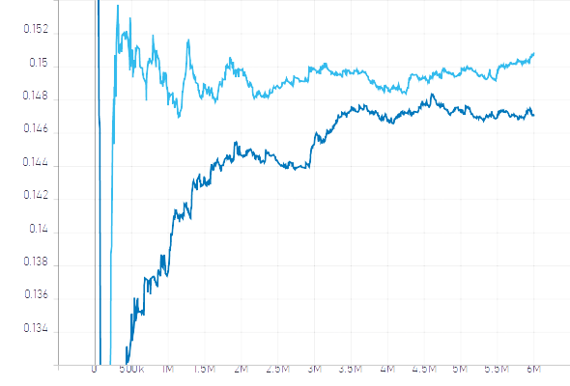
Anyrl – Space Invaders
Rewards
Losses

Slide 12
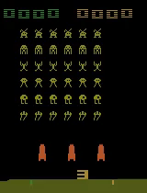

Anyrl – Space Invaders
Episode 0
~ Episode 14000

Slide 13
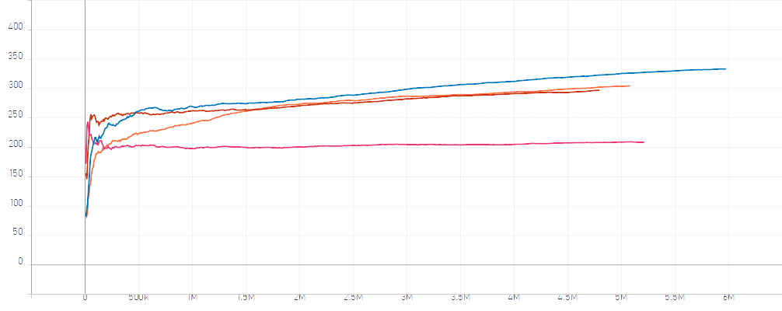
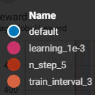
Anyrl – Space Invaders

Slide 14
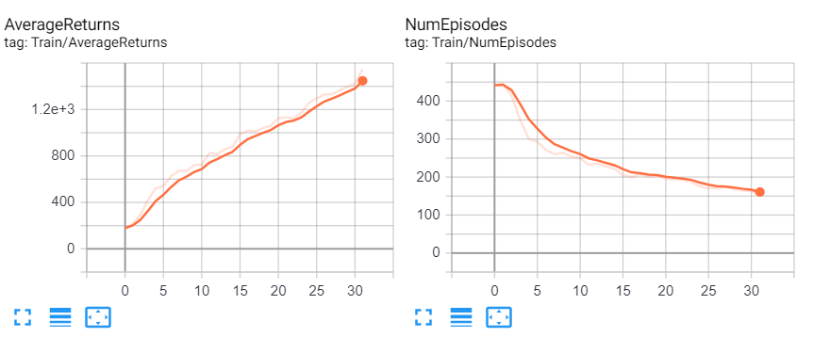
Dopamine

Slide 15
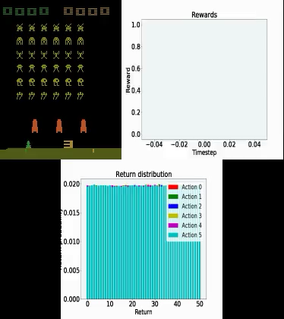
Dopamine

Slide 16
Sources
Paper:
https://arxiv.org/pdf/1710.02298.pdf
Github:
https://github.com/AyHaski/DL_AtariRainbow
Frameworks:
https://github.com/unixpickle/anyrl-py
https://github.com/google/dopamine
https://github.com/astooke/rlpyt
https://github.com/Kaixhin/Rainbow
https://github.com/ray-project/ray/tree/master/rllib
https://github.com/openai/retro-baselines
Links:
https://www.freecodecamp.org/news/diving-deeper-into-reinforcement-learning-with-q-learning-c18d0db58efe/
https://medium.com/intelligentunit/conquering-openai-retro-contest-2-demystifying-rainbow-baseline-9d8dd258e74b

Slide 17
DQN – Deep Q-learning Network
Epsilon-greedy strategy
Exploration at the beginning
Exploitation with time
Experience Replay
All experience is stored in replay memory
Random samples are used instead of most recent transistions
Online/Target Network
Online is periodically copied to target network
Target → For future rewards computations
Notes:
Combination enables stable learning
→ experiences aren‘t forgotten;
→ reduces correlations between experiences
https://towardsdatascience.com/welcome-to-deep-reinforcement-learning-part-1-dqn-c3cab4d41b6b
3.
→ stable learning; TD error(loss) difference between TD target(Q target) and current Q-value (estimation of Q) → same parameters(weights) for estimating target and Q values → big correlation
Use separate network with fixed parameters
17

Slide 18



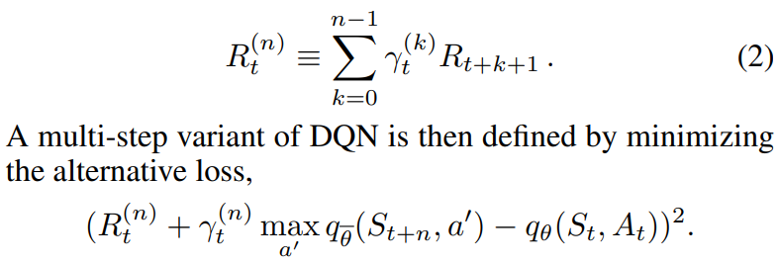
Formulas
Dqn Loss
DDQN
Prioritized
Dueling
MutliStep
15. Januar 2020
Aylin Haskioglu
18

Slide 19


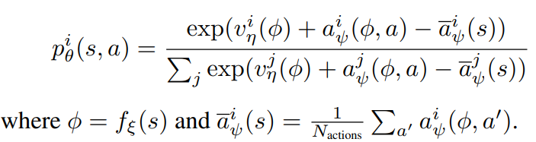
Formulas - Integrated Agent
Distributional
Prioritized
Dueling
15. Januar 2020
Aylin Haskioglu
19

