Slide 1
GIT and HTML5

Slide 2
GIT
Begin
During Project
Master User:
Create Repository in github
Share it with users
Clone it to desktop (git clone link)
2nd User
Confirm invitation
Clone it to desktop
… User
Redo process
Git pull ➔ Get information/latest updates
git add . or git add specific file ➔ to add file
Git commit –m ➔ to comment file
Git status ➔ check status
Git push ➔ upload new data

Slide 3
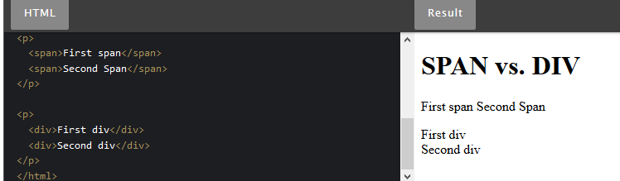
HTML 5
Important always close code with </…>
Check spelling
Difference between span and div

Slide 4
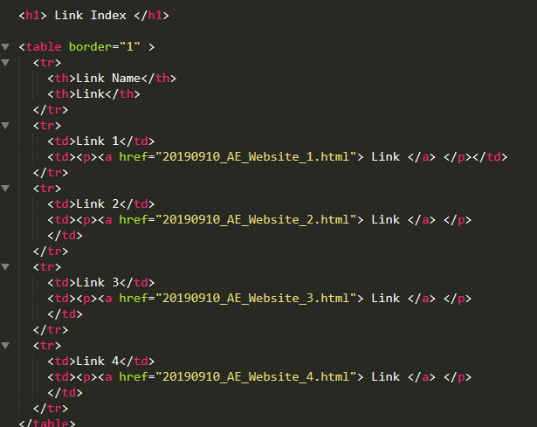
HTML 5.2 Table

Slide 5
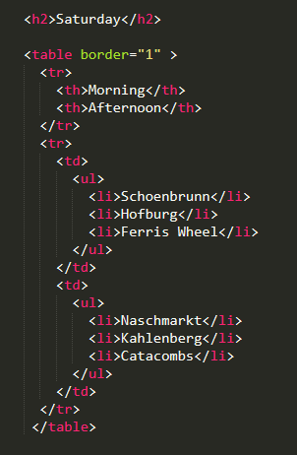
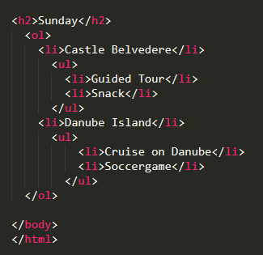
Table + List

