Slide 1
Web Traffic Time Series
Forecasting & Anomaly Detection on 145,063 Wikipedia Pages
Dataset: Kaggle Web Traffic Time Series Forecasting
Daily page views · 2015-07-01 → 2017-09-10
Team: Aymane Zeroual · Otmane ZAIM· Omar Tanji

Slide 2
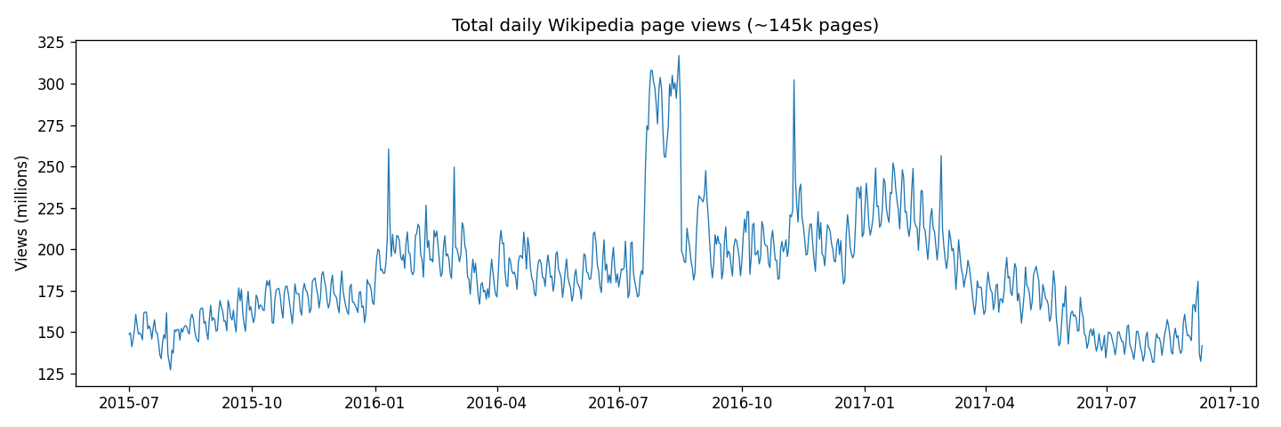
Dataset Overview
From 145k noisy page-level series to one clean aggregate signal
145,063
803
185.5M
316.9M
Wikipedia pages
days (Jul 2015 – Sep 2017)
mean daily views
all-time daily peak
Why aggregate?
Individual pages are sparse and noisy. Summing all pages gives one dense series with strong structure, ideal for SARIMA, Prophet and decomposition.
Missing values
Page-level gaps exist, but the aggregate has zero missing days (missing pages contribute 0).
2

Slide 3
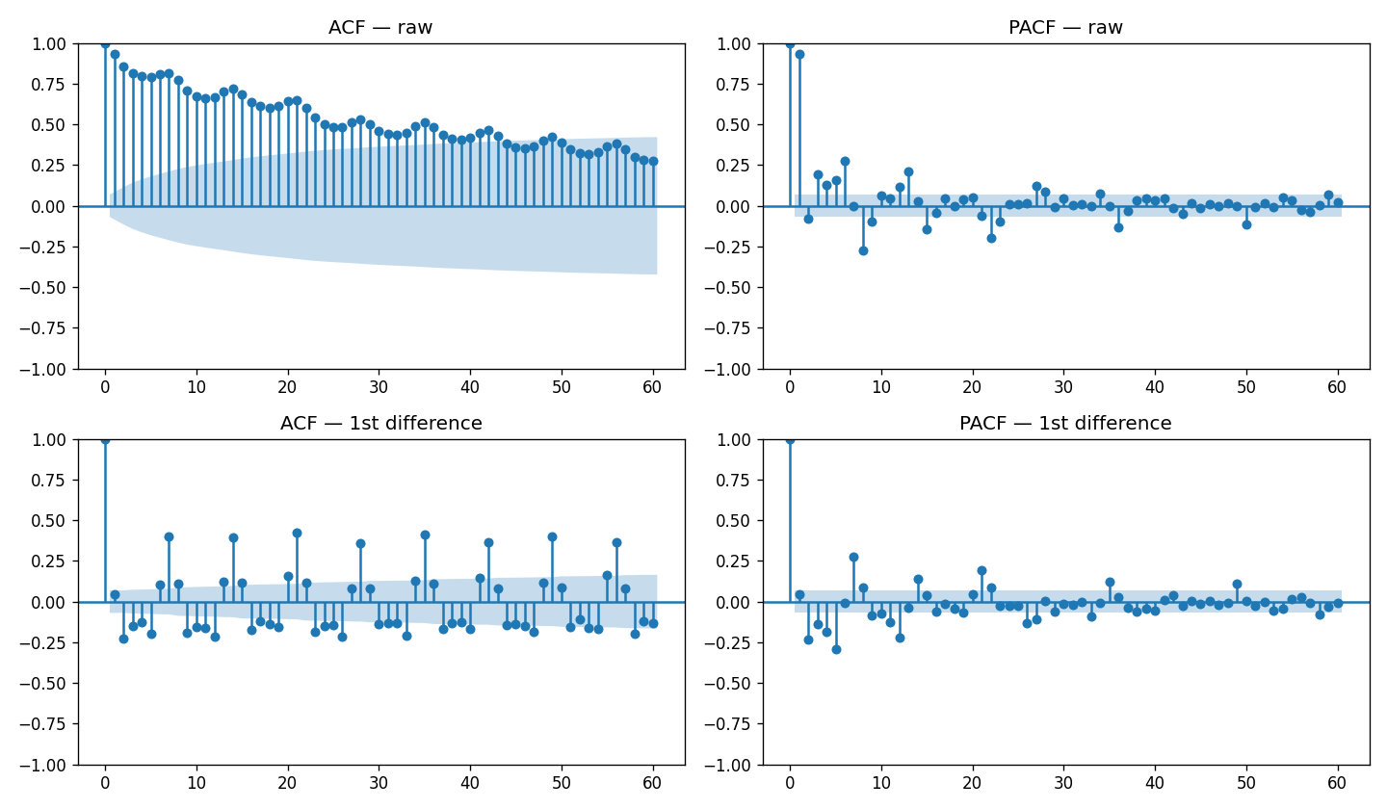
Stationarity & Correlation Structure
ADF test and ACF/PACF drive the model choice
ADF test
raw: p = 0.082 → non-stationary
Δ1: p = 2.2e-6 → stationary
⇒ difference once (d = 1)
ACF/PACF reading
Sharp ACF spikes at lags 7, 14, 21 → weekly seasonality (m = 7)
⇒ a seasonal ARIMA (SARIMA) is required
3

Slide 4
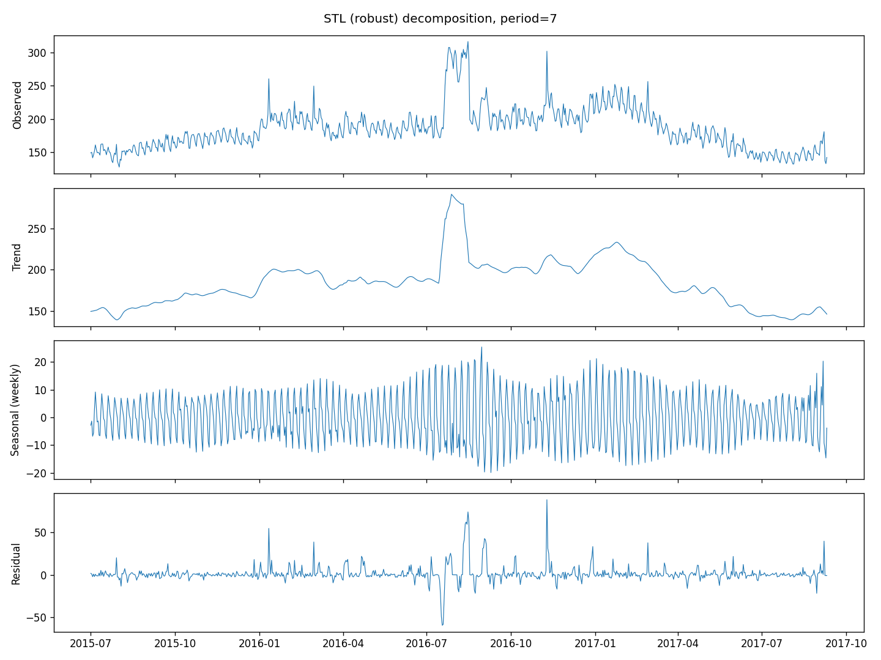
Decomposition: Classical & STL
Robust STL keeps outliers in the residual, where anomaly detection can find them
Trend (strength 0.90)
Growth from ~150M to an early-2017 plateau near 190M; visible mid-2016 surge.
Seasonality (strength 0.37)
Stable weekly cycle: Monday peak (+11M), Friday trough (−10M), a workweek browsing.
Residuals (σ ≈ 10M)
Mostly noise, plus large isolated spikes, real-world events, hunted in the anomaly step.
4

Slide 5
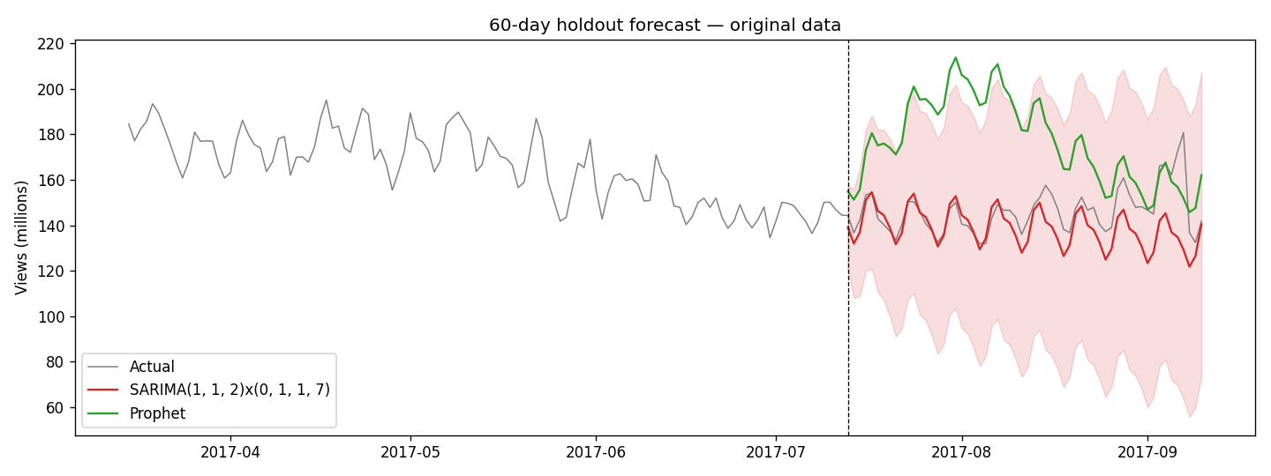
Initial Forecast: SARIMA vs Prophet
60-day holdout (2017-07-13 → 2017-09-10) · SARIMA order chosen by AIC grid search
Best model
SARIMA
(1,1,2)(0,1,1)₇
AIC 5316.9
BIC 5339.9
Model | RMSE (M) | MAE (M) | Rel. error
SARIMA(1,1,2)(0,1,1)₇ | 12.65 | 8.53 | ≈ 7%
Prophet | 38.11 | 32.38 | ≈ 20%
Prophet extrapolates a yearly cycle distorted by the anomalous 2016 regime; SARIMA's differencing anchors it to the recent level.
5

Slide 6
Anomaly Detection: Four Methods
Two statistical, one machine-learning, one deep-learning · combined by consensus vote
Robust Z-score Statistical
MAD-based z on STL residuals, |z| > 3.5. Most sensitive: 99 flags.
SARIMA residuals Statistical
Standardized 1-step forecast errors, |z| > 3. Precise: 13 flags.
99
13
Isolation Forest Machine learning
Trees on [level, Δ1, Δ7, residual, weekday], 2% contamination.
LSTM Autoencoder Deep learning
Reconstruction error on 14-day windows, > μ + 3σ. 8 flags.
17
8
Consensus rule: keep days flagged by ≥ 2 of 4 methods → 20 anomalous days
6

Slide 7
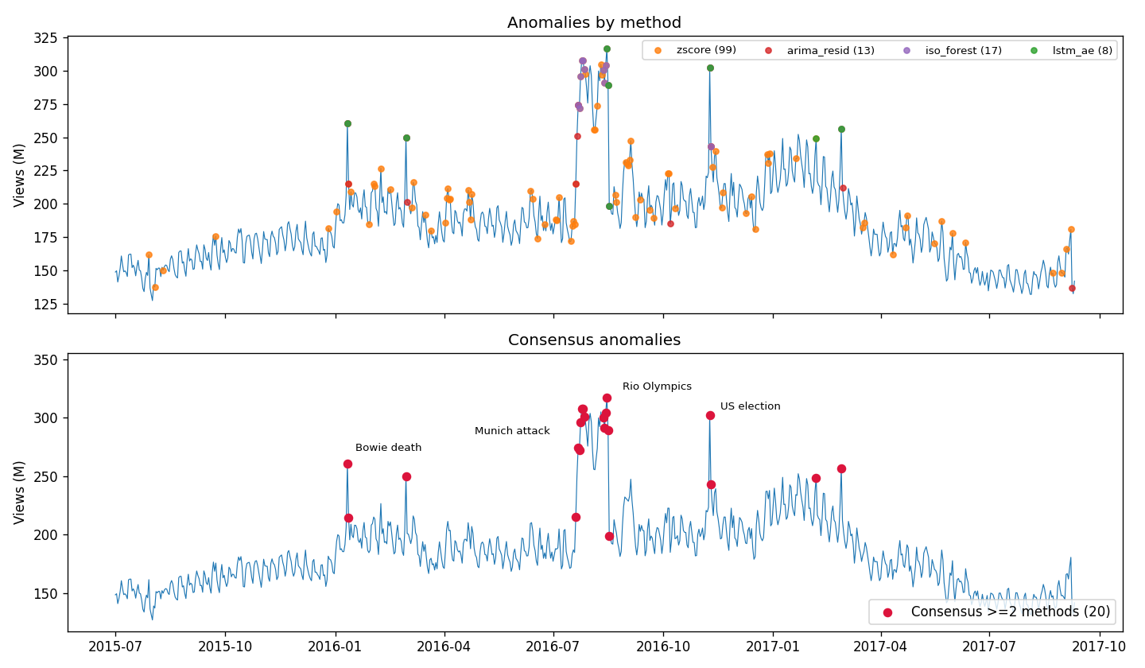
Anomalies Map to Real-World Events
The 20 consensus anomalies are explainable, not statistical artefacts
Date(s) | Event
Jan 11–12, 2016 | Death of David Bowie
Feb 29, 2016 | Leap day
Jul 20 – Aug 17, 2016 | Munich attack · DNC · Rio Olympics (all-time peak 317M)
Nov 9–10, 2016 | US election result (302M)
Feb 6 / Feb 27, 2017 | Super Bowl LI / Oscars mix-up
Impact: spikes inflate variance, widen prediction intervals, and drag the trend / yearly-seasonality estimates of global-fit models.
7

Slide 8
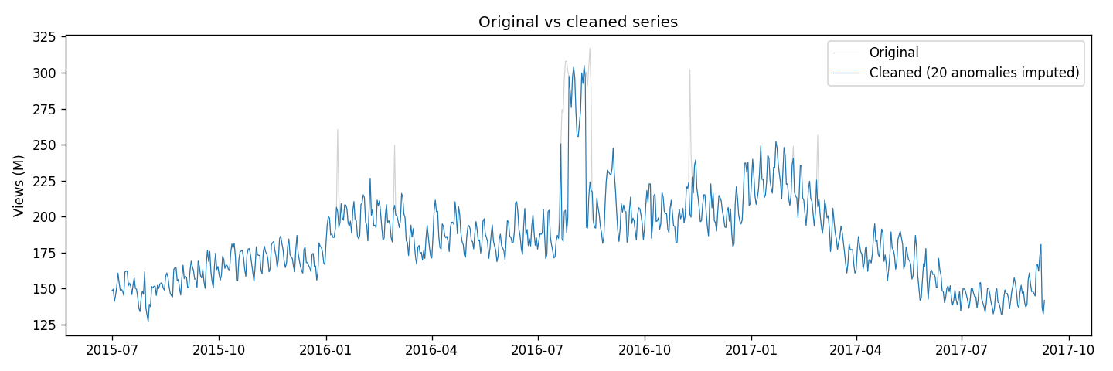
Cleaning the Series
Seasonality-aware imputation (replace, don't delete)
Method
Each anomalous day is replaced by the median of the same weekday within ±4 weeks.
This preserves the weekly cycle and the local trend level.
Fair evaluation: models are re-trained on the cleaned history, but always scored against the original, uncleaned test data, the real future is what we must predict. All 20 anomalies fall before the forecast origin.
8

Slide 9
Re-Forecast: Before vs After Cleaning
Cleaning rescues Prophet; SARIMA never needed it
Prophet: −42% RMSE
38.11 → 22.16 (MAE 32.4 → 17.8). Trend & yearly seasonality no longer distorted by the 2016 spikes.
SARIMA: slightly worse
12.65 → 16.06. SARIMA was already robust, imputing spikes it had absorbed altered the variance structure, so cleaning was unnecessary here.
9

Slide 10
Insights & Recommendations
SARIMA is the right operational model
Best accuracy (≈7% relative error), robust to anomalies, interpretable orders backed by ACF/PACF and AIC.
1
Anomaly handling matters most for global curve-fitters
Prophet improved 42% after cleaning; SARIMA got slightly worse. Clean the history for global curve-fitters, not for differencing models.
2
Use consensus voting for anomaly detection
Single methods are noisy (z-score: 99 flags): agreement of ≥2 of 4 methods yields 20 precise, fully explainable events.
3
Treat event spikes as signal, not garbage
Elections, sports, celebrity deaths are predictable in kind. Better than deletion: event/holiday regressors in SARIMAX or Prophet.
4
10

Slide 11
Thank you
Questions?

