Slide 1
P7 — Handwritten Sudoku
Reader and Solver
Search + CSP + Neural Network
10-minute presentation + 5-minute live demo
Prototype uses real MNIST glyphs arranged into synthetic Sudoku mosaics
P7 • Handwritten Sudoku Reader and Solver | 1

Slide 2
1. The problem
A handwritten digit can be misread (for example, 7 as 1).
Duplicate digits in a row, column, or box reveal an inconsistent reading.
The system ranks likely corrections and asks a Sudoku CSP solver whether the corrected grid is solvable.
If no acceptable correction is found within the edit budget, report “unreadable” and show low-confidence cells.
P7 • Handwritten Sudoku Reader and Solver | 2

Slide 3
2. Data: real digits, generated puzzles
MNIST: 28×28 grayscale handwritten digits, classes 0–9; this classifier keeps 1–9.
Fixed-seed split: 50,000 train / 10,000 validation from the official training partition; official test held out.
Sudoku solutions and clue removal are generated; uniqueness is preserved by the puzzle generator.
Mosaics and injected hard digits are generated; this is not a dataset of photographed Sudoku sheets.
P7 • Handwritten Sudoku Reader and Solver | 3

Slide 4
3. System architecture
Neural Network → class probabilities for each occupied cell
AC-3 → detect duplicate-given conflicts and prune domains
Search → try low-cost digit corrections (UCS / Greedy / A*)
CSP → Backtracking, Forward Checking, AC-3; accept first solvable candidate
Correction log → cell, old digit, new digit, nonnegative cost
NN
AC-3
SEARCH
CSP
P7 • Handwritten Sudoku Reader and Solver | 4

Slide 5
4. Neural Network and calibration
CNN input: one 28×28 grayscale cell; output: nine logits / probabilities (digits 1–9).
Temperature scaling is fitted on validation data only.
Report accuracy, confusion matrix, ECE and NLL; compare against Logistic Regression.
STATUS: code is included, but MNIST download failed in the preparation environment. No trained weights or measured classifier metrics are claimed.
P7 • Handwritten Sudoku Reader and Solver | 5

Slide 6
5. Search model and verified demo trace
State: current 9×9 reading; action: change one conflicting cell to a top-3 alternative.
Cost: max(0, log(p(old) / p(new))); never negative.
UCS uses g; Greedy uses h; A* uses g+h with a conflict-matching lower bound.
Verified synthetic demo: two edits (1→9 and 1→4), total cost 0.2892; 4 expanded and 27 generated states.
P7 • Handwritten Sudoku Reader and Solver | 6

Slide 7
6. CSP: three switchable inference levels
BT: Backtracking only.
BT+FC: Forward Checking removes an assigned digit from peers.
BT+FC+AC-3: AC-3 enforces arc consistency before and during search.
Counters: nodes, assignments, backtracks, and pruned values. Optional uniqueness mode checks for exactly one solution.
P7 • Handwritten Sudoku Reader and Solver | 7

Slide 8
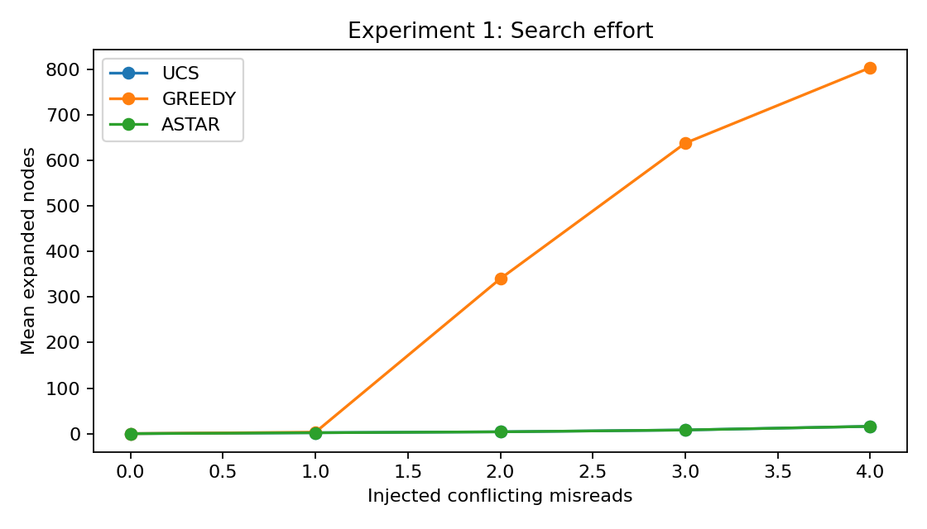
7. Experiment 1 — Search comparison (pilot)
Five puzzles per misread level (0–4); controlled synthetic probabilities, not CNN output.
At 2 misreads: UCS recovery 1.00 ± 0.00; A* 1.00 ± 0.00; Greedy 0.80 ± 0.40.
Mean expanded nodes at 2 misreads: UCS 4.0; A* 4.0; Greedy 340.4.
Interpret cautiously: pilot only; run the required 100 puzzles per level before final submission.
P7 • Handwritten Sudoku Reader and Solver | 8

Slide 9
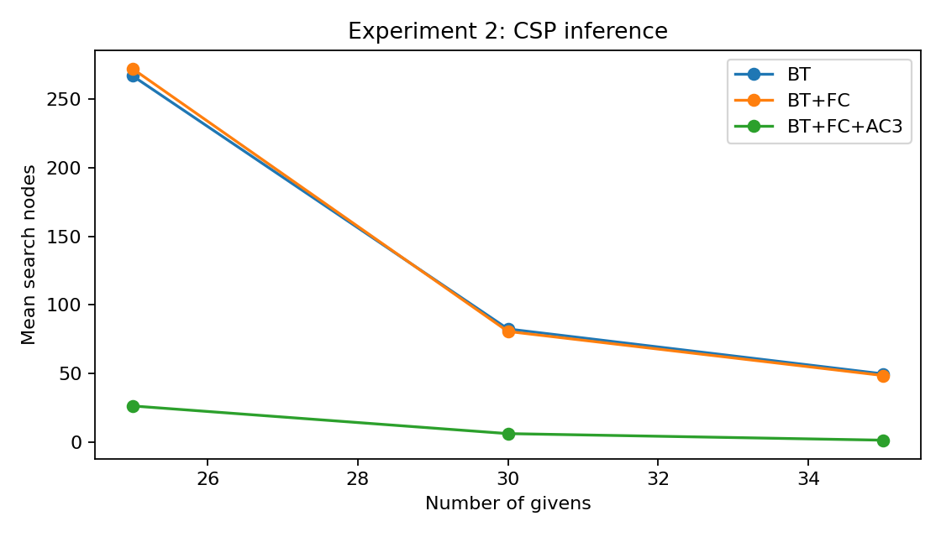
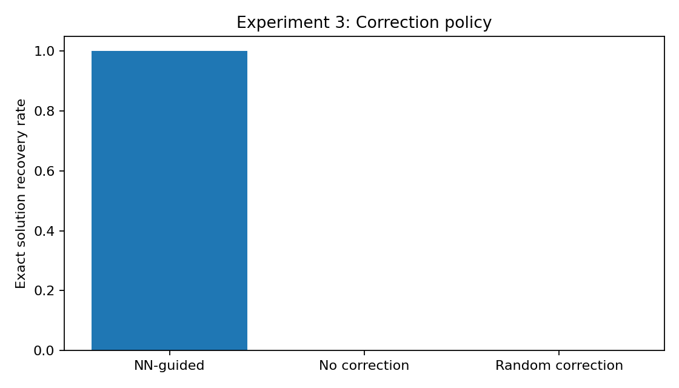
8. Experiments 2 and 3 — CSP and correction policy (pilot)
CSP experiment uses five seeds and 25 / 30 / 35 givens. At 25 givens, mean nodes: BT 267.2; BT+FC 272.4; BT+FC+AC-3 26.2.
At 35 givens, mean nodes: BT 49.6; BT+FC 48.4; BT+FC+AC-3 1.2.
Correction policy at 2 injected errors: NN-guided synthetic probabilities 1.00 ± 0.00; no correction 0.00; random 0.00.
All are pilot/synthetic measurements, not measured CNN performance.
P7 • Handwritten Sudoku Reader and Solver | 9

Slide 10
9. Limitations and conclusion
Grid boundaries are known; no camera capture, perspective correction, or grid localization.
Injected errors are controlled and conflict-based; more realistic ambiguous handwriting is future work.
Tests: 17 passed. Synthetic demo: completed. Full 100-puzzle experiment and CNN training remain to be run on a network-enabled machine.
The integrated architecture demonstrates how probabilistic perception, correction Search, and CSP solving cooperate.
P7 • Handwritten Sudoku Reader and Solver | 10

Slide 11
5-minute live demo plan
0:00–1:00 Show input grid and injected conflicting readings.
1:00–2:00 Show Search trace: expanded/generated counters and correction log.
2:00–3:00 Compare CSP modes: BT vs BT+FC vs BT+FC+AC-3 using experiment_2_nodes.png.
3:00–4:00 Show synthetic NN-off demo, then trained-CNN mosaic mode after MNIST training.
4:00–5:00 Show unreadable case / least-confident cells and discuss limits.
P7 • Handwritten Sudoku Reader and Solver | 11

Slide 12
Before final submission
Download MNIST and run the CNN training script; save measured CNN and Logistic Regression metrics.
Run the full experiment command: 100 puzzles per misread level, at least five seeds; replace pilot tables with full results.
Fill in each student’s ≤200-word contribution statement and add authentic team git commits.
Update REPORT.pdf and this deck with measured outputs; do not present synthetic probabilities as CNN predictions.
P7 • Handwritten Sudoku Reader and Solver | 12

