Slide 1
Real-Time Face Mask Detection
Using transfer learning and classical technique

Slide 2
TABLE OF CONTENTS
01
02
03
PROBLEM DEFINITION
DATA PREPROCESSING
DATA & DEVELOPMENT ENVIRONMENT

Slide 3
TABLE OF CONTENTS
04
05
06
RESULTS
FUTURE WORK
CONCLUSION

Slide 4
01
PROBLEM DEFINITION

Slide 5
PROBLEM DEFINITION
Since we are still in pandemic circumstances, the need for face mask detection is increasing.
It’s a binary classification, that classify images either with mask or without mask.

Slide 6
02
DATA & DEVELOPMENT ENVIRONMENT

Slide 7
DESCRIBE THE DATASET
WITH MASK
WITHOUT MASK
There are 691 images of faces with mask, the dimension of each image is (224*224*3)
There are 687 images of faces without mask, the dimension of each image is (224*224*3)

Slide 8
THE DEVELOPMENT ENVIRONMENT
GOOGLE COLAB
It allows us to run the notebook on a hosted computer that is most-likely better/faster/stronger than our local machine. That means faster training for your CNN model.

Slide 9
03
DATA PREPROCESSING

Slide 10
DATA PREPROCESSING
Labeling
One-hot encoding
Partitioning
Data Augmentation
extract the class label from the filename
perform one-hot
encoding on the labels
75% training, 25% testing
to expand the training dataset in order to improve the performance

Slide 11
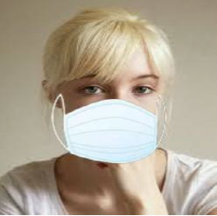

BEFORE DATA PREPROCESSING
AFTER DATA PREPROCESSING

Slide 12
RESULTS
04

Slide 13
RESULTS
VGG-16
DenseNet
2 Convolutional Layers
MobileNet
92.1%
Optimizer = adam, learning rate =0.001, epochs =10
99.6%
Optimizer = nadam, learning rate = 0.001, epochs = 20
99.2%
Optimizer = nadam, learning rate = 0.001, epochs = 20
99.9%
Optimizer = adam, learning rate =0.01, epochs = 30

Slide 14
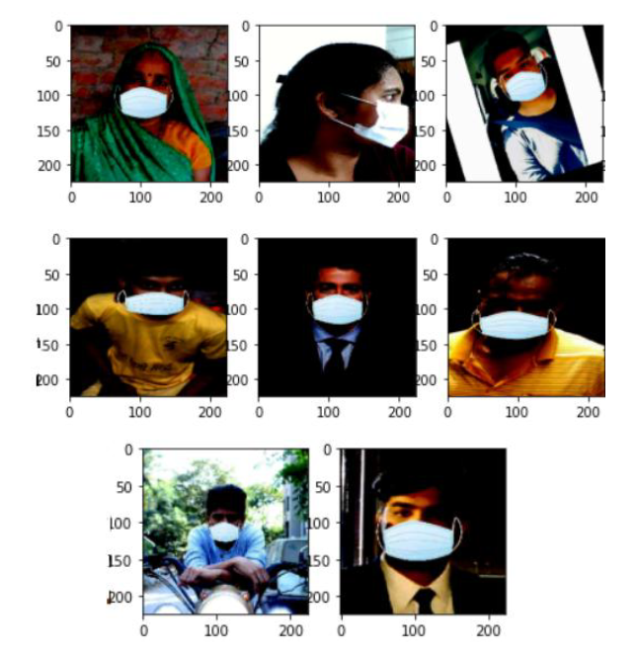
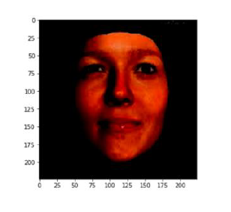

CONFUSION MATRIX PLOTTING (ONE OF DENSE EXPIREMNTS)
False positive
False negative

Slide 15
05
FUTURE WORK

Slide 16
FUTURE WORK
Distance
Small
Objects detection
2+
meters
(RetinaNet)

Slide 17
CONCLUSION
06

Slide 18
VGG-16
99.9%

Slide 19
Real-time detecting ?

Slide 20
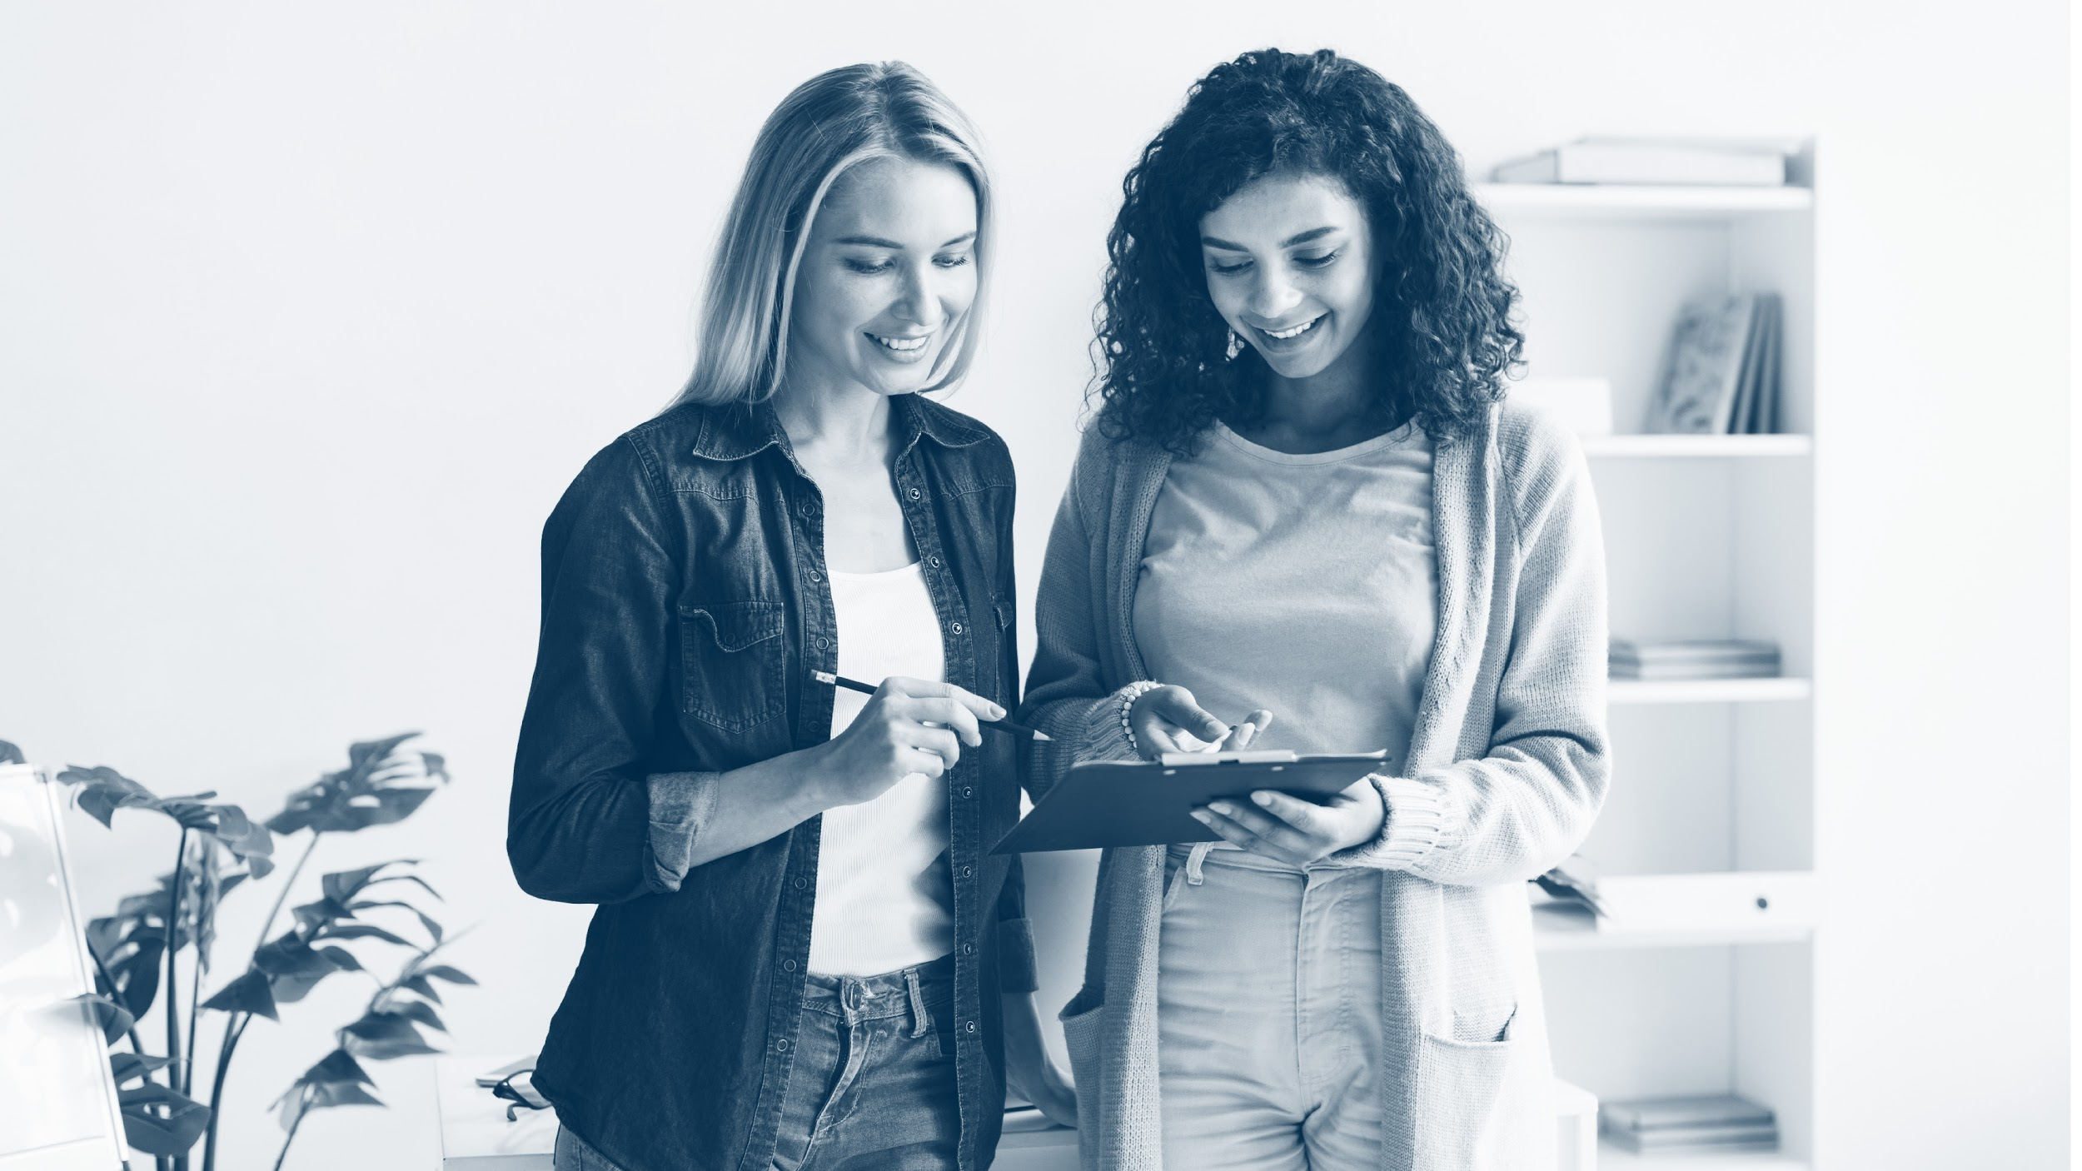
THANKS

