Slide 1

Jordan University of Science and Technology
Faculty of Computer and Information Technology
Department of Computer Engineering
CPE 591: Graduation Project II Report
AI-BASED INTERACTIVE DIGITAL CONTENT APPLICATION:
[search|summarize|save|translate|integrate|chat and present]
Presented: by Aya Mahmoud & Noor Sharqawi
Supervised by: Dr. Lo’ai Tawalbeh
Fall 2024

Slide 2
Table of content
Problem Statement
Our solution
Application Walkthrough
System Architecture
Database Architecture
Technology stack
Future work
Conclusion

Slide 3
Problem Statement
21% of people feel like they never have work under control !
In the modern digital era, document management and staying productive mean switching between several applications.
Most file readers available are merely content displayers without features that actually increase productivity.
Users spend precious time navigating between apps to summarize information, take notes, or manage their documents.
Tools lack an integrated solution that harmoniously integrates smart AI-driven summarization, note-taking, and document organization all within one single workspace.

Slide 4
The All-in-One Productivity App AI-powered tools for chatting, summarizing, and organizing documents
It’s a Flutter-based mobile app that helps users manage tasks efficiently, combining Firebase Firestore and Auth for data storage and authentication, with a custom Python Flask backend to handle advanced logic and API integration.

Slide 5
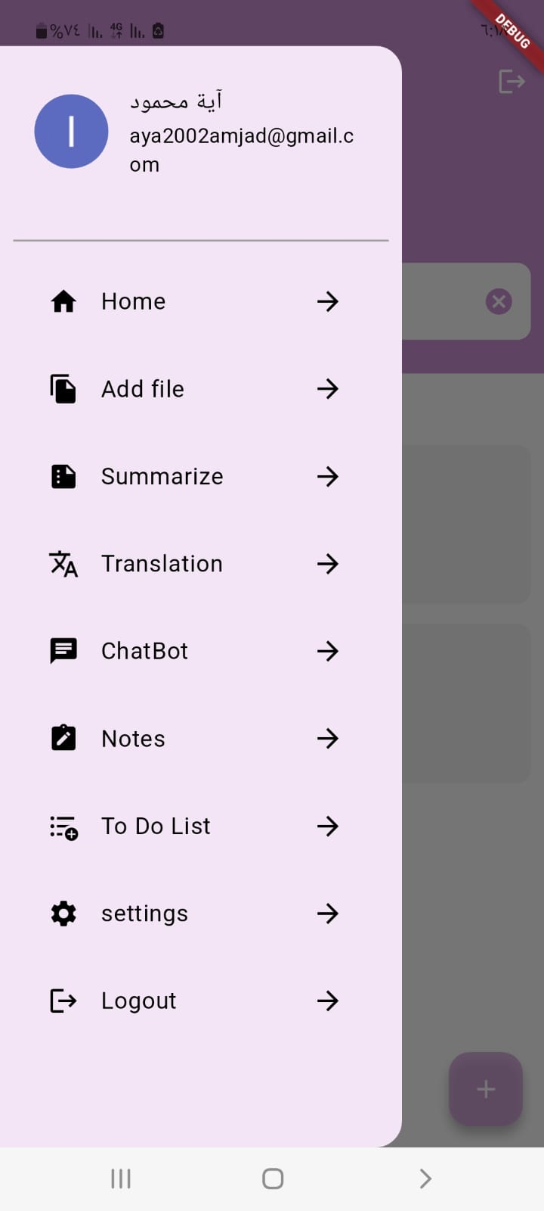
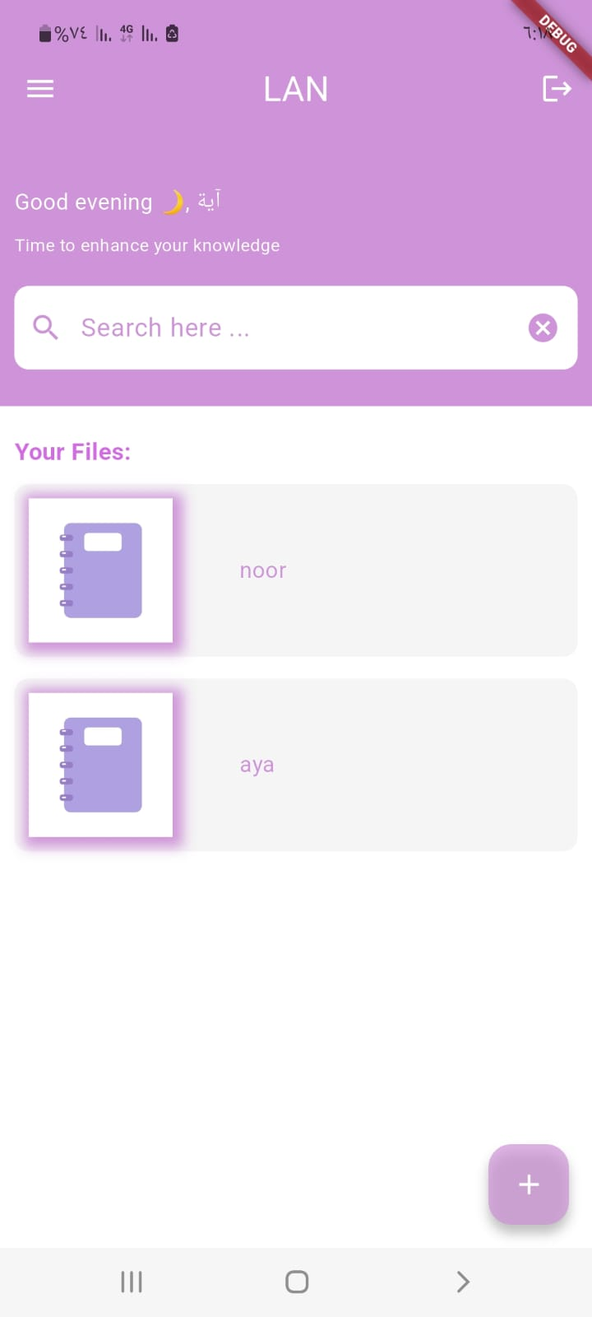
App Walkthrough

Slide 6
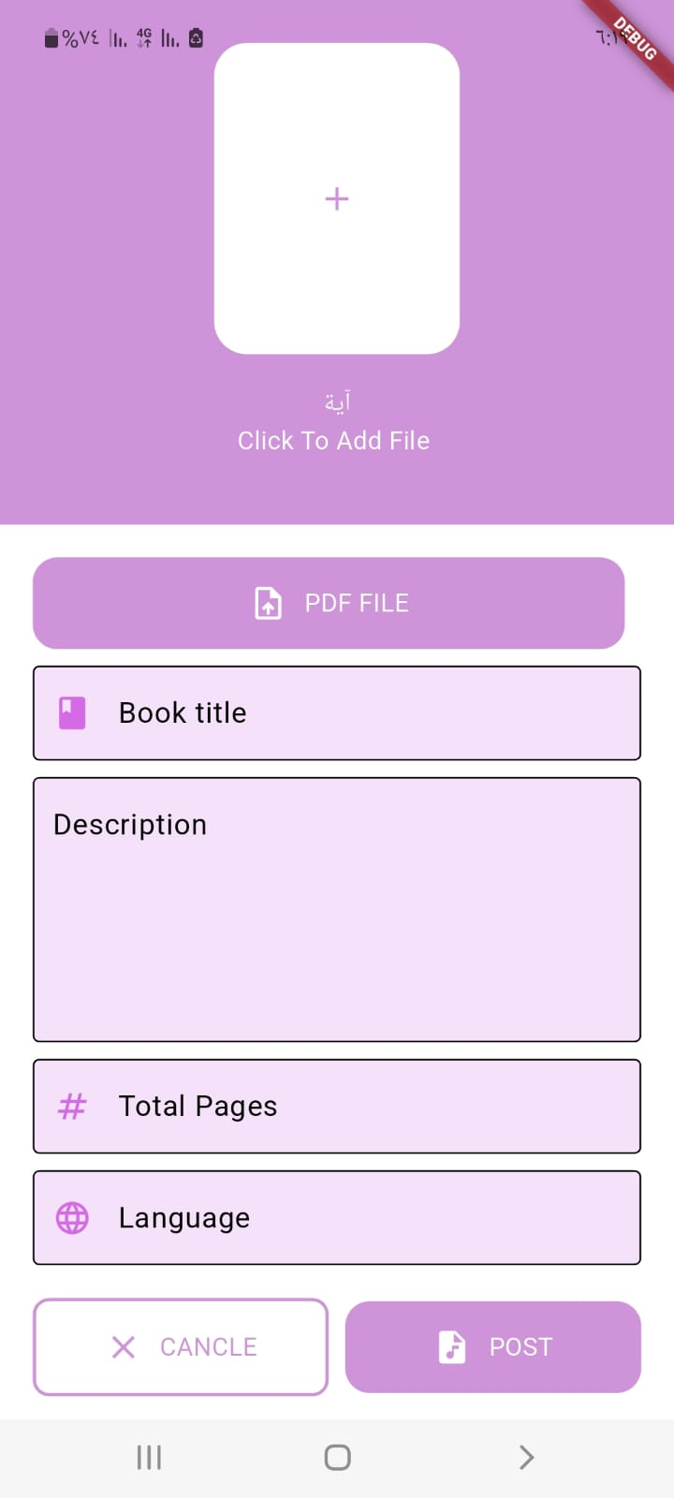
App Walkthrough

Slide 7
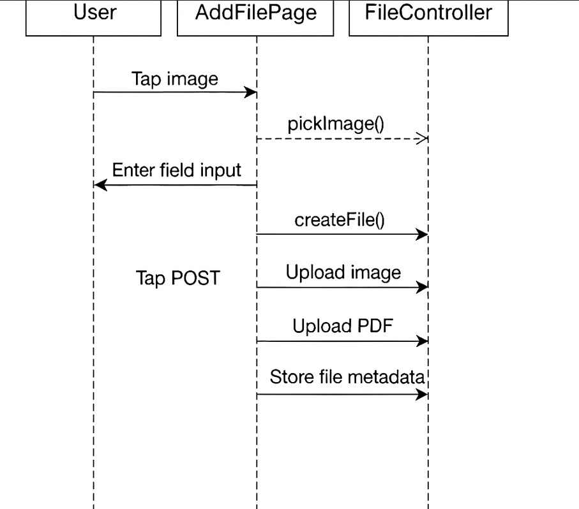
Add file sequence diagram

Slide 8
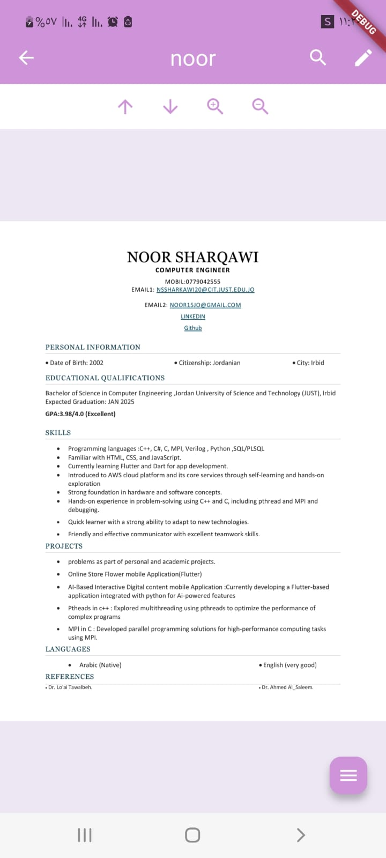
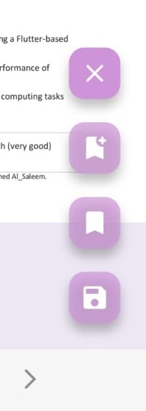
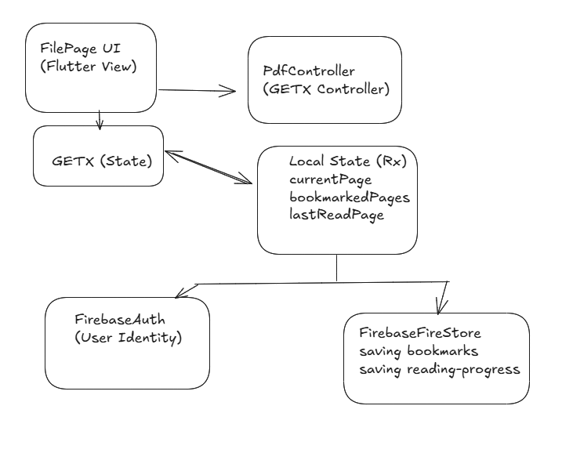
File Page Component diagram

Slide 9
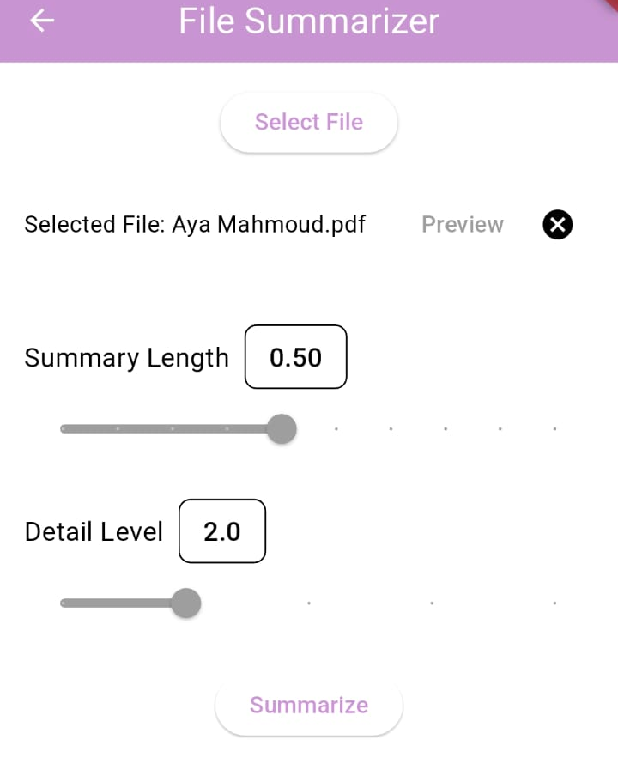
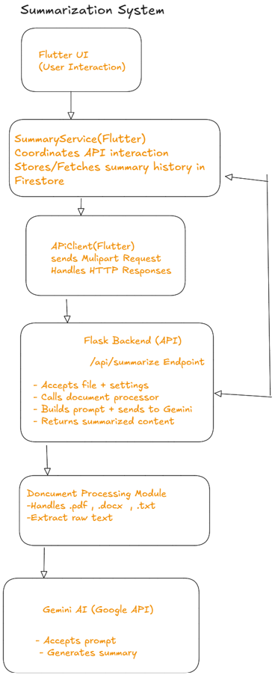
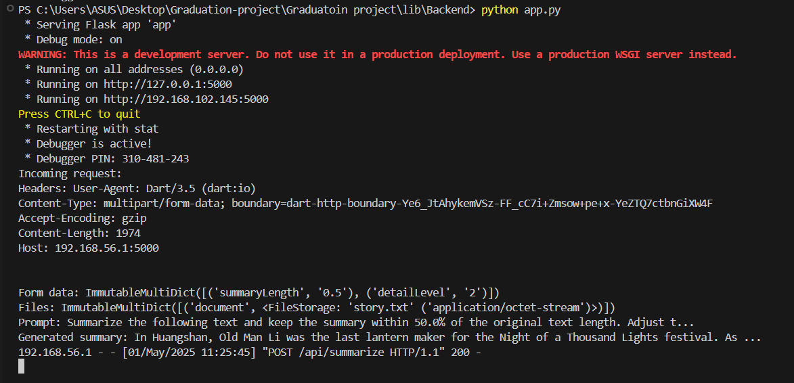
Summarization Component diagram

Slide 10
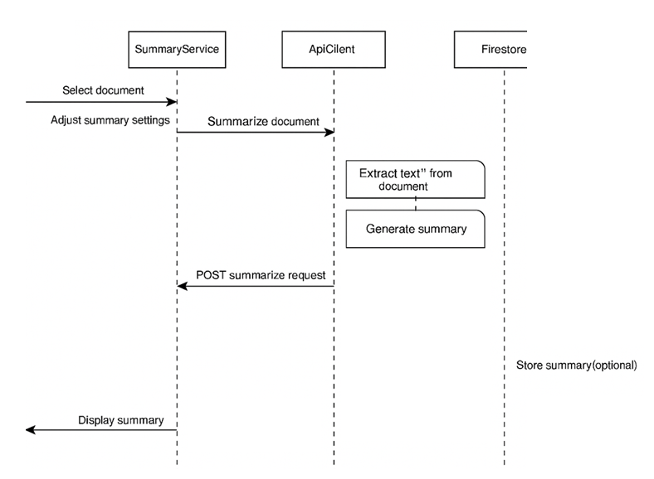
Summarization sequence diagram

Slide 11
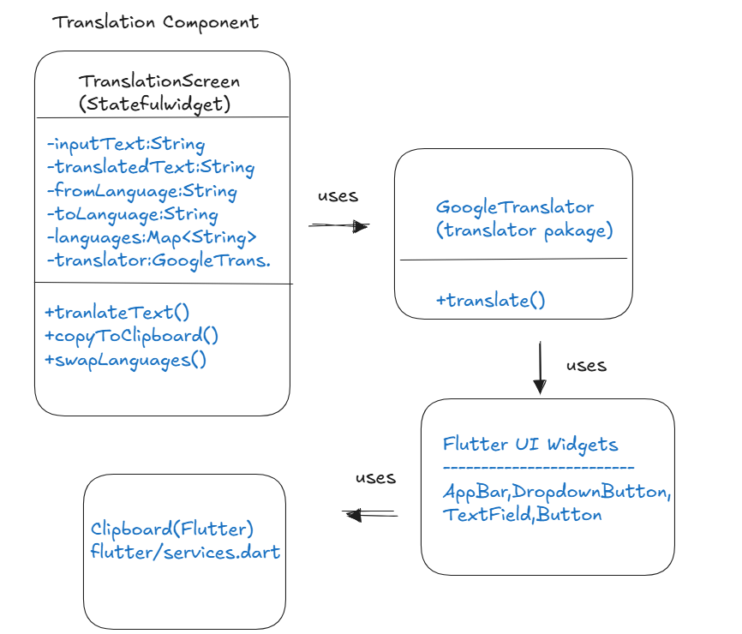
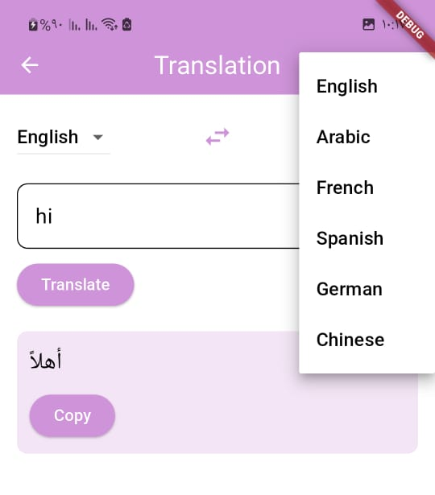
Translation Component diagram

Slide 12
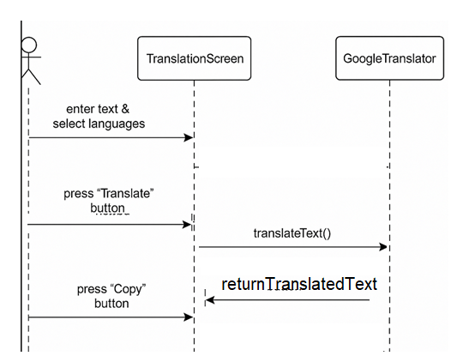
Translation sequence diagram

Slide 13
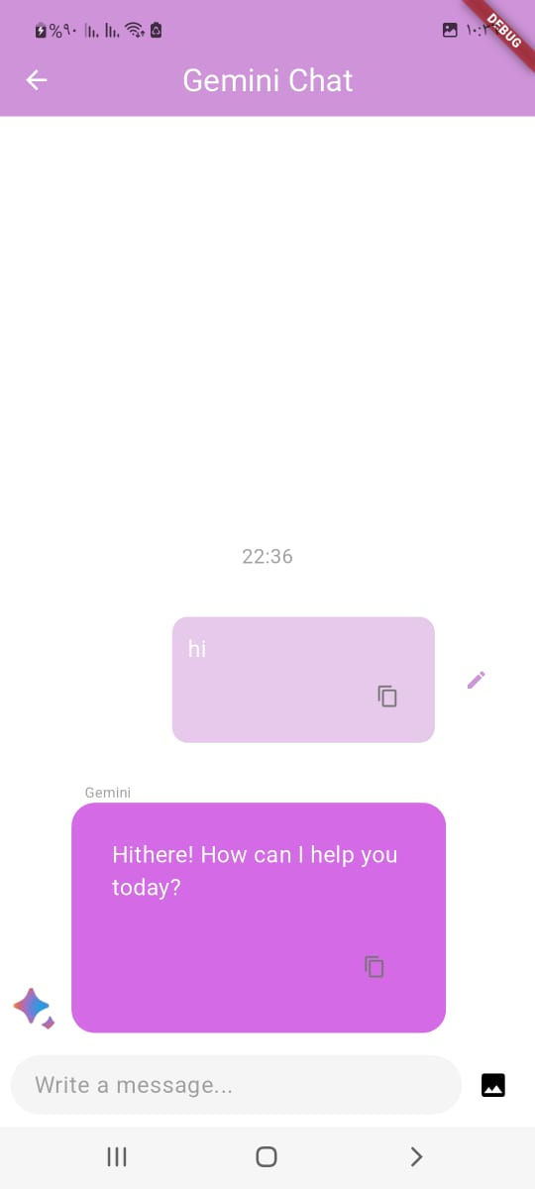
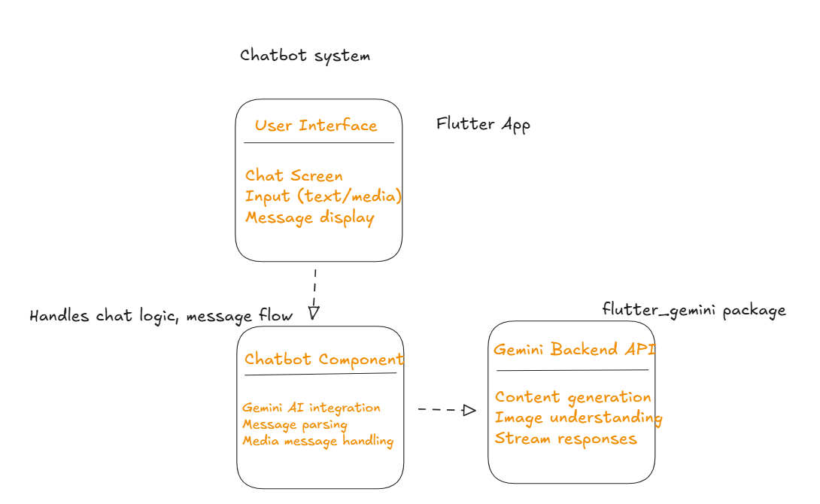
Chatbot Component diagram

Slide 14
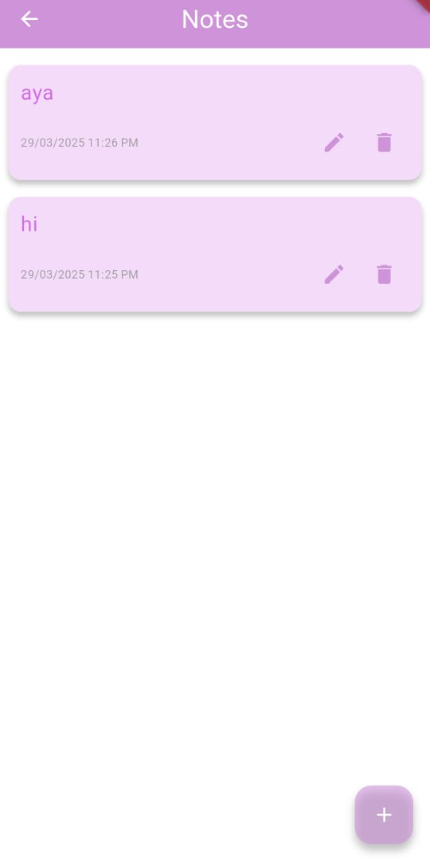
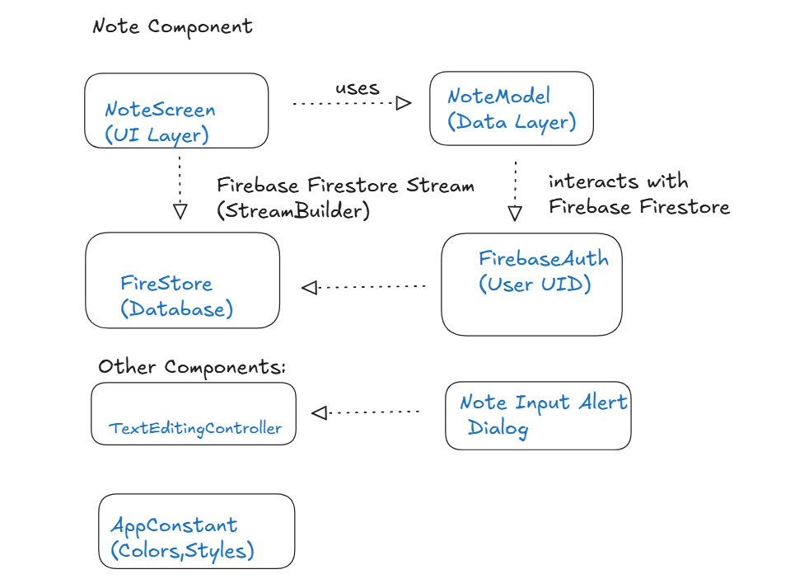
Notes Component diagram

Slide 15
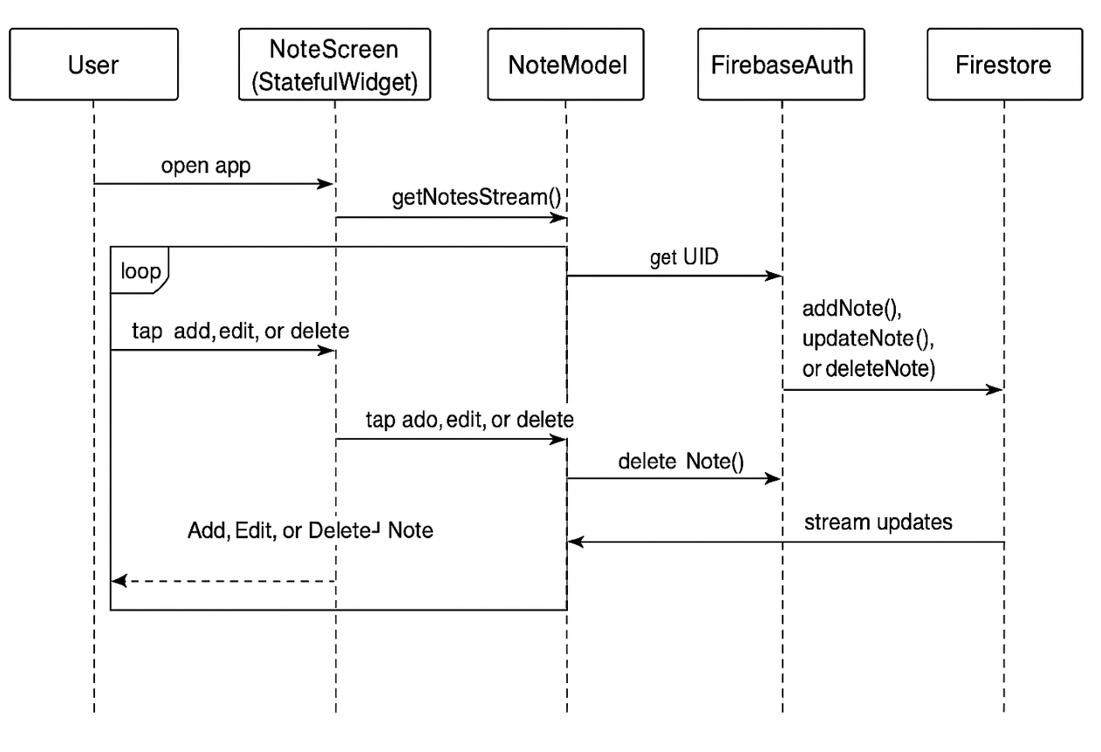
Notes sequence diagram

Slide 16
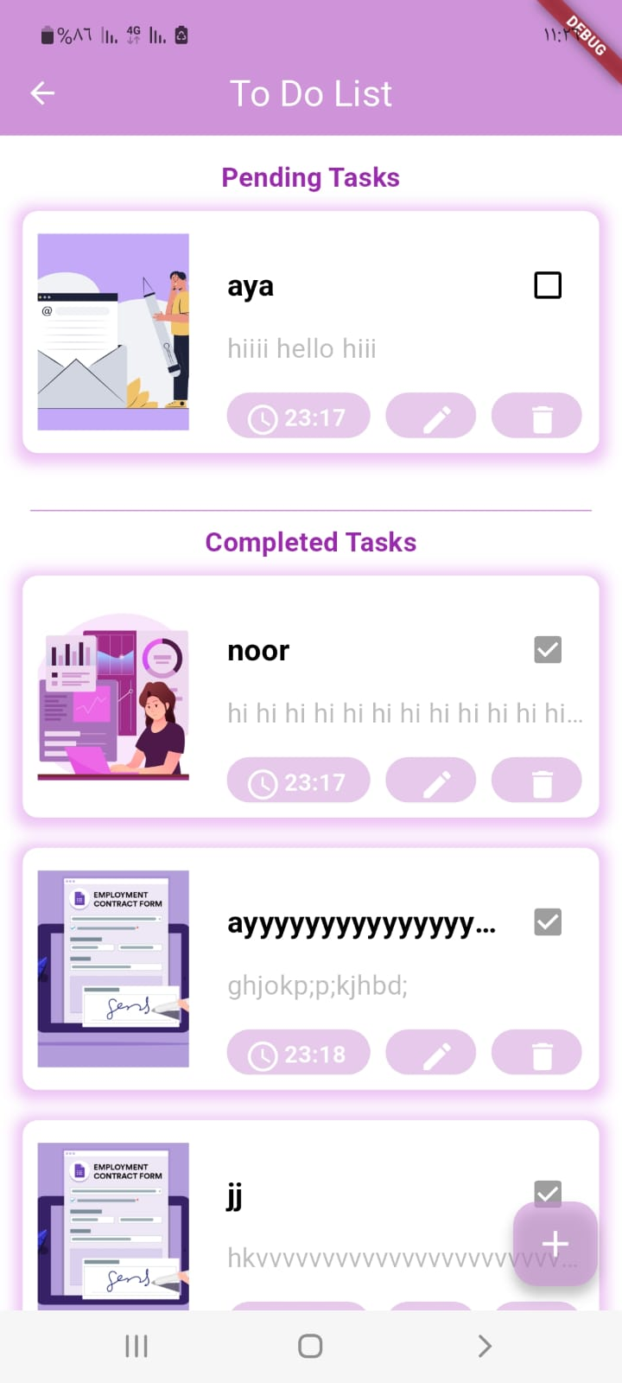
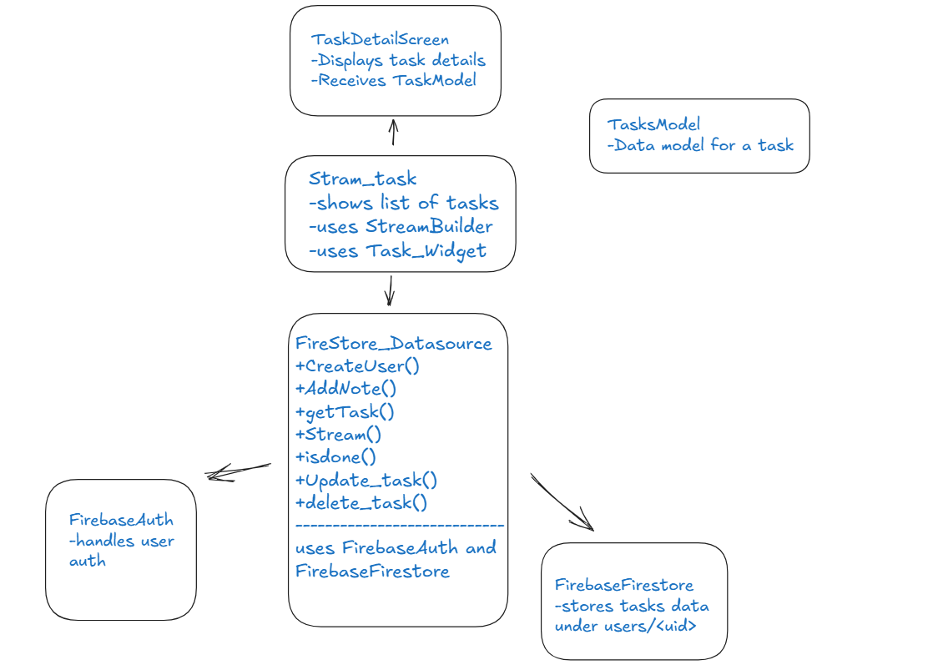
Todo List Component diagram

Slide 17
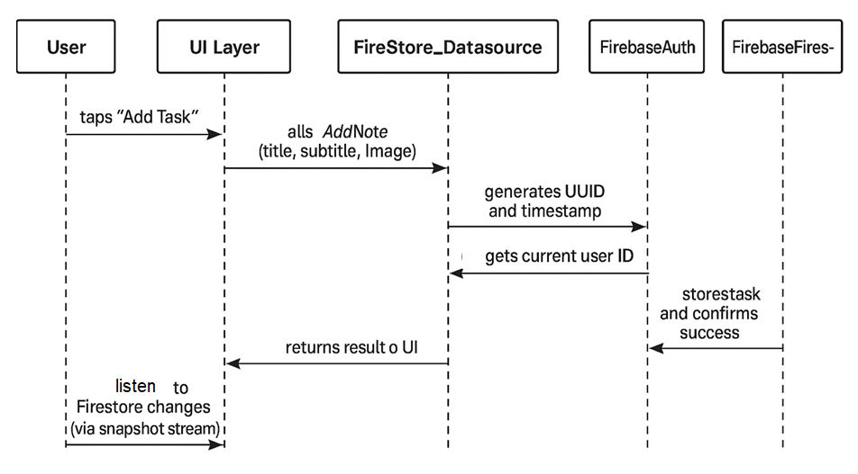
Todo List sequence diagram

Slide 18
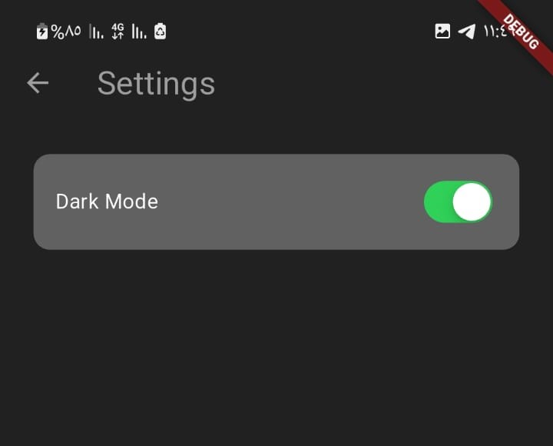
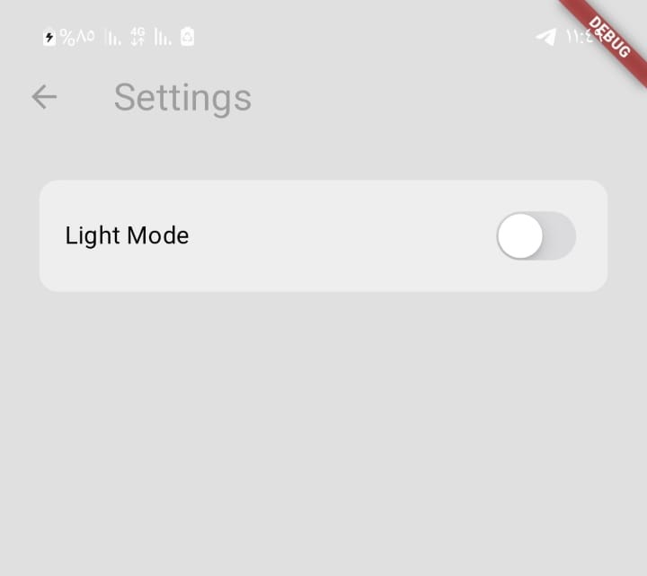
App Walkthrough

Slide 19
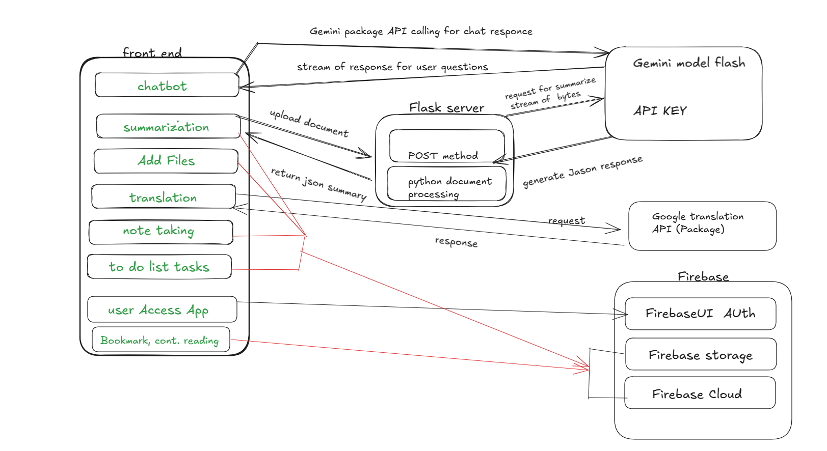
System Architecture with major components

Slide 20
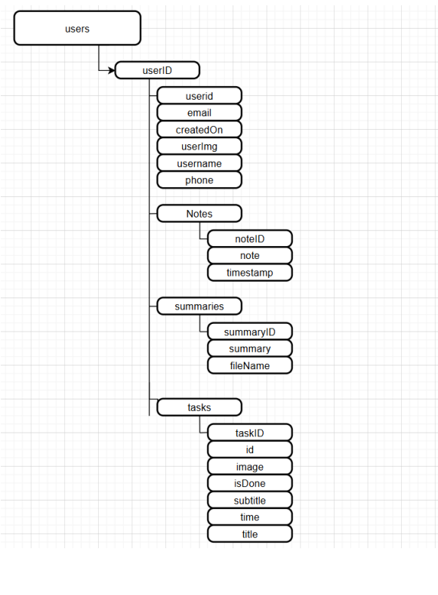
Database Architecture
Firebase (NoSQL – Cloud Firestore / Realtime Database)
Data Type: Unstructured (JSON Format)
Firebase stores data in documents or JSON trees (Realtime Database).
Data is stored in key-value pairs, with flexible structure.
Firebase supports: Flexible schema don’t need to define the structure before inserting data

Slide 21
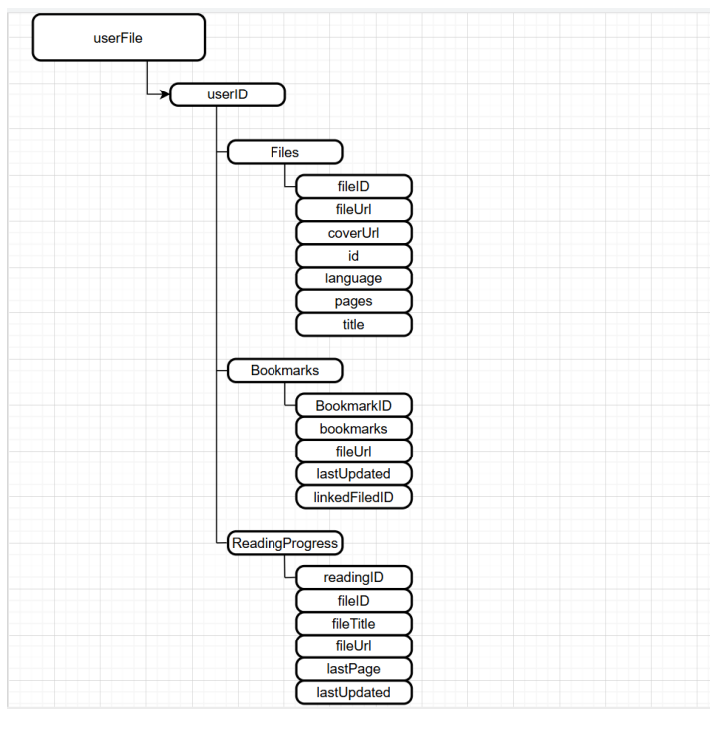
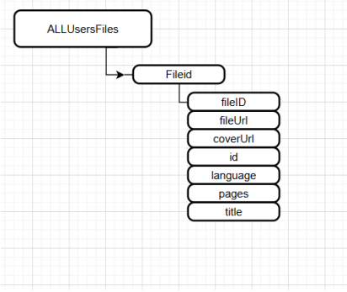
Database Architecture

Slide 22






Tech Stack

Slide 23
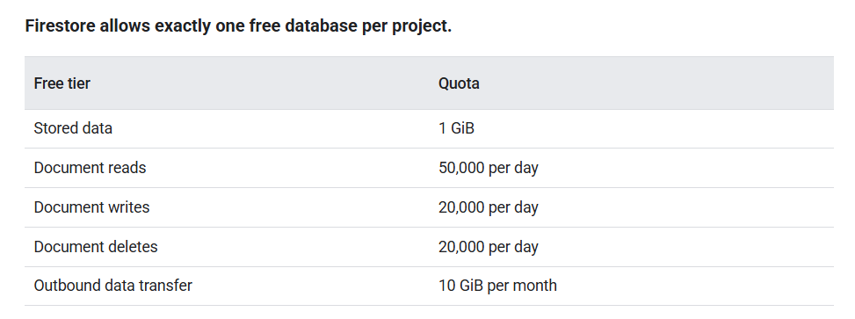
https://firebase.google.com/docs/firestore/quotas

Slide 24
Future Work
For future Improvements and Expansions based on the knowledge and experience gained during the development and piloting of the AI-Based Interactive Digital Content Application, the following are the recommendations for future improvements and expansions:
Enhance AI Capabilities: Enhance the accuracy and contextual awareness of the AI-powered chatbot and summarization features. Adding more advanced natural language processing (NLP) models can enhance the user experience.
Expand Language Support: Extend the translation widget to support additional languages, making the app usable by a global user community.
Implement Offline Mode: Offer offline functionality for certain features, such as viewing previously summarized content, saved notes, and bookmarked PDFs. This will render it more functional where connectivity is poor.

Slide 25
Future Work
Advanced Search and Filter Options: Implement additional advanced search functionality, including keyword suggestions and voice search, to facilitate easy content discovery.
User Customization: Provide options for users to customize the look and feel of the app, font size, reading themes, and layout options for a personalized reading experience.
Multi-Platform Support: Develop desktop and web-based application versions, with a consistent user experience across devices.
Security Improvements: Incorporate additional security measures, like two-factor authentication (2FA) and more robust data encryption, to protect user information.
Integration of User Feedback: Design a feedback system within the app, where users can report issues and suggest features for subsequent updates.
Video summarization : Make the users not only summarize files but also videos.

Slide 26
Conclusion
Created and designed an AI-powered interactive digital content application to enhance the e-reading experience through smart features.
Implemented AI-powered tools using Gemini API such as: Summarizatoin,chatbot
Tackled and resolved key development challenges:Real-time data synchtonization,designing user-friendly interface,API integration
Using technologies Flutter,python with flask Firebase

Slide 27
Conclusion
Enhanced usability with additional features: Translation, Note-taking, To-do list.
Overall, the project successfully delivered a functional and user-friendly digital content management platform.
Demonstrated how AI can significantly improve the digital reading experience and open doors for future innovations in e-reading.

Slide 28
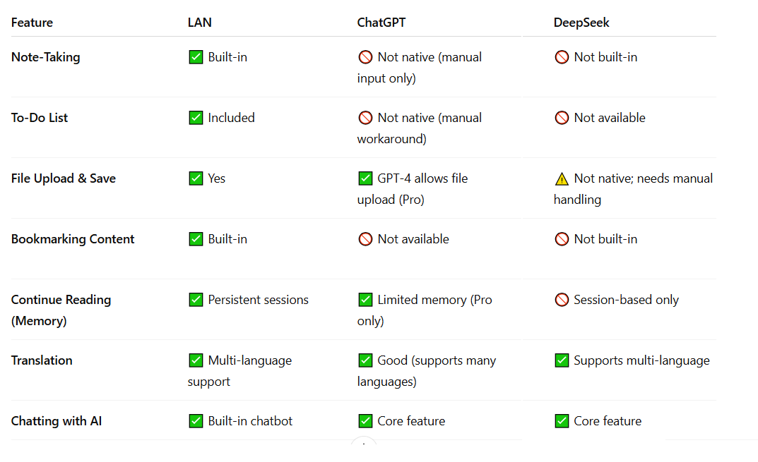
Feature Comparison Table

Slide 29
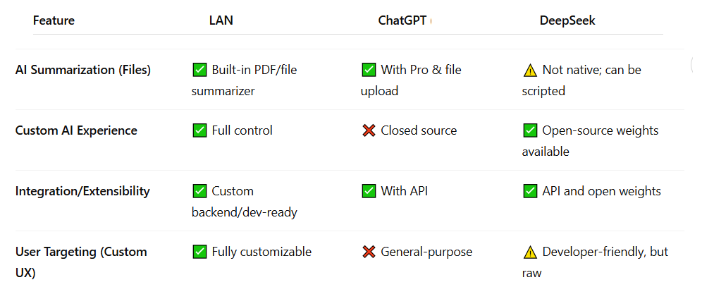
Feature Comparison Table

Slide 30

THANK YOU

