Slide 1
SJF(Non-Preemptive) SCHDULEING ALGORITHM
CS 480 (operating systems) project
Aya Alharbi - 3820123

Slide 2
SJF SCHEDULING ALGORITHM
Shortest Job First (SJF) is an algorithm in which the process having the smallest execution time is chosen for the next execution. This scheduling method can be preemptive or non-preemptive. It significantly reduces the average waiting time for other processes awaiting execution.

Slide 3
SJF Steps
Here are the steps for the non-preemptive version of the SJF algorithm:
Sort the list of processes in ascending order based on their burst times.
2. Select the process with the smallest burst time from the sorted list. Furthermore, if multiple processes have the same arrival time, use their process ID to break the tie.
3. Execute the selected process until completion.
4. Update the system time and process list by remove the completed process from the list and recalculate the waiting and turnaround times for the remaining processes.
5. Repeat steps 2 to 4 until all processes are executed.

Slide 4
Result of SJF Implementation
The report utilizes Table 1 that includes process Id and burst time to assess the performance of the SJF CPU scheduling algorithm:
Process Id | Burst time
1 | 8
2 | 3
3 | 6
4 | 1
5 | 5

Slide 5
Result of SJF Implementation
The following Figure presents the result of SJF algorithm after sorted order based burst time:
Now the average waiting time: (0 + 1 + 4 + 9 + 15) / 5 = 29 / 5 = 5.8 time units.

Slide 6
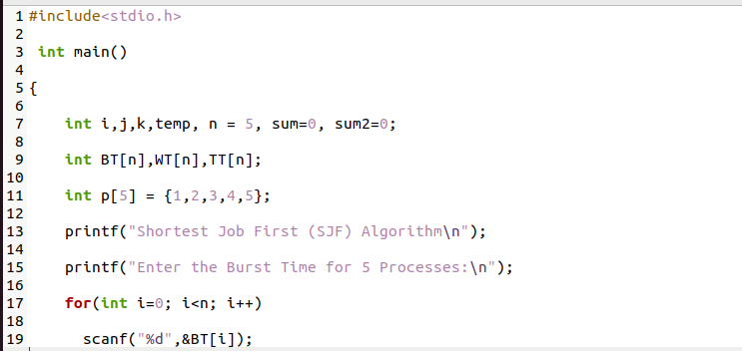
C code:

Slide 7
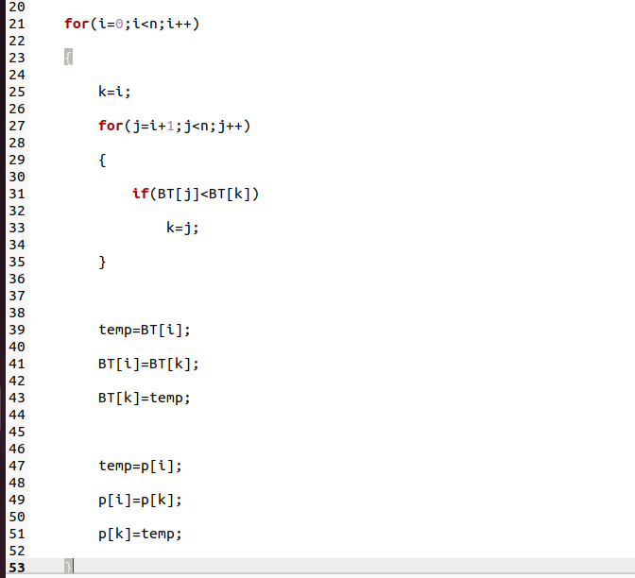
C code:

Slide 8
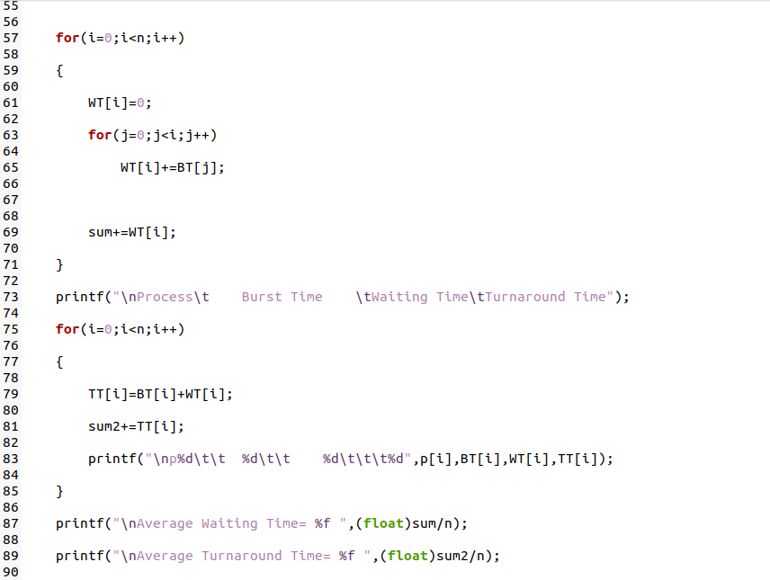
C code:

Slide 9
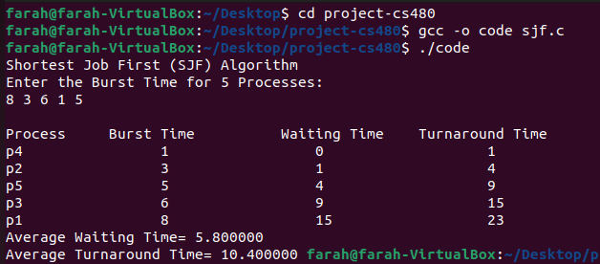
Output:

Slide 10


Advantages of SJF
Minimized
waiting time
Increased throughput
Suitable for batch systems

Slide 11




Disadvantages of SJF
Starvation
Difficulty predicting burst time
No priority consideration
Not suitable for interactive systems

Slide 12
THINK YOU

