Slide 1


AI JOB MARKET
A Data-Driven Analysis of Global AI Hiring Trends, Salaries & Skills
PREPARED BY
Noran Hatem • Aya Ayman • Dalia Khaled
Ziad Ashraf • Kirolos Ibrahim • Arwa Ahmed
Supervised by: Eng. Dina Mohsen
Python · SQL · Power BI
Notes:
1

Slide 2
PRESENTATION WORKFLOW
What We'll Walk Through
01
02
03
Project Introduction
Dataset Overview
Python Workflow
Goals and problem framing
Scope, fields and coverage
Exploration, cleaning, validation, visualization
04
05
06
SQL Analysis
Power BI Dashboards
Dashboard Insights
Techniques and business questions
Objectives, audiences, KPIs & DAX
Key findings & business conclusions
07
Final Deliverables
GitHub repository structure
AI Job Market | Noran · Aya · Dalia · Ziad · Kirolos · Arwa
02
Notes:
2

Slide 3

01 — INTRODUCE THE PROJECT
Understanding the Global AI Job Market
The rapid growth of Artificial Intelligence has reshaped the global job market — creating new roles, shifting required skill sets, and driving significant salary premiums. This project analyzes a global AI job-postings dataset end-to-end, moving from raw data to a clean analytical dataset, structured SQL analysis, and interactive Power BI dashboards.
Job Roles & Categories
Salary & Compensation
PROJECT GOAL
Skills & Requirements
Explore, clean and analyze global AI job postings to uncover patterns in roles, salaries, required skills and market demand — then translate those patterns into decision-ready dashboards for job seekers, recruiters and analysts.
Demand & Market Trends
AI Job Market | Noran · Aya · Dalia · Ziad · Kirolos · Arwa
03
Notes:
3

Slide 4
02 — INTRODUCE THE DATASET
Global AI Jobs Dataset
1,500
37
25
12
Job Postings
Data Fields
Distinct AI Job Titles
Job Categories
KEY DATA FIELDS
Job Details
Compensation
job_title, job_category, experience_level, years_of_experience, education_required
annual_salary_usd, salary_min/max_usd, ai_salary_premium_pct, salary_tier
Location & Setup
Skills & Demand
city, country, remote_work, company_size, industry
required_skills, skill_count, demand_score, demand_growth_yoy_pct, is_llm_role
AI Job Market | Noran · Aya · Dalia · Ziad · Kirolos · Arwa
04
Notes:
4

Slide 5

03 — PYTHON WORK (COLAB)
From Raw Data to Analysis-Ready Dataset
Notebook: ai_jobs_global_processed.ipynb
open in google colab
1
2
3
4
Data Exploration
Data Cleaning
Data Validation
Data Visualization & Feature Engineering
Loaded the dataset in Pandas and inspected shape, columns, data types, and initial structure to understand the raw data.
Removed whitespace, standardized missing-like values, checked duplicates, and converted date columns into proper formats.
Validated numeric ranges, categorical consistency, salary logic, binary indicator fields and detected outliers using IQR & Z-score.
Engineered features such as skill_count, salary_range_midpoint and posting_date, then profiled distributions to prepare the dataset for SQL and Power BI.
AI Job Market | Noran · Aya · Dalia · Ziad · Kirolos · Arwa
05
Notes:
5

Slide 6

04 — SQL ANALYSIS
Turning Data Into Business Answers
Four SQL scripts were written against the cleaned dataset — one per dashboard — combining aggregate functions, GROUP BY, JOIN logic, CASE statements, subqueries and window-style analysis to answer 28 targeted business questions.
SQL TECHNIQUES USED
Aggregate Functions
(COUNT, AVG, MIN, MAX)
GROUP BY & ORDER BY
ranking analysis
JOINs & CASE
conditional logic
Subqueries
nested comparisons
STRING_SPLIT +
CROSS APPLY for skills
TOP N
filtering
FOUR SQL DASHBOARDS OF ANALYSIS
Dashboard 1
Dashboard 2
Dashboard 3
Dashboard 4
AI Job Market Overview
Salary & Compensation Analysis
AI Skills & Career Requirements
AI Job Demand & Market Trends
4 KPIs · 7 questions
4 KPIs · 7 questions
4 KPIs · 7 questions
4 KPIs · 7 questions
AI Job Market | Noran · Aya · Dalia · Ziad · Kirolos · Arwa
06
Notes:
6

Slide 7
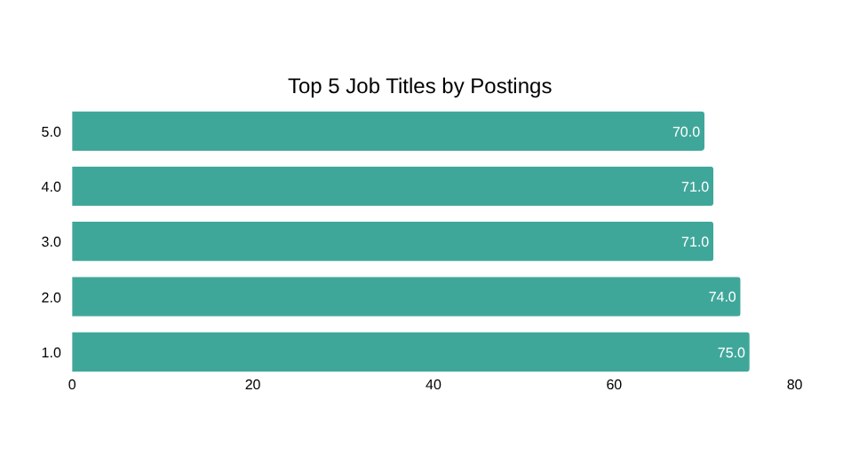
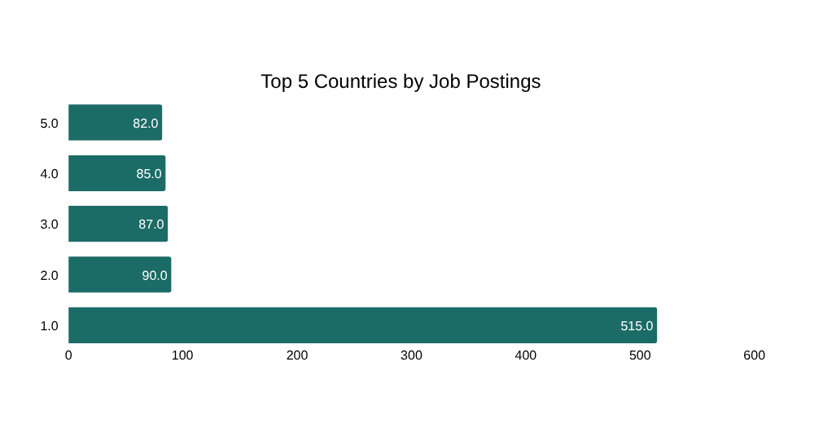
DASHBOARD 1 — 05. POWER BI
AI Job Market Overview
OBJECTIVE
TARGET AUDIENCE
Provide an overall view of the AI job market and identify major trends in job roles, categories, locations, industries and experience levels.
Job Seekers • Career Analysts • Recruiters
Main KPIs: Total Job Postings · Total Job Roles · Total Job Categories · Average Annual Salary
1,500
25
12
$194,892
Total Job Postings
Total Job Roles
Total Job Categories
Average Annual Salary
AI Job Market | Noran · Aya · Dalia · Ziad · Kirolos · Arwa
07
Notes:
7

Slide 8
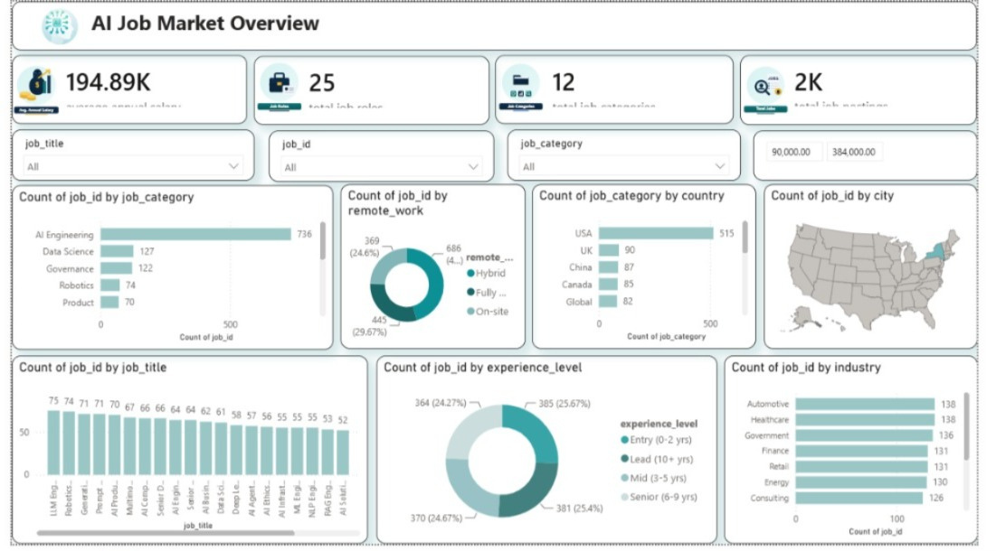
DASHBOARD 1 — LIVE POWER BI VIEW
AI Job Market | Noran · Aya · Dalia · Ziad · Kirolos · Arwa
08
Notes:
8

Slide 9
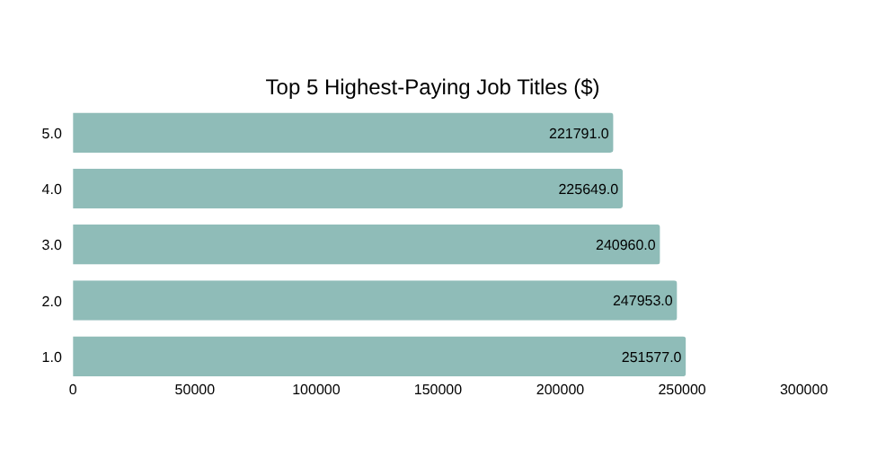
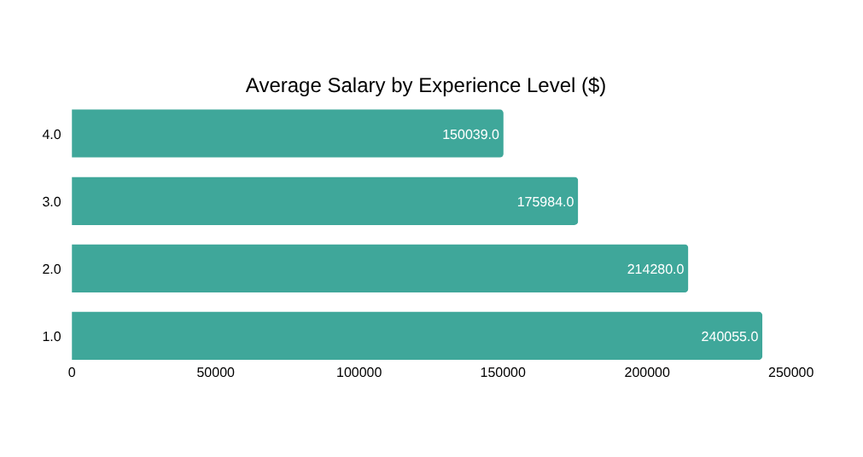
DASHBOARD 2 — 05. POWER BI
Salary & Compensation Analysis
OBJECTIVE
TARGET AUDIENCE
Analyze salary patterns in the AI job market and understand how salary varies by job title, experience level, location, company size and work arrangement.
Job Seekers • HR Teams • Recruiters • Career Planners
Main KPIs: Average Salary · Minimum Salary · Maximum Salary · Average AI Salary Premium %
$194,892
$90,000
$320,000
10.86%
Average Salary
Minimum Salary
Maximum Salary
Avg. AI Salary Premium
AI Job Market | Noran · Aya · Dalia · Ziad · Kirolos · Arwa
09
Notes:
9

Slide 10
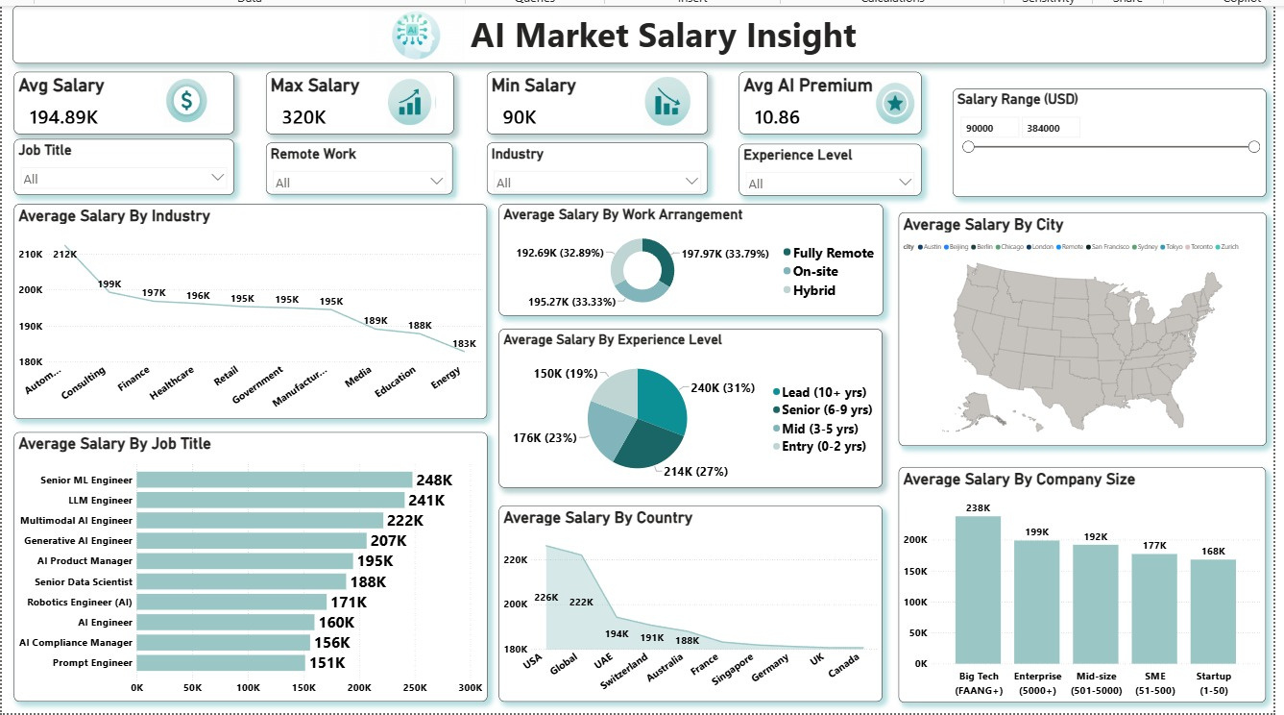
DASHBOARD 2 — LIVE POWER BI VIEW
10
Notes:
10

Slide 11
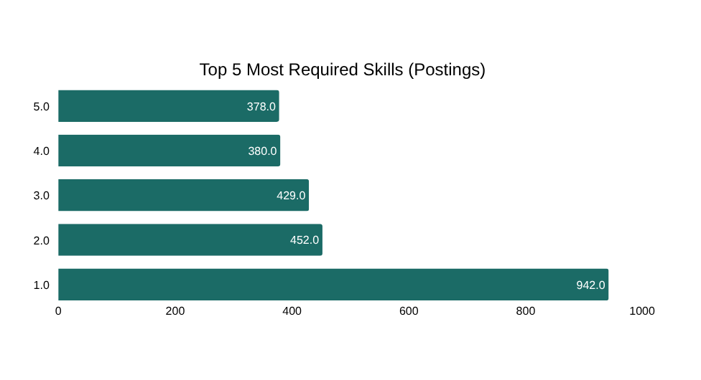
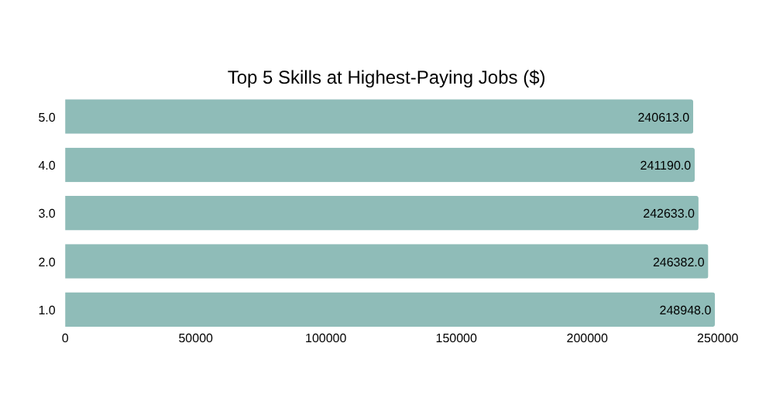
DASHBOARD 3 — 05. POWER BI
AI Skills & Career Requirements
OBJECTIVE
TARGET AUDIENCE
Identify the most demanded skills in the AI job market and understand how skill requirements vary across job roles, experience levels and salaries.
Job Seekers • Students • Career Planners • Recruiters
Main KPIs: Average Skills per Job · Maximum Skills Required · Most In-Demand Skill · % Jobs with Specified Skills
6.37
10
Python
100%
Average Skills per Job
Maximum Skills Required
Most In-Demand Skill
Jobs with Specified Skills
AI Job Market | Noran · Aya · Dalia · Ziad · Kirolos · Arwa
11
Notes:
11

Slide 12
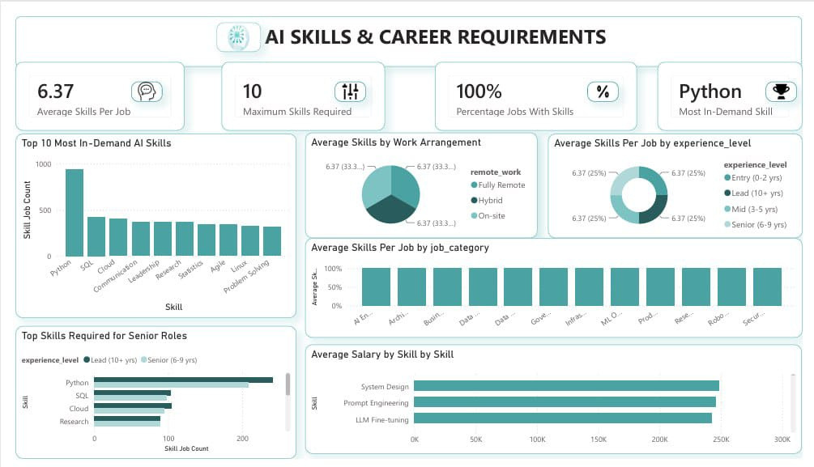
DASHBOARD 3 — LIVE POWER BI VIEW
12
Notes:
12

Slide 13
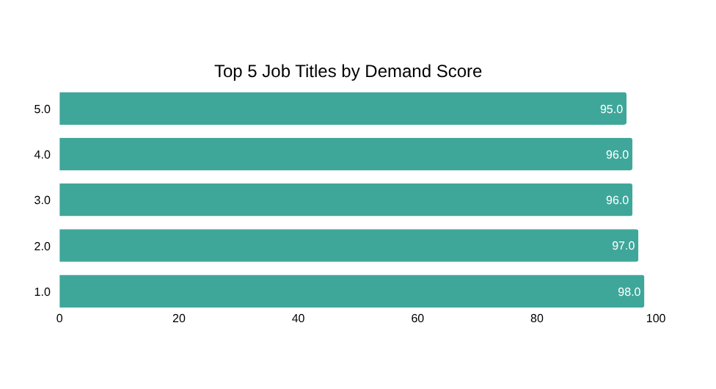
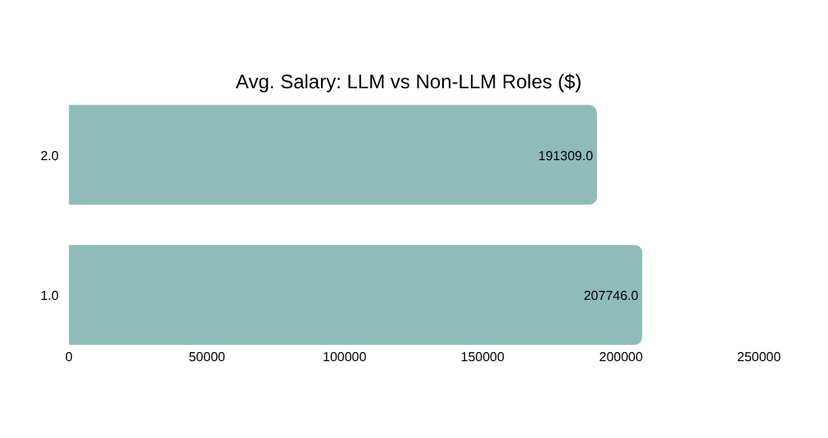
DASHBOARD 4 — 05. Tableau
AI Job Demand & Market Trends
OBJECTIVE
TARGET AUDIENCE
Analyze AI job demand and market trends across job roles, job categories, industries, countries and experience levels.
Job Seekers • Career Analysts • Recruiters • Market Analysts
Main KPIs: Average Demand Score · Average Demand Growth % · Highest Demand Job Role · % LLM Roles
87.5 / 100
31.1%
LLM Engineer
21.8%
Average Demand Score
Average Demand Growth
Highest Demand Role
LLM-Related Roles
AI Job Market | Noran · Aya · Dalia · Ziad · Kirolos · Arwa
13
Notes:
13

Slide 14
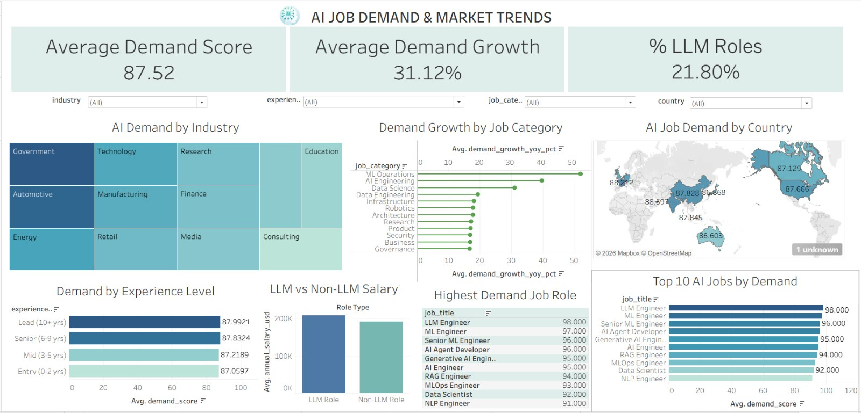
DASHBOARD 4 — LIVE Tableau VIEW
14
Notes:
14

Slide 15

06 — DASHBOARD INSIGHTS
Key Insights From the Dashboards
Market Overview
Compensation
The market is dominated by AI Engineering roles (736 of 1,500 postings) and led by the USA (515 postings), with Hybrid the most common work arrangement.
Salary rises sharply with seniority — from $150K at Entry level to $240K at Lead level — and Big Tech (FAANG+) pays roughly 42% more than Startups.
Skills
Demand & Growth
Python appears in 942 of 1,500 postings (63%), yet the highest-paying skills are specialized: System Design, Prompt Engineering and RAG all average $240K+.
LLM Engineer is both the highest-demand (98/100) and among the highest-paid roles; LLM-related roles pay ~$16.4K more on average than non-LLM roles.
AI Job Market | Noran · Aya · Dalia · Ziad · Kirolos · Arwa
15
Notes:
15

Slide 16
06 — DASHBOARD INSIGHTS
Business Conclusions
For Job Seekers
For Recruiters
Prioritize LLM, RAG and system-design skills — they carry both the highest demand and the strongest salary premiums in the current AI job market.
Competitive offers should benchmark against Big Tech pay bands ($238K avg.); remote-friendly and hybrid roles now represent over 75% of postings.
For Career Planners
For Market Analysts
Skill depth matters more than skill count — average skills per job stay flat (~6.3) across experience levels, but which skills you hold drives salary.
LLM-related roles are the fastest-growing segment (demand score 98, +42.7% YoY for top titles) and command a clear salary premium over non-LLM roles.
AI Job Market | Noran · Aya · Dalia · Ziad · Kirolos · Arwa
16
Notes:
16

Slide 17
Thank You
Questions & Discussion
AI Job Market — A Data-Driven Analysis
Noran Hatem • Aya Ayman • Dalia Khaled
Ziad Ashraf • Kirolos Ibrahim • Arwa Ahmed
Supervised by: Eng. Dina Mohsen
Notes:
18

