Slide 1




Prediction of Hotel Booking Cancellations
Classification Problem
Presented To:
Dr. Olubisi Runsewe
Presented BY Group 5: Esraa Fayad Aya Mahmoud Abdelrahman Ali

Slide 2

01
Problem Formulation
02
Agenda
Introduction
03
Details & Models
04
Evolutions & Summary

Slide 3
01
Problem Formulation

Slide 4

Problem
Today, booking cancellations are without a doubt one of the major problems facing any revenue management or hotel manager. According to data on the European market, 49.8% of reservations made through the OTA Booking.com were canceled in 2018 [1].
The typical reasons for cancellations include change of plans, scheduling conflicts, etc. This is often made easier by the option to do so free of charge or preferably at a low cost which is beneficial to hotel guests but it is a less desirable and possibly revenue-diminishing factor for hotels to deal with[2].

Slide 5
02
Introduction

Slide 6



Methodology of the Project
Collecting Relevant Data
Data Pre-processing & Visualization
Feature Engineering
Model Selection & Training
Quality 1
Model Evaluation
Model Comparison
Model Deployment
Model Saving

Slide 7
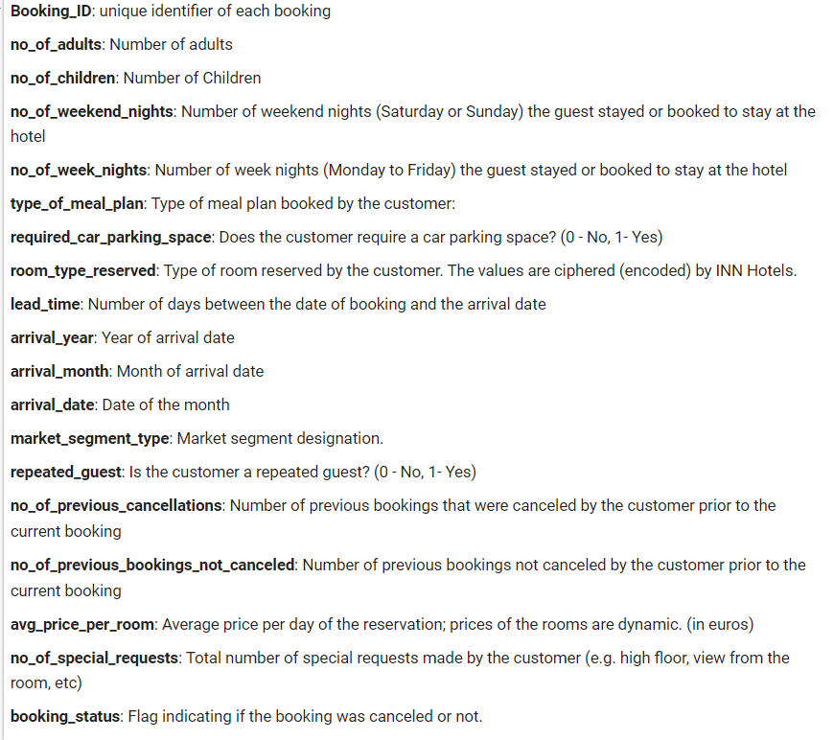
Predicting whether a customer will cancel their reservation is crucial for planning and managing hotel resources effectively. In our project we aim to develop a prediction model for hotel reservation cancellations that can help hoteliers optimize their resources and minimize their losses.
The Data Dictionary
https://www.kaggle.com/datasets/ahsan81/hotel-reservations-classification-dataset

Slide 8
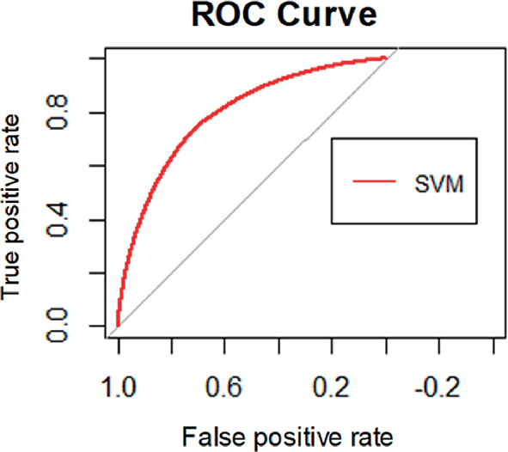
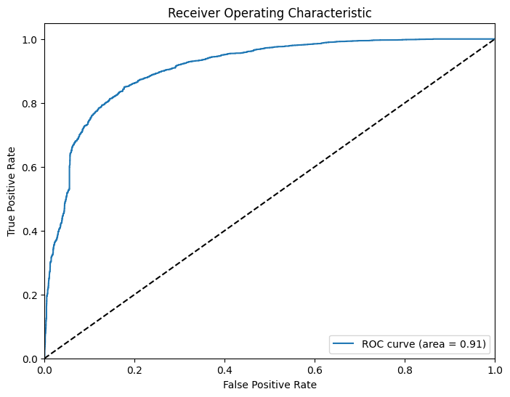
Related Work
Support Vector Machine
Test Accuracy of related work | 73%
Test Accuracy of our model | 83%
ROC Curve of Related work [3]
ROC of our work

Slide 9
03
Details & Models

Slide 10
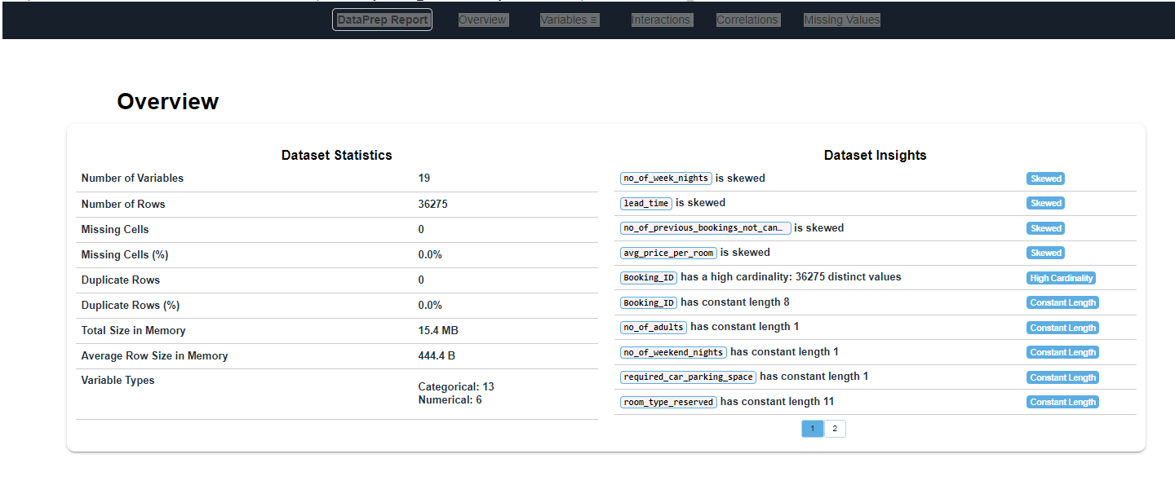
Preprocessing

Slide 11
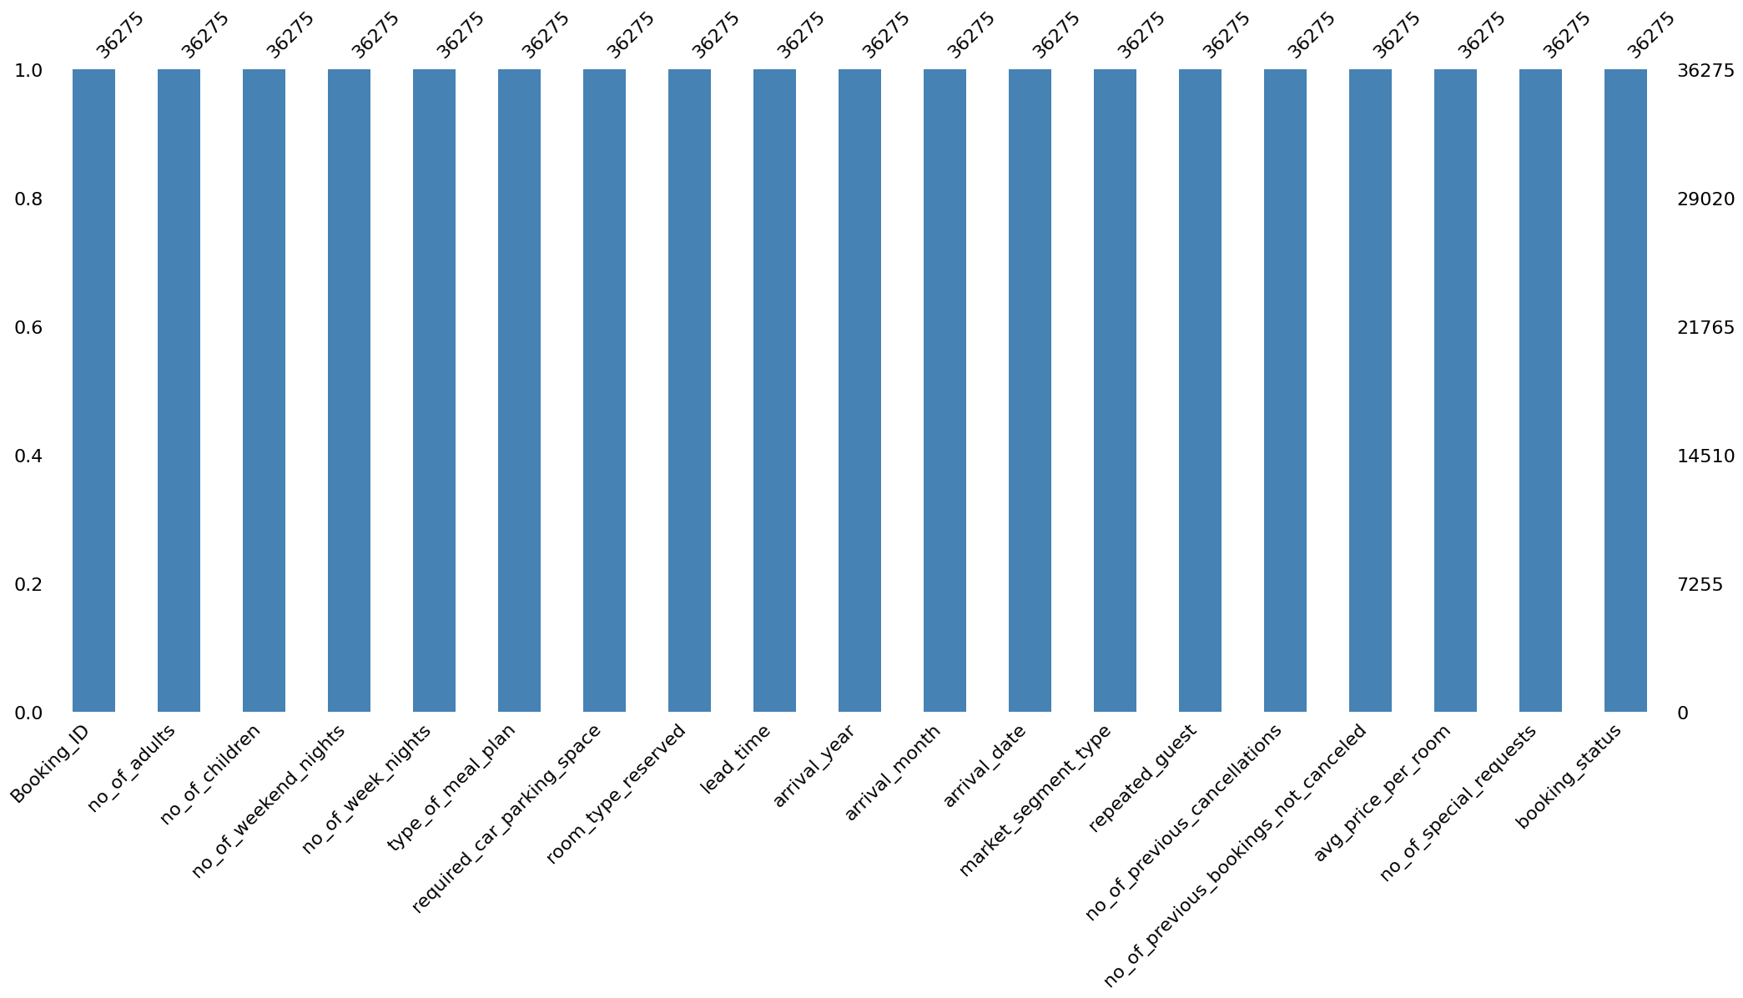
Preprocessing

Slide 12
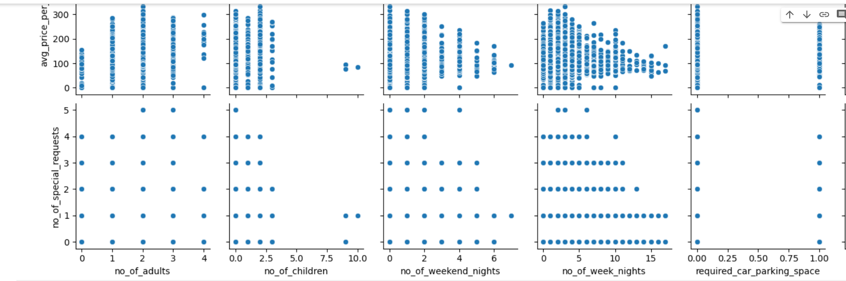
Data Visualization
Relationship between features

Slide 13
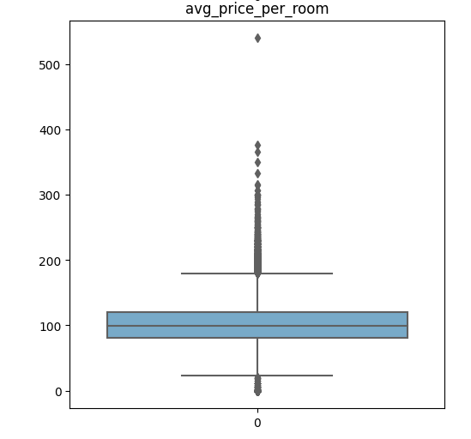
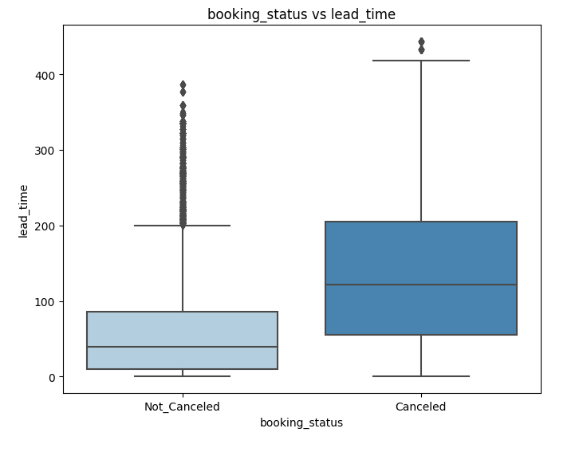
Data Visualization
Boxplot for numeric features

Slide 14
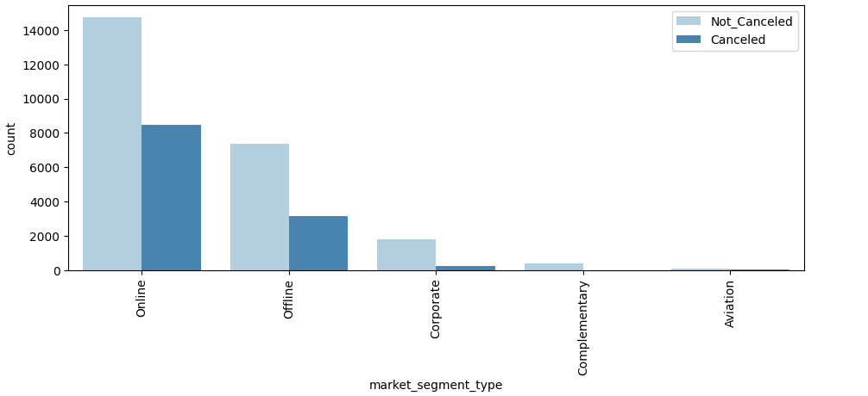
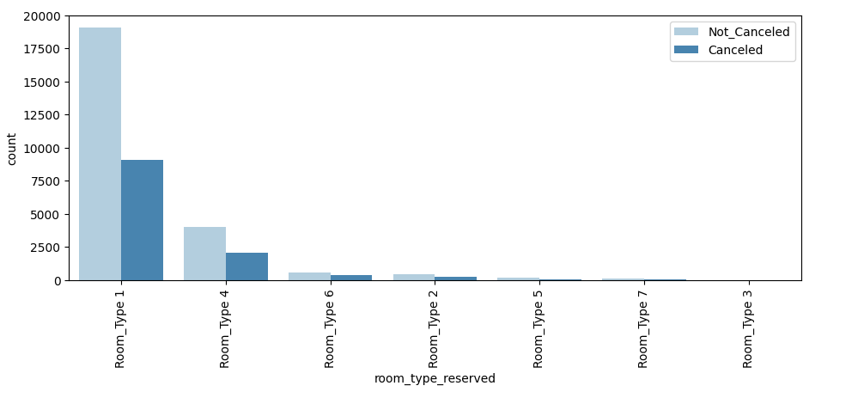
Data Visualization
Categorical features distribution

Slide 15
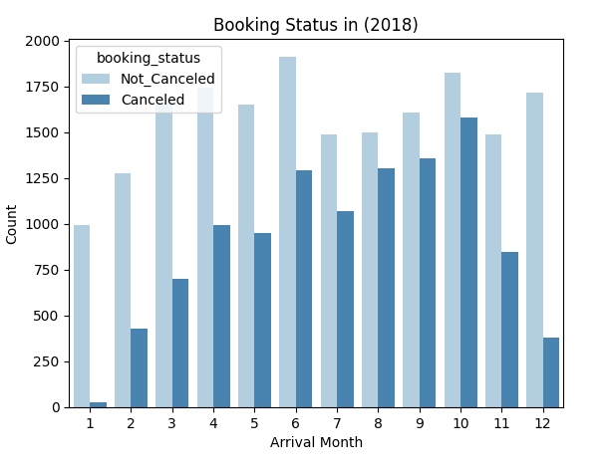
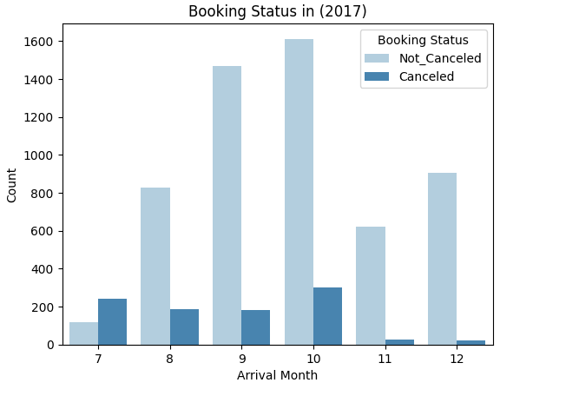
Data Visualization
Booking Status in every year

Slide 16
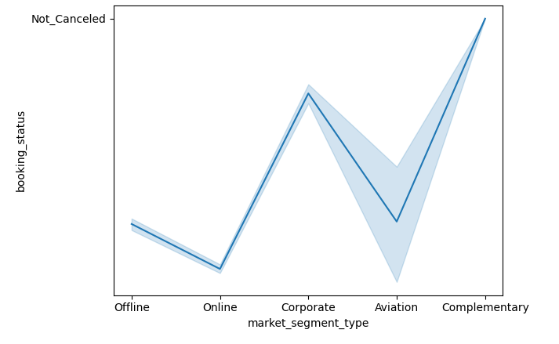
Data Visualization
Complementary and Corporate -----> Less segments that cancel booking

Slide 17
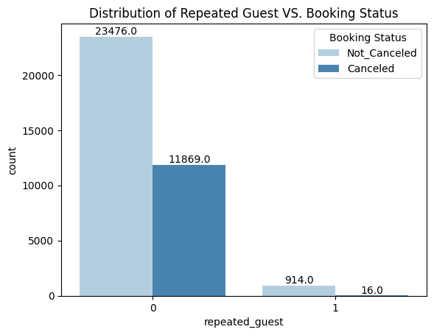
Data Visualization
Most of guests are visitors for the first time

Slide 18
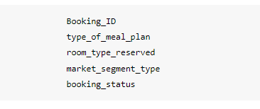
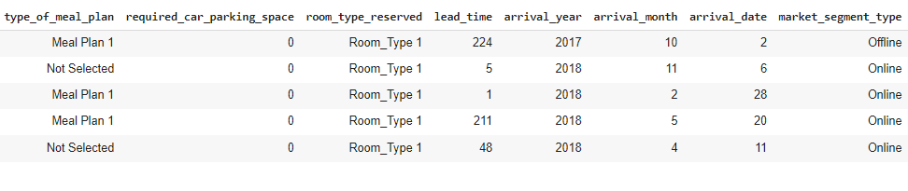
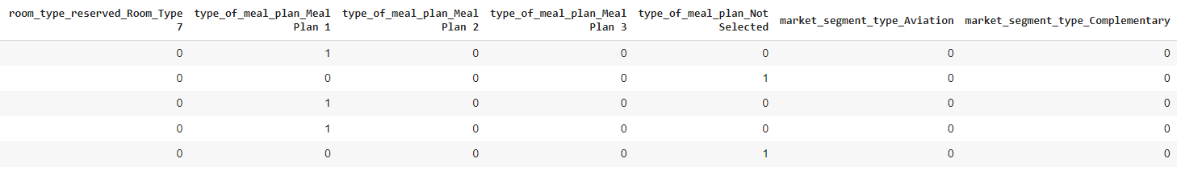
Feature Engineering
Categorical Columns
Before
After

Slide 19
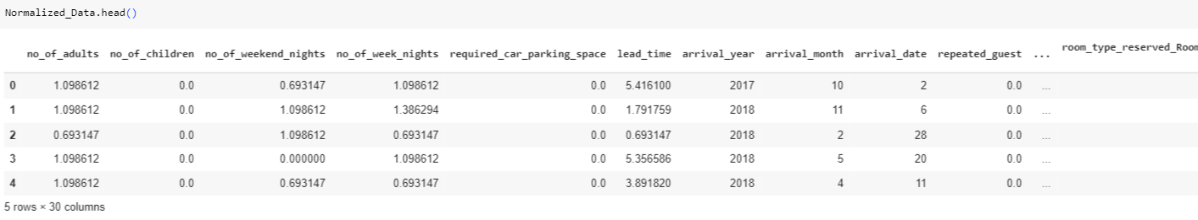
Numerical Columns
For numerical features with wide range of values, we perform log normalization to reduce the impact of extreme values (outliers).

Slide 20
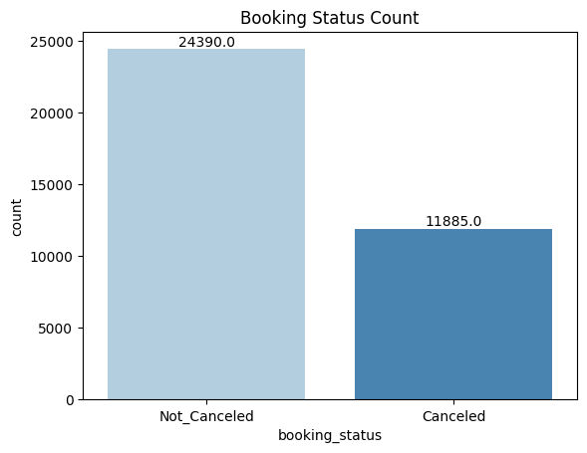
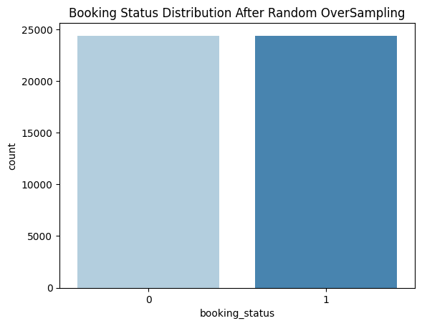
Target column
The data is imbalanced. Not_canceled class has a much larger number of instances compared to Canceled class.
So we used oversampling technique.

Slide 21
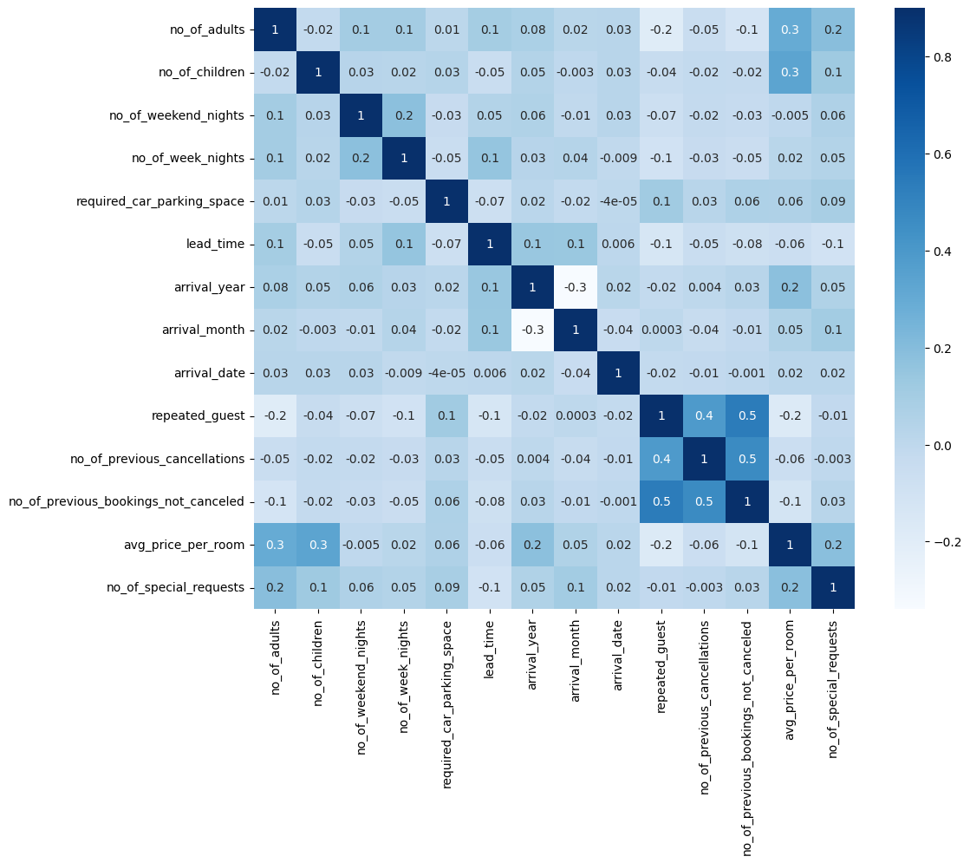
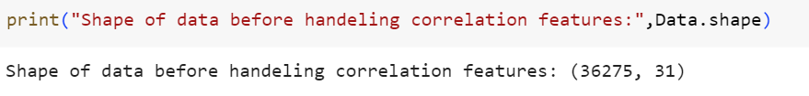

Correlation Matrix

Slide 22
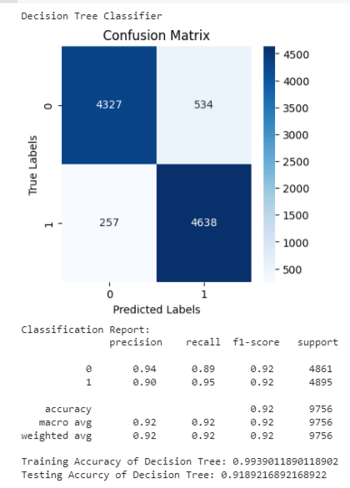
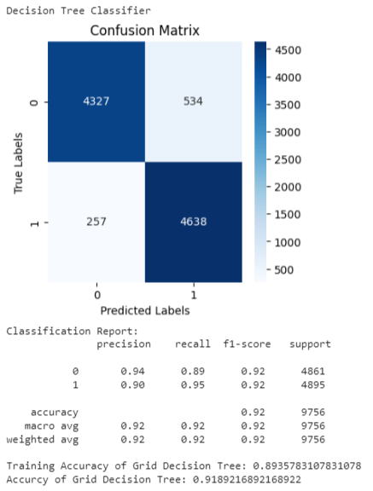
Models
We applied 5 classification algorithms for our dataset: Decision Tree, SVM, Random Forest, XG-boost and Neural Network.
We compare the accuracy of different models to choose the champion model.
Decision Tree
Decision Tree with Grid Search

Slide 23
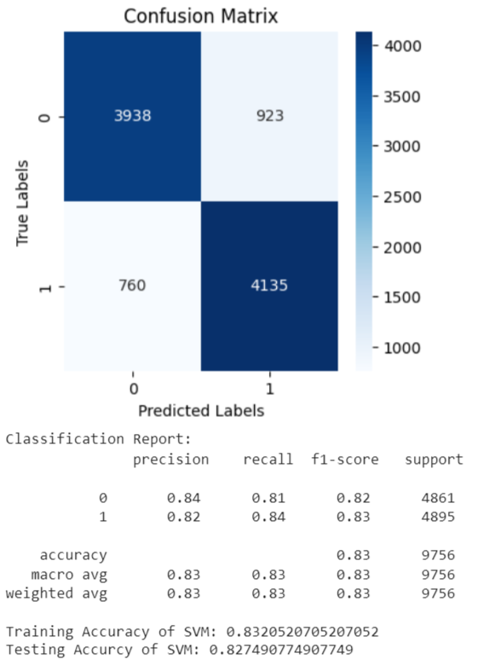
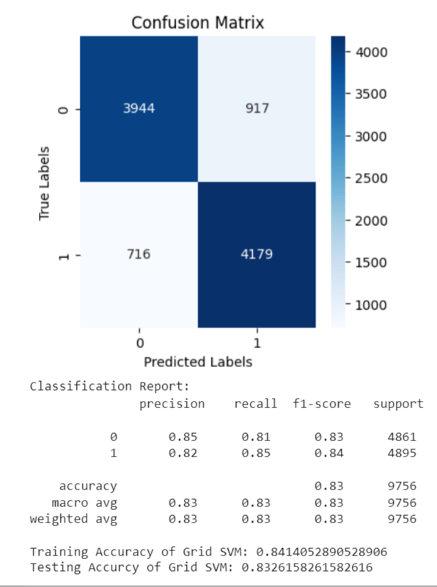
Models
Support Vector Machine
Support Vector Machine with Grid Search

Slide 24
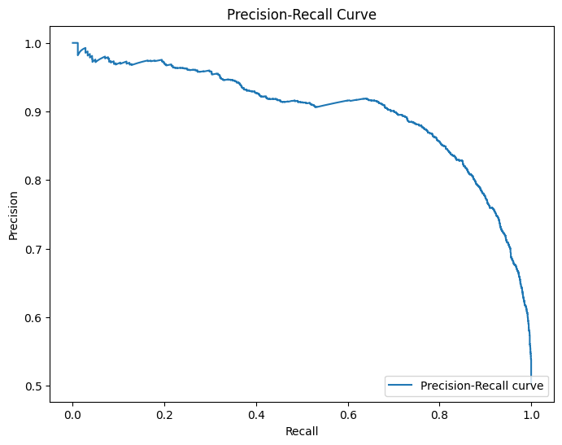
Models
Support Vector Machine with Grid Search

Slide 25

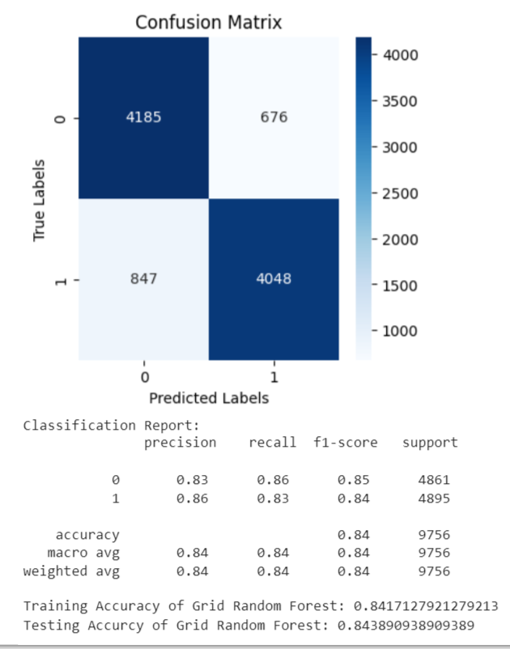
Models
Random Forest
Random Forest with Grid Search

Slide 26
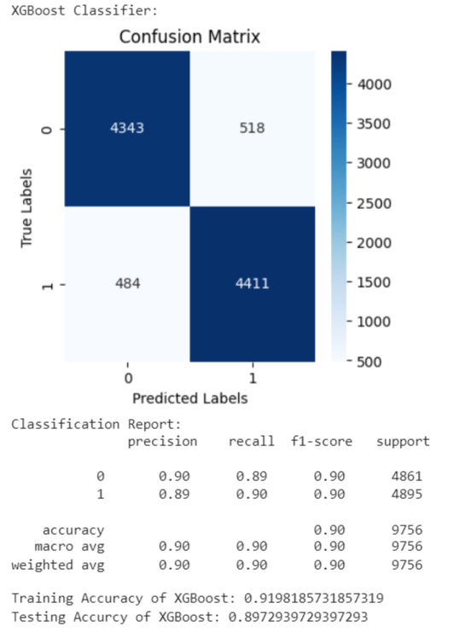
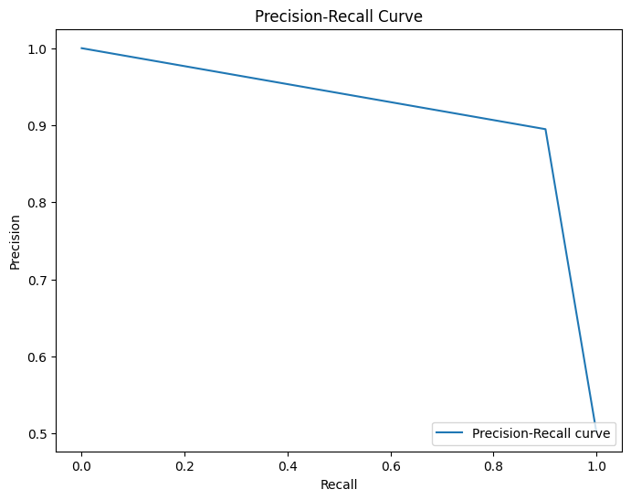
Models
XG-Boost

Slide 27
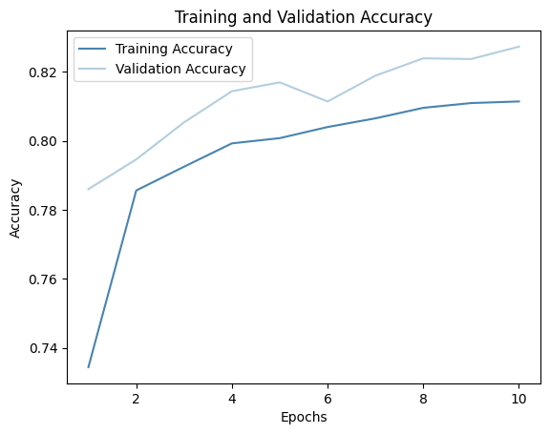

Models
Neural Network

Slide 28
04
Evaluation & Summery

Slide 29

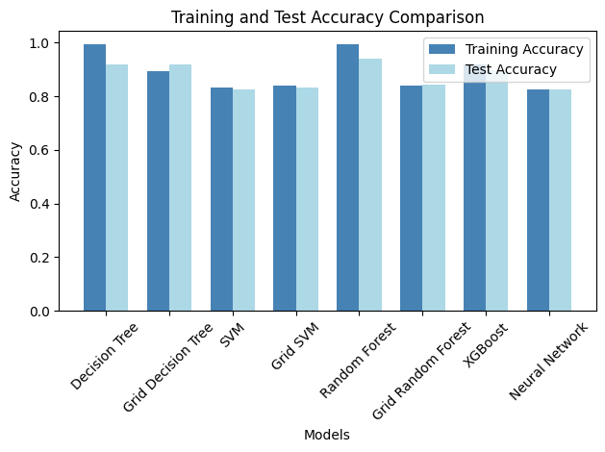
Champion Model: Random Forest with testing accuracy of 94%

Slide 30
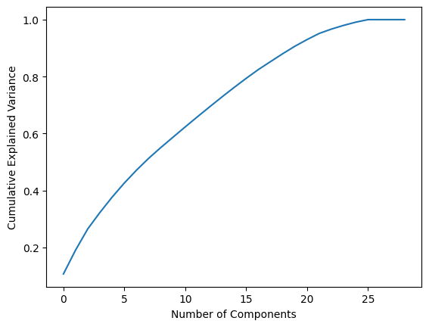
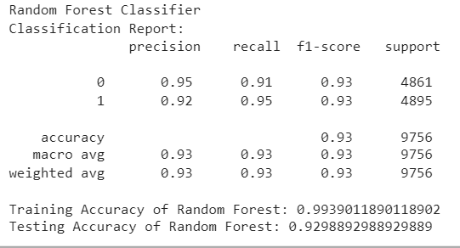
Champion Model: Random Forest
We applied PCA with n_components = 20

Slide 31
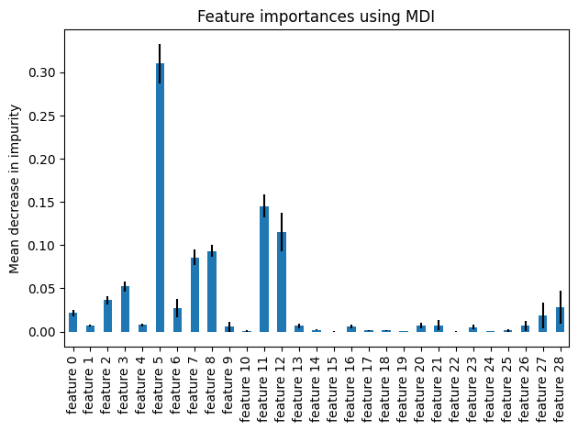
Feature Importance of Random Forest
Feature 5 that refers to lead_time is the most important feature in the dataset.

Slide 32
Summary
We handled the problems with data like converting categorical features to numerical.
As we perform a machine learning classification task on a dataset, we applied different classification algorithms.
We tried each algorithm with default parameters and with grid search to improve the performance.
We compute the accuracy, confusion matrix and classification report for each model.
We compare the accuracy of different models to choose the champion model.
Random Forest was the best model based on testing accuracy with score 94%.

Slide 33
References
Banza, M. (n.d.). Predicting Hotel Booking Cancellations Using Machine Learning. Step by Step Guide with Real Data and Python. https://www.linkedin.com/pulse/u-hotel-booking-cancellations-using-machine-learning-manuel-banza/
Raza, A. (2023) Hotel Reservations dataset, Kaggle. Available at: https://www.kaggle.com/datasets/ahsan81/hotel-reservations-classification-dataset (Accessed: 17 July 2023).
Eleazar C-Sánchez, A. J. Sánchez-Medina, and L. Romero-Domínguez, “Forecasting Hotel-booking Cancelations Using Personal Name Records: An Artificial Intelligence Approach,” pp. 3–14, Jan. 2022, doi: https://doi.org/10.1007/978-981-16-9268-0_1.

Slide 34

THANK YOU
Any Questions?

