Slide 1
Anime Recommendation Chatbot

Slide 2
Group 5
Ahmed Nasser
Aya Mahmoud
Esraa Fayad
Abdelrahman Ali

Slide 3
Table of contents
01
03
02
04
Introduction
Competency Questions
Prepare choose the Data Science subjects
Choose the atomistic competency questions.
Ontology
Test-Cases
Use Protege to develop the knowledge structure.
Using Google Dialog Flow

Slide 4
01
Introduction

Slide 5
Our project is about chatbot and its purpose to recommend Animes for new viewers who want to watch new kind of Art
“Anime Recommendation System”

Slide 6
02
Ontology

Slide 7
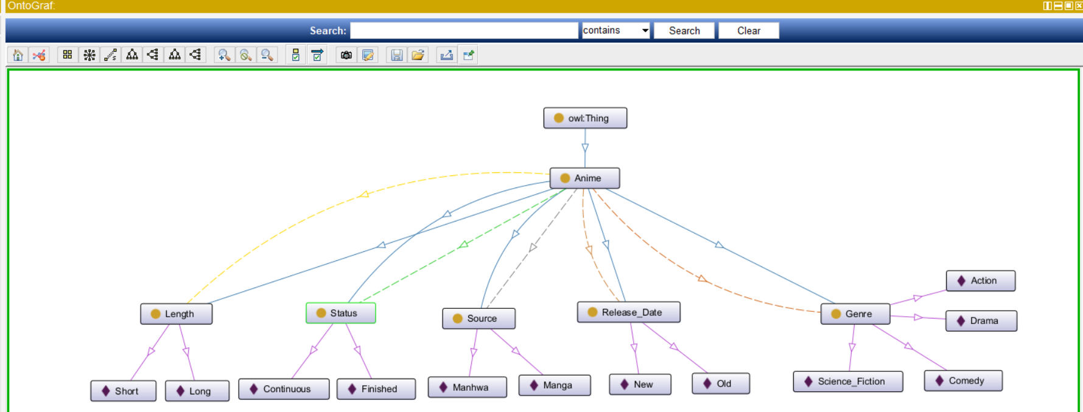
Ontology Diagram

Slide 8
03
Competency Questions

Slide 9
Questions
How can I assist you?
what do you like to watch?
What is your favorite genre?
Do you like anime new or old?
Do you like complete or continued?
Do you like short or long anime?
Do you like manga or manhwa?

Slide 10
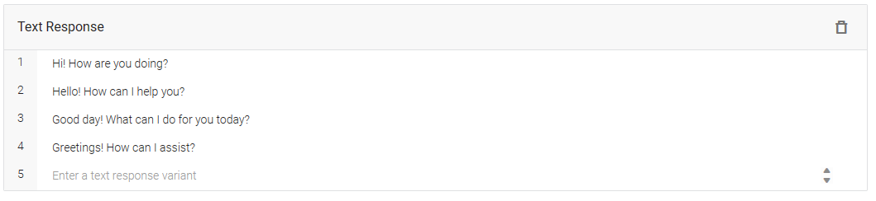

Training Question-Answers

Slide 11
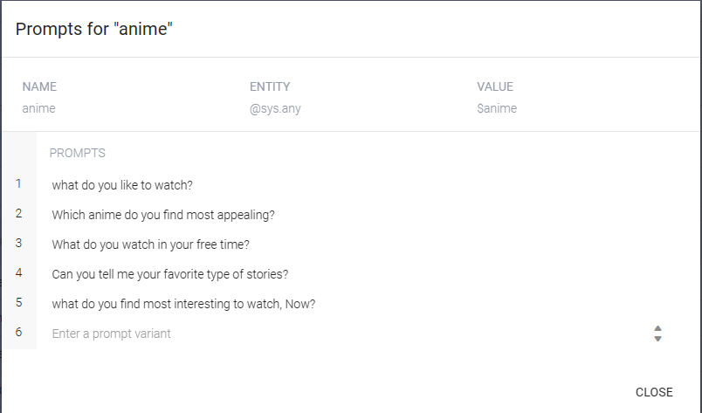
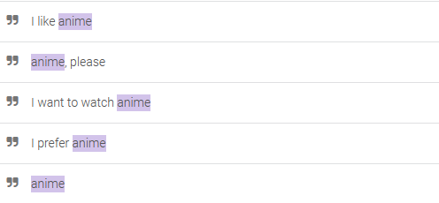
Questions

Slide 12
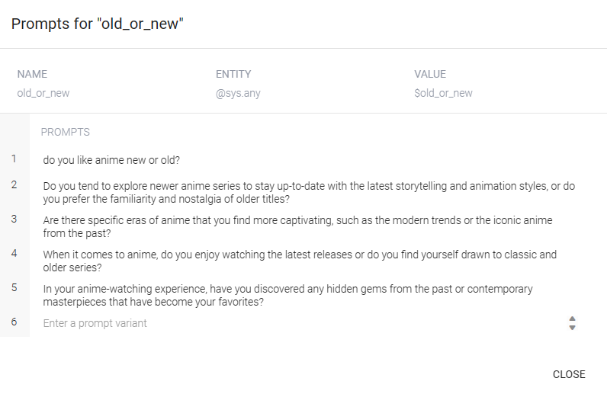
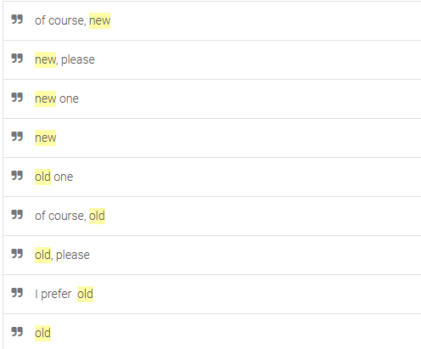
Questions

Slide 13
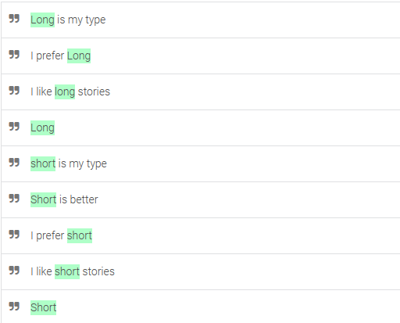
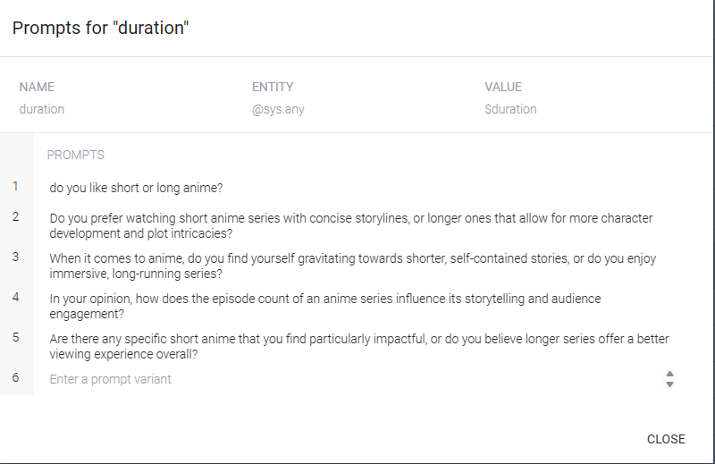

Questions

Slide 14
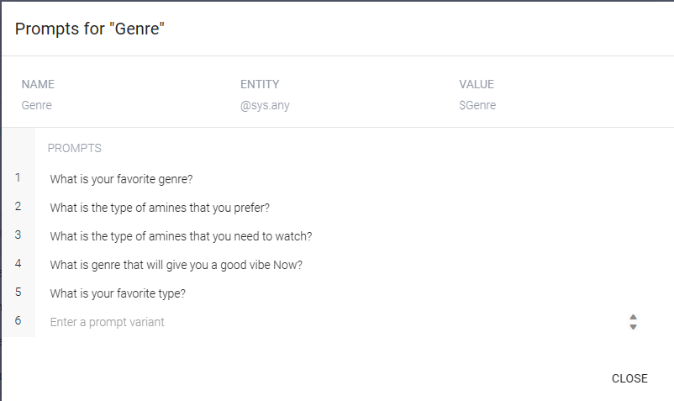
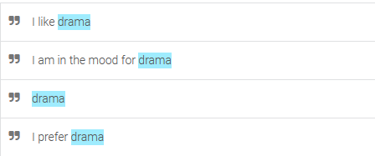

Training Question-Answers

Slide 15
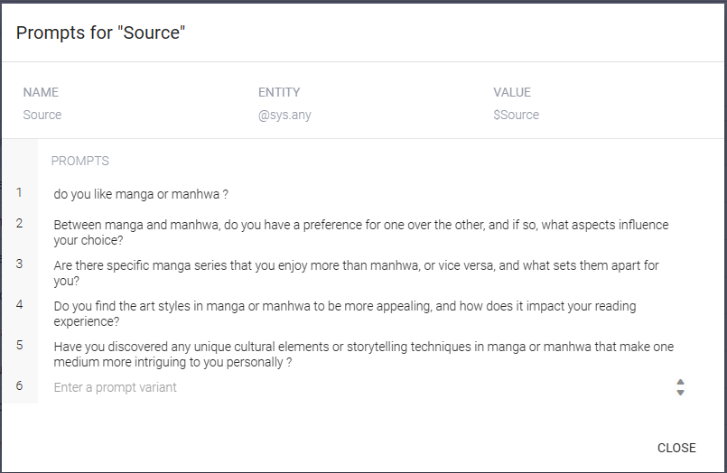
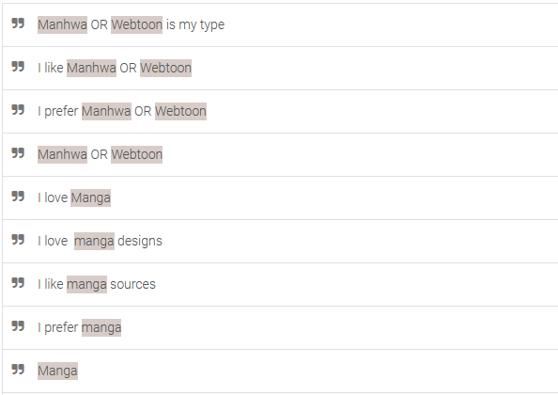
Training Question-Answers

Slide 16
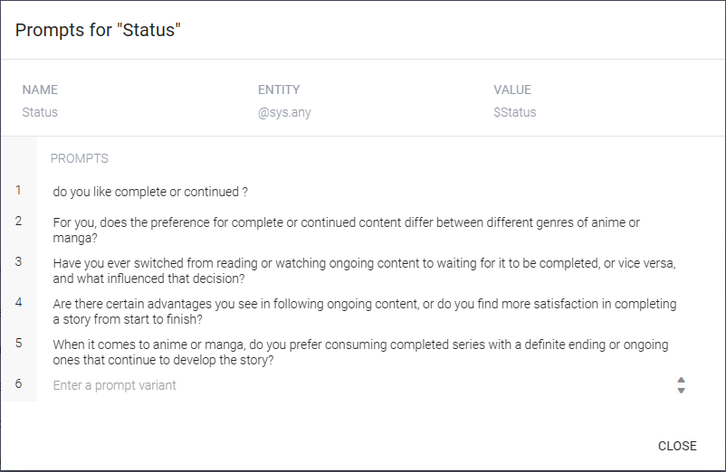
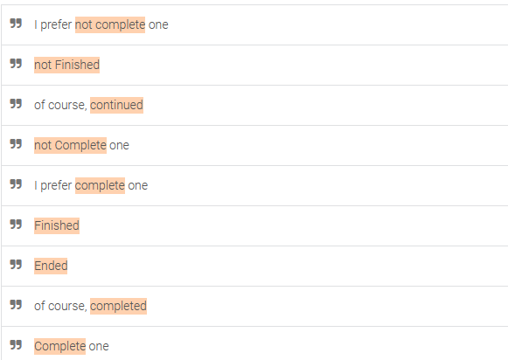

Training Question-Answers

Slide 17
04
Test-Cases
No Errors && Deployement

Slide 18
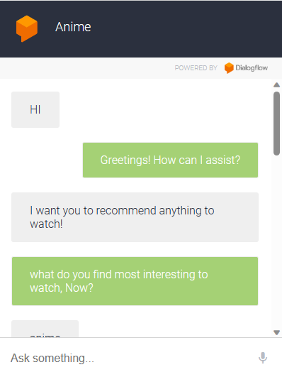
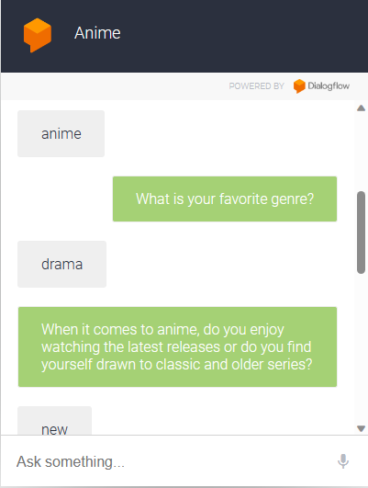
Test-Cases

Slide 19
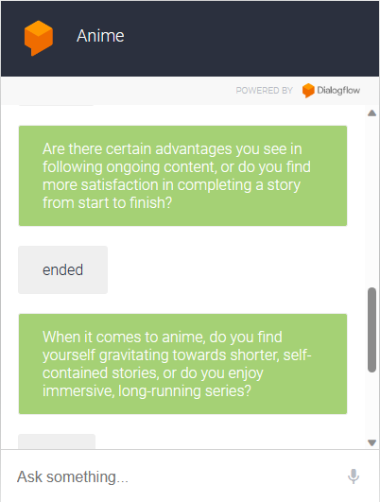
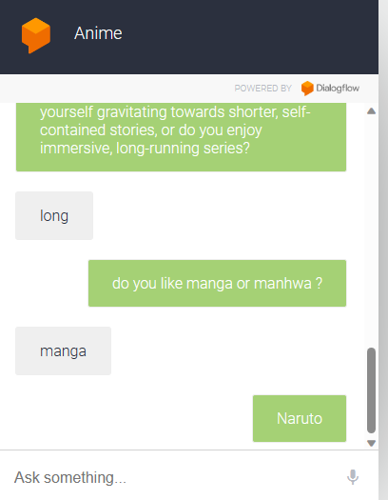
Test-Cases

Slide 20
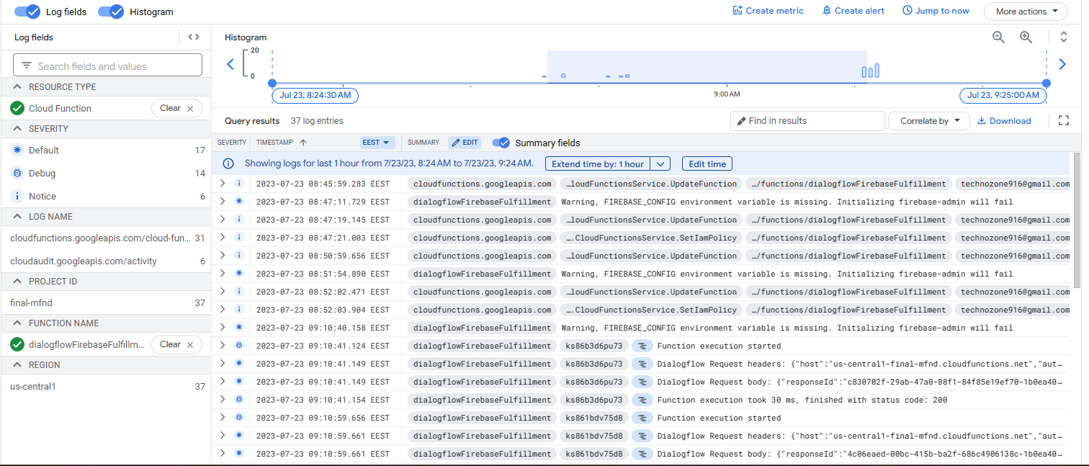
Test-Cases

Slide 21
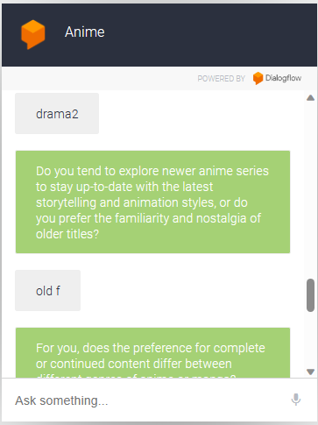
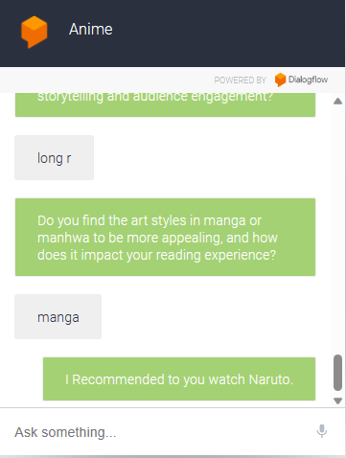
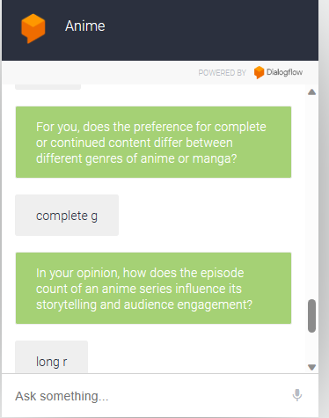
Evaluate and weakness

Slide 22


