Slide 1
Netflix
1

Slide 2
Saudi ARABIA
Most watched shows on the in saudi?
Finding the best Month for releasing content IN saudi?
Which has the highest rating Tv show or Movies for saudi?
How many movies got the "TV-14" rating in saudi?
In which year highest number of the TV shows & Movies were released in saudi?
What are the Top Genres in saudi?
2

Slide 3
eGYPT
Most watched shows on the in egypt?
Finding the best Month for releasing content IN egypt?
Which has the highest rating TV show or Movies for egypt?
How many movies got the "TV-14" rating in egypt?
In which year highest number of the TV shows & Movies were released in egypt?
What are the Top Genres in egypt?
3

Slide 4
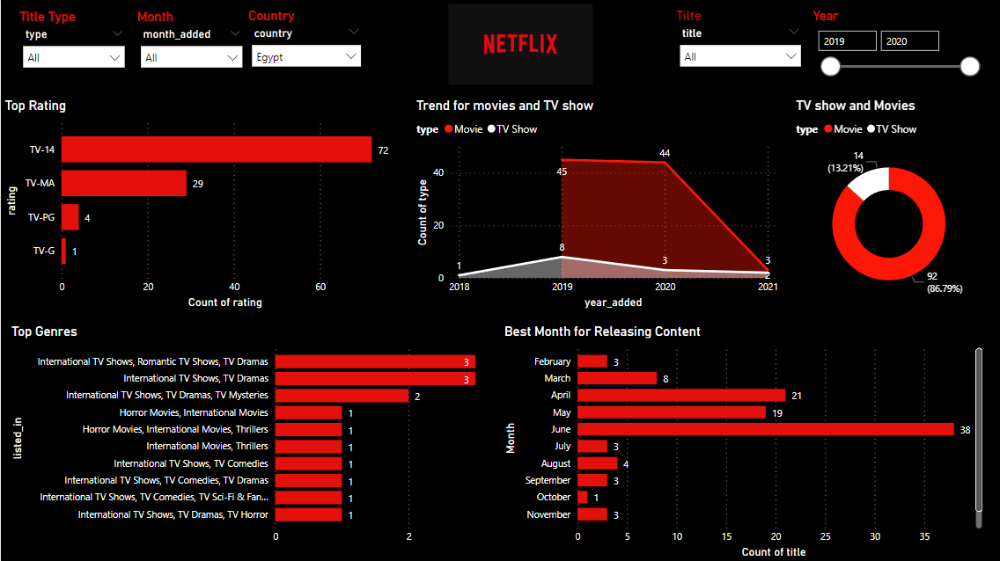
DASHBOARD FOR NETFLIX ON EGYPT
4

Slide 5
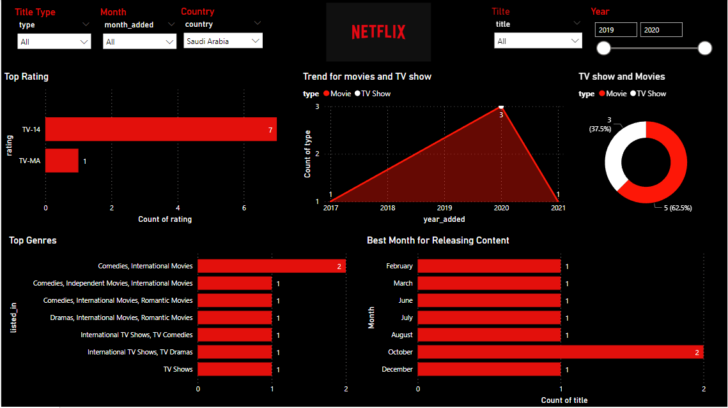
DASHBOARD FOR NETFLIX ON SAUDI ARABIA
5

Slide 6
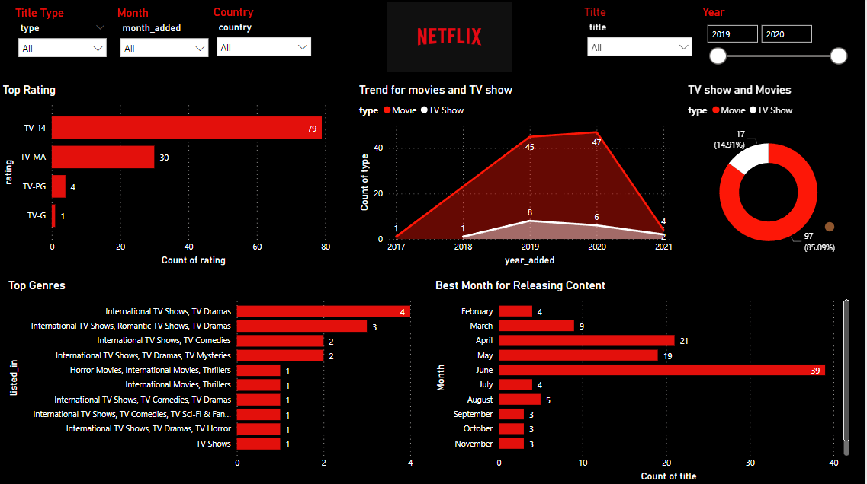
Dashboard for egypt & saudia arabia
6

Slide 7
Insights for egypt
Most watched shows on the in egypt: Movies
the highest rating TV show or Movies for egypt: TV-14
Number of movies got the "TV-14" rating in egypt: 61
The year In which highest number of the TV shows & Movies were released in egypt:
2019
the top Genres in egypt : International TV, Romantic TV, TV Dramas
the best Month for releasing content IN egypt: June.
7

Slide 8
INSIGHTS FOR SAUDI ARABIA
Most watched shows on the in saudi: Movies
the best Month for releasing content IN saudi: Octuber.
the highest rating TV show or Movies for saudi: TV-14
Number of movies got the "TV-14" rating in saudi: 4
The year highest In which number of the TV shows & Movies were released in saudi:
2020
the top Genres in saudi:
Comedies, International Movies
8

Slide 9
How does Machine learning help the investors in making decision
It predicted that most will be watched on netflix in egypt and saudia arabia
Movies
Notes: This link show the video for the dashboard
https://drive.google.com/file/d/1qaM9mPX2UZ-6DA-HItXKB5JZQ7c8lR2H/view?usp=sharing
9

Slide 10

1

Slide 11


