Slide 1
Exceptions in Java

Slide 2
Exceptions
An exception is
an object describing an unusual or erroneous situation
Exceptions are thrown by a program, and may be
caught and handled by another part of the program
A program can be separated
into a normal execution flow and
an exception execution flow

Slide 3
Exceptions
Exception
an indication of a problem occurring during program’s execution
The name “exception” implies that the problem occurs infrequently
With exception handling,
a program can continue executing (rather than terminating)
after dealing with a problem.
Robust and fault-tolerant programs
(i.e., programs that can deal with problems as they arise and continue executing).

Slide 4
Examples of Exceptions
ArrayIndexOutOfBoundsException
occurs when an attempt is made to access an
element past either end of an array.
ClassCastException
occurs when an attempt is made to cast an object
that does not have an is-a relationship with the type specified in the cast operator.
NullPointerException
occurs when a null reference is used
where an object is expected.

Slide 5
Example: Divide by zero without Exception Handling
Exceptions are thrown (i.e., the exception occurs)
when a method detects a problem
and is unable to handle it.
Stack trace
information displayed when an exception occurs and is not handled.
Information includes:
The name of the exception in a descriptive message
that indicates the problem that occurred
The method-call stack (i.e., the call chain) at the time it occurred.
Represents the path of execution that led to the exception method by method.
This information helps you debug the program.

Slide 6
Example: Divide by zero without Exception Handling (Cont.)
Java does not allow division by zero in integer arithmetic.
Throws an ArithmeticException.
Can arise from a several problems,
so an error message (e.g., “/ by zero”) provides more specific information.
Java does allow division by zero with floating-point values.
Such a calculation results in the value positive or negative infinity
Floating-point value that displays as Infinity or -Infinity.
If 0.0 is divided by 0.0,
the result is NaN (not a number),
which is represented as a floating-point value that displays as NaN.

Slide 7
Example: Divide by zero without Exception Handling (Cont.)
Last “at” line in the stack trace started the call chain.
Each line contains the class name and method followed
by the file name and line number.
The top “at” line of the call chain indicates
the throw point—the initial point at which the exception occurs.
As you read a stack trace top to bottom, the first “at” line
that contains your class name and method name is typically
the point in the program that led to the exception.

Slide 8
Example: Divide by zero without Exception Handling (Cont.)
Prior examples that read numeric values from the user
assumed that the user would input a proper integer value.
Users sometimes make mistakes and
input noninteger values.
An InputMismatchException occurs when
Scanner method nextInt receives a String
that does not represent a valid integer.

Slide 9
Exception handling

Slide 10
Exception Handling
Java has a predefined set of exceptions
that can occur during execution
A program can deal with an exception
in one of three ways:
ignore it
handle it where it occurs
handle it an another place in the program
The manner in which an exception
is processed is an important design consideration

Slide 11
Exception Handling
If an exception is ignored by the program,
the program will terminate abnormally and
produce an appropriate message
The message includes a call stack trace that:
indicates the line on which the exception occurred
shows the method call trail that lead to
the attempted execution of the offending line

Slide 12
The try-catch Statement
To handle an exception in a program,
the line throwing exception is executed within a try block
A try block is followed
by one or more catch clauses
Each catch clause has an associated
exception type and is called an exception handler
When an exception occurs, processing continues
at the first catch clause that matches the exception type

Slide 13
The finally Clause
A try statement can have an optional clause
following the catch clauses, designated by
the reserved word finally
The statements in finally are always executed
If no exception is generated,
the statements in the finally clause are executed
after the statements in the try block complete
If an exception is generated,
the statements in the finally clause are executed after
the statements in the appropriate catch clause complete

Slide 14
Example: Divide by zero with Exception Handling
This example uses exception handling to process any
ArithmeticException and
InputMistmatchException that arise.
If the user makes a mistake,
the program catches and handles the exception
in this case, allowing the user to try to enter the input again.

Slide 15
Example: Divide by zero with Exception Handling (Cont.)
try block encloses
code that might throw an exception
code that should not execute if an exception occurs.
Consists of the keyword try followed
by a block of code enclosed in curly braces.
catch block (called a catch clause or exception handler)
catches and handles an exception.
Begins with the keyword catch and is followed
by an exception parameter in parentheses and
A block of code enclosed in curly braces.

Slide 16
Example: Divide by zero with Exception Handling (Cont.)
When an exception occurs in a try block,
the catch block that executes is the first one
whose type matches the type of the exception that occurred.
If an exception occurs in a try block,
the try block terminates immediately and
program control transfers to the first matching catch block.
After the exception is handled,
control resumes after the last catch block.

Slide 17
Example: Divide by zero with Exception Handling (Cont.)
If no exceptions are thrown in a try block,
the catch blocks are skipped and
control continues with the first statement after the catch blocks
When a try block terminates,
local variables declared in the block go out of scope.
The local variables of a try block are not accessible
in the corresponding catch blocks.
When a catch block terminates,
local variables declared within the catch block (including the exception parameter) also go out of scope

Slide 18
Exception Propagation

Slide 19
Exception Propagation
An exception can be handled at a higher level
if it is not appropriate to handle it where it occurs
Exceptions propagate up
through the method calling hierarchy until
they are caught and handled or until
they reach the level of the main method
A try block that contains a call to a method
in which an exception is thrown
can be used to catch that exception

Slide 20
Exception class hierarchy

Slide 21
The Exception Class Hierarchy
Classes that define exceptions are related
by inheritance, forming an exception class hierarchy
All error and exception classes are
descendants of the Throwable class
A programmer can define an exception by
extending the Exception class or one of its descendants
The parent class used depends on
how the new exception will be used

Slide 22
The Exception Class Hierarchy
Exception classes inherit directly or indirectly
from class Exception, forming an inheritance hierarchy.
Can extend this hierarchy with your own exception classes.
Throwable is the superclass of class Exception.
Only Throwable objects can be used with
the exception-handling mechanism.
Class Throwable has two subclasses:
Exception and
Error.

Slide 23
The Exception Class Hierarchy
Class Exception and its subclasses
represent exceptional situations that can
occur in a Java program
These can be caught and handled by the application.
Class Error and its subclasses
represent abnormal situations that
happen in the JVM.
Errors happen infrequently.
These should not be caught by applications.
Applications usually cannot recover from Errors.

Slide 24
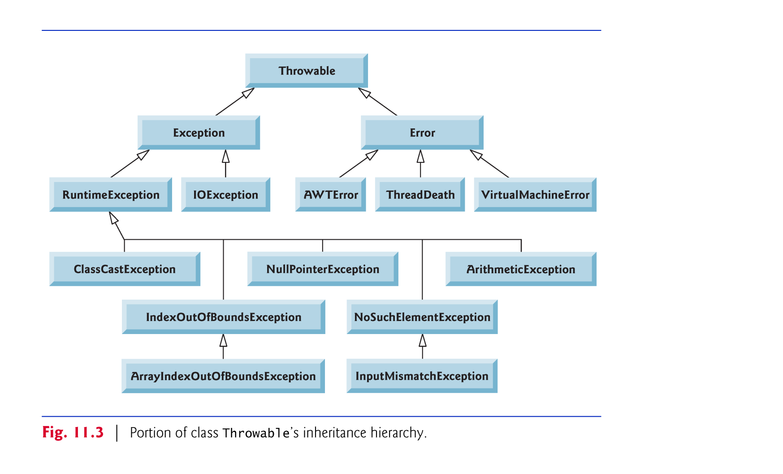
The Exception Class Hierarchy

Slide 25
The Exception Class Hierarchy
Checked exceptions vs. unchecked exceptions.
Compiler enforces a catch-or-declare requirement
for checked exceptions.
An exception’s type determines
whether it is checked or unchecked.
Direct or indirect subclasses of class RuntimeException
are unchecked exceptions.
Subclasses of Exception but not RuntimeException
are checked exceptions.

Slide 26
The throw Statement
Exceptions are thrown using the throw statement
Usually a throw statement is executed
inside an if statement that evaluates a condition
to see if the exception should be thrown

Slide 27
Checked Exceptions
An exception is either checked or unchecked
A checked exception
either must be caught by a method, or
must be listed in the throws clause
of any method that may throw or propagate it
A throws clause is appended to the method header
The compiler will issue an error
if a checked exception is not caught or
asserted in a throws clause

Slide 28
The throws Statement
throws clause
specifies the exceptions a method throws.
Appears after the method’s parameter list
and before the method’s body.
Contains a comma-separated list of the exceptions
that the method will throw if various problems occur.
Method can throw exceptions of the classes listed
in its throws clause or of their subclasses.
Clients of a method with a throws clause are thus
informed that the method may throw exceptions.

Slide 29
Unchecked Exceptions
An unchecked exception does not require
explicit handling, though it could be processed that way
The only unchecked exceptions in Java are
objects of type RuntimeException or
any of its descendants

