Slide 1

Egyptian Air Quality
Monitoring
Alaa Osama Mohamed & Batool Ayman Mohamed

Slide 2
Project Idea
The Egyptian Air Quality project aims to monitor and analyze air pollution levels across different regions in Egypt using real datasets.
We collect, process, and visualize air quality data to support awareness and data-driven decision making.
Main goal
Transform raw environmental data into meaningful insights.

Slide 3
The Problem
Egypt is facing increasing air pollution due to:
Urbanization
Traffic emissions
Industrial activities
Challenges:
No unified and easy-to-use air quality platform
The data is scattered across sources
Hard for people to understand raw environmental data
So… we needed a centralized and visual solution.

Slide 4
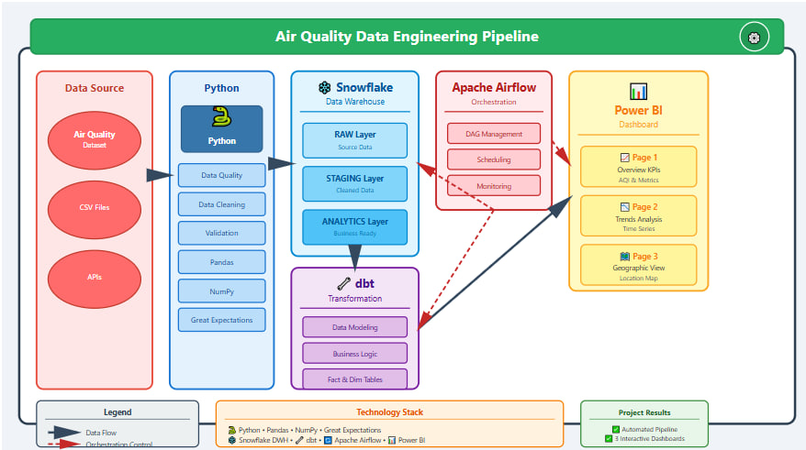
Architecture

Slide 5
Challenges We Faced
Main challenges during the project:
Different data formats between APIs
Missing values and duplicates
Large data volume
Manual data collection took too much time
Transforming complex data into readable insights
We needed an automated data pipeline.

Slide 6
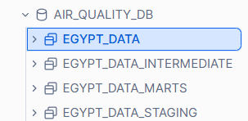
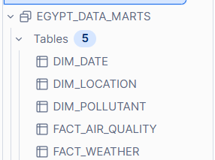
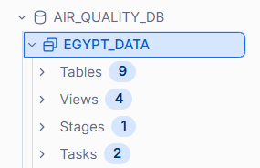
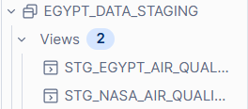
Snowflake Data Warehouse

Slide 7
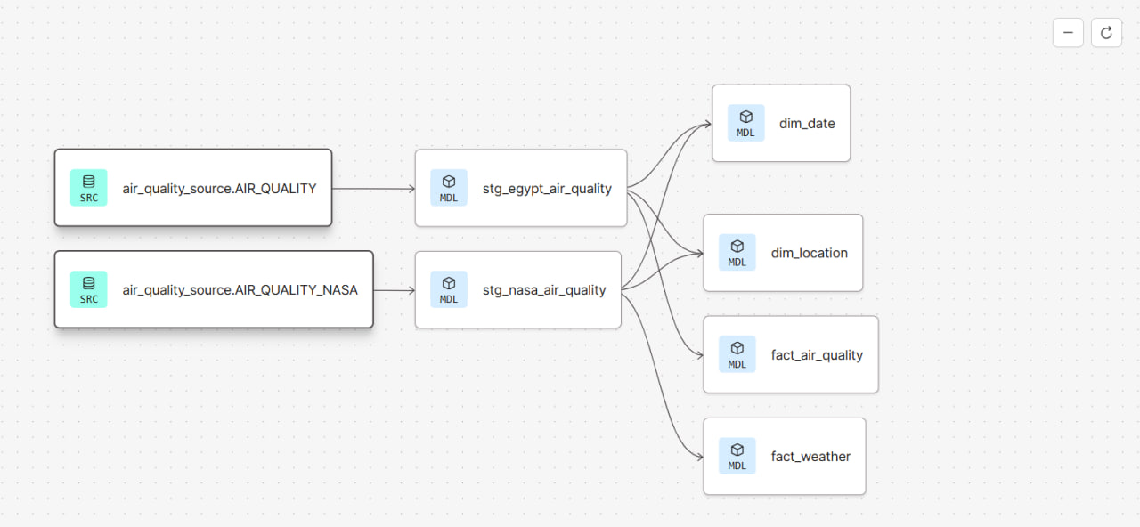
DBT Transformations

Slide 8
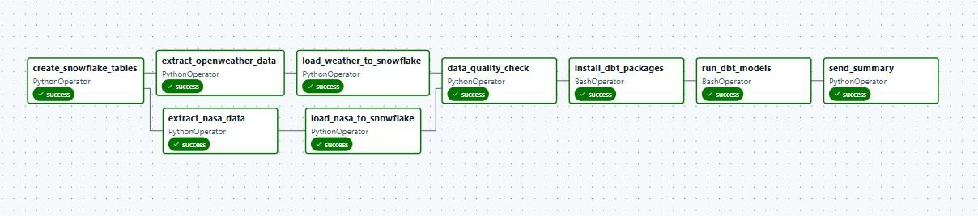
Airflow Orchestration

Slide 9
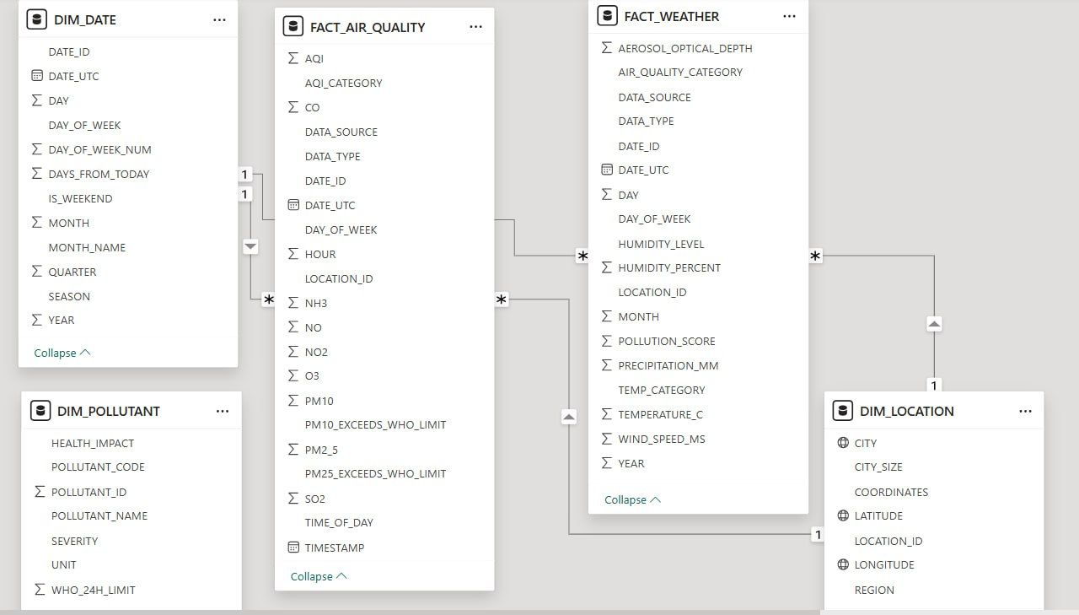

Power BI Dashboards: Modeling

Slide 10
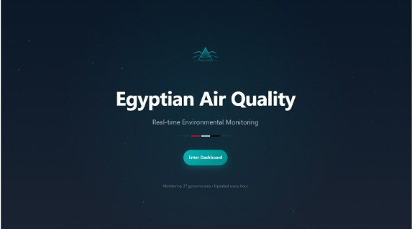
Power BI Dashboards: Onboarding

Slide 11
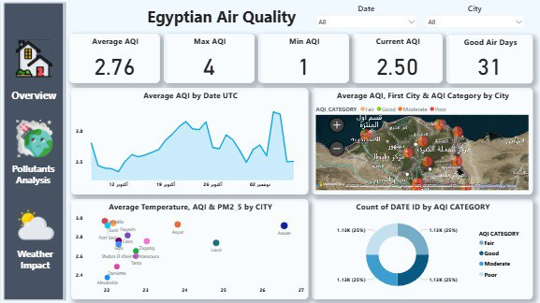
Power BI Dashboards: Overview

Slide 12
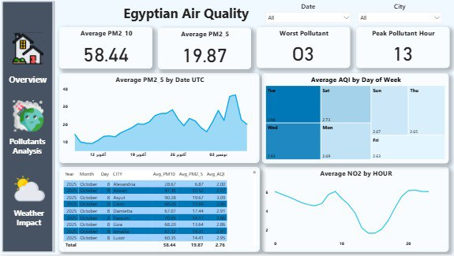
Power BI Dashboards: Pollutants Analysis

Slide 13
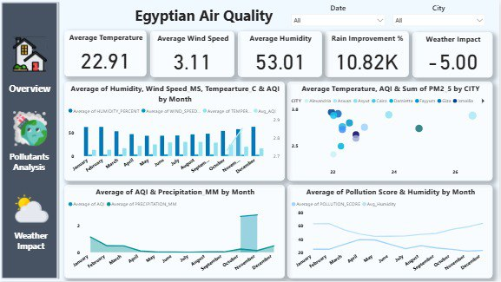
Power BI Dashboards: Weather Impact

Slide 14
Thanks

