Slide 1


Slide 2
introduction
Bookstore gives you an online shopping cart and point-of-sale system for your school's bookstore.
Students who want to pay later can charge their Bookstore orders to their accounts.

Slide 3
Problem defination
Almost every activity in the world today is controlled by computer driven software programs.
According to the above fact, managing and maintaining a book shop could also be controlled by efficient software.
This project focuses attention on designing efficient and reliable software which controls the transactions of a bookshop.

Slide 4
System objectives
The main objective of “Online Book Store” is to provide an essence of online book store via a simple and yet powerful medium.
The project has been designed to simulate the working of an actual
online book store.

Slide 5
Related work comparison
My Library.
Amazon
Our application “Online Bookstore”.

Slide 6
Time plan
1. Interview with system actors.
2. Determine system requirement.
3. Collect system requirement.
4. Design initial plan.
5. Time plan.
6. Estimate coast.
7. Design a proposal system contract.
8. Analyze system requirement.
9. Designing “UML”diagram.
10. Design database.
11. Implement system.
12. Maintain final system.
13. Testing the deliverable system.

Slide 7
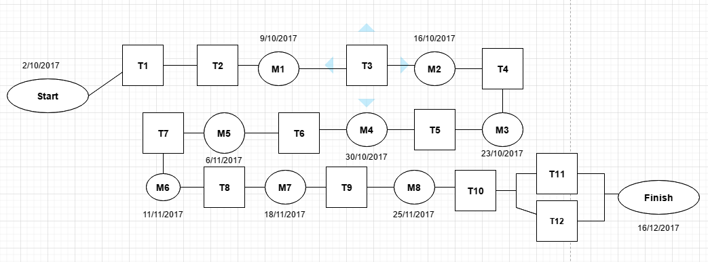
Activity network

Slide 8
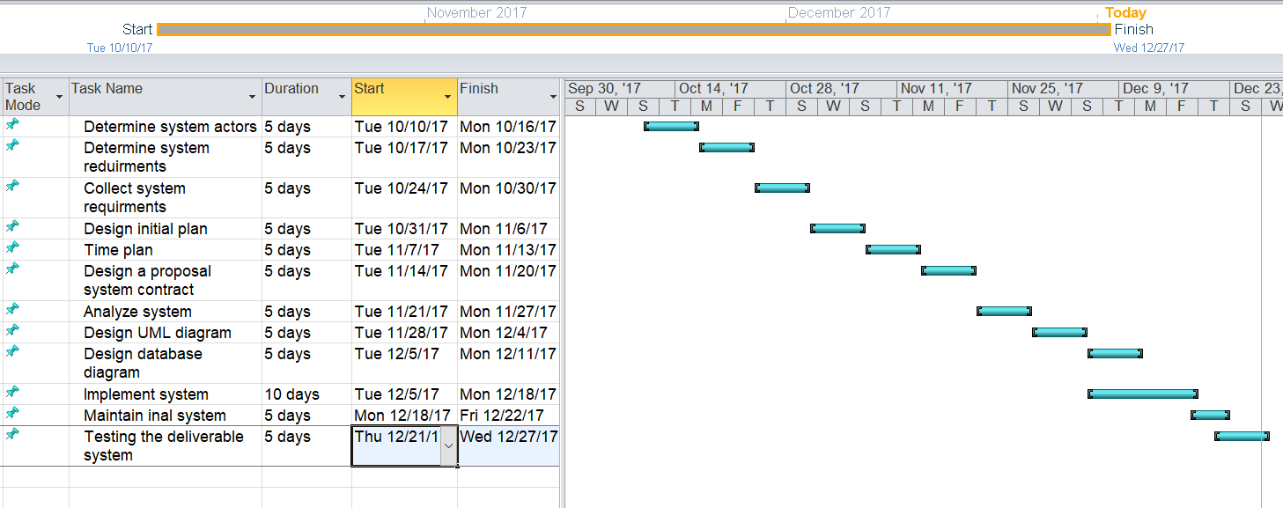
Gantt chart

Slide 9
System analyze
User system requirement(functional requirement):
The user registers his data.
The user can log in easily.
The user can search about any book easily.
The user can buy any book easily.

Slide 10
System requirement
Non functional requirement

Slide 11
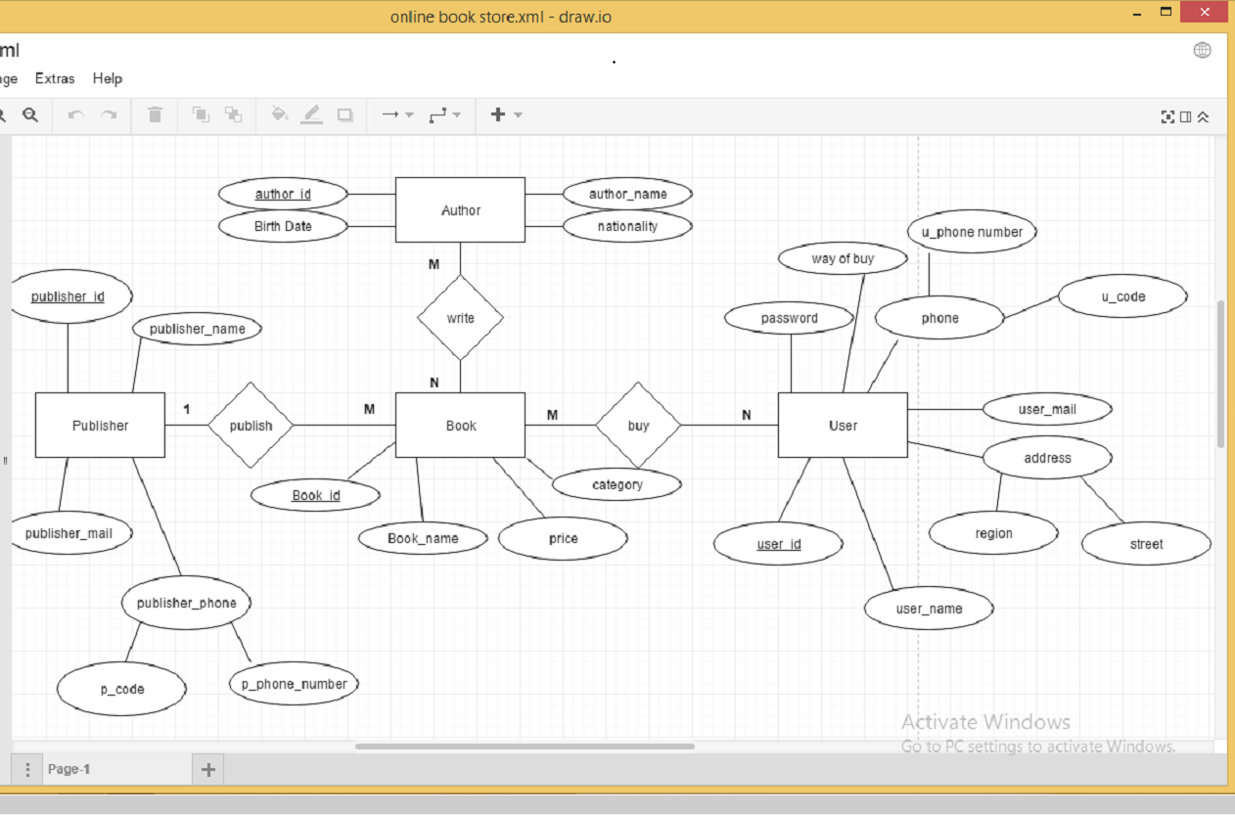
System design
ERD

Slide 12
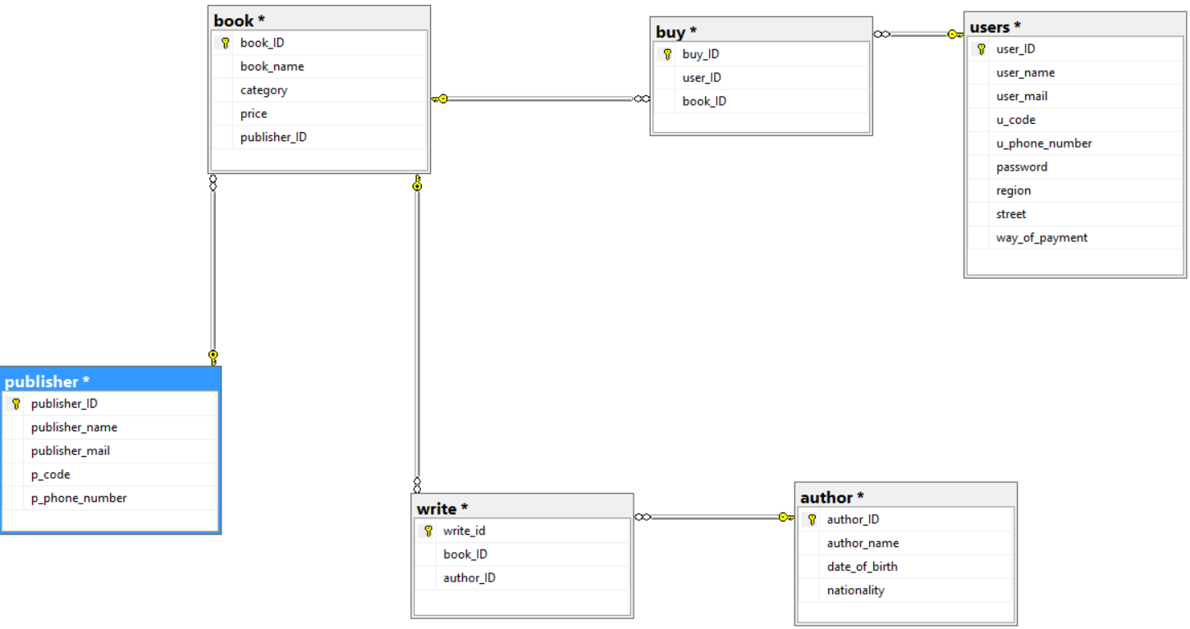
Database diagram.

Slide 13
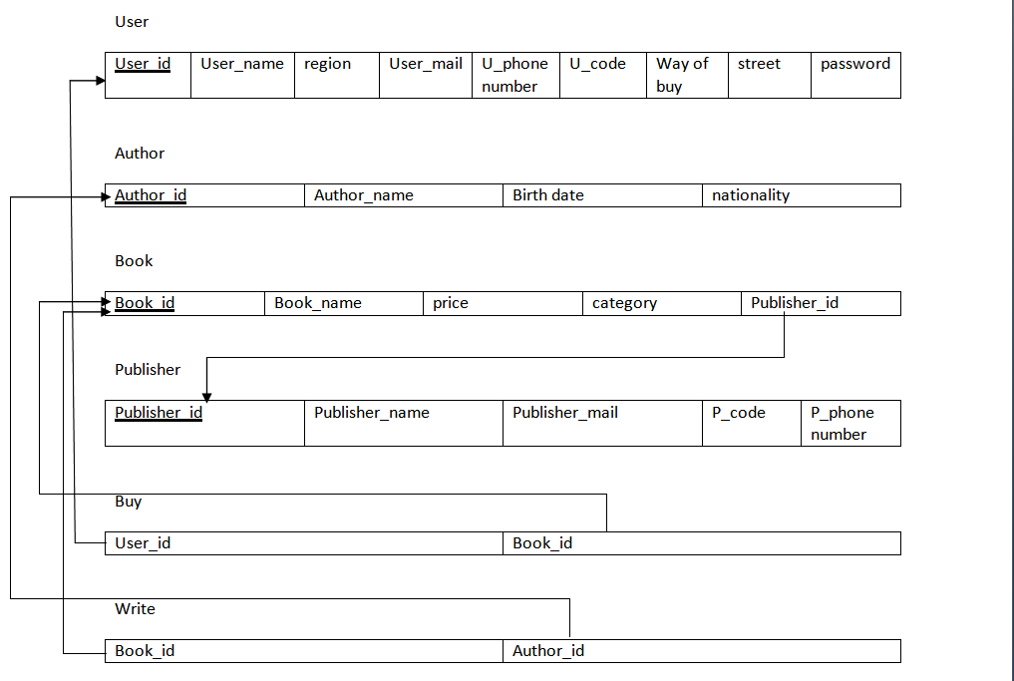
Schema

Slide 14
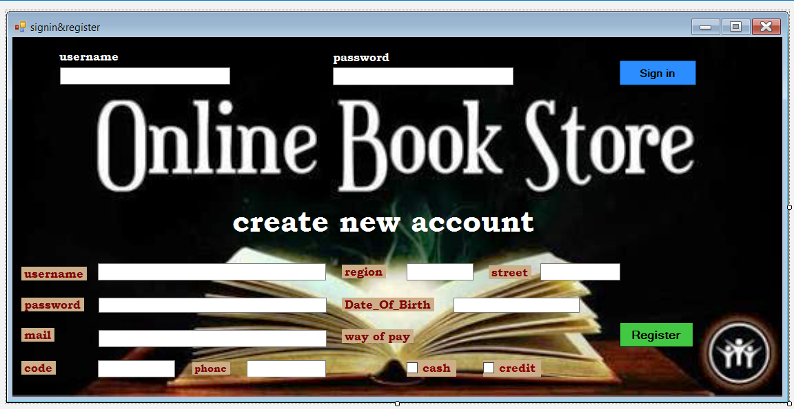
Application user interface.

Slide 15
reference
Lectures
Lectures Notes
IS laps
Instructor instructions

