Slide 1



Smart Charger For Electric Vehicles

Slide 2
Team Members
Asmaa Anwer
Aya Ramzy

Slide 3

Our Sponsors & Mentors
Supervised By:
Dr. Ali Rashed
Dr. Maha Medhat
Mentored By:
Eng. Ahmed Assaf
Eng. Alaa Nofal
Eng. Omar Mekkawy

Slide 4
Our Thought During Idea Searching Phase(why)?
CAREER:
Our jobs requirements and meets our team intended learning objectives through graduation project.
MARKET
SKILLS
CAREER
SKILLS:
Choose idea which assembles different technical skills in our team.
MARKET:
Trend idea which is competitive and meets up to date market requirement.

Slide 5

How We Got The Idea ? (Process)
ENGINEERS
Communication with different experienced engineers in our scope
SEARCHING
Searching for innovative market trends
Linkedin TALKS
Getting in touch with different connections and Engineers.
FORMER COLLEAGUES
Getting in touch with our former colleagues in order to learn more about their experience

Slide 6
Problem Definition
NEED EVs
GM
says it will make only electric vehicles by 2035
Ford
says all vehicles sold in Europe will be electric by 2030
VW
says 70% of its sales will be electric by 2030

Slide 7

Suppliers in Egypt
CoreTech Innovations
Siemens

Slide 8
Our Project Scope
Smart WallBox Charger For Electric Vehicles
Features
Provide Charging For EVs
Controlling the Voltage and Current using switch mode regulator
Smart by display the values of voltage, current, temp and progress on web application for mentoring
Help users to charge their EV from home or job place
Providing real communication between EV and Charger
Protection

Slide 9
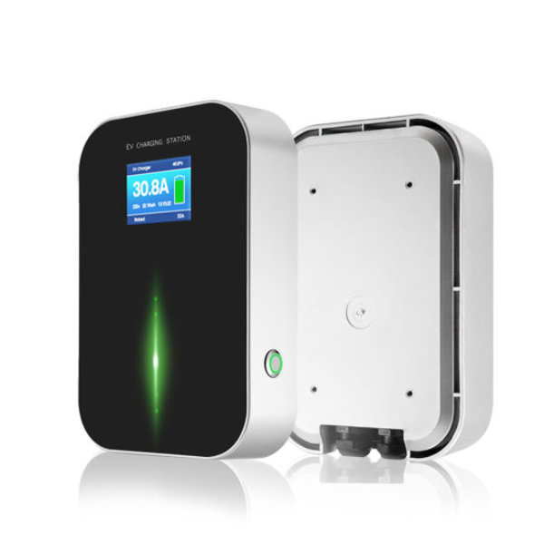
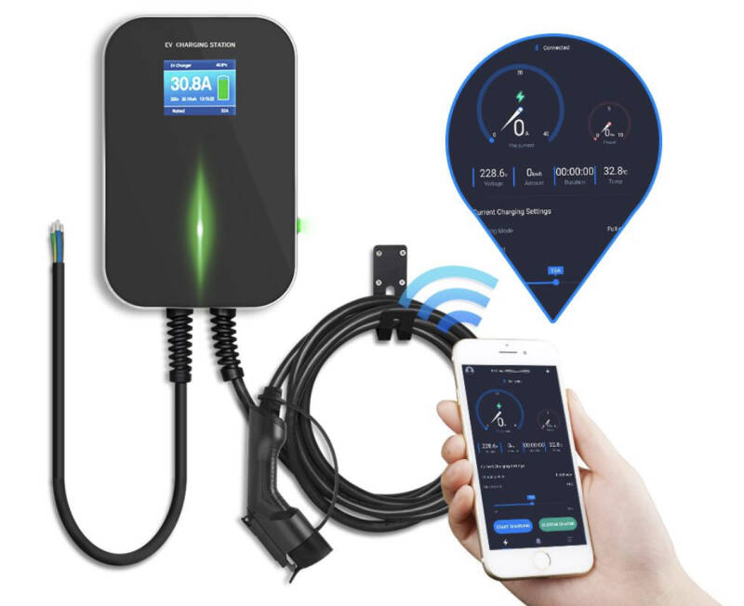
Model Expected

Slide 10
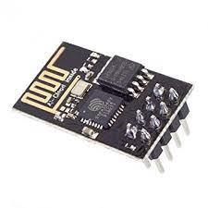
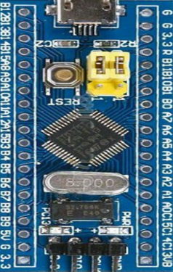

System Design
Work Done
EV
Charger
Pilot Contact
Bus Signal

Slide 11
Charger ECU (Block Diagram)
AC
Rectifier
DC
DC-DC Converters
Battery
Gate Driver
Voltage Sense
PWM1
MCU
Current Sense
Temperature Sensor
PWM2
Control Pilot
Test
Read
GFCI
Input
Display
Out
Communication
Block Diagram

Slide 12
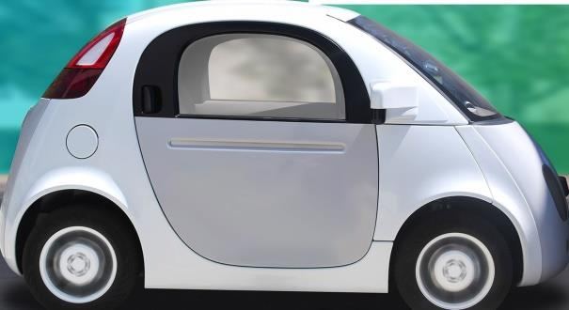
Control Pilot Communication
Send PWM 1KHz, +-12V
Different Load

Slide 13
Control Pilot Communication (States)
States
State | Pilot High Voltage | Pilot Low Voltage | Freq | Resistance | Description
A | 12V | - | DC | - | Not Connected
B | 9V | -12V | 1KHz | 2.74KΩ | Connected and Ready
C | 6V | -12V | 1KHz | 882Ω | EV Charging

Slide 14
Control Pilot Communication
Work Done
EV
Charger
MCU
S1
Pilot Contact
MCU
882Ω
EV is Connected

Slide 15
Control Pilot Communication
Battery
Work Done
EV
Charger
UART Signal
MCU
S1
Pilot Contact
MCU
882Ω
6V
PWM 1KHz,+-12v
Charging

Slide 16
System Diagram In Details
Battery
Thingspeak
EV
Charger
UART Signal
MCU
C
S1
Pilot Contact
UART
Wifi
MCU
882Ω
6V
ESP
8266
SPI
PWM 1KHz,+-12v
TFT

Slide 17
Software Block Diagram
STK
STK
RCC
RCC
DIO
DIO
USART
USART
ADC
APP
SPI
APP
TEMP
TFT
RCC
RCC
DIO
DIO
RCC
ADC
USART
DIO
VOLT
ESP
RELAY
RCC
RCC
DIO
DIO
ADC
PWM
CURRENT
Charger ECU
Car ECU

Slide 18
Files And Naming Convention
Files Division Rules
Module
ModuleName_private.h
ModuleName_Interface.h
ModuleName_Config.h
ModuleName_Program.c
Registers definition , Pins definitions
Definition of the APIs that another modules use it
Configuration parameters that the user should select it
Implementation of the Functions

Slide 19
Detailed Design
Module | APIs | Description
ESP | void ESP_u8Init(void); | Its an initialization function that init the esp wifi module - It takes void and return void
 | u8 ESP_u8ConnectAP(u8*SSIDName, u8* SSIDPass ) ; | Its an interface function , another modules can use it to connect wifi with the internet It takes the network name and password and returns u8
 | u8 ESP_u8ConnectServer(u8* ip); | Its an interface function , another modules can use it to connect wifi with the Server It takes the IP of the server and returns u8

Slide 20
Detailed Design
Module | APIs | Description
ESP | Void ESP8266_VoidSendHttpReq( u8 * Copy_u8Key , u8 *Copy_u8Data , u8 *Copy_u8Length , u8 *field ); | Its an interface function , another modules can use it to send data to the internet It takes key of the channel , data the will be sent , Length of the URL , Field that the data will sent to it .

Slide 21
Detailed Design
Module | APIs | Description
TFT | void TFT_voidInit (void); | Its an initialization function that init the Initialize TFT module - It takes void and return void
 | void TFT_voidPrintText(s8 *copy_s8Text , u16 copy_u16X , u16 copy_u16Y, u8 copy_u8Size , u16 copy_u16Color , u16 copy_u16BackColor); | Its an interface function , another modules can use it to print text on the TFT It takes the text that will be displayed , its place (x ,y ) , Size of text , text colour and back ground colour .
 | void TFT_voidPrintChar(s8 copy_s8Char , u16 copy_u16X , u16 copy_u16Y, u8 copy_u8Size , u16 copy_u16Color, u16 copy_u16BackColor); | Its an interface function , another modules can use it to Print character on the display It takes the Char that will be displayed , its place (x ,y ) , Size of text , text colour and back ground colour

Slide 22
Detailed Design
Module | APIs | Description
USART | void USART_voidInit(sUART_Config_t *UART_Config); | Its an initialization function that init the Initialize USART module - It takes struct that hold the USART config and return void
 | void USART_voidSendCharSynch( eUSART_Num_t USART_Number, u8 copy_u8Char); | Its an interface function , another modules can use it to send character using uart It takes the UART that will send the data , character that will be sent
 | u8 USART_u8ReceiveCharSynch( eUSART_Num_t USART_Number) ; | Its an interface function , another modules can use it to receive char It returns the character , takes the UART that will receive the data

Slide 23
Detailed Design
Module | APIs | Description
USART | void USART_voidSendStringSynch( eUSART_Num_t USART_Number, u8 * Pu8Char); | Its an interface function , another modules can use it to send String using uart It takes the UART that will send the data , Text that will be sent
 | void USART_voidReceiveStringSynch(eUSART_Num_t USART_Number, u8 * Pu8String); | Its an interface function , another modules can use it to receive Text It takes the UART that will receive the data , pointer that will hold the string .

Slide 24
Detailed Design
Module | APIs | Description
SPI | u8 SPI_u8ConfigureCh(SPI_Ch_t copy_channel , SPI_config_t *copy_config) | Its an initialization function that init the Initialize SPI module - It takes struct that hold the SPI config and SPI that will send data
 | u16 SPI_voidSendRecSynch (SPI_Ch_t copy_channel , u16 copy_u16SendData) | Its an interface function , another modules can use it to send character and receive data using SPI It takes the SPI that will send the data , DATA that will be sent
 | void SPI_voidSendRecAsynch (SPI_Ch_t copy_channel , u16 copy_u16SendData , void (*func)(u16)) ; | Its an interface function , another modules can use it to send character and receive data using SPI but using interrupt It takes the SPI that will send the data , DATA that will be sent , and pointer to a function .

Slide 25
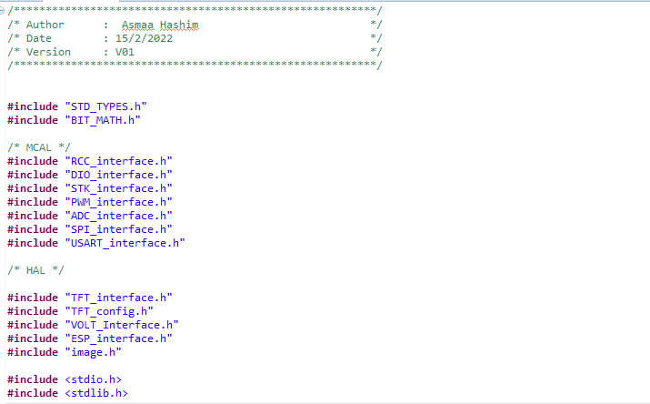
Application

Slide 26
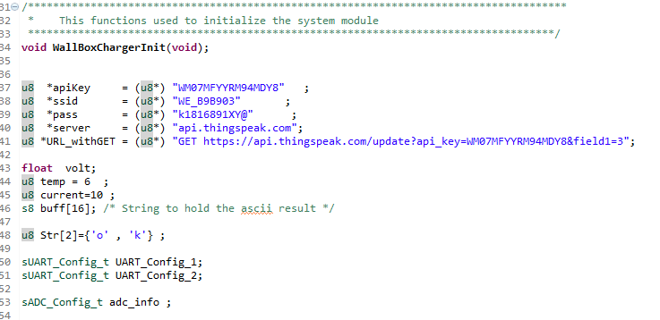
Application

Slide 27
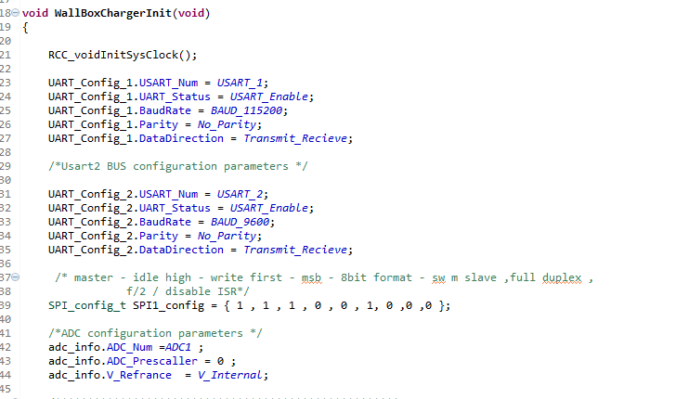
Application

Slide 28
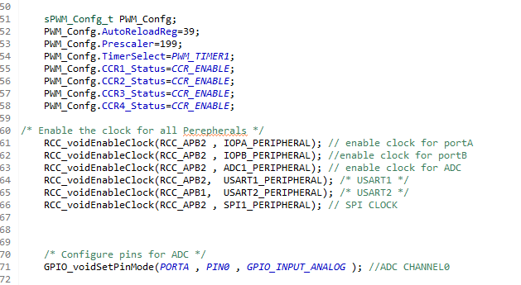
Application

Slide 29
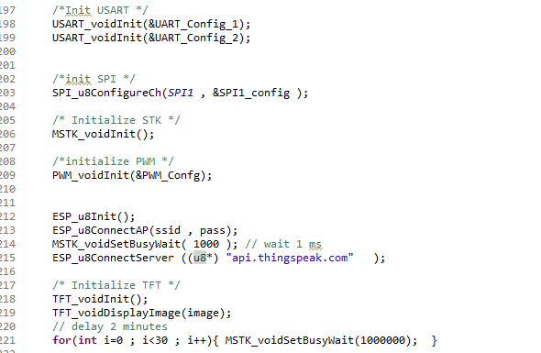
Application

Slide 30
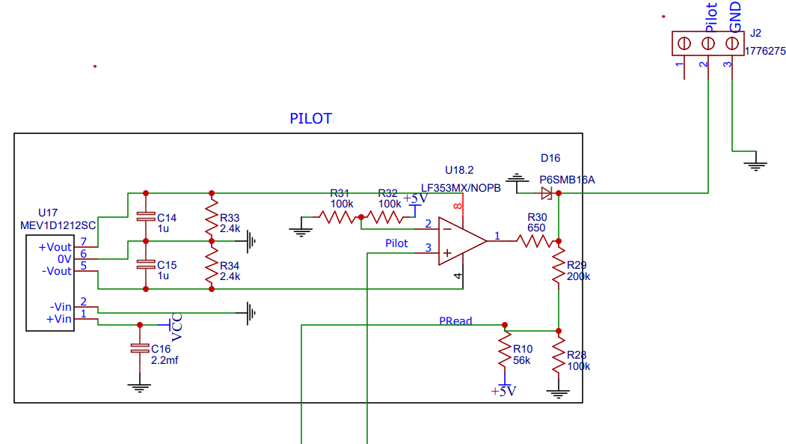
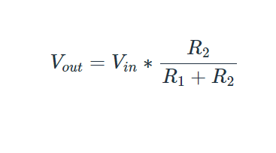
Protection and Some Challenges?
Voltage Divider
Max Volt (6)
MCU
R1
A0
ADC
R2
Gnd

Slide 31
Volt Driver with Solution
#include "STD_TYPES.h"
#include "BIT_MATH.h"
#include "ADC_Interface.h"
#include "VOLT_Interface.h"
#include "VOLT_Config.h"
float VOLT_f32ReadValue (void)
{
u16 Local_u16ReadValue = 0 ;
float Local_f32ReadVolt =0.0;
//Read ADC Value
Local_u16ReadValue =( u16 )ADC_u16Read(ADC1,0);
//Calculate the voltage value from the ADC value
Local_f32ReadVolt = ((float)(Local_u16ReadValue))*(3.3/4096)*((100000+100000)/100000) ;
return Local_f32ReadVolt;
}

Slide 32
Providing 5v to relay for Switching (Know How)
Transistor
Relay
Gnd
MCU
5V
C
Common
Load
B
NO
E

Slide 33
Prototype
Let’s go videos and our hardware

