Slide 1

Shipping Management System

Slide 2
Outline
Team Members
Shipping Management Cycle
Project Features
Technologies

Slide 3
Team Members
Rehab Hesham El-Sarawy
Omar Mohamed El-Shazly
Aya Saeed Mostafa
Mohamed Ashraf Darwish
Rahma Ehab Ismail

Slide 4

Shipping System
Our System connects merchants who have products to sell with clients who want these products and delivers orders to clients.
There are two users who can use our system: merchant and system employee, each of them have his permissions in the system.

Slide 5

Shipping System Cycle

Slide 6
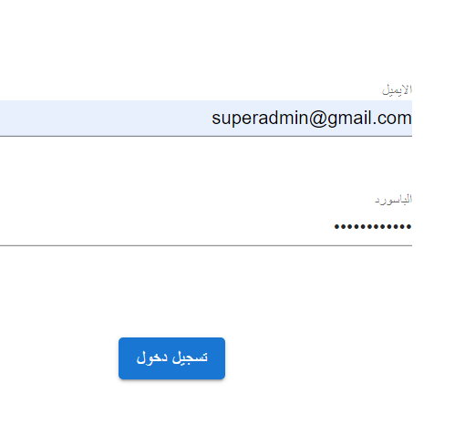
Login
Validation:
Token Claims
Create a JWT token
Create cookie

Slide 7
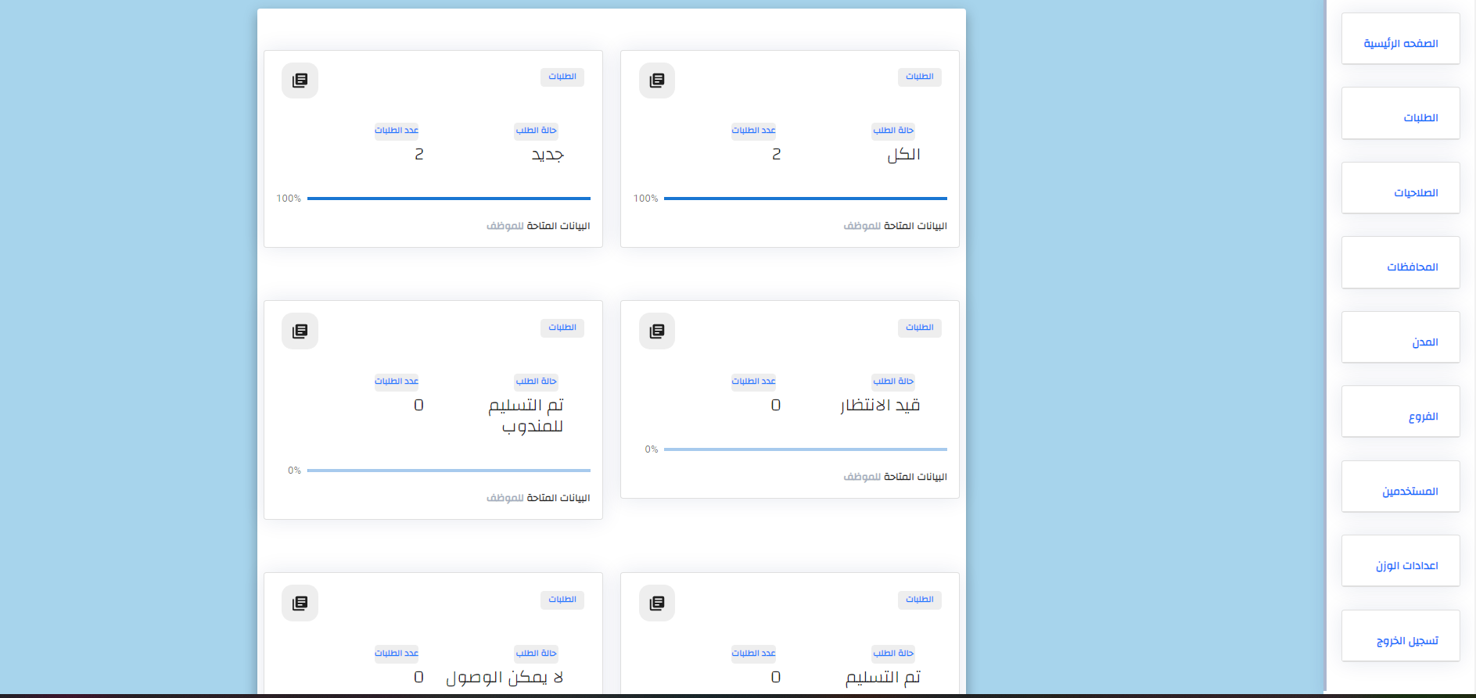
Admin’s Home Page

Slide 8
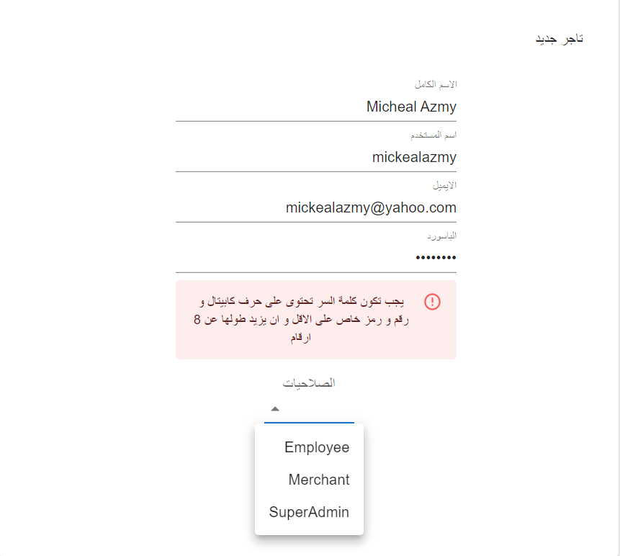
Add New User
Admin can add new users and assign the permissions.
Validation:
Password must have capital letters and special letters, and the length isn’t less than 8 digits.
All fields are required
Username mustn’t start with a digit or _ or dot.
Email address is valid

Slide 9
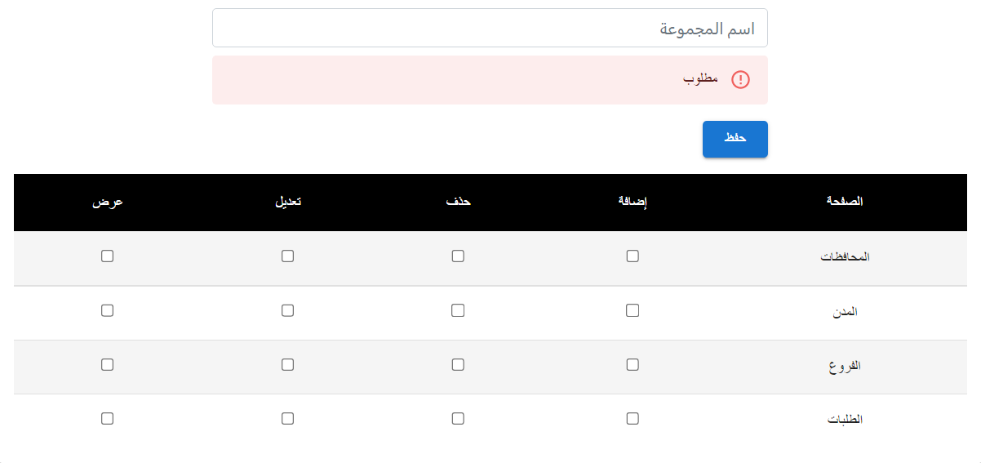
Add New Role
The admin can add a new role and set the permissions for it.

Slide 10
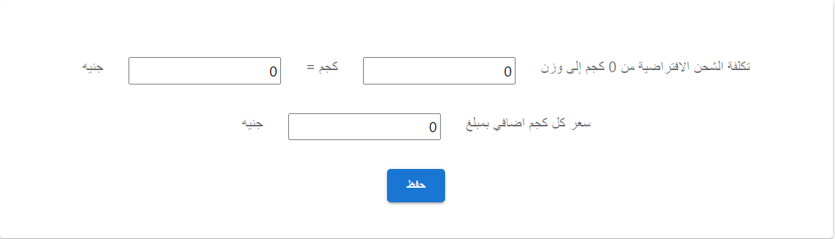
Weight Settings
Only Admin can add new weight settings.
Validation:
Default Weight, Additional weight, and the additional price are required and aren’t less than one value.

Slide 11
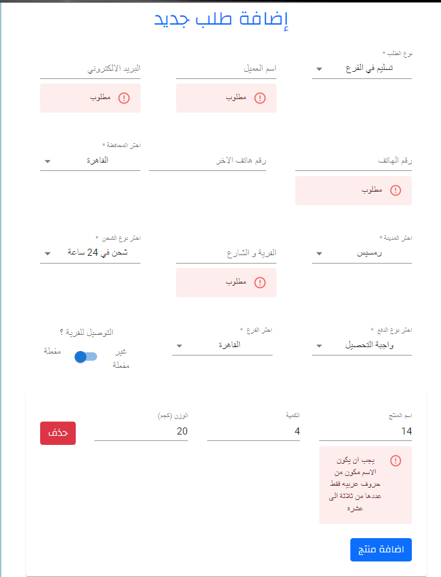
Add New Order
Merchant can add new orders

Slide 12
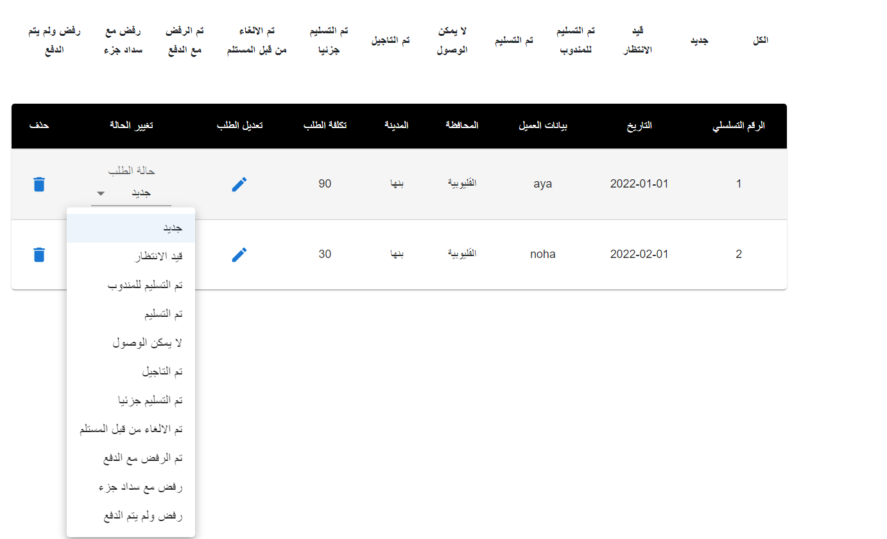
Orders List
Employees can edit, delete, and view orders.
Meanwhile, merchants can view their orders and add new ones.

Slide 13
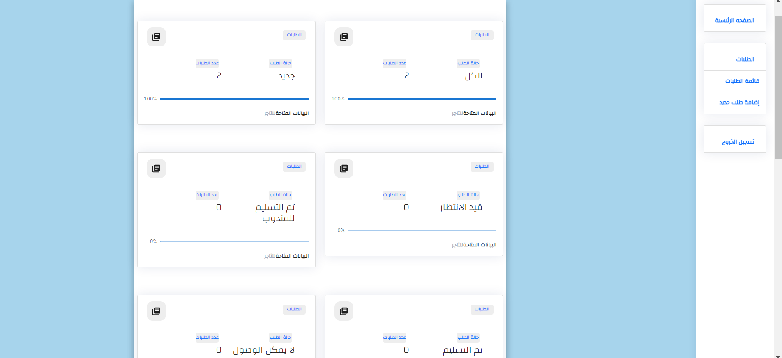
Merchant’s Home Page

Slide 14
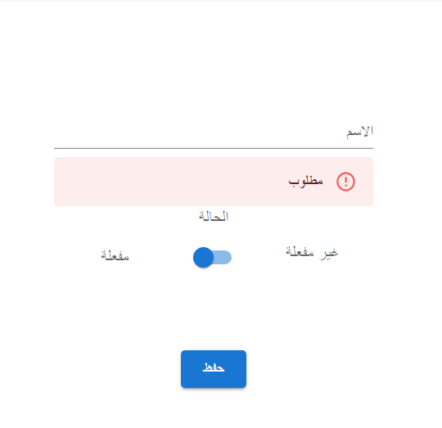
Add New Governorate
Admin and employees can add a new one.
Validation:
In Arabic
Length from 4 to 20 letters.

Slide 15
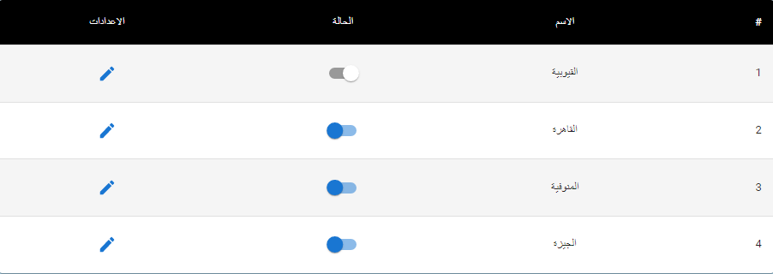
Governorates List
- Admin and permitted employees can view the list of governorates.

Slide 16
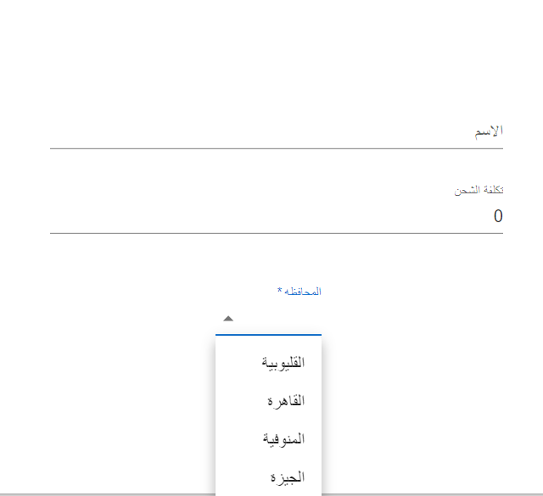
Add New City
Admin and employees can add a new one.
Validation:
City Name should be in Arabic
Length from 3 to 20 letters.
Shipping cost is required and more than 0.

Slide 17
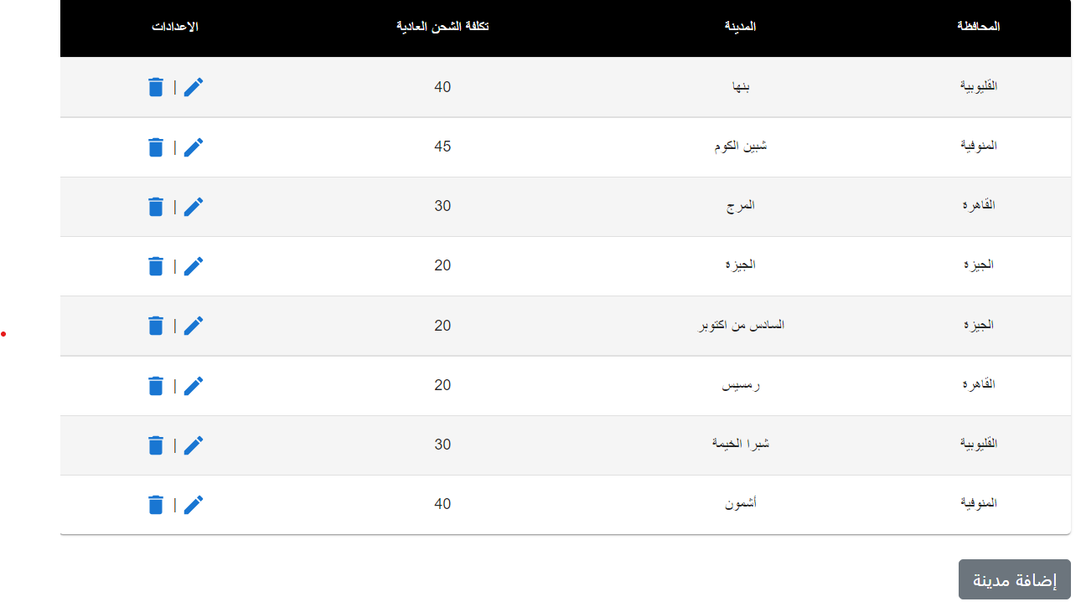
Cities List
- Admin and employees can see the list of cities.

Slide 18
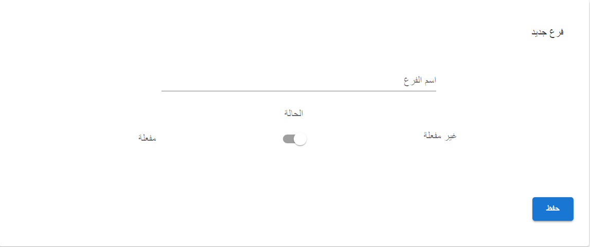
Add New Branch
Admin and employees can add a new one.
Validation:
Branch Name should be in Arabic
Branch Name is required, and the length is from 4 to 20 letters.

Slide 19
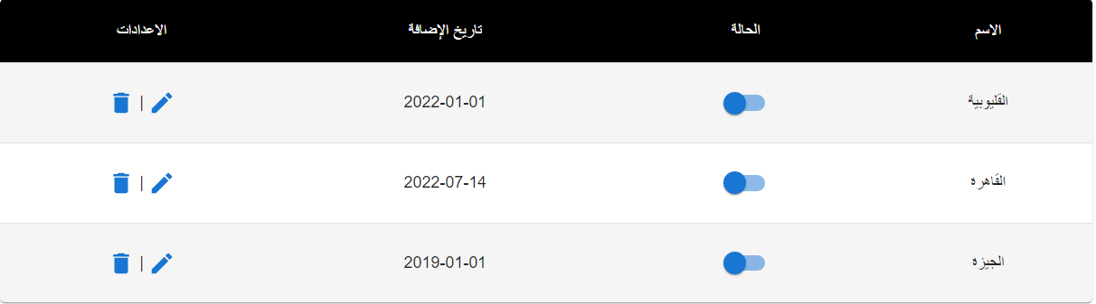
Branches List
- Admin and employees can view the list of branches.

Slide 20
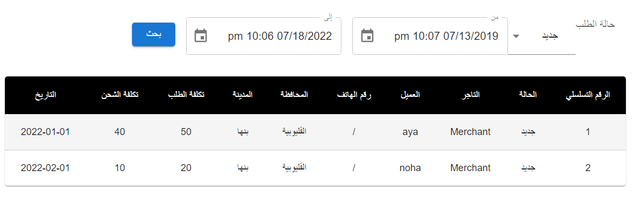
Order Report
- Can Find order Reports by State and between the starting and end dates.

Slide 21
Frontend Technologies
React
Bootstrap
Formik
Martial UI

Slide 22
Backend
MS SQL database
Entity Framework
ASP.NET Web API

Slide 23
Thank You!
Any Questions?

