Slide 1
Gaussian Mixture Models
Aya Saadaoui
Supervisor: Dr. Montassar Ben Messaoud
November 17, 2025

Slide 2





Table of Contents
Introduction
What is a GMM? Origin and History
GMM fundamentals and mechanics
How Likely Is This Point in Cluster k? How Likely Is This Data Point Overall? Expectation-Maximization (EM) Algorithm
GMM Experimentation & Results Research Questions & Dataset Clustering Metrics Comparison Supervised Models Evaluation Clustering Results Visualization Explainability & Complexity
Conclusion References
1
2
5

Slide 3
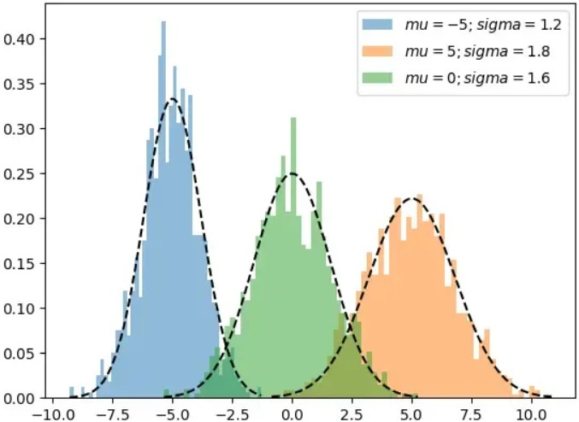
Gaussian Mixture Model (GMM)
A GMM assumes data comes from several Gaussian (Normal) distributions.
Each distribution represents a latent cluster in the data.
Unlike K-Means (hard clustering), GMM does soft clustering, each point has a probability of belonging to each cluster.

Slide 4
Origin and History
1894
Karl Pearson
First mixture of two Gaussians
1977
Dempster, Laird & Rubin EM Algorithm formalized
Today
GMM is used in clustering, anomaly detection, density estimation

Slide 5
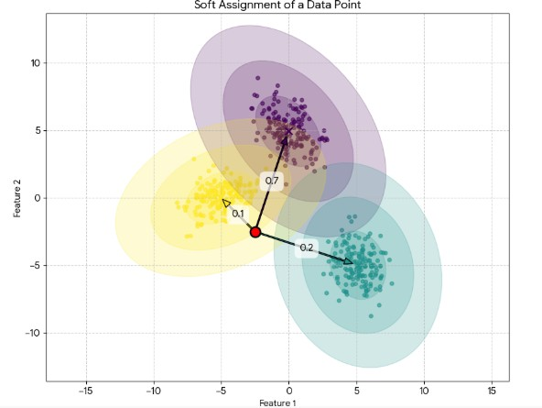
How Likely Is This Point in Cluster k?
K
k=1
Σ
π_{k} · N(x_{n} | µ_{k}, Σ_{k} )
P(z_{n} = k | x_{n}) =
π_{k} · N(x_{n} | µ_{k}, Σ_{k} )
where:
z_{n} = k is a latent variable indicating which Gaussian the point belongs to.
π_{k} is the mixing probability of the k-th Gaussian.
N(x_{n} | µ_{k}, Σ_{k} ) is the Gaussian distribution with mean µ_{k} and covariance Σ_{k} .

Slide 6
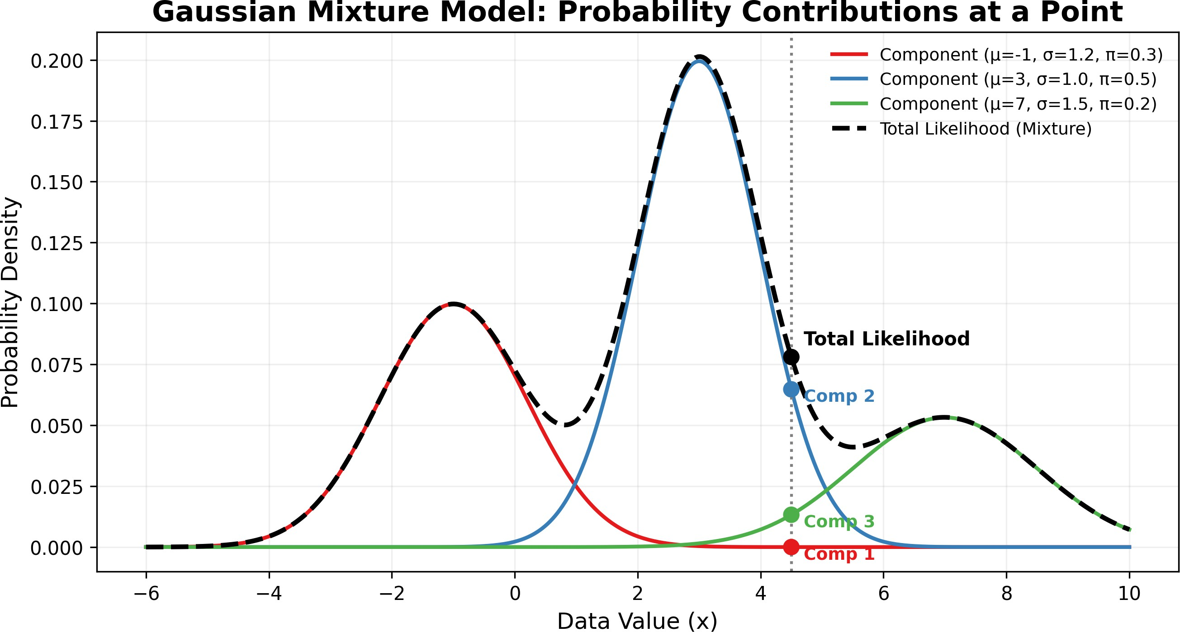
How Likely Is This Data Point Overall?
K
P(x ) = π N(x | µ , Σ )
Σ
n k n k k
k=1
where:
P(x_{n}) is the overall likelihood of observing the data point x_{n}.
The sum accounts for all possible Gaussians k. The total probability of observing x_{n} is the sum of contributions from all K Gaussians.
Each Gaussian contributes proportionally to its weight π_{k} .

Slide 7
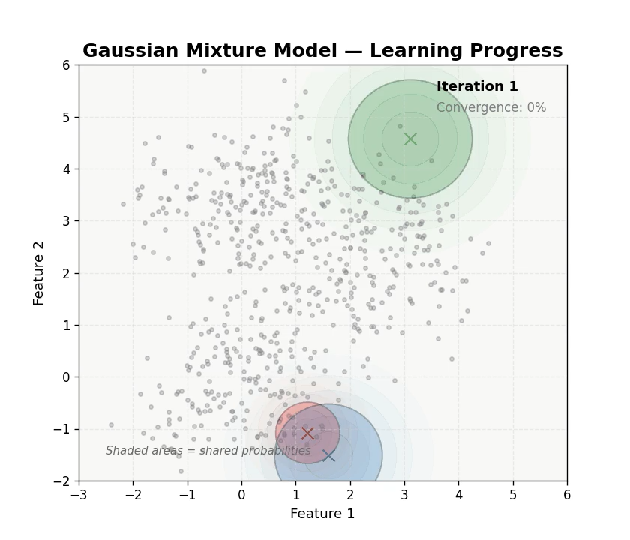
GMM Likelihood and EM Algorithm
N K
L(µ , Σ , π ) =
Y Σ
π N(x | µ , Σ )
k k k
k n k k
n=1 k=1
Initialization: Start with random guesses for mean (µ), covariance (Σ), and mixing weights (π).
E-step (Expectation): Compute the probability that each data point belongs to each Gaussian (soft assignment).
M-step (Maximization): Update the means, covariances, and weights using these probabilities.
Repeat: Iterate E and M steps until convergence (log-likelihood stops increasing).

Slide 8
Research Questions (RQs) and Dataset
Research Questions (RQs):
Can GMM effectively cluster high-dimensional image data (handwritten digits)? How does GMM compare with KMeans on standard clustering metrics?
What insights can GMM provide through explainability (soft assignments, responsibilities)?
Dataset:
Digits dataset from sklearn.datasets 1797 samples, 64 features (8x8 pixel images) 10 clusters expected (digits 0–9)

Slide 9
Clustering Metrics Comparison
Model Performance Metrics:
Model Silhouette ↑ | DB Index ↓ | CH Index ↑ | AIC / BIC ↓ | n clusters
KMeans 0.139 | 1.877 | 113.204 | – | 10
GMM 0.118 | 2.003 | 102.577 | -150542 /-32704 | 10
Key Points:
KMeans achieves better cluster separation metrics (Silhouette, CH index) and finds all 10 digit clusters.
GMM detected fewer clusters 10 and shows negative silhouette → some overlapping clusters.
GMM still valuable for probabilistic assignments and soft clustering explanations.

Slide 10
kNN and CNN Classification Metrics
kNN Test Metrics:
Accuracy : 0.9750
Precision: 0.9765
Recall : 0.9769
F1-score : 0.9765
CNN Test Metrics:
Accuracy : 0.9667
Precision: 0.9724
Recall : 0.9671
F1-score : 0.9685
Observation: Supervised models outperform clustering, demonstrating high reliability for classification tasks.

Slide 11
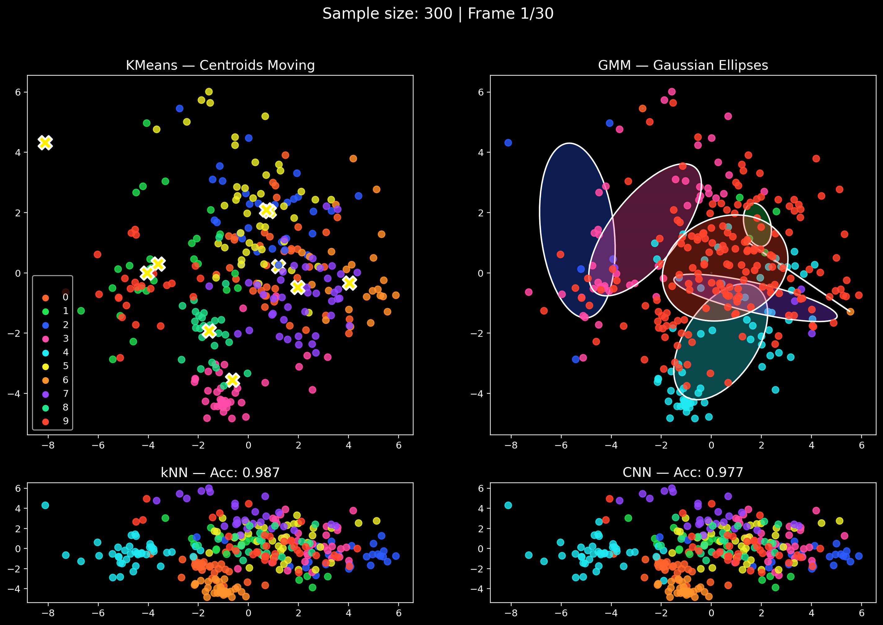
Cluster Assignments and Patterns
9 / 13

Slide 12
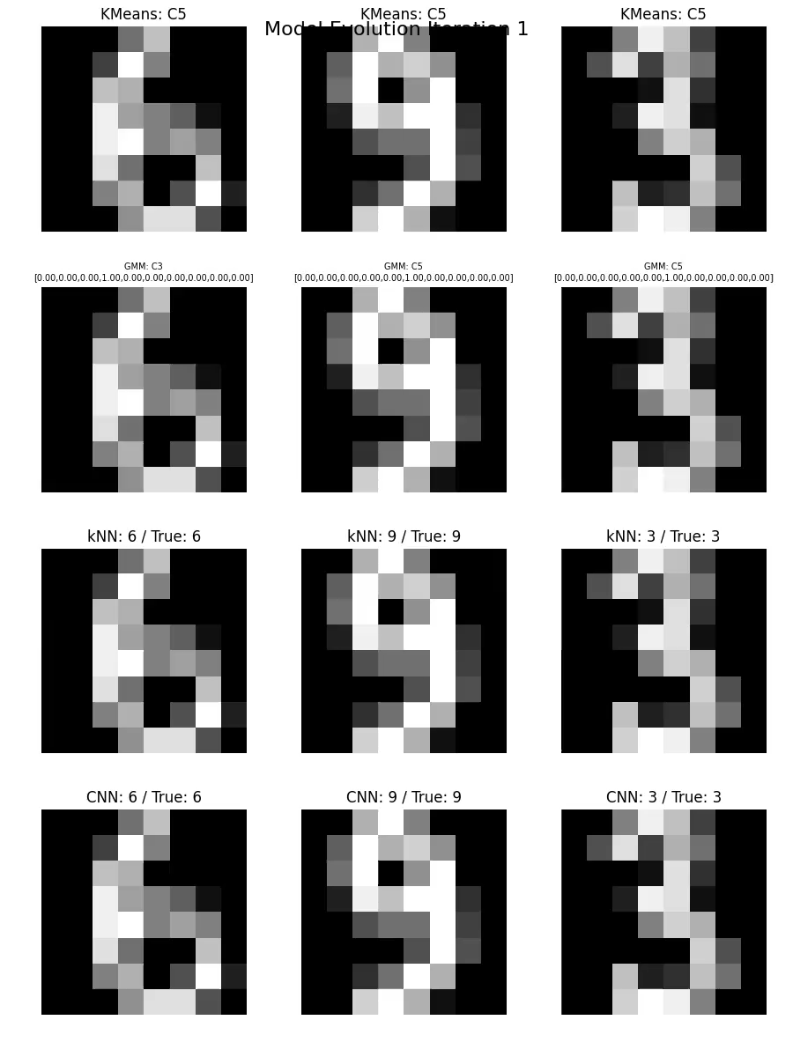
Cluster Assignments and Patterns
10 / 13

Slide 13
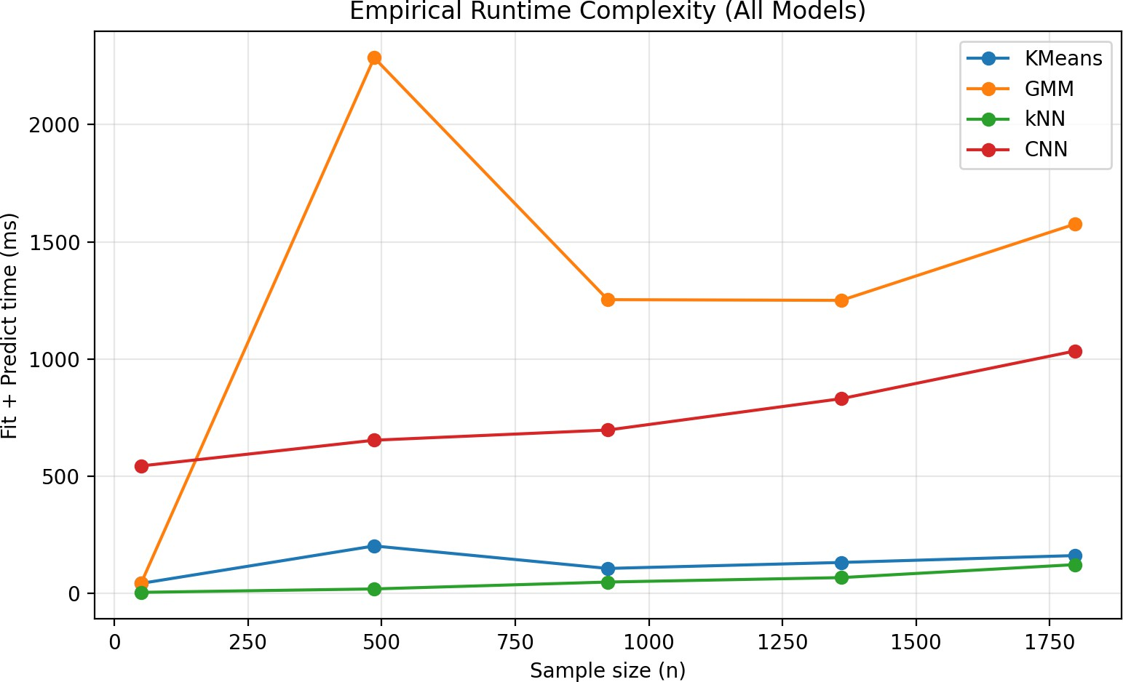
GMM Explainability & Model Complexity
Explainability:
Responsibilities: Probabilistic assignments of points to clusters.
Ambiguous digits can be identified (e.g., “8” vs “3”).
Cluster prototypes: Mean pixel values per cluster.
Highlight key pixels differentiating clusters.
Complexity:
GMM fit time: 0.44s (slower than KMeans: 0.059s)
Complexity grows with O(k · n · d ), where
k=clusters, n=samples, d =features.

Slide 14
Conclusion
GMM offers interpretability advantages despite slightly slower fit time. Ideal when cluster probabilities or uncertainty matters.
Supervised learning could achieve higher accuracy on labeled datasets like digits, but clustering is useful for exploratory analysis or unlabeled data.
GMM’s probabilistic outputs help identify ambiguous or overlapping digits, aiding downstream tasks such as OCR or semi-supervised learning.

Slide 15
References
Deep Gaussian Mixture Models https://arxiv.org/pdf/1711.06929
DataMListic GMM, 945-952. Retrieved from https://youtu.be/wT2yLNUfyoM?si=-pk7N_{Y} OpsFzzha1
Scikit Learn Gaussian mixture models, 8392. Retrieved from https://scikit-learn.org/stable/modules/mixture.html GeeksforGeeks. (2021). ”Gaussian Mixture Model”. Retrieved from
https://www.geeksforgeeks.org/machine-learning/gaussian-mixture-model/

Slide 16
Thank You!

