Slide 1



Superstore BI Dashboard Analysis
Business Intelligence Mini-project
Presented By: Aya Saadawi, Mariem
Mhadhbi, Eya Hadj Hassen

Slide 2


Introduction
Analyzing the Superstore dataset using Python for ETL, MySQL for storage, and Power BI for visualization. With detailed data on orders, shipping, customer demographics, product categories, sales performance, and profitability, this project identifies sales trends, customer insights, and profit drivers to optimize strategies, improve operations, and enable data-driven decision-making for business growth.

Slide 3


Methodology
To effectively manage and analyze the dataset, we utilized a combination of tools and technologies, including:
Python for ETL: Used for extracting, transforming, and loading the data efficiently, leveraging its versatility and extensive libraries to structure the dataset for analysis.
MySQL for Data Storage: Served as a robust database management system, providing a solid foundation for storing cleansed and transformed data.
Power BI for OLAP and Visualization: Enabled exploration of complex relationships, trends, and patterns through interactive dashboards, facilitating deeper insights and data-driven decision-making.

Slide 4

Key Objectives
Analyzing Sales Performance: Identify trends and performance across regions, product categories, customer segments, and shipping methods to uncover high-performing areas and improve sales strategies.
Understanding Order Patterns: Evaluate order trends by product category, region, and time to recognize customer demand and optimize inventory and supply chain operations.
Maximizing Profitability: Focus on profitability metrics, including profit margins by category, top-performing products, and regional profitability, to inform decisions that enhance overall business growth and sustainability.
Strategic Insights for Growth: Utilize data-driven insights to tailor marketing efforts, refine operational strategies, and improve customer satisfaction for sustained success.

Slide 5


Data Gathering
Our comprehensive data exploration leverages the Superstore dataset, sourced from the Kaggle website, a detailed and versatile resource that provides insights into various aspects of sales, profitability, customer demographics, and shipping operations. The dataset is provided in multiple file formats, including XLSX and CSV, and comprises four sub-datasets that collectively enable in-depth analysis of business performance.

Slide 6

ETL Process

Slide 7

Data Extraction
The extraction phase is the first step in the ETL process, where raw data is retrieved from multiple sources and saved to a staging area for further processing. This ensures that the original data remains unchanged and can be reused if needed. The data sources include:
CSV files: inventory data.csv, sales data.csv, and time data.csv.
Excel files: customer data.xlsx and shipping data.xlsx.
Using Pandas, the CSV files were read with pd.read_csv() and the Excel files with pd.read_excel(). Each dataset was loaded into a separate DataFrame for manipulation. The extracted data was then saved to the staging directory (data/staging) in its raw format to maintain consistency and traceability. The screenshots below illustrate the code used for extracting data and saving it to the staging area.

Slide 8
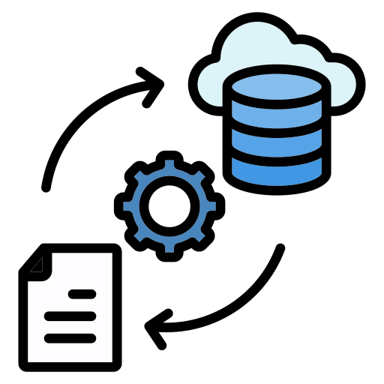
Data Transformation
The transformation phase involves cleaning, validating, and structuring the data into dimension and fact tables for analytical purposes. This phase ensures data quality, consistency, and readiness for downstream processes. The following steps were performed during transformation:
Data Cleaning
Data Transformation
Data Validation

Slide 9

Data Loading
The loading phase involves transferring the transformed data into a MySQL database for storage
and analysis. This phase includes the following steps:
Establishing a Database Connection
Creating Database Tables
Loading Data into Tables
Data Integrity and Error Handling

Slide 10

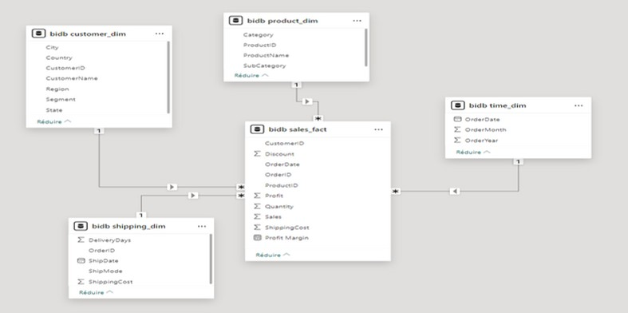
Data Warehouse Model

Slide 11

ROLAP Data Visualization
To harness the insights gleaned from our comprehensive data model, we employed Power BI as our ROLAP Data Visualization tool. This powerful tool allowed us to create interactive and insightful reports, transforming raw data into meaningful visualizations.
Power BI seamlessly connects to a variety of data sources. We linked our data warehouse, hosted on MySQL server, to Power BI, ensuring real-time access to the most up-to-date information. The direct connectivity facilitated smooth data extraction for reporting.
Once Connected, we imported data from our MySQL server into PowerBI. Allowing us to define relationships between our Fact table and Dimension tables.
These relationships enabled us to perform in-depth analysis, allowing for dynamic visualizations and insightful metrics across different dimensions.

Slide 12
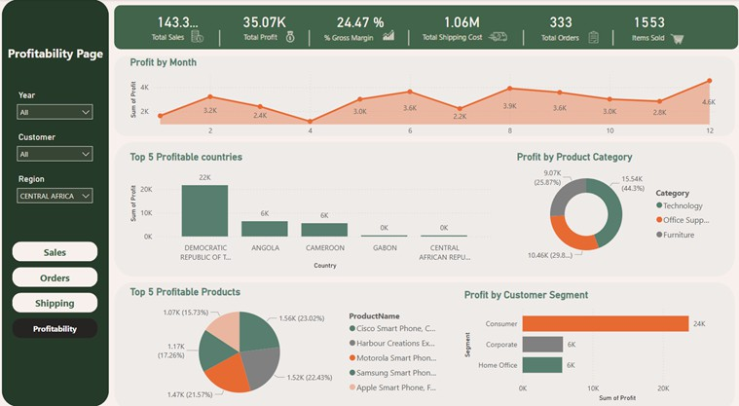
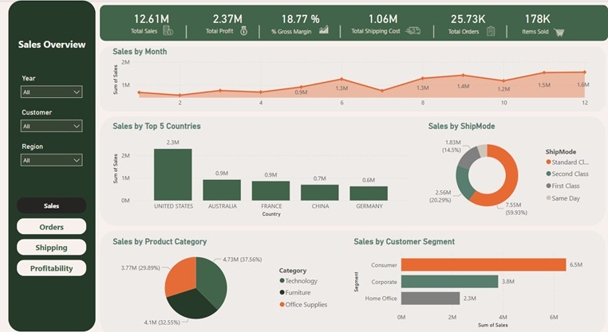
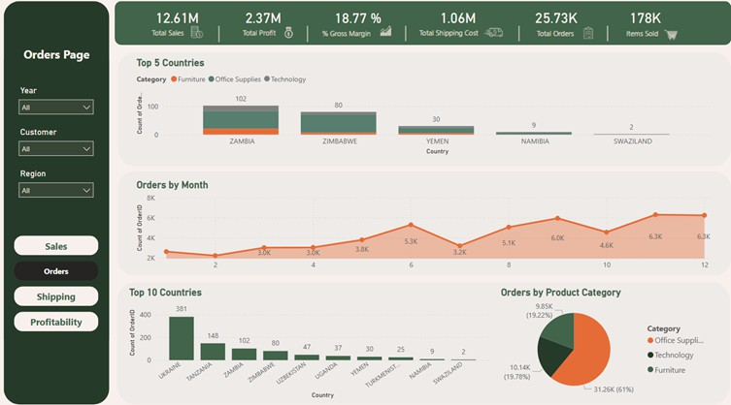
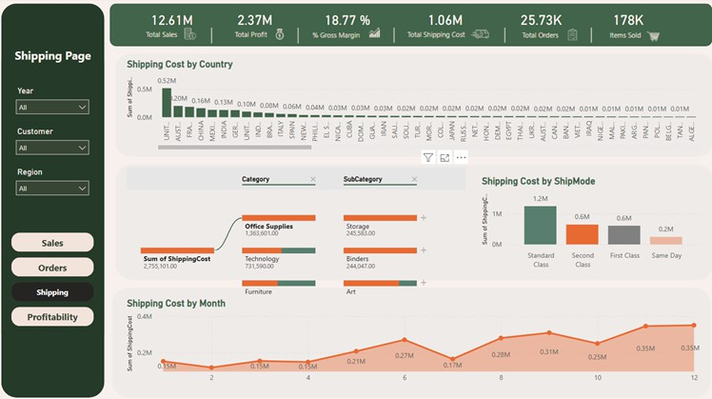
Dashboard

Slide 13



Insights and Decision Support
Geospatial Analysis
Top Markets: The U.S. leads in sales (13.8%), followed by Australia, France, China, and Germany. The U.S. also leads in order volume (9.98K orders).
Profit Analysis
Total Profit: The company generated 2.37M in profit, with the U.S. contributing the largest share (0.44M). The Consumer segment leads profit generation, contributing 1.21M.

Slide 14

Insights and Decision Support
Product Categories and Sales Drivers
Top Categories: Technology (37.56%) and Office Supplies (32.55%) are the largest contributors to sales. Office Supplies also dominate orders, comprising 61% of total orders.
Profitable Products: The Canon ImageClass (28.16%) and Motorola Smartphone (21.25%) are the most profitable.
Orders and Shipping Efficiency
Order Volume: The company processed 25.73K orders, with a notable peak toward year-end.
Shipping Insights: Total shipping costs amounted to 1.06 million, with Standard Class being the most expensive, totaling 1.8 million.

Slide 15


Conclusion
To drive growth and address key challenges, the company should:
Promote High-Demand Products: Continue focusing on Technology and Office Supplies to maintain strong sales.
Optimize Shipping: Improve Standard Class shipping efficiency to enhance profitability.
Leverage Seasonal Peaks: Align marketing and inventory strategies with peak order months.
Focus on the Consumer Segment: Capitalize on the dominant contribution of the Consumer segment to profit.
By implementing these strategies, the company can optimize operations, reduce inefficiencies, and position itself for sustained growth.

Slide 16



Thank You !

