Slide 1


FINAL PROJECT · PHASE A
ErgoMon
Ergonomic Posture Monitoring System
COURSE
TEAM
ADVISOR
61998
Aya Saeed · Marwan Zayyad
Dr. Reuven Cohen
1
github.com/AyaSaeed10/ergonomic-posture-monitoring-system
Notes:
Good morning everyone. . I am Aya Saeed, this is Marwan Zayyad, and our advisor is Dr. Reuven Cohen. Our project is called ErgoMon. It is an ergonomic posture monitoring system — basically, a smart assistant that watches how you sit at the computer and helps you fix bad posture in real time.

Slide 2



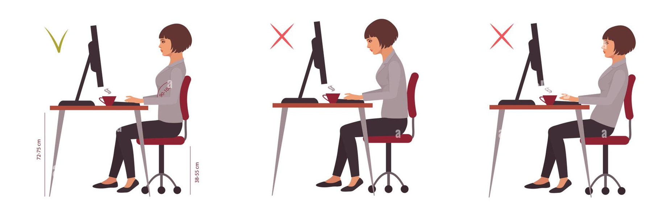
THE PROBLEM
Prolonged Computer Use Is Hurting Our Posture
More hours at the screen means more time in poor posture — and the neck and lower back pay the price.
Forward head posture
Lower-back strain
Sedentary work
Tilting the head forward sharply multiplies the load on the cervical spine.
Slouching and weak lumbar support drive stiffness and chronic pain over time.
Long, uninterrupted sitting compounds discomfort — most users feel it within minutes.
2
Notes:
why does this matter? Today we all spend many hours in front of a screen — for work, for study, for everything, Because of that, we often sit in a bad posture. Two body parts affected the most. the neck and the lower back. When we push our head forward, the neck carries much more weight than it should. When we slouch, the lower back gets tired and starts to hurt. In the future this can cause pain and discomfort. need for a tool that can catch this early, while it is happening. In this picture, you can see the difference between good and bad posture.

Slide 3










PROJECT GOAL
ErgoMon Goal & Objectives
Goal Build an intelligent system that acts as a real-time virtual ergonomic assistant — monitoring upper-body posture (neck & lower back) during computer use and guiding correction.
OBJECTIVES
Monitor in real time
Detect poor posture
Smart, timely feedback
Breaks & stretches
Capture posture continuously from a side-positioned camera.
Identify forward-head and slouching patterns reliably.
Alert only when poor posture truly persists.
Recommend rests and exercises after long sitting.
WHO BENEFITS
Students
Office workers
Developers
Physiotherapists
Organizations
3
Notes:
Our goal was to create a virtual ergonomic assistant. The system watches the user's posture and helps them sit correctly. It works in real time, detects bad posture, gives feedback when needed, and reminds users to take breaks and stretch. The system can help students, office workers, and many other people.

Slide 4
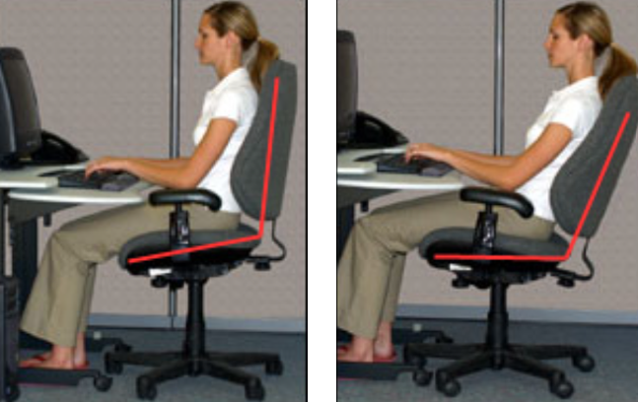
BACKGROUND · CLINICAL FOUNDATION
Ergonomic Safe Zones (OSHA & ROSA)
Healthy posture is a range, not a single pose. These clinical thresholds define the data the system is measured against.
Body region | Safe zone | Why it matters
Neck / head | 0° – 20° downward | Limits upper-trapezius strain; load rises sharply beyond 20°.
Lower back — upright | ≈ 90° vertical | Neutral spine; weight spread evenly across the lumbar vertebrae.
Lower back — reclined | 105° – 120° | Supported recline lowers disc pressure vs. a strict 90°.
Monitor placement | 50–100 cm · 15°–20° | Centered, arm's length, slightly below eye level reduces strain.
4
OSHA and ROSA guidelines: These are internationally accepted ergonomic standards
Notes:
"we needed to know what good posture looks like. We used OSHA and ROSA guidelines. These are internationally accepted ergonomic standards.
We focused on the neck and lower back because research papers and a physiotherapist told us that these are the body parts most affected by long sitting.
Good posture is not one exact position. It is a safe range of positions.

Slide 5






GAP ANALYSIS
Existing Solutions, Limitations & Our Edge
Existing approaches
The ErgoMon edge
TWO MAIN APPROACHES
Pose estimation + a lightweight Random Forest — accurate yet efficient.
Geometric
Deep learning
Angle-based methods
Neural pose models
Laser-focused on neck and lower-back alignment.
Side-view setup that best reveals neck angle and back curvature.
THEIR LIMITATIONS
Geometric methods miss complex posture variation.
Temporal smoothing — alerts only when poor posture persists.
Deep learning needs large datasets and GPU power.
Occlusion and noisy keypoints reduce reliability.
Runs on standard hardware — no GPU or special equipment.
Weak accuracy on the back; few target neck & lower back.
5
Notes:
We looked at existing posture monitoring systems. Some are simple but not very accurate. Others are accurate but need powerful computers. Our system combines accuracy with efficiency. It focuses on the neck and lower back, works with a side camera, and runs on a regular computer

Slide 6

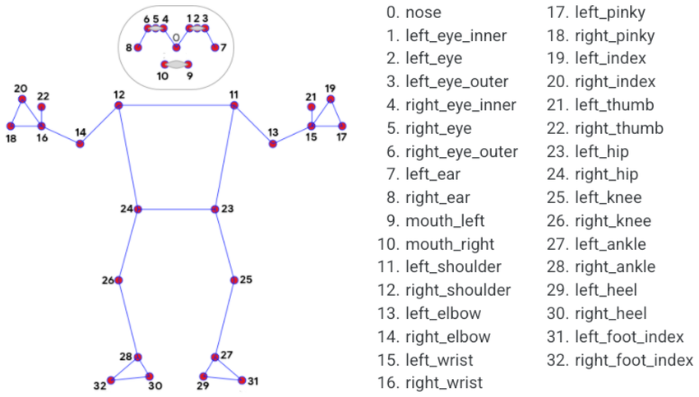
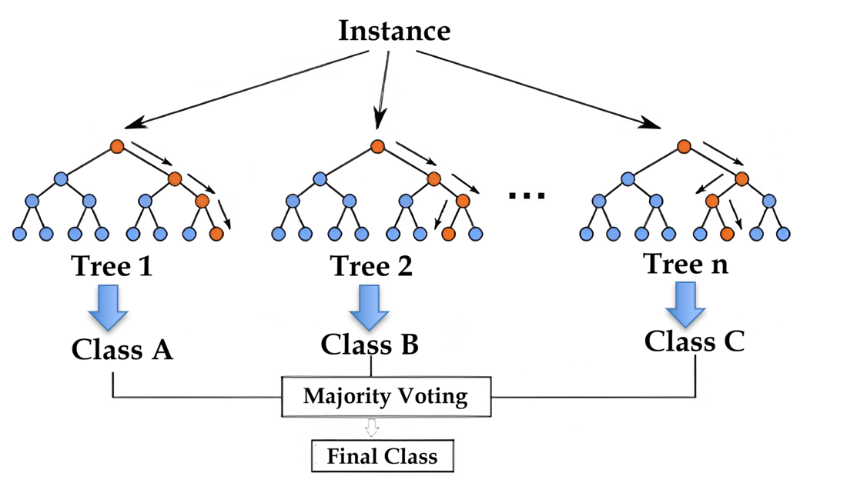


TECHNOLOGIES & METHODS
Core Building Blocks
MediaPipe Pose
Geometric Feature Extraction
Real-time skeletal landmark detection (ear, shoulder, hip, knee) — accurate and lightweight on standard PCs.
Landmark coordinates become posture features — a clean mathematical description of how the body is aligned.
Neck angle
Torso / back angle
ear → shoulder → hip
shoulder → hip → knee
Random Forest Classifier
Technology Stack
An ensemble of decision trees votes on the posture class — robust to body type and camera angle, and resistant to overfitting.
Python
OpenCV
scikit-learn
Firebase Firestore
Desktop UI
6
Notes:
Our system has four main parts.
The first is MediaPipe Pose. It detects body landmarks.
The second is Geometric Feature Extraction. This component calculates angels such as the neck and the back angles. These angles describe the user's posture.
The third is the Random Forest classifier. It is a machine learning model that classifies posture into different categories. We chose it because it is accurate, reliable, and works well with a small dataset.
The last part is our technology stack. We used Python for development, OpenCV for image processing, MediaPipe for pose detection, scikit-learn for machine learning, Firebase for saving data, and a desktop interface for user interaction."

Slide 7








AI TRAINING STRATEGY
Trained Offline, Deployed for Real-Time Inference
Training
performed offline, away from the app
Application
real-time inference only, on the device
labeled dataset Side-view images, labeled into seven posture classes.
Loads the trained model No training ever happens on the device.
Train the Random Forest Learns which posture class corresponds to each picture.
Classifies each frame live Instant posture prediction from the camera.
trained
model
high-performance hardware Required for efficient training on large datasets.
Stays light & fast Runs smoothly on standard hardware.
BUILT FOR MANY POSTURE CLASSES
Correct posture
Neck forward
Neck backward
Neck left
Neck right
Back forward
Back backward
Easy to expand. Add a new posture by collecting more labeled data and retraining offline — the updated model drops straight back into the app, with no change to the real-time logic.
7
Notes:
A key design decision is that training and running are two separate worlds. Training is done offline: we build a custom labeled dataset, use Google Colab for extra compute power if we need it, and train the Random Forest there. Only the finished model is placed inside the application, which does real-time inference and never trains — so the app stays light and fast. Finally, the system is built for many posture classes — neck forward and backward, neck left and right, back forward and backward, correct posture, and more. To add a new one, we just collect more data and retrain offline; the new model slots right back in.

Slide 8
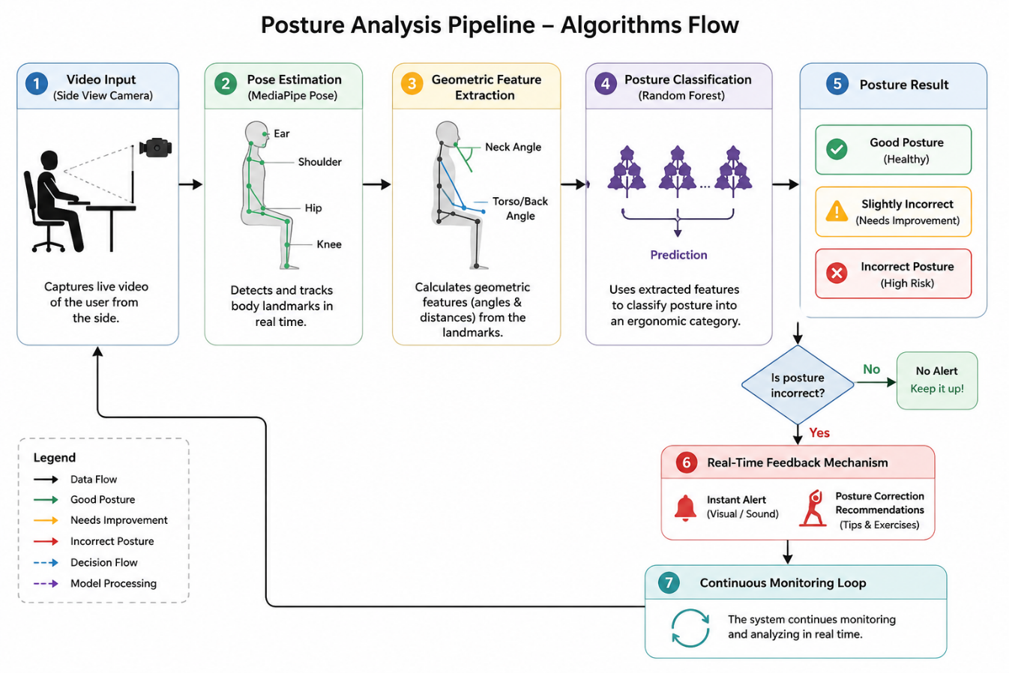


SYSTEM LOGIC
Posture Analysis Pipeline
6 staged steps
From capture to classification in a clear, traceable flow.
Decision gate
Selects the appropriate action for each posture state.
Continuous loop
Continuously processes and analyzes posture frame by frame.
8
Notes:
This is the full pipeline. Video flows through pose estimation, geometric feature extraction, and Random Forest classification into one of three states. The decision diamond is important: if posture is fine, no alert; if it's incorrect, real-time feedback fires and the system loops back to keep monitoring continuously.

Slide 9
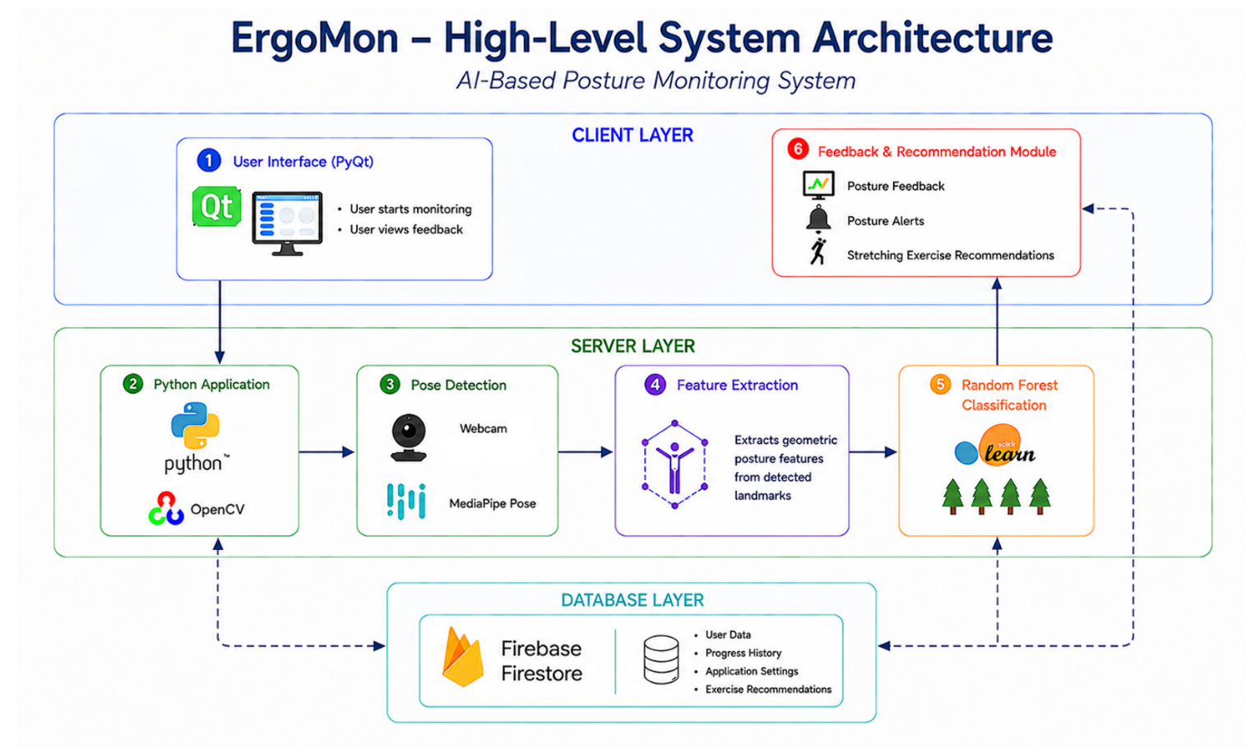

ARCHITECTURE
High-Level System Architecture
Client layer
User interface and camera access — start sessions, view alerts and reports.
Server layer
Pose detection, feature extraction and ML classification of posture.
Database layer
Firestore stores settings, recommendations, exercises, profiles and history.
9
Figure 5 — Client, server and database layers of ErgoMon.
Notes:
Three layers. The client handles the interface and camera. The server does the heavy lifting — pose detection, feature extraction, and classification. The database, Firebase Firestore, keeps user settings, recommendations, exercise content, and session history, and lets us update content remotely without touching the client.

Slide 10
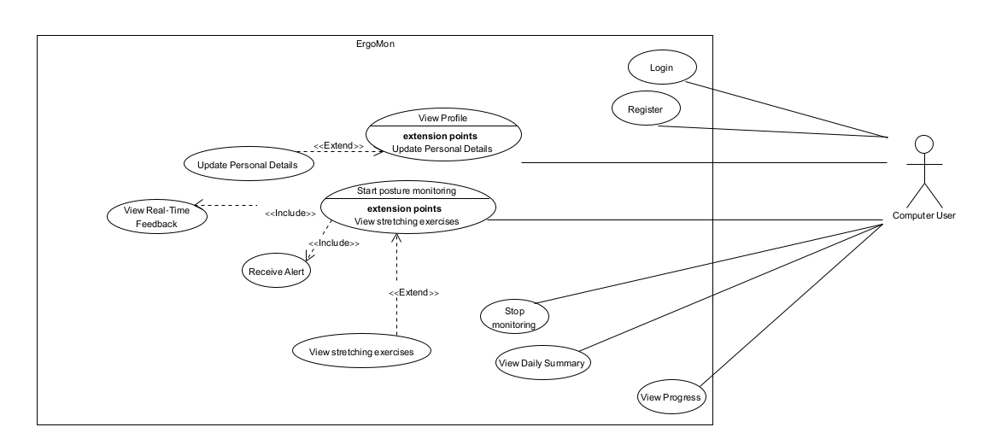
DESIGN · UML
Use-Case Model
Use-Case Diagram
Primary use cases
Register & Login
Monitor posture
Receive recommendations
View daily reports
Summarizes the key user interactions supported by the ErgoMon posture monitoring system.
10
Notes:
The use-case diagram shows everything the user can do: monitor posture, get feedback and alerts, manage their profile, and review daily summaries.

Slide 11
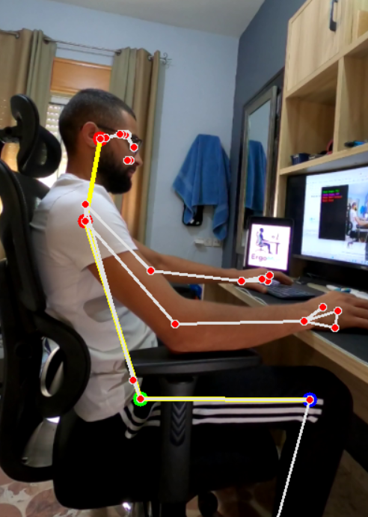


PROTOTYPE
Working Prototype
What's running today
Built in Python with OpenCV + MediaPipe Pose.
Live input from a webcam (GoPro), side-view setup.
Correct-posture samples are collected during calibration.
Neck and torso angles are extracted, and noisy measurements are removed.
Collected angles are used to determine the acceptable posture ranges.
Live neck and torso angles are extracted and compared with the calibrated ranges for posture classification.
11
Notes:
This isn't just a plan — a prototype already runs in Python with OpenCV and MediaPipe, taking live side-view input and computing the neck and torso angles. A calibration tool with percentile filtering establishes reliable ranges. The pseudo-code on the right captures the core loop: detect, measure, predict, and only alert when a bad state persists.

Slide 12
ENGINEERING CHALLENGES
Challenges & Mitigation Strategies
Choosing a pose model
Hardware limits
Lighting & camera
Additional landmarks may be required; alternative models or derived landmarks will be evaluated.
Model training may require more computing power; Google Colab will be used if needed.
Lighting conditions may reduce detection accuracy; image enhancement will be applied if needed.
No suitable dataset
Variability between users
Defining correct posture
Available datasets may not meet our requirements; a custom dataset will be collected if needed.
Variations in human body dimensions may require collecting data from diverse participants.
Reliable training required correctly labeled posture samples, verified by a physiotherapist.
12
Notes:
Six real engineering challenges and how we handled each. No good off-the-shelf dataset existed, so we built and labelled our own. To handle different body types we use angle-based features rather than raw coordinates. And because defining 'correct' posture needs expertise, we brought in a physiotherapist to set the safe ranges and recommend the exercises.

Slide 13
TESTING & EVALUATION
A Structured Test Plan
14 TEST CASES
# | Test Case | What It Verifies | Expected Result
1 | User Login | Successful login into ErgoMon | User dashboard appears
2 | Start Monitoring Session | Start real-time posture monitoring | Live posture analysis begins
3 | Camera Detection | Verify the side-camera connection | Neck & back clearly visible
4 | Pose Detection (MediaPipe) | Detect body landmarks correctly | Skeleton drawn on the body
5 | Feature Extraction | Calculate posture angles correctly | Neck & back angles computed
6 | Posture Classification | Classify posture with Random Forest | Posture state shown with feedback
7 | Incorrect Neck Alert | Detect forward-head posture | “Straighten your neck” alert
8 | Incorrect Back Alert | Detect lower-back slouching | “Sit upright” alert appears
9 | Real-Time Feedback | Provide live posture feedback | Recommendations shown in real time
10 | Daily Feedback Summary | Generate a daily posture report | Daily report displayed correctly
11 | Recommendations & Exercises | Suggest posture-improvement exercises | Ergonomic exercises displayed
12 | Database Logging | Save monitoring results to the database | Session history stored in the DB
13 | Monitoring History | Display a previous monitoring session | Detailed session report shown
14 | System Performance | Verify real-time responsiveness | Feedback with minimal delay
13
Notes:
we prepared 14 test cases.
We tested the system from beginning to end. This includes the functional tests, posture detection tests, feedback tests, and database and performance tests Each test has three parts: what we test, what the system should do, and the expected result. This helps us check that every part of the system works correctly."

Slide 14


SUCCESS CRITERIA
Success Criteria
Detection accuracy
Responsiveness
Effective feedback
Posture classification accuracy for neck & lower-back detection>=95% .
Feedback generated within 1 second after incorrect posture is detected.
Clear corrective alert for every detected posture issue.
Reliable daily summary
Positive user feedback
1–5
FPS
Of sessions generate a summary with posture score, alerts and 100% recommendations.
Positive rating from users and physiotherapists >=85%.
Processes 1-5 frames per second for real-time monitoring.
14
Notes:
we defined clear success criteria.
at least 95% posture detection accuracy.
The user should receive feedback within one second after deciding to give an alert.
Every detected posture problem should show a clear correction message.
Every session should generate a summary after the session ends.
Finally, we expect at least 85% positive feedback from users and physiotherapists.
The system also runs at 1 to 5 frames per second, which is enough for smooth real-time monitoring.

Slide 15
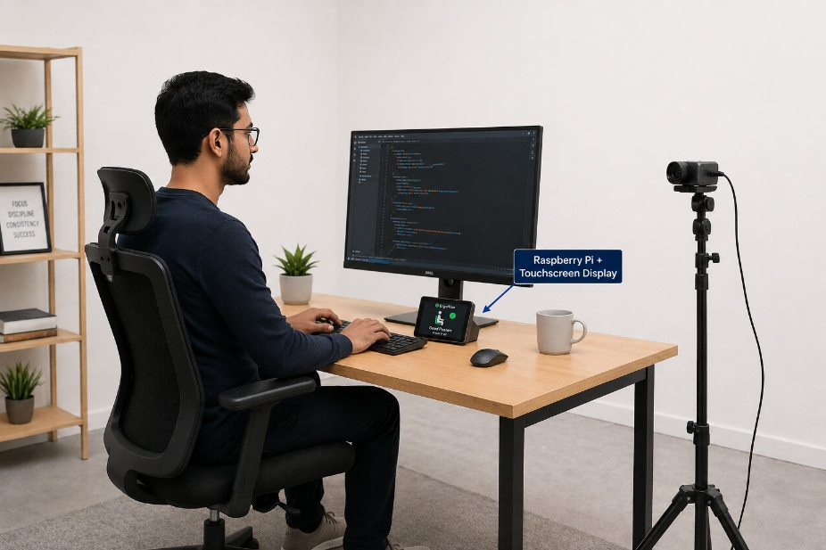
FUTURE WORK
Toward a Standalone Smart Device
Embedded ErgoMon
The same pipeline, repackaged as a portable, dedicated device — turning the desktop tool into a standalone ergonomic monitor.
Raspberry Pi embedded computer
Camera for real-time monitoring
Small touchscreen for feedback
Optional battery-powered setup
The model trains off-device; the Pi runs only real-time inference — no major changes to the core architecture.
Figure 10 — Concept of the future standalone device.
15
Notes:
Looking ahead, ErgoMon can move off the desktop and become a standalone smart device on a Raspberry Pi, with its own camera and a small touchscreen, optionally battery-powered. The model would be trained on a regular computer and the Pi would just run inference — so the core architecture stays the same.

Slide 16
THANK YOU
Questions & Discussion
ErgoMon — Ergonomic Posture Monitoring System
Aya Saeed · Marwan Zayyad
Advisor: Dr. Reuven Cohen | Course 61998 · Phase A
github.com/AyaSaeed10/ergonomic-posture-monitoring-system
16
Notes:
Thank you — we're happy to take your questions. To recap: ErgoMon is a real-time, lightweight ergonomic assistant focused on the neck and lower back, with a working prototype and a clear path to a standalone device.

