Slide 1
Zoo Bazaar
PRESENTED BY:
AYA SHIKH SULIMAN
ERFAN ALIZADA
ALAA BOLBOL
Notes:
Aya

Slide 2
Topic outline
01
02
Introduction
Demo
03
04
About our product
Reflection
Notes:
Aya

Slide 3
Our team
Aya Shikh Suliman
Erfan ALizada
Alaa Bolbol
Notes:
Aya

Slide 4
Introduction
01
Notes:
Erfan

Slide 5
Demo
02
Notes:
DA – Aya
WA - Alaa

Slide 6
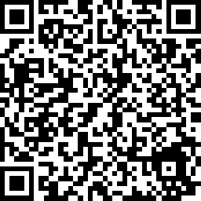
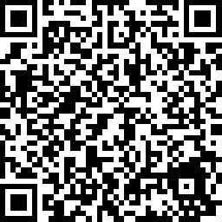
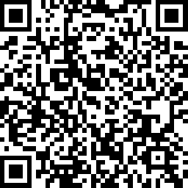

Slide 8
Why our product is good?
01
02
03
04
Best solution
Selling features?
Decisions
Why to buy it?
Notes:
Erfan

Slide 9
Reflection
What we learned? | Patience | -
What went well? | Communication | -
What didn’t go well? | Plans | -
Why didn’t it go well? | Work load | -
What would we do next time? | Easily | -
Notes:
Aya – Erfan - Alaa

Slide 10
Thank you for listening
Any questions!

