Slide 1

Second ain shams computer vision competition

Slide 2


Pseudocode converter

Slide 3
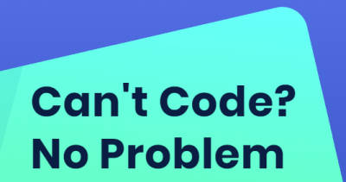
The idea description
Our android application convert simple pseudecode lines scanned from an image to Python code using python and image processing libraries .
Also you can run the implemented output code .

Slide 4
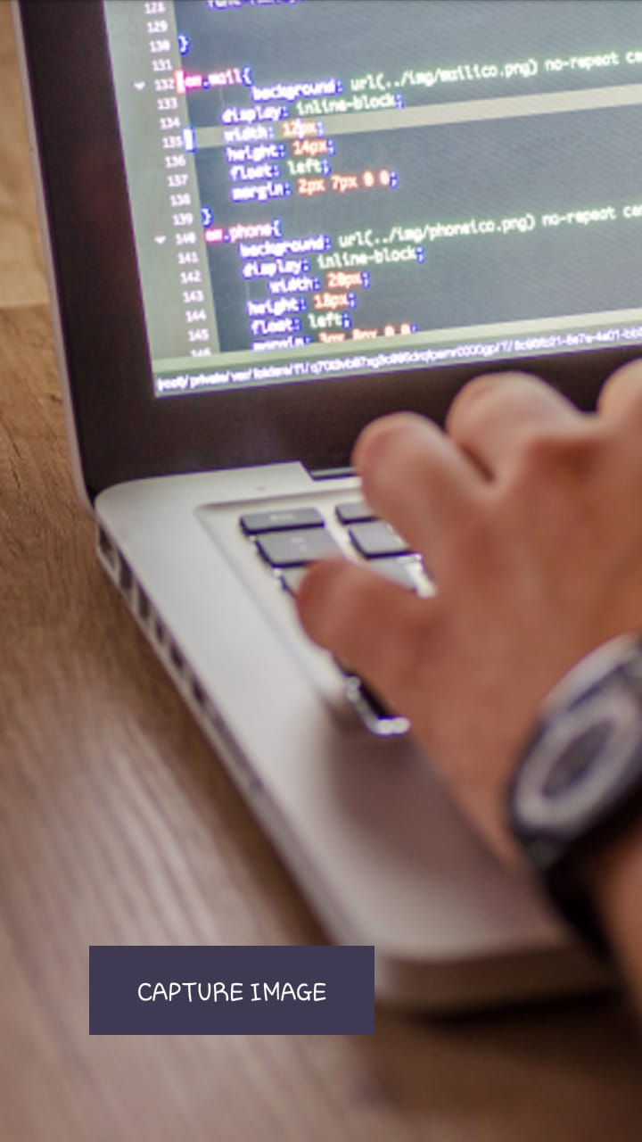
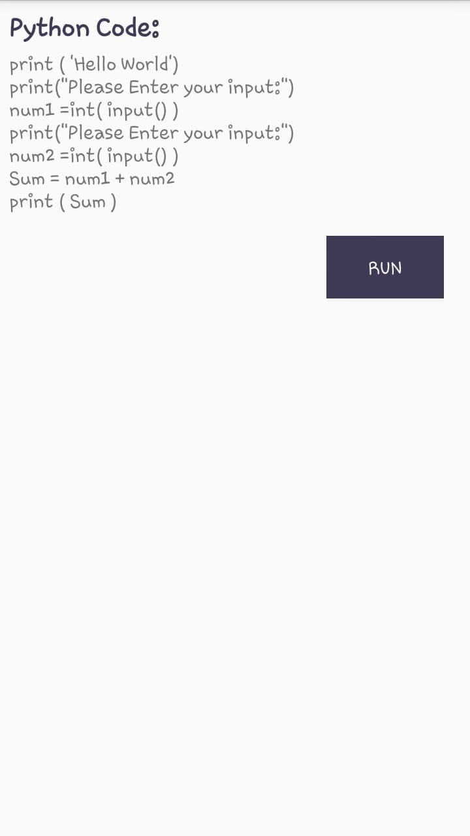
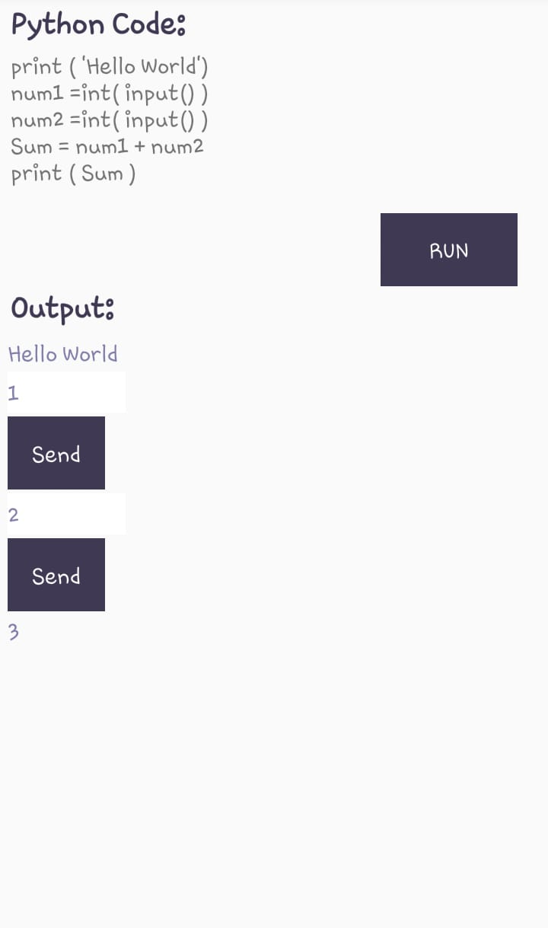
How to use the application
Have the output code
Capture the image
Run if you want to execute the code

Slide 5
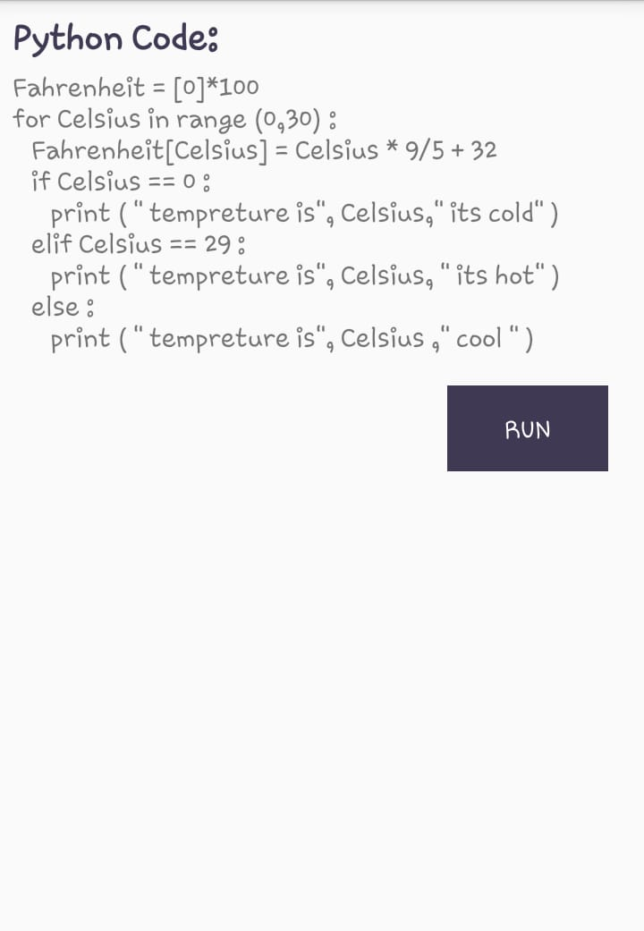
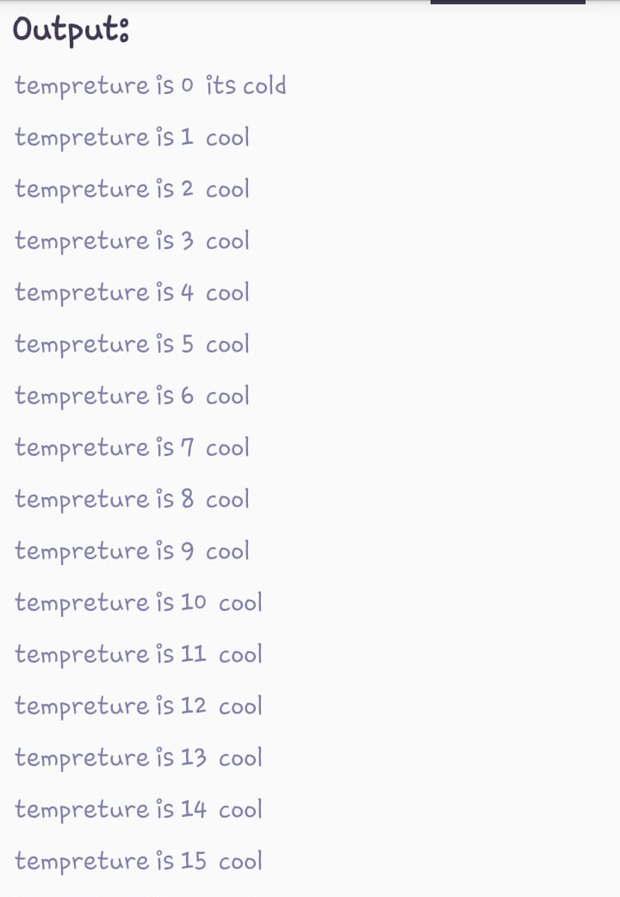
Another example

Slide 6

Stages of execution
Android application
Preprocessing
Compile
Run

Slide 7

Client – Server System
Server :
- All the processing is on the server
- It can serve multiple clients currently as it based on multithreading using java and python sockets
Client :
It is the android application on the mobile which the user interface with

Slide 8
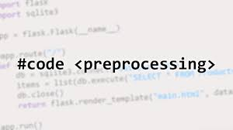

Preprocessing
The main purpose for this stage is to extract the text from the captured image from the application through :
Resizing the image and make binary thresholding
Extract text from image using tesseract-ocr

Slide 9
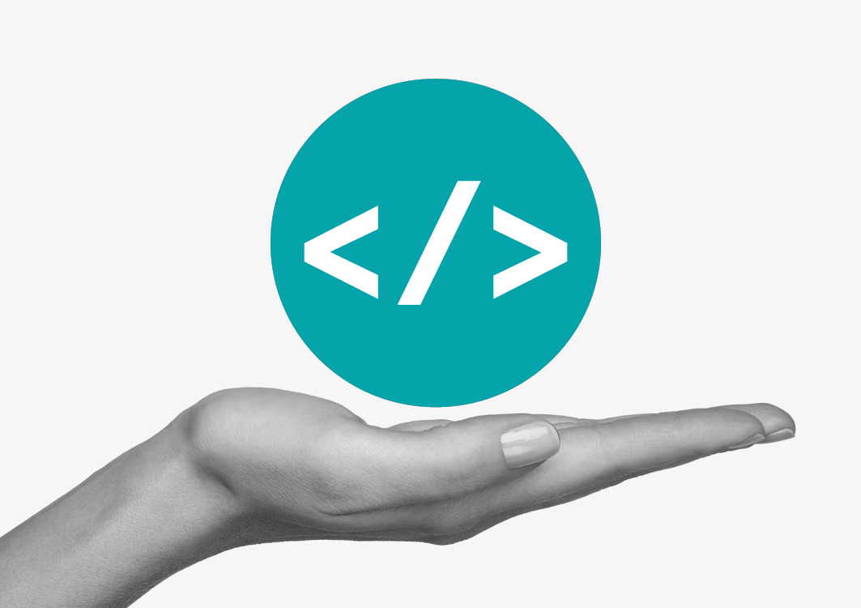
Compilation
In this stage we take the scanned pseudocode from the image resulted from preprocessing stage and change it to python code .

Slide 10
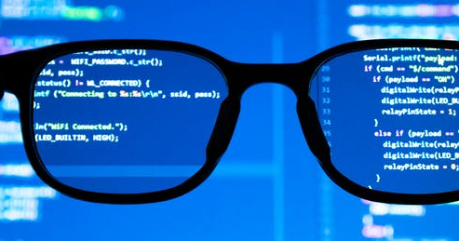
Run
In this stage we enable the user to execute the output code from the compilation stage

Slide 12
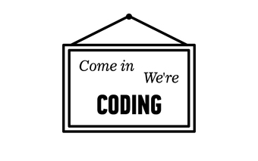
Pesudocode writing limitations
1 - To allow the user to input a variable use “Promot” keyword
2 - To print string use “Display” keyword
3 - To print any thing else use “print” keyword
4 - To initialize list use “initialize” keyword
5 - To initialize variable use “set ” keyword
6 - use endfor and endif when you end for or if body
7 – To write operations
{equal,greater_than,less_than,greater_than_or_equal,less_than_or_equal,not_equal}

Slide 13

Thank you ☺

