Slide 1
SMART INDIA HACKATHON 2024

Slide 2
Problem Statement
ID-1596
Agriculture, FoodTech & Rural Development
OrganizationAICTE, MIC-Student Innovation
Department-Ministry of Education's Innovation Cell (MIC)
Category-Software
PS - Developing solutions, keeping in mind the need to enhance the primary sector of India - Agriculture and to manage and process our agriculture produce

Slide 3
Proposed solution
Develop a comprehensive digital platform, AgriBoost, designed to empower farmers by integrating precision farming tools, efficient supply chain management, and direct market access. The platform will offer services like real-time data on weather and market prices, access to quality seeds and fertilizers, crop insurance, and a marketplace for selling produce directly to consumers and businesses.

Slide 4
TECHNICAL APPROACH
Technologies used
Frontend:
React.js : For building a responsive and user-friendly interface.
HTML5/CSS3: For structuring and styling the web pages.
Backend:
Node.js: For handling server-side logic and API integrations.
Express.js For building robust APIs.
Database:
PostgreSQL or MySQL: For relational database management.
MongoDB: For storing unstructured data, such as real-time analytics.
Security:
OAuth2: For secure user authentication.
APIs:
Weather API: For real-time weather data integration.
Payment Gateway APIs (e.g., Razorpay, PayPal): For handling financial transactions.
GIS API (e.g., Google Maps API): For location-based services and farm mapping.

Slide 5
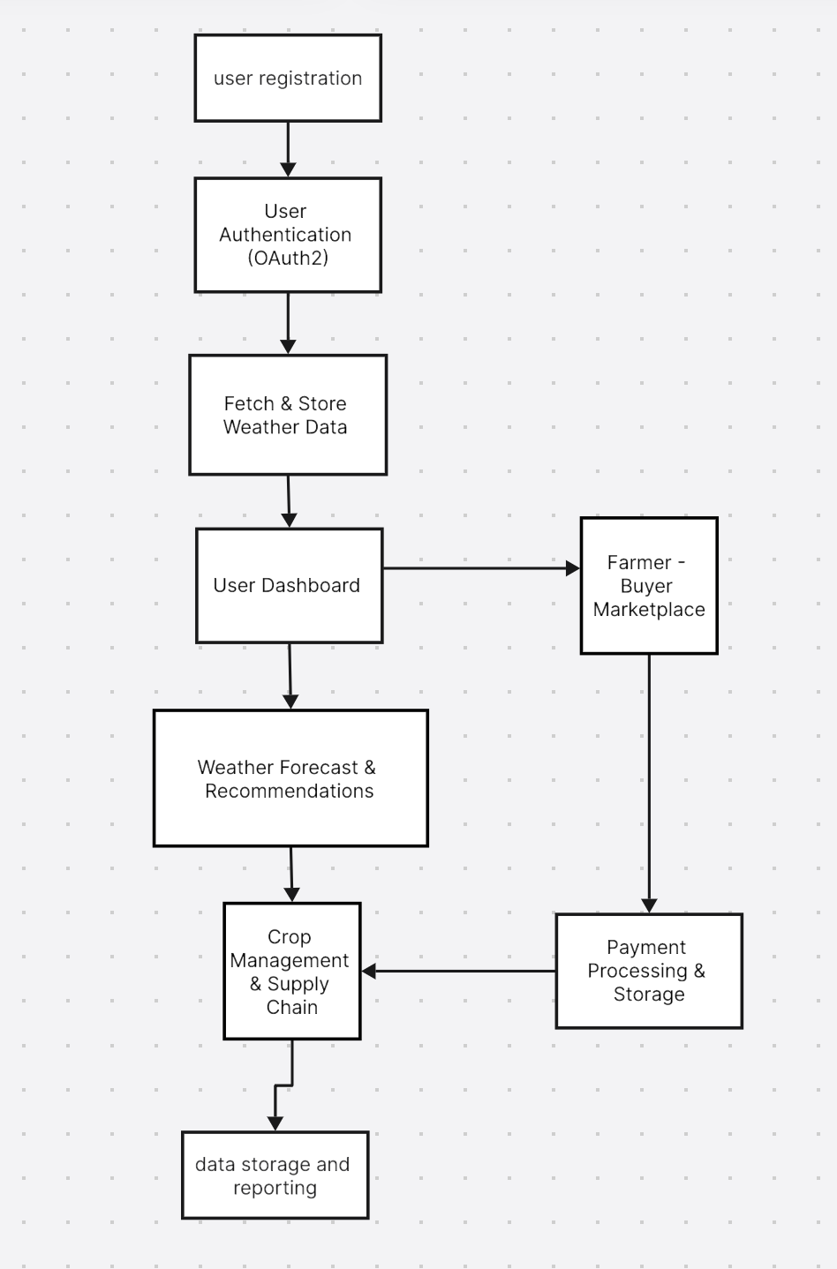

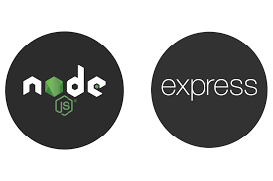



TECHNICAL APPROACH
FLOW CHART
TECHNOLOGIES USED

Slide 6
IMPACT AND BENEFITS
Potential Impact on the Target Audience
The AgriBoost platform is designed to significantly impact the lives of farmers, agribusinesses, and the broader agricultural community. The potential impacts include:
Improved Productivity: By providing real-time weather data, market prices, and tailored farming recommendations, farmers can make informed decisions, leading to better crop management and higher yields.
Increased Income: Direct market access through the platform allows farmers to sell their produce without intermediaries, ensuring they receive better prices. This increased income can lead to improved living standards and financial stability.
Reduced Post-Harvest Losses: The platform's supply chain management features help in tracking and optimizing the logistics of moving produce from farm to market, reducing waste and losses.
Enhanced Market Access: Farmers, especially those in remote areas, gain access to a wider market, allowing them to sell their produce to a larger and more diverse group of buyers, including businesses and end consumers.

Slide 7
USP (unique selling points)
Integrated Farming Solution:
AgriBoost is a comprehensive platform that combines precision farming, supply chain management, and direct market access. It’s a one-stop solution for farmers, eliminating the need for multiple disparate tools.
Direct Market Access:
AgriBoost connects farmers directly with buyers, removing intermediaries and ensuring farmers receive better prices for their produce. This direct access improves profitability and fosters transparency in the agricultural market.
Localized & Tailored Recommendations:
The platform offers tailored recommendations based on regional specifics, crop type, and local weather conditions. This ensures that advice and strategies are highly relevant to the farmer's unique circumstances.
Sustainability & Resource Optimization:
AgriBoost promotes sustainable farming practices by offering tools for precision agriculture. These tools help in optimizing the use of water, fertilizers, and pesticides, reducing environmental impact while improving yield.

Slide 8
Business Model
Freemium Model:
Free Tier: Basic access to essential features such as weather data, market prices, and general farming tips.
Premium Subscription: Advanced features, including personalized recommendations, detailed analytics, precision farming tools, and full access to the marketplace.
Transaction Fees:
Marketplace Commission: A small commission fee on each transaction made through the platform's marketplace, where farmers sell produce directly to consumers or businesses. This fee incentivizes the platform’s growth while remaining affordable for users.
Advertising and Promotion:
Targeted Advertising: Agricultural companies can advertise products and services directly to the platform’s users, generating additional revenue. The platform can leverage user data to offer highly targeted ad placements.
Sponsored Content: Premium content, such as in-depth farming tutorials or webinars hosted by experts, can be sponsored by companies interested in reaching the farming community.
Training and Support Services:
Premium Support: Offering paid support services, including personalized farm management advice, technical support, and training programs for using the platform’s advanced features.
Workshops and Training Programs: Conducting paid workshops and training sessions in collaboration with local agricultural institutions or experts to help farmers better utilize the platform and modern farming techniques.

Slide 9
THANKS!
TEAM NAME – MECHACODE
MEMBERS
vaibhav sharma
Aarush mangla
Yashika
Khushi panghal
Ayaan ali
Kundan bansal

