Slide 1

CaMPUS CART
Under Supervision of
Internal: Ashwini kumar External: Saransh Sharma
School of Engineering and Technology
Team Members: Ayaan Ur Rehman (2401560036)
Riya Srivastav (2401560047)
Harshvardhan Singh (2401560064)
Manish Yadav (2401560045)

Slide 2

Problem Statement
Despite the growing demand for digital convenience, many campus-based retail stores still operate without streamlined digital systems. This results in several pain points for students:
❌ Long wait times due to overcrowding, especially during peak hours.
❌ Inefficient checkout processes, leading to frustration and delays.
❌ Frequent payment failures caused by unstable in-store connectivity.
So, the limitations of delivery-focused e-commerce platforms underscore the urgent need for a practical alternative. Local campus stores require a cost-effective, efficient, and pickup based digital solution that meets the specific needs of students and small retailers alike.

Slide 3
OBJECTIVES
Develop a Flutter-based mobile app with a clean and user-friendly UI
Enable product browsing, cart management, and checkout.
Implement secure online payment integration using Razorpay.
Allow users to select pickup slots for hassle-free collection.
Ensure customers can order from home and complete payment online, avoiding network issues at the store.
Admin panel for store owners to manage products and orders.

Slide 4
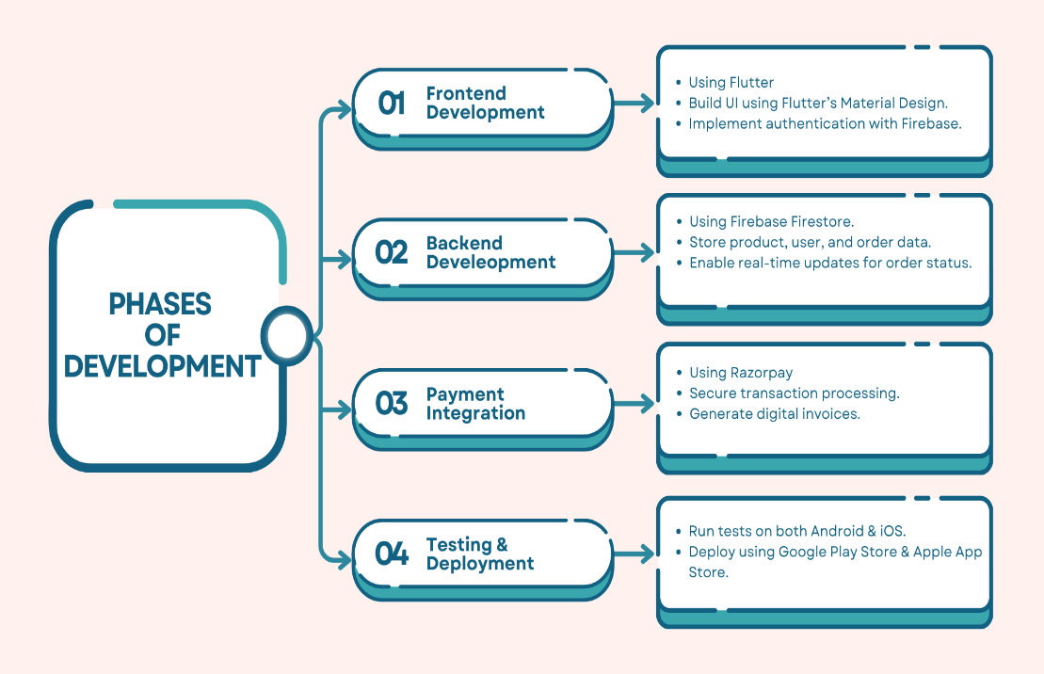
methodology

Slide 5
Key features of the project
Student-Centric Design: Simplifies shopping for college students and hostellers through a convenient, app-based platform.
Scheduled Pickups: Eliminates delivery dependency with campus-near pickup points, reducing costs and store congestion.
Secure Online Payments: Razorpay integration for seamless transactions and reduced wait times.
Flutter-Based UI: Clean, intuitive user interface built using Flutter with Firebase backend for real-time data sync.
Admin Panel: Store owners can easily manage products and monitor orders through a dedicated backend.
Order Management: Real-time updates and digital invoices provide transparency and reliability.

Slide 6
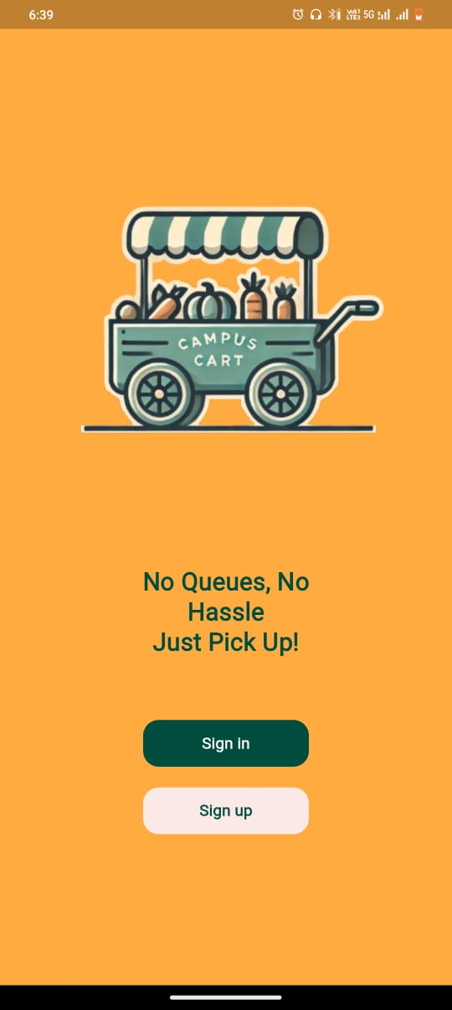
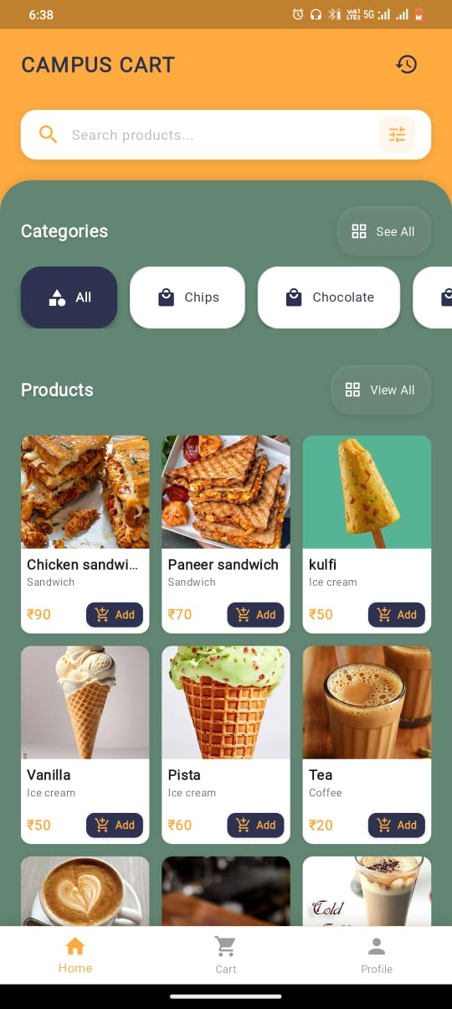
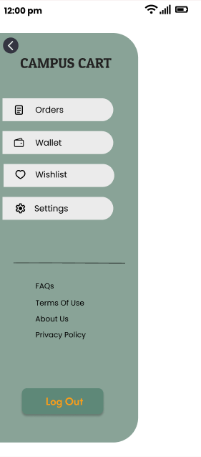
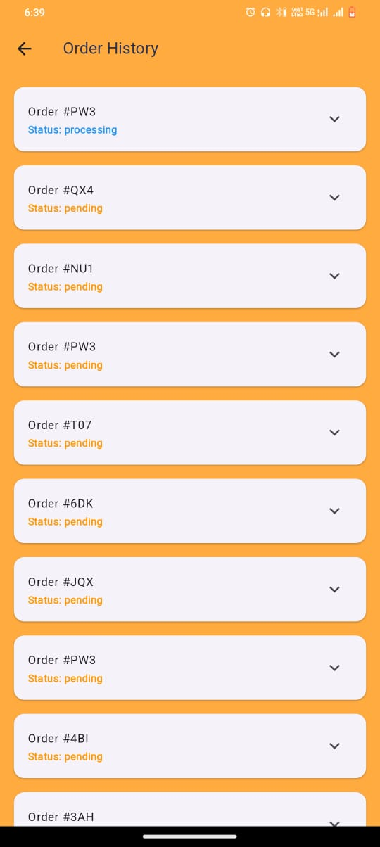
APP SCreenshots

Slide 7
Conclusion & Future work
Conclusion:
Campus Cart is a mobile-first, student-friendly solution that modernizes local shopping through scheduled pickups, group ordering, and secure digital payments. By leveraging Flutter, Firebase, and Razorpay, it delivers an efficient, low-cost alternative to traditional delivery systems.
Future Work:
Expand to support multiple stores and product categories.
Introduce AI-powered recommendation systems.
Enable digital wallet and loyalty point integration.
Enhance analytics for store performance insights.
Scale infrastructure for larger campus and city-wide implementations.

