Slide 1

KMC-SCHOOL PORTAL
This is a website based in html, css and javascript which helps students and teachers to manage there daly tasks easily. It has features for both students and teachers.

Slide 2
STUDENTS-AREA
Students area has mainly 3 features Timetable, Notices and homework. They can view their daily routine through timetable page , They can know about competition in school or any event in school through Notices page and they can know their homeworks through homework page. It has one more feature for parents to complain to class teachers or give feedback.

Slide 3
Features of Students Area.
Online homework viewing: Students can view their homework through kmc school portal.
Notice viewing: students can view notices online.
Timetable viewing: students can view their class routine online.
Parents complain: parents can give feedback online.

Slide 4
TEACHERS-AREA
TEachers area is designed for our teachers to manage their teaching life by providing time saving services like digital attendAnce , to do task manager , viewing their class routine, informing students about any group work or competition online.

Slide 5
FEATURES OF TEACHERS-AREA
Digital attEndance: Digital attendence helps teachers to do attendAnce online without calling students name loud.
Update notices- teachers can upload notices through their phone.
Send homework- teacher can send homeworks online.

Slide 6
Problem I saw.
Manual attendance: teachers have to always carry attendance register in first hour and they need to mark everybody present/absent for 10 minutes
Parent-teachers communication: Parents have to complain but sometime they don’t have time to go school office due to their office work.
Homework sending- students have to carry their diary daily if they forget they cant remember their homework.
Notice: school has to waste hunderds of paper to print notice.

Slide 7
Solution for this
Digital attendance: now teachers can mark present/absent to any students in just 1 minutes without screaming.
Digital parents communication: parents can write and send feedback to class teachers through our webpage.
Digital homework uploader and viewer: now teachers can use our digital homework service to upload homeworks without diary.
Digital notice: now by using kmc-school protal teachers can upload notices and students can view it by sitting in their home. School don’t have to waste papers.

Slide 8
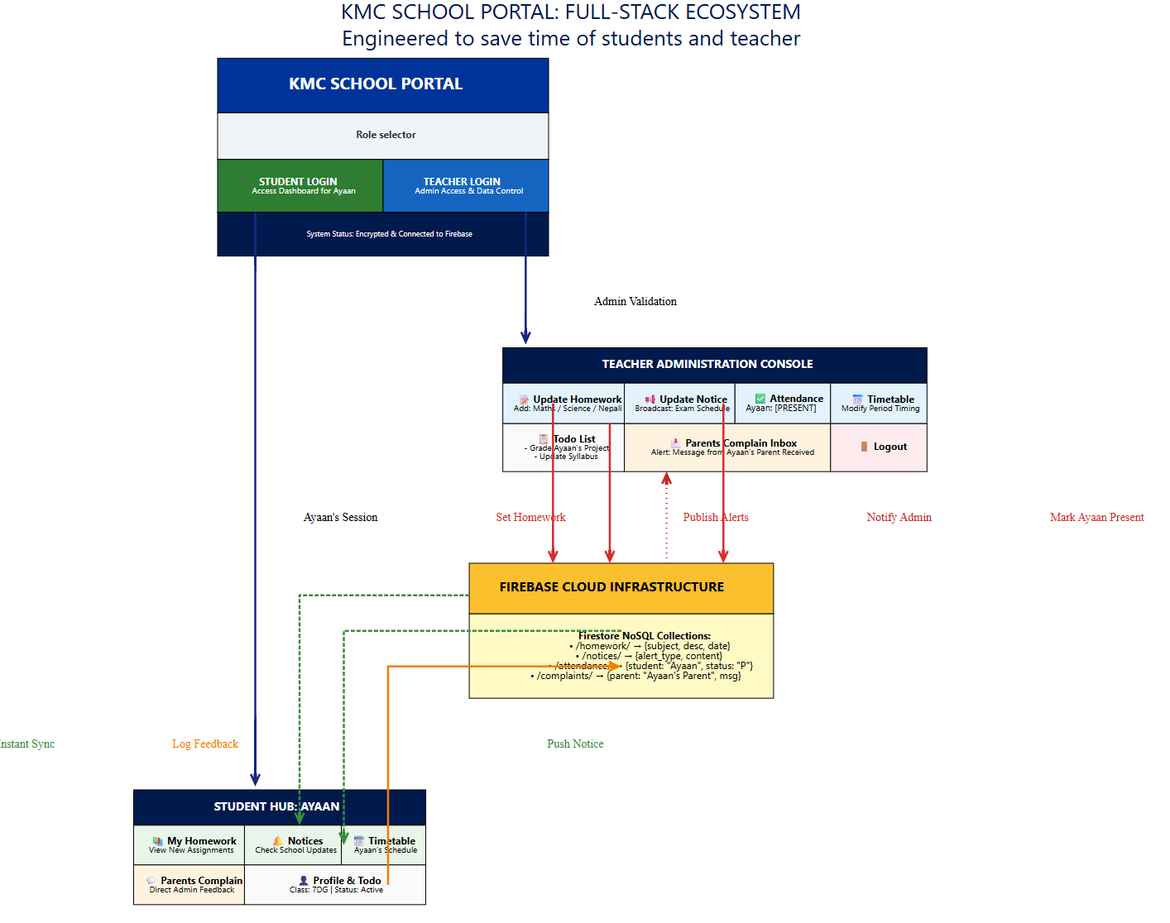
WIRE-FRAME DIGRAM

Slide 9
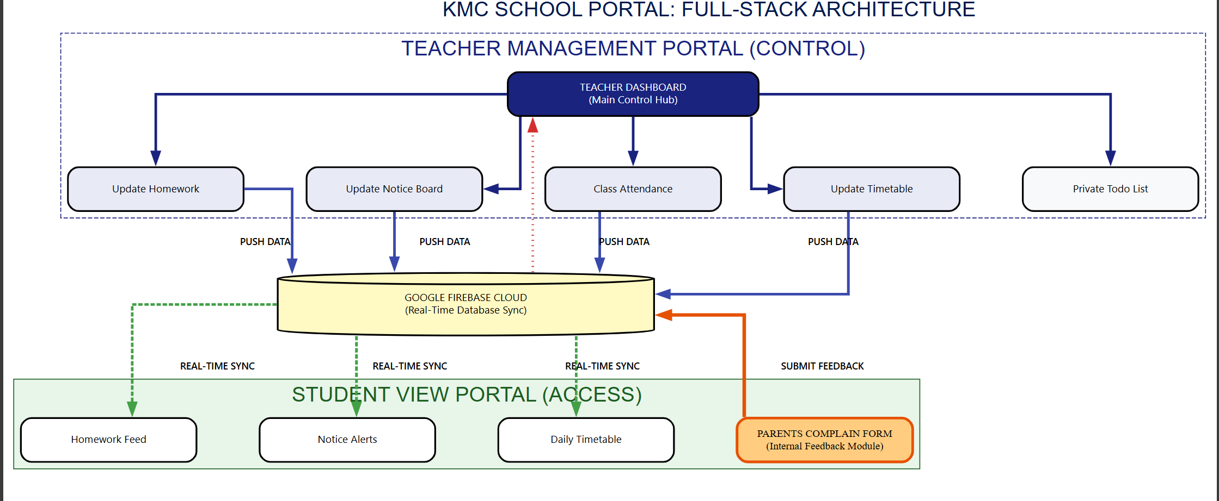
WORK -FLOW DIGRAM

Slide 10
THANKYOU

