Slide 1


Slide 2





Theme – Ed-Tech
Problem Statement Title- Real Time Collaboration in Virtual Learning Lab
Team ID -
Team Name - Reformers
Idea submission- Template
www.codecrax.com

Slide 3

· Provides a synchronized programming codespace with real-time IDE collaboration, instant mentorship guides,
and rapid AI-powered code suggestions with task requests & debugging
· Real‑Time Collaboration & Workflow: Share one Codespace link for simultaneous file/folder editing, in‑app chat/video,
task assignment & debugging, with granular access control for final code approval · Expert Mentorship & AI‑Driven Quality: Tap into an industry‑expert guide and AI bot for top‑tier code suggestions, plus
seamless Git/GitHub support to push production‑ready code
· Unique / Key Features:
· Video / Chat Conferencing · Access Control Distribution · Task Management · Git / Github Support · AI-Agent
Idea submission- Template
www.codecrax.com

Slide 4



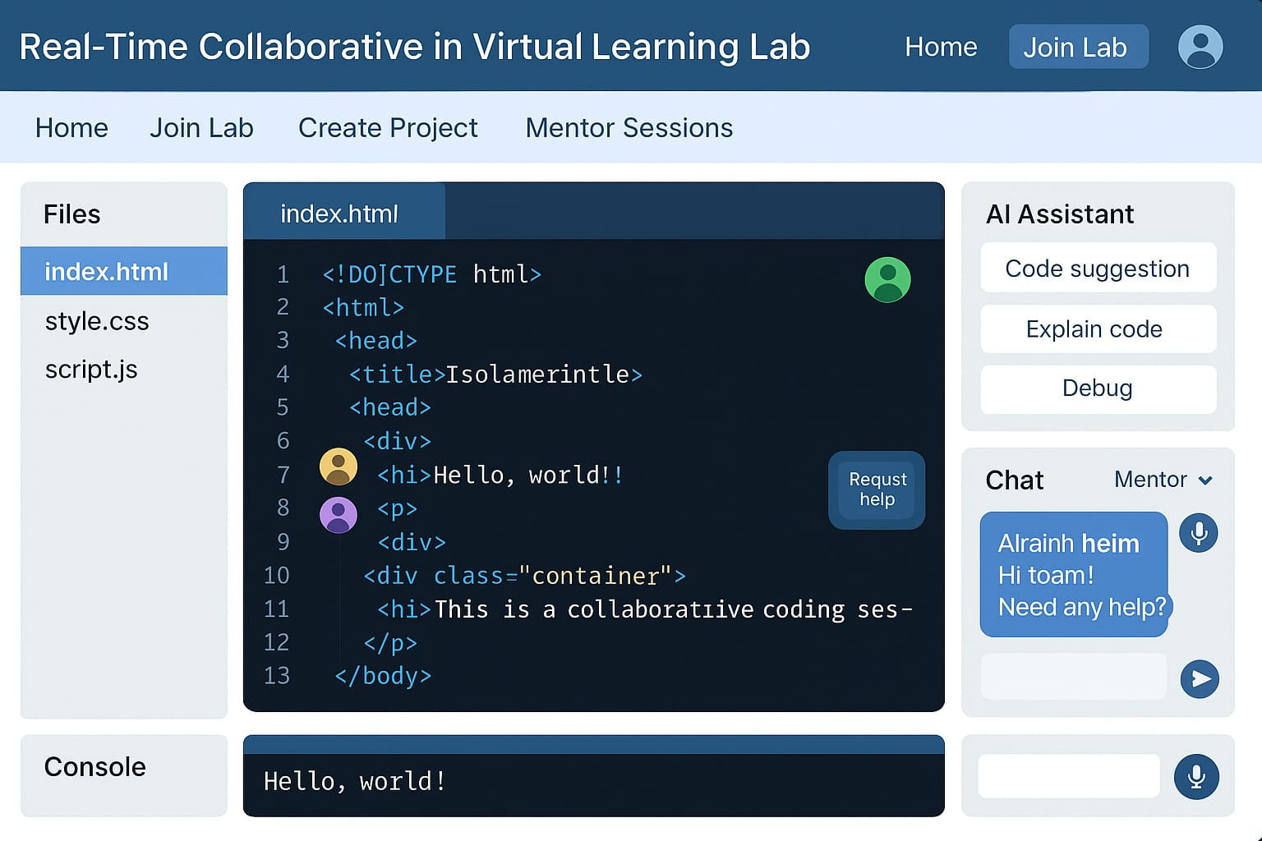







Component | Technology
Frontend
Backend
AI Assistance
API
Database & Auth
Idea submission- Template
www.codecrax.com

Slide 5
Feasibility
Challenges & Risks
Mitigation Strategies
Real‑time sync via
WebSockets + CRDT/OT
AI code hints through a
lightweight API call
Cloud‑hosted backend
for on‑demand scaling
Potential lag under heavy
load
AI suggestions may misfire
Matching students with
mentors asynchronously
• Auto Scale Servers and use
edge caching
• Continuous AI retaining with
user feedback
• Simple Mentor portal with
Slot booking and alerts
Idea submission- Template
www.codecrax.com

Slide 6
IMPACT
BENEFITS
Students: Instant peer‑to‑peer coding &
AI guidance
Educators: Live visibility into progress &
reduced grading load
Mentors: Flexible, asynchronous code
reviews
Social: Builds global, inclusive learning
communities
Economic: Cuts lab costs & accelerates
job readiness
Environmental: Eliminates commute &
shared cloud resources
LONG-TERM VALUE
Scalability: Cloud‑native, multi‑tenant architecture
Future Potential: AR/VR labs & corporate upskilling integration
Idea submission- Template
www.codecrax.com

Slide 7






Reference Models :-
Visual Studio Live Share https://visualstudio.microsoft.com/services/live-share/
Replit Teams for Education. https://replit.com/teams-edu
Codeshare.io https://codeshare.io
AI & Mentorship Integration :-
OpenAI Codex / GitHub Copilot https://openai.com/blog/openai-codex
Stack Overflow for Teams & MentorCruise https://mentorcruise.com/
Idea submission- Template
www.codecrax.com

