Slide 1


Slide 2

“HEALTHYMATE” ^{Your Handy Consultant}
MAKING HEALTHCARE SIMPLE AND ACCESSIBLE TO EVERYONE!!
Theme : Healthcare
Problem statement title : Lack of immediate symptom analysis, doctor access, and emergency support leads to delayed healthcare actions, increasing risks during medical emergencies
Team ID :
Team Name : Krish Verse
Members : krish bagri, krish kanojia, krish lala, krish keswani.
www.codecrax.co
m

Slide 3
BASIC IDEA
WELCOME TO HEALTHYMATE!!!
- Predicts diseases on the basis of entered symptoms and past medical problems
- Locates nearby doctors in the town and provide their reviews
- Provides first-aid and reminders for curing the problem
- Provides Emergency helpline numbers
Overview : An AI-powererd app that predicts diseases, connects users to doctors, provides first-aid help, and assists during emergencies – making healthcare smarter, faster, and more accessible.
Idea submission-
efficient recycling.
www.codecrax.co
m

Slide 4

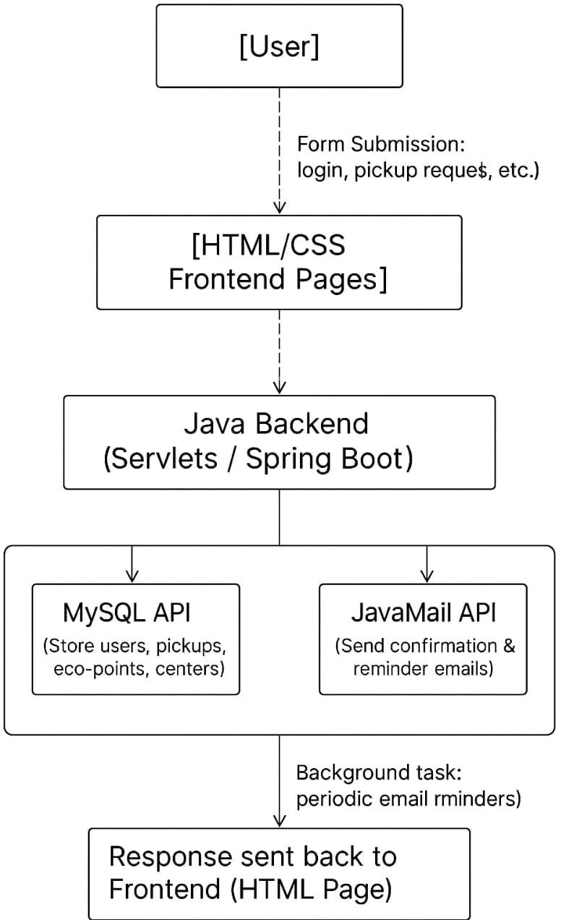

Process Flow:
Technologies Used:
Frontend: HTML, CSS, JS;
Backend:
Java(Servlets / Spring Boot), ScheduleExecutorServer, React Native, Flutter, Node.js, Python;
API’S:
JavaMail API, Google Maps API (for locating doctors) Health APIs (for symptom checking)
Database: MySQL, JDBC
Methodology:
Symptom input ➡ML prediction ➡ Doctor location ➡ Emergency help.Approach: Agile, User-Centric Design, Data-driven improvements.
www.codecrax.co
m

Slide 5

Feasibility : High: Uses existing technologies, APIs, and scalable databases. Mobile-first makes it easily adoptable even in rural areas with smartphones.
Challenges & Risks : - Data Privacy & Security
- Accurate Symptom Prediction
- Doctor Availability
- Network Issues in Rural Areas
Mitigation Strategies : - Secure encryption for health data - Continuous ML model updates - Partnering with verified doctors - Offline Mode for basic services
www.codecrax.co
m

Slide 6
Target Audience Impact:
- Faster healthcare access - Life-saving emergency help - Greater healthcare literacy - Bridging rural-urban healthcare gap
Key Benefits:
24/7 Health Companion - Predictive Healthcare Support - Easy Doctor Access
Long-Term Value:.
- Transforming proactive healthcare - Scalable to global use - Enabling AI-driven, preventive medical systems
www.codecrax.co
m

Slide 7

WHO Symptom Database, Open Health Data repositories
Development Tools: React Native, Flutter, Node.js, Python Flask
Database Services: Firebase, SQLite
APIs Used:
Google Maps API (for locating doctors)
Health APIs (for symptom checking)
AI/ML Libraries: TensorFlow Lite, scikit-learn
Design: Figma, Adobe XD
www.codecrax.co
m

