Slide 1


Slide 2



BUG BUSTERS
Theme – ED-TECH
Problem Statement Title- AI-Based Question Generator for Personalized Learning
Team ID - (As per Unstop registration)
Team Name –BUG BUSTERS
Idea submission- Template
www.codecrax.com

Slide 3

.
.
.
BUG BUSTERS
Solution Overview: An AI tool that instantly generates MCQs from provided materials, enabling effective self-testing and revision for students. It works in real time, reducing teachers' administrative tasks.
Problem-Solving: Students lack personalized quizzes, leading to ineffective revision, while teachers spend excessive time on manual tasks. This tool solves both issues with fast, intelligent quiz generation.
Innovation: Instant question generation from a single text input, customizable by difficulty, type, and subject—accessible directly via web browser with no downloads needed.
Idea submission- Template
www.codecrax.com

Slide 4

BUG BUSTERS
Technologies Used: Frontend: Style and Structure with HTML, CSS, JavaScriptBackend/API: Using OpenAI GPT API or HuggingFace Transformers
Methodology: User submits a topic or notes, which the app sends to GPT to generate questions and answers. Questions appear one by one, and the quiz can be saved, reattempted, or shared.
Process Flow: User inputs a topic or notes, which are sent to the GPT API to generate questions and answers. The quiz is displayed interactively, with options to save, reattempt, or share.
Idea submission- Template
www.codecrax.com

Slide 5
.
BUG BUSTERS
.
Feasibility: Technically feasible using existing GPT APIs and web technologies; requires minimal infrastructure to build and scale.
Challenges & Risks: Challenges include ensuring content accuracy, managing data privacy, and dependency on GPT APIs. Adoption resistance and scalability can also pose risks.
MITIGATING STRATEGIES- Mitigate risks with content review, secure data handling, cost control, training etc.
Idea submission- Template
www.codecrax.com

Slide 6
.
BUG BUSTERS
Target Audience Impact: The impact includes improved student learning, reduced teacher workload, and enhanced educational efficiency
Key Benefits: Key benefits include personalized learning, efficient self-assessment, time-saving for teachers, and easy accessibility without downloads.
Long-Term Value: Sustained personalized learning, improved student outcomes etc.
Idea submission- Template
www.codecrax.com

Slide 7

BUG BUSTERS
OpenAI API docs: https://platform.openai.com/docs
HuggingFace Transformers: https://huggingface.co/docs
Idea submission- Template
www.codecrax.com

Slide 8
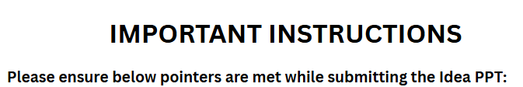
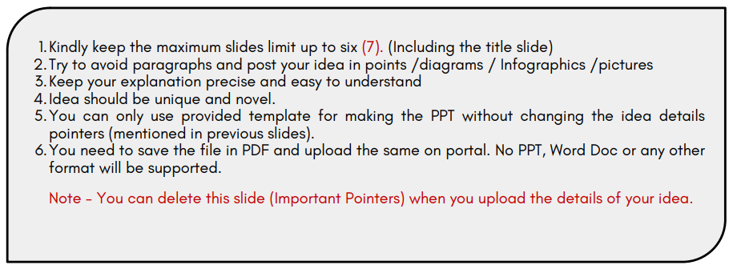
Kindly keep the maximum slides limit up to six (7). (Including the title slide)
Try to avoid paragraphs and post your idea in points /diagrams / Infographics /pictures
Keep your explanation precise and easy to understand.
Idea should be unique and novel.
You can only use provided template for making the PPT without changing the idea details pointers (mentioned in previous slides).
You need to save the file in PDF and upload the same on portal. No PPT, Word Doc or any other format will be supported.
Note - You can delete this slide (Important Pointers) when you upload the details of your idea.
Idea submission- Template
www.codecrax.com

