Slide 1
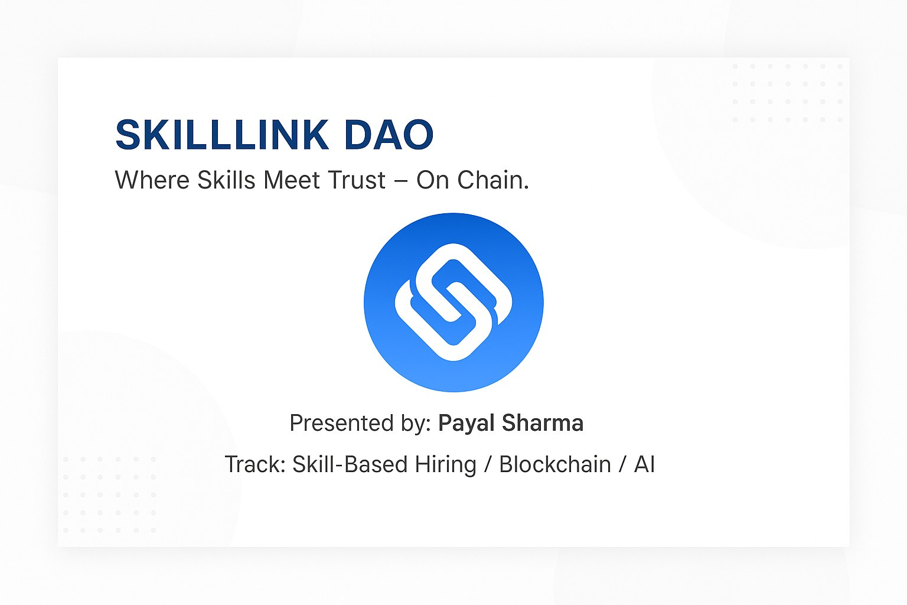

KRATOS
SKILLLINK DAO
Presented By- Team KRATOS
Theme: ED Tech

Slide 2

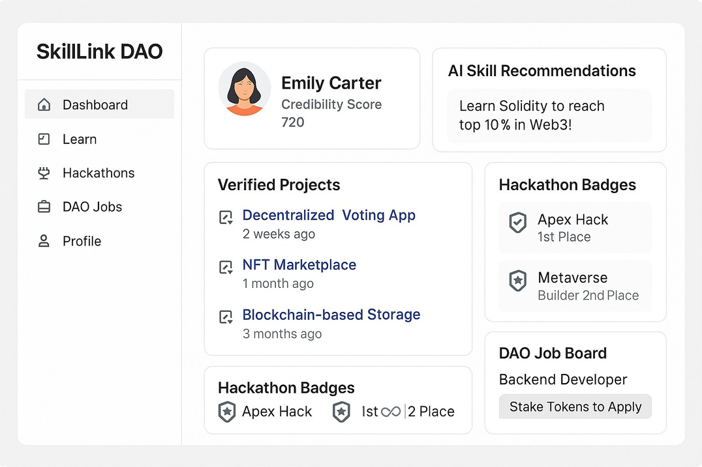
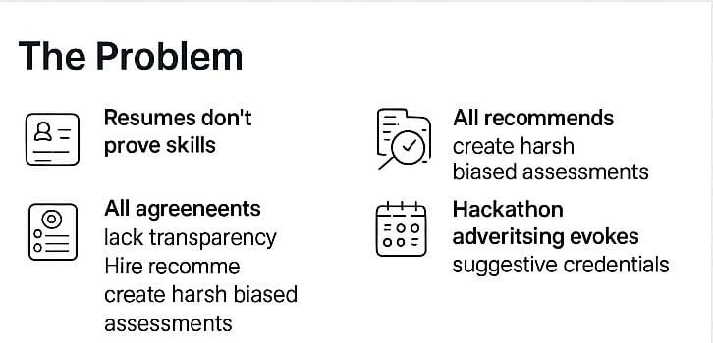
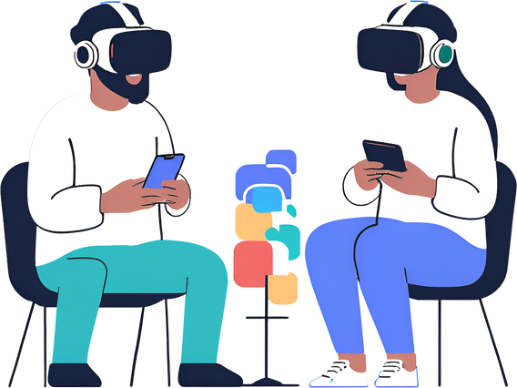
KRATOS
PROFILE OVERVIEW
Theme - EdTech
Team ID -
Team Name - KRATOS
PROBLEM STATEMENT:
-Personalized learning platforms and Gamification of education: Tailored learning experiences to individual needs and preferences, making education more engaging and effective.
Idea submission- Template
www.codecrax.com

Slide 3
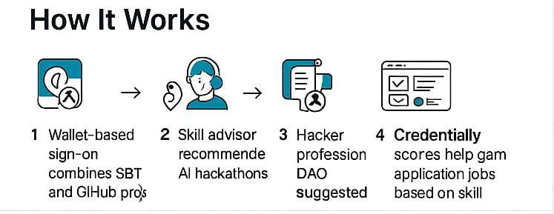
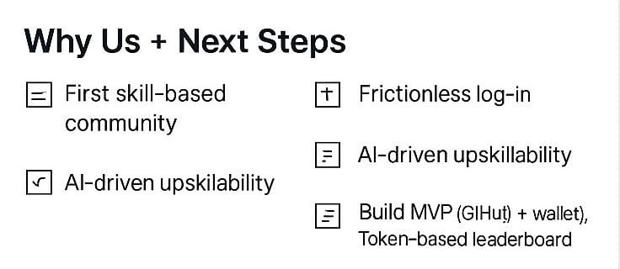
KRATOS
SkillLink DAO
SkillLink DAO is a decentralized, AI-powered platform that revolutionizes hiring by validating skills through on-chain credentials and a transparent reputation system.
🎯 Our Idea:
A DAO-based ecosystem for
VR/2D learning
GitHub-verified projects
Hackathon integration
SBT credentials
Idea submission- Template
www.codecrax.com

Slide 4

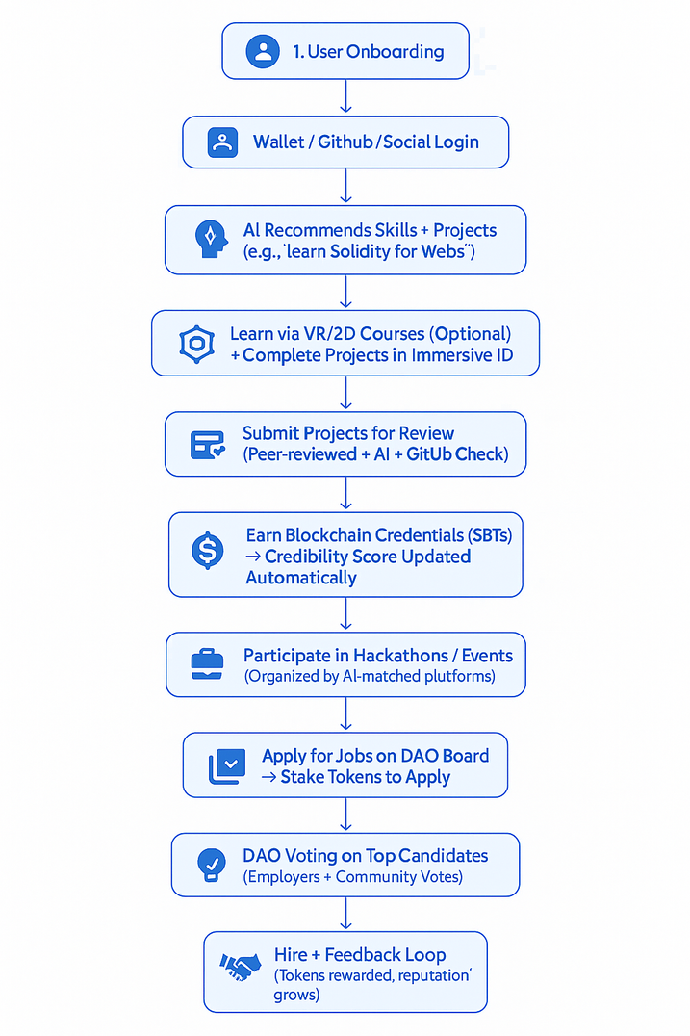
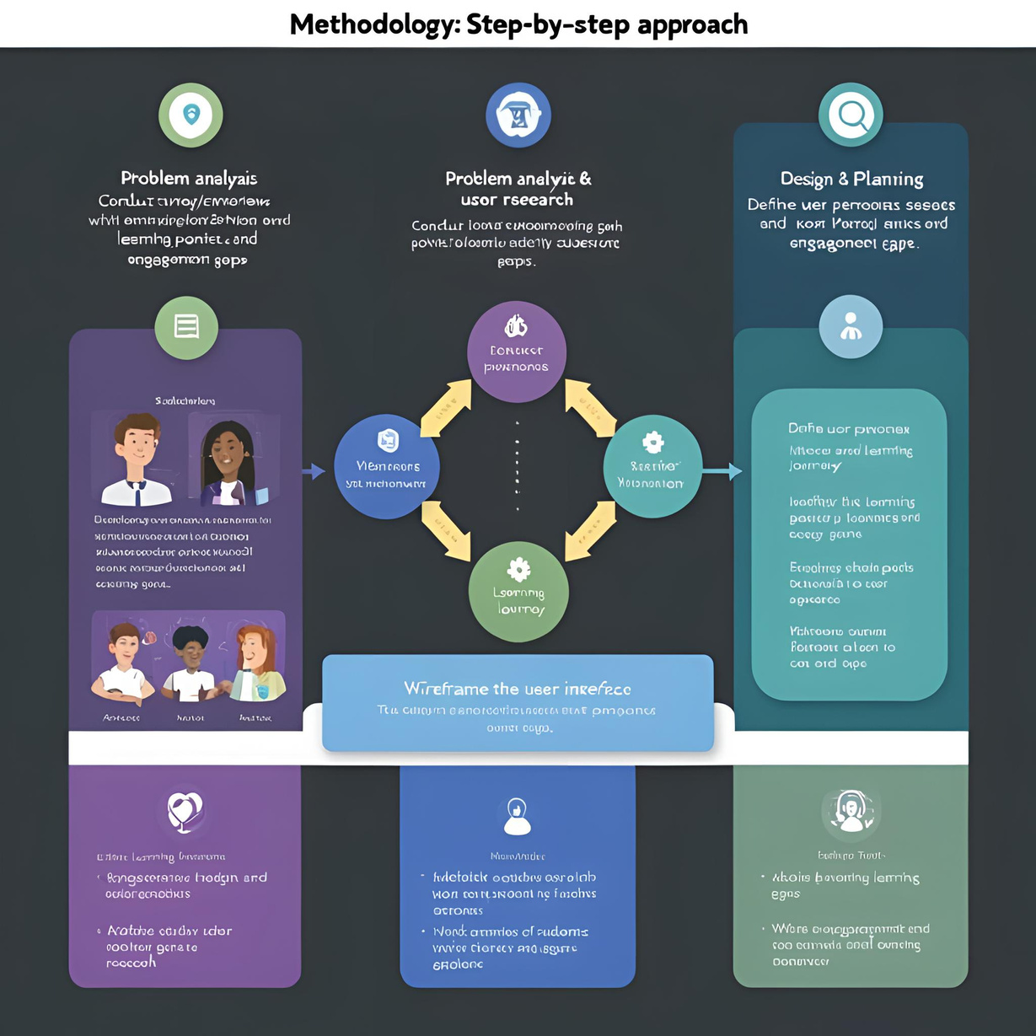
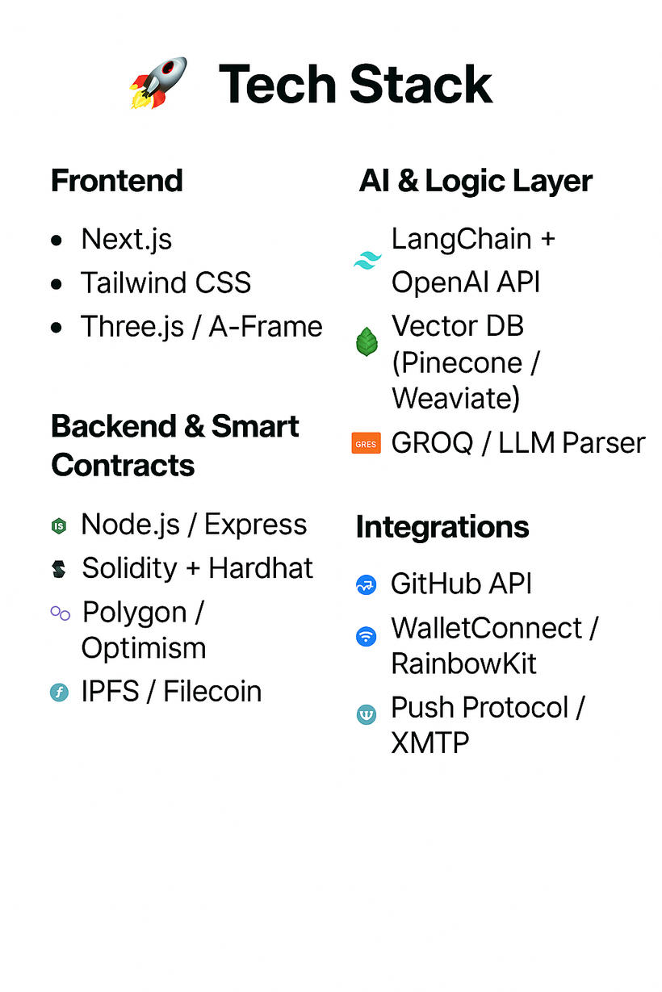
KRATOS
Idea submission- Template
www.codecrax.com

Slide 5
KRATOS
FEASIBILITY AND VIABILITY
Mitigation Strategies
Challenges
& Risks
Feasibility
Uses existing tech: Web3, GitHub, AI, VR/2D interfaces
Modular architecture for smooth integration
Scalable via DAO governance & token economy
Easy UX: Social login + embedded wallets
Project Validation Layer: AI + Peer reviews + GitHub repo scoring
DAO Incentives: Token rewards for voters & validators
Adoption Resistance: Users unfamiliar with wallets/blockchain
On-Chain Spam: Risk of fake submissions/projects
DAO Governance Complexity: Low voter participation or bias
Idea submission- Template
www.codecrax.com

Slide 6
KRATOS
Learners: Earn real credibility through on-chain projects & AI-guided upskilling.
Employers: Discover verified talent faster, reduce hiring noise.
Communities/DAOs: Build stronger ecosystems with transparent skill validation.
Social: Democratizes access to global job markets.
Economic: Reduces hiring costs & boosts employment based on merit.
Environmental: Promotes remote-first, skill-based work—less travel, more efficiency.
Scalable DAO Governance: Grows with community voting, not central control.
AI + Blockchain Synergy: Adapts to job trends, builds the future of skill identity.
Global Talent Grid: Creates a borderless, trustless skill economy.
👥 Target Audience Impact
🌱 Key Benefits
🚀 Long-Term Value
Idea submission- Template
www.codecrax.com

Slide 7
KRATOS
THANKYOU
Docs we Following:
Team Members:
https://ethereum.org/en/developers/docs/
Shatakshi Gupta
Payal Sharma
Anamika Mishra
Amisha Patel
https://solana.com/docs
and more....
Idea submission- Template
www.codecrax.com

