Slide 1

Agroverse

Slide 2




Theme – AGRICULTURE AND RURAL DEVELOPMENT
Problem Statement Title- AgroVerse: A Smart Web Platform for Renting Agricultural Equipment.
Team ID - …..
Team Name – HackBuddy
www.codecrax.com

Slide 3
PROPOSED IDEA
Problem Statement :
Solution :
Many farmers face high costs in purchasing and maintaining agricultural equipment, making it difficult to access necessary tools for farming.
Small-scale farmers often struggle with limited access to modern machinery, leading to inefficiencies and lower productivity.
The lack of centralized rental platforms and limited services in rural areas further adds to their challenges, reducing efficiency and overall profitability.
Rural areas often have limited access to equipment rental services, leaving farmers without affordable and convenient options.
Develop a web application that facilitates the rental and tracking of agricultural equipment, such as tractors, harvesters, and plows, ensuring that these tools are affordable, transparent, and easily accessible to farmers.
With features like real-time tracking, flexible rental durations, and transparent pricing, the platform will allow farmers to access high-quality equipment on-demand without the upfront cost of ownership..
www.codecrax.com

Slide 4
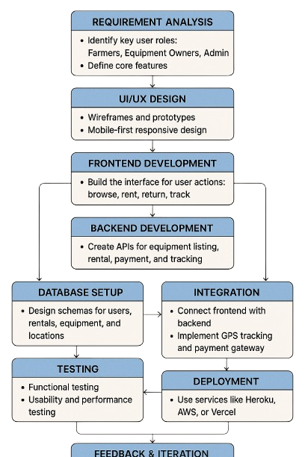
TECHNICAL APPROACH
🔧 Frontend
HTML / CSS / JavaScript – Base structure and interactivity
React.js – For building fast, reactive UI.
Tailwind CSS – Utility-first CSS framework for responsive design.
Mapbox / Leaflet – Real-time map tracking and geolocation display.
⚙️ Backend
Node.js – JavaScript runtime for server-side logic
Express.js – Lightweight web application framework
REST APIs – For client-server data communication
JWT (JSON Web Tokens) – Secure authentication for users.
🗃️ Database
MongoDB – databases for storing users, equipment, and rentals
Firebase (Realtime Database) – For instant data syncing (e.g., live equipment tracking or booking updates)
www.codecrax.com

Slide 5
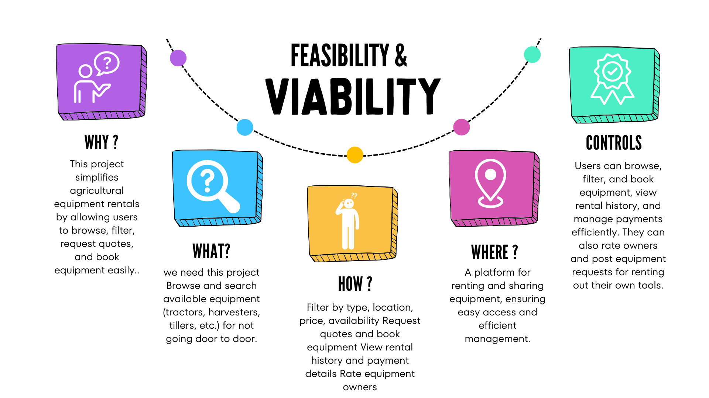
www.codecrax.com

Slide 6
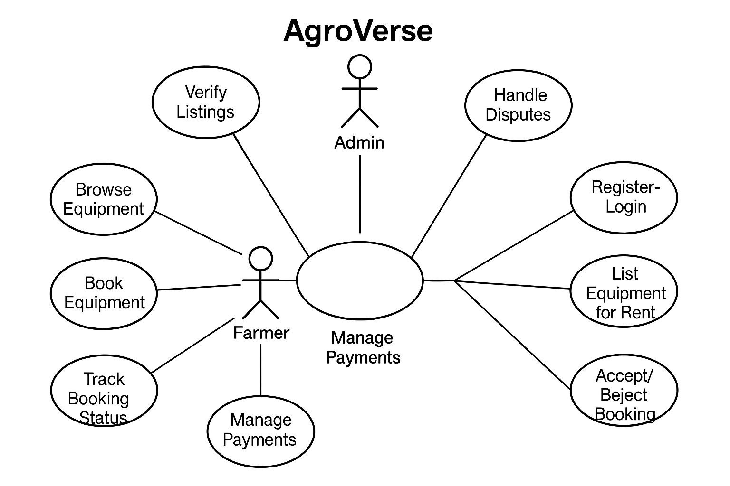
IMPACTS BENEFITS AND WORKFLOW OF PROJECT
Long-Term Value
Scalability & future potential
Platform can expand to new regions.
Add features like predictive maintenance, smart contracts.
Supports sustainable and inclusive agricultural growth.
Target Audience Impact
Who benefits & how?
Farmers gain access to equipment without high upfront costs.
Equipment owners earn from underused machinery.
Admins monitor and manage system efficiency.
Key Benefits
Social, economic, environmental advantages
Social: Community collaboration and trust.
Economic: Cost-effective farming, additional income streams.
Environmental: Reduced equipment redundancy, shared usage lowers emissions.
www.codecrax.com

Slide 7

Future Scope & Revenue
Project Demo :
Revenue Generation
As a Farmer : link
As an Owner : link
As an Admin : link
Rental fees (%)
Subscription Plan
Advertisement Revenue
Future Scope:
Collaboration with Agricultural Startups and NGOs
Integration with IoT and Smart Farming Tools
Track vehicle by Map tracking System
Voice recognition & Native languages
www.codecrax.com

