Slide 1
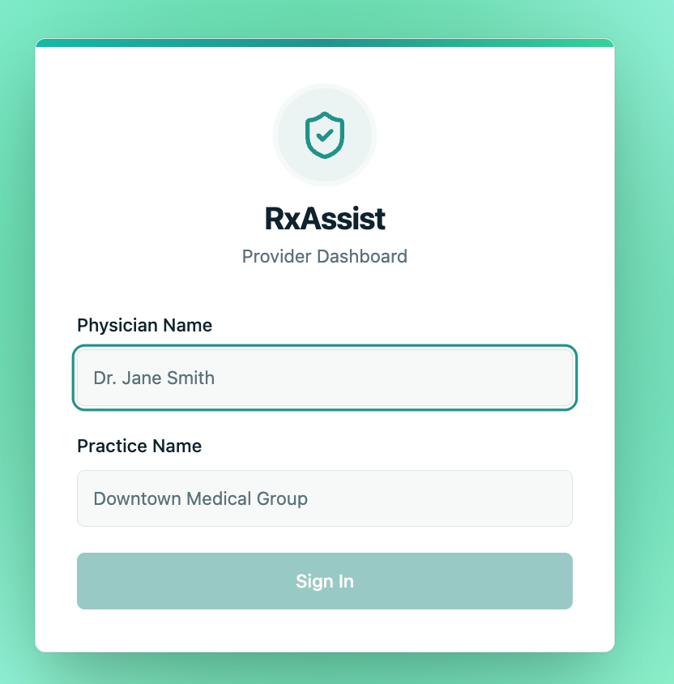

RxAssist
Unified platform combining formulary data, patient records, and AI to streamline coverage review and prior authorizations, so patients get the medications they need without delays or surprises.
HEALTHCARE IT
PRIOR AUTHORIZATION
FORMULARY INTELLIGENCE
Fasi Ullah Khan Mohammed Ayaan Ehsan Mohammed

Slide 2
Who does RxAssist Support
Providers
Patients
How ?
How ?
- Quick Look-up.
- Personalized Prior Auth Drafted.
- Save Cost
- Auto Notify Patients on all Med’s

Slide 3
The Problem RxAssist Solves
Even when a provider knows exactly which medication a patient needs, operational barriers slow treatment down. Coverage workflows are fragmented across disconnected tools and manual lookups.
Is the drug in the formulary?
What tier is it on?
No unified lookup - staff bounce between payer portals and internal spreadsheets.
Tier placement directly determines patient cost, but it changes without notice.
Is prior auth required?
What goes in the PA request?
PA, and quantity limits are buried in spreadsheets and plan-specific documents.
Drafting takes time - clinical notes, diagnosis, failed therapies, plan identifiers. Reasonings for PAs are not the same.

Slide 4



How RxAssist Is Structured
Three distinct layers, each with a clear, non-overlapping role - work together to take raw insurance data all the way to a provider-ready authorization draft.
ETL/
Prepares and loads formulary, plan, and cost data into Supabase
app/
FastAPI backend - powers personalized prior authorization drafting support, detects drug tier changes, answers coverage-related queries and plan requirements explain.
front_end/
React + TypeScript provider dashboard, the full workflow in one place

Slide 5
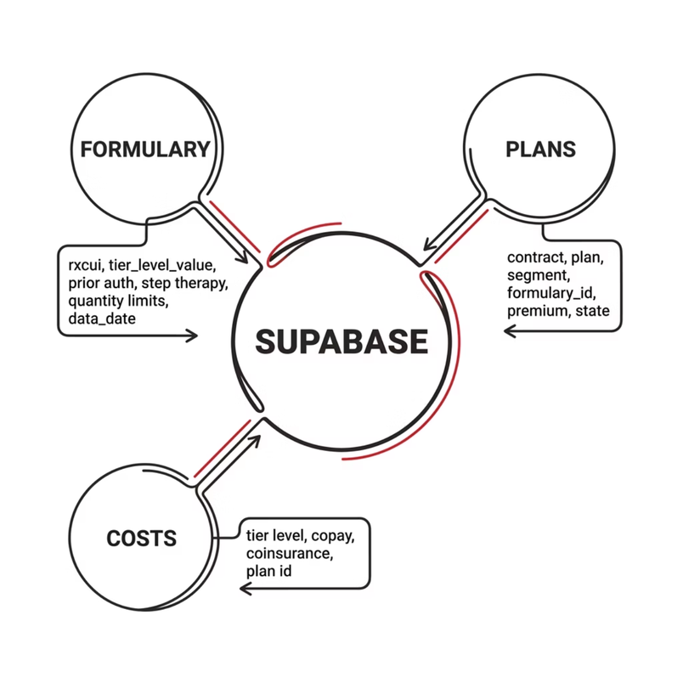

The Data Foundation: ETL Layer
The ETL layer is the backbone. The backend can only answer formulary questions if the underlying data has already been cleaned, shaped, and loaded into Supabase. Three core tables power all downstream logic.
formulary
plans
costs
rxcui, tier level, PA flags, step therapy, quantity limits, data_date
contract, plan, segment, formulary_id, premium, deductible, state
Cost-sharing details by plan and tier — connects tier changes to real patient dollars

Slide 6




Backend: Where the Logic Lives
The FastAPI backend connects Supabase, RxNav, , and Gemini into one reasoning pipeline. It is not only a data server — it assembles clinical and insurance context into structured, actionable outputs.
Formulary Lookup
Coverage Rules
Matches a drug name to RxCUI values via RxNav, then narrows results to the patient's specific formulary_id.
Returns tier level, prior auth requirements, step therapy flags, and quantity limits, not just a yes/no.
PA Draft Generation
Tier Change Detection
Sends Provider and Patient clinical data from EHR to AI, generating a ready to use complete PA letter in Markdown.
Compares formulary snapshots across two dates — surfaces medications that moved tiers between billing cycles.

Slide 7
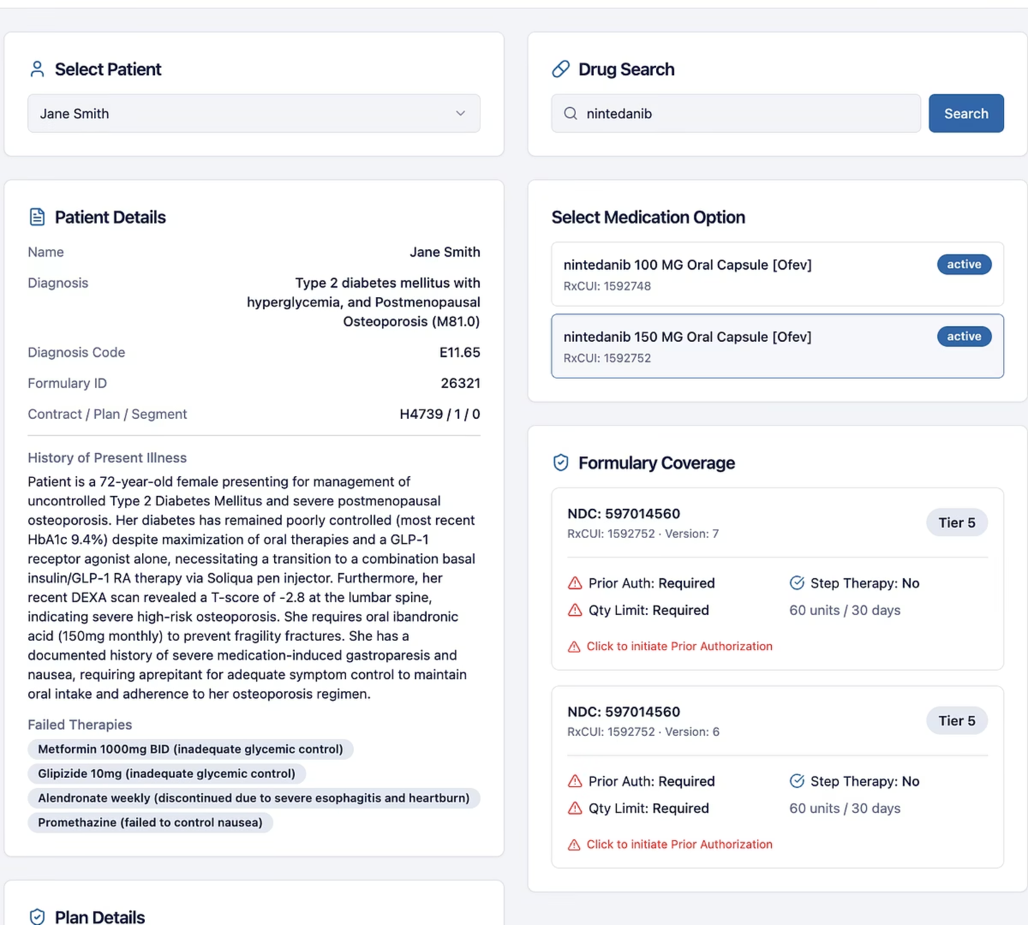

The Provider Workflow
The frontend turns backend capabilities into a guided, step-by-step experience. Every action is contextualized by patient and plan data, no switching between tools.
Provider Login
Select Patient
Load Plan
Search Drug
The dashboard surfaces patient diagnosis, clinical notes, and coverage rules at every step, so the provider always has context before taking action.

Slide 8
Secure AI + Ease of AI use
PII - Personally Identifiable Information.
PII Masking instead of Hosting a model it etc..

Slide 9
Market
Mass market.
Affordable (not only major EHRs)
PBM
Adaptable floats over any EHR.

Slide 10
Quantify - Improvements
50% lesser clicks to providers

Slide 11
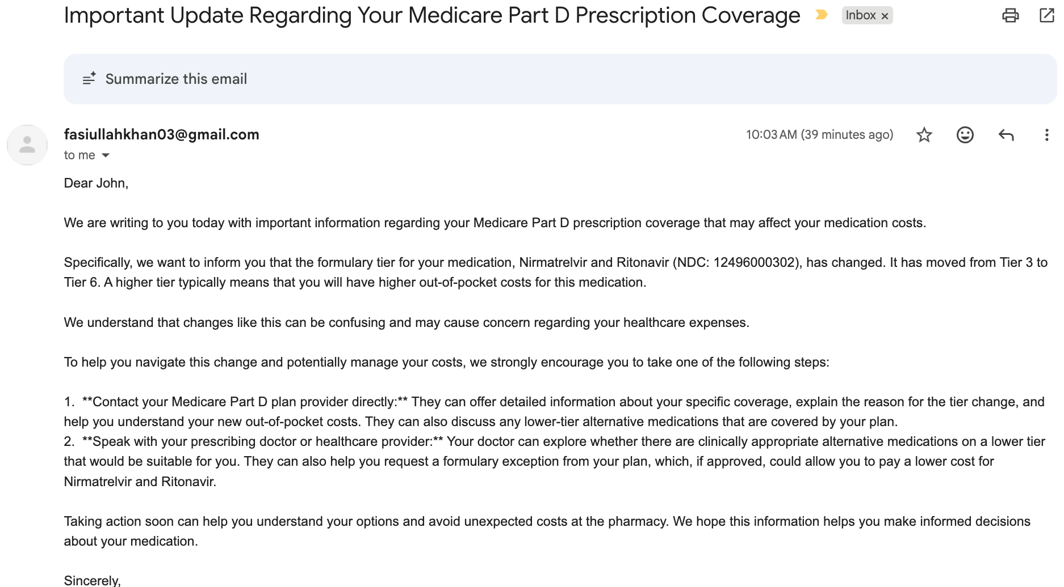
Patient Alerts

Slide 12
Formulary Tier Change Detection
A medication's tier can change between plan years or mid-cycle, raising a patient's out-of-pocket cost without any change to the drug itself. RxAssist auto compares formulary every week and flags any tier movements.
Example API Response
rxcui: 617314
Why It Matters
old_tier: 2 → new_tier: 4
A drug moving from Tier 3 → Tier 6 can mean hundreds of dollars per refill
Early detection gives patients and providers time to respond before the next fill
To avoid unexpected medication costs
dates: 2025-01-01 to 2025-04-01
message: Medication moved to a higher tier and may now cost more.

Slide 13
Patient Value: Proactive Intervention
RxAssist is not just a data comparison tool. When a tier change is detected early enough, patients and care teams can act before the next refill becomes a surprise cost event.
01
02
Detect the Change
Alert the Care Patient
Tier shift identified across formulary snapshots before the next fill date
Patients can be notified via email, context already assembled, no manual lookup needed.

Slide 14
References –
- https://data.cms.gov/provider-summary-by-type-of-service/medicare-part-d-prescribers/monthly-prescription-drug-plan-formulary-and-pharmacy-network-information
- https://github.com/dariusk/corpora/blob/master/data/medicine/drugs.json
- https://rxnav.nlm.nih.gov/REST/drugs.json?name=Metformin
- https://rxnav.nlm.nih.gov/REST/rxcui/1592748.json

