Slide 1

Clinicians Unchained
An autonomous AI workflow engine that resolves prescription issues without clinician intervention

Slide 2

The Administrative Burden Crisis
Clinicians spend a significant portion of their day resolving administrative issues rather than providing patient care. One of the most time-consuming and frustrating tasks is handling unfilled prescriptions, which often require repeated phone calls to pharmacies and insurance providers.
These interruptions contribute directly to clinician burnout, delayed treatment protocols, and compromised patient outcomes. The current system forces highly trained medical professionals to act as administrative coordinators.

Slide 3
Current Workflow Pain Points
Excessive Phone Time
Manual Follow-Up
Clinicians spend 30+ minutes per day navigating IVR systems and waiting on hold with insurers and pharmacies
Multiple touchpoints required to track prescription status across fragmented systems
Medication Delays
Fragmented Communication
Patients wait days for essential medications due to authorization bottlenecks
No integrated platform connects pharmacy, insurer, and clinical systems

Slide 4
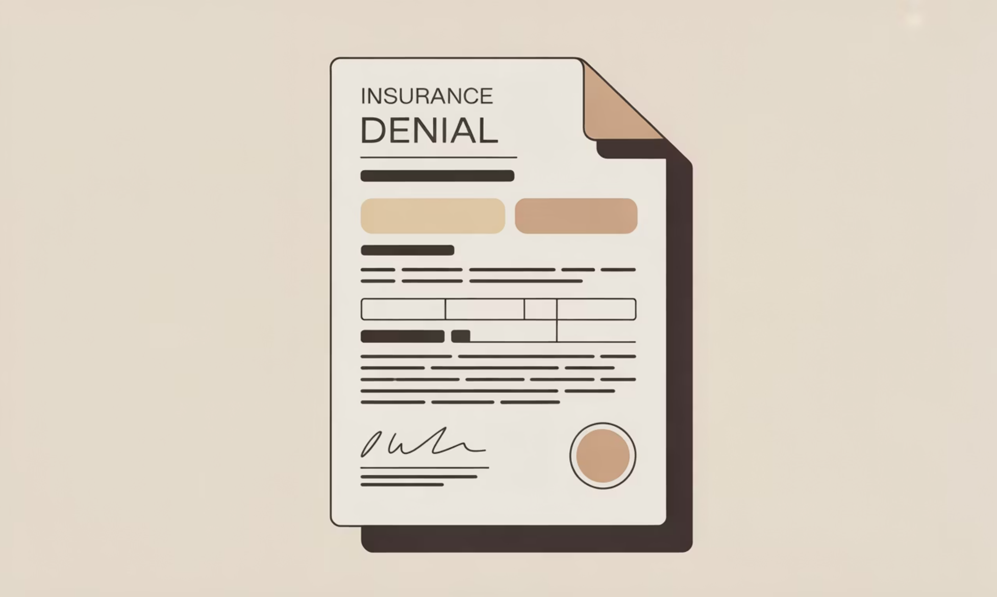
Prescription Fulfillment Failures
Common Failure Causes
Insurance claim denials requiring justification
Prior authorization requirements not submitted
Formulary mismatches between prescribed and covered medications
Pharmacy stock availability issues
Missing patient eligibility verification

Slide 5

The Clinicians Unchained Solution
An agentic AI workflow engine that autonomously resolves prescription issues without requiring clinician involvement. The system deploys intelligent agents capable of calling pharmacies and insurers, navigating IVR systems, understanding responses, and taking appropriate corrective actions.
These autonomous agents function as 24/7 administrative assistants, handling the entire prescription resolution workflow from initial rejection to fulfillment confirmation.

Slide 6

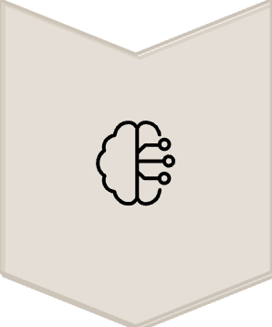


Core Technical Architecture
Autonomous Voice Agents
AI-powered calling system with speech recognition and natural language understanding for human-like conversations
Prescription Intelligence Engine
Analyzes rejection reasons using NLP and determines optimal corrective actions based on context
Insurance Policy Reasoning
Understands formulary rules, prior authorization logic, and coverage policies across payers
Clinician Notification System
Only escalates cases requiring medical judgment or complex clinical decisions

Slide 7

Key Features in Detail
Intelligent Call Routing
Document Processing
Alternative Recommendations
Automatically identifies correct department and navigates complex IVR menus using learned patterns
Extracts required information from patient records and formats for insurer submission
Suggests formulary-appropriate medication alternatives when original prescription cannot be approved

Slide 8
Real-Time Workflow Example
01
02
Prescription Rejection Detected
Insurance Call Initiated
System automatically flags insurance denial during claim submission
AI agent calls payer, navigates IVR, and connects to appropriate representative
03
04
Reason Identification
Authorization Submitted
Agent queries denial code and obtains detailed explanation for rejection
Required clinical documentation gathered and prior authorization request processed
05
06
Pharmacy Coordination
Confirmation Delivered
Updated claim status communicated to pharmacy with expected fulfillment timeline
Patient notified and clinician receives completion summary
Total elapsed time: 8-15 minutes | Clinician involvement: 0 minutes

Slide 9

Transformative Impact
85%
24/7
3x
100%
Time Savings
Continuous Operation
Faster Resolution
Compliance
Reduction in clinician administrative burden per prescription issue
Round-the-clock automated resolution without staffing constraints
Decrease in medication access delays for patients
HIPAA-compliant audit trails for all communications and actions

Slide 10

Restoring Clinical Focus
Clinicians Unchained restores clinician focus to patient care by eliminating administrative friction and automating prescription resolution workflows.
This project represents a major step toward autonomous healthcare operations and sustainable clinical practice. By removing repetitive administrative tasks, we empower clinicians to dedicate their expertise where it matters most: direct patient care and clinical decision-making.

