Slide 1
Brain STROKE PREDICTION
Project Mentor:
dr. Pintu PAl
Team Members:
Shilpi Kumari
Ratna Kushwaha
Farah Ghazala
Moumita Goswami
Vaishali Kumari
Ayan Jawaid

Slide 2


Contents
Project Objective & Scope
Data Description
Methodology
Data Preprocessing
Models Used
Accuracy Comparison
Limitations
Future Scope of Improvements

Slide 3
Project objective & scope
Objective:
Given: A Brain Stroke Prediction application dataset taken from Kaggle (contains training and test data).
Goal: To Predict whether the person is having Brain Stroke or not based on applicant data.
Finally: Apply the test dataset and compare the differences in the results.
Scope :
The scope of a Brain Stroke Prediction project typically includes developing a machine learning model that can accurately predict an individual’s likelihood of a stroke based on various input factors such as age, gender, medical history, lifestyle factors, and other health-related indicators.

Slide 4
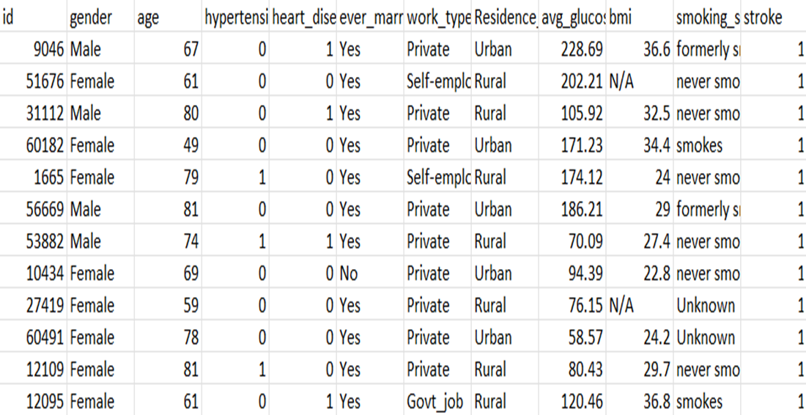
Data description
The description of the data with type and description of each Attribute is given/shown in the table.

Slide 5
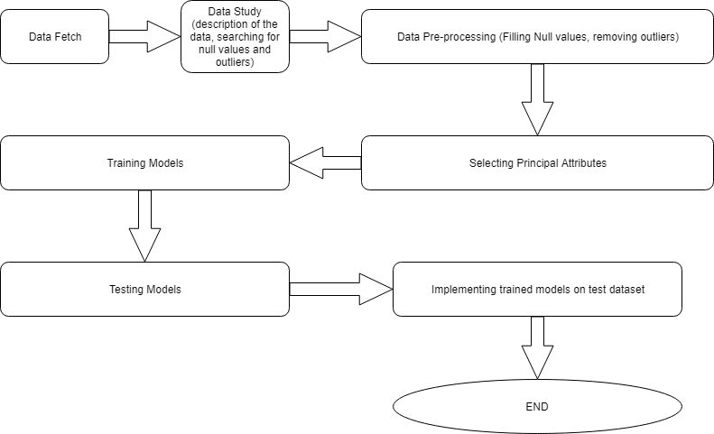
Methodology:

Slide 6
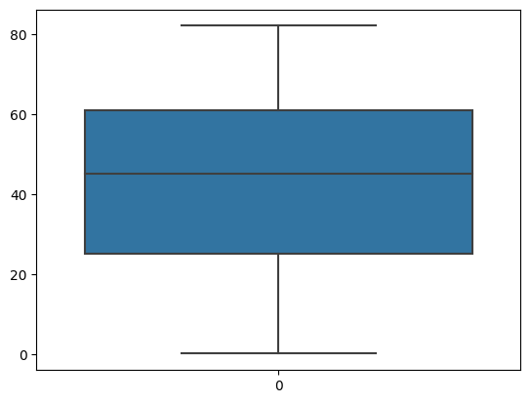
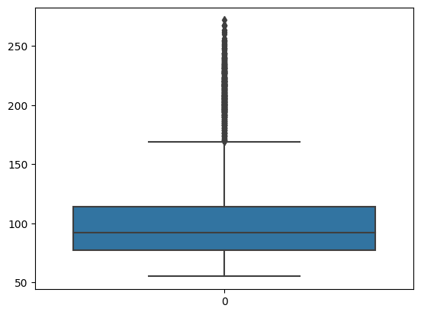
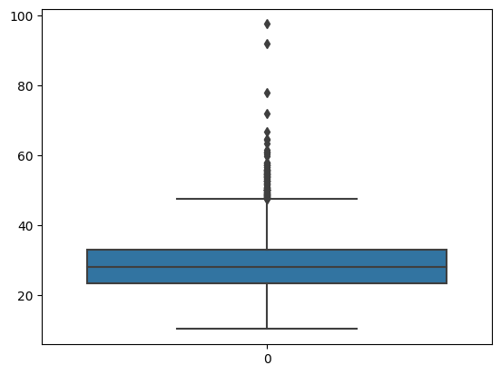
Data Preprocessing

Slide 7
Models USED
The Machine Learning models used for this project are:
Decision Tree
KNN
XGBoost
Random Forest
Logistic Regression

Slide 8
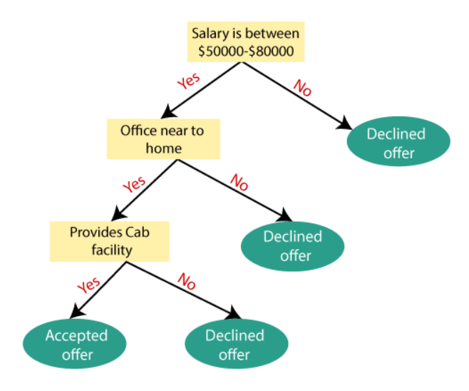
Decision Tree
A decision tree is a type of supervised machine-learning algorithm that is used for classification and regression tasks. It is called a "tree" because it is composed of a hierarchy of nodes, each of which represents a decision or a test of some attribute, and branches, which represent the possible outcomes of the decision or test.
There are several algorithms used to build decision trees, including ID3, C4.5, and CART. These algorithms differ in how they choose which attribute to test at each node and how they determine the best split.

Slide 9
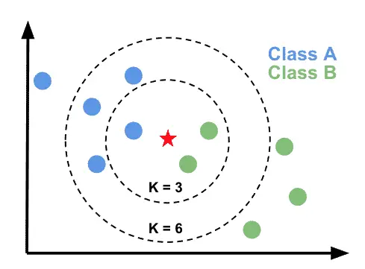
KNN
K-Nearest neighbor is one of the most commonly used classifier based in lazy learning.
It is one of the most commonly used methods in recommendation systems and document similarity measures.
It mainly uses Euclidean distance to find the similarity measures between two data points.

Slide 10
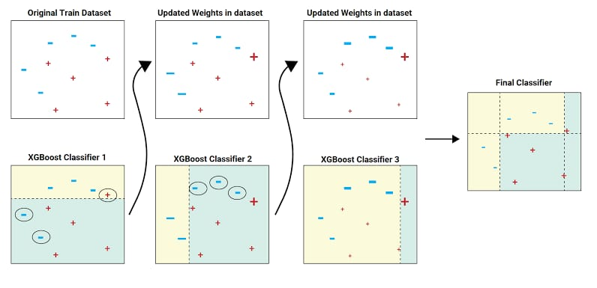
xgboost
XGBoost is a popular machine learning algorithm that combines many simple models together to create a powerful predictive model. It is designed to handle large datasets and can work with various types of data, including missing data. XGBoost is often used in competitions and real-world applications to make predictions and find patterns in data.
XGBoost (Extreme Gradient Boosting) is a popular open-source library for gradient boosting, a type of ensemble machine-learning algorithm

Slide 11
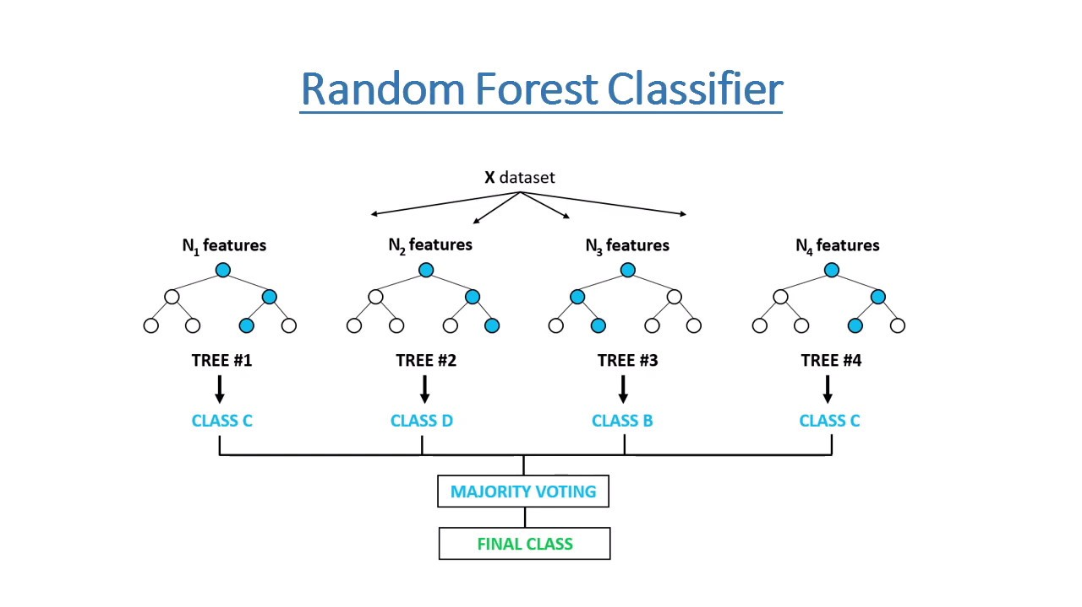
Random Forest
Random Forest is a popular machine learning algorithm used for both classification and regression tasks.
It is an ensemble method that combines multiple decision trees to make a more accurate prediction.
The algorithm can handle both categorical and continuous data, making it suitable for a wide range of applications.

Slide 12
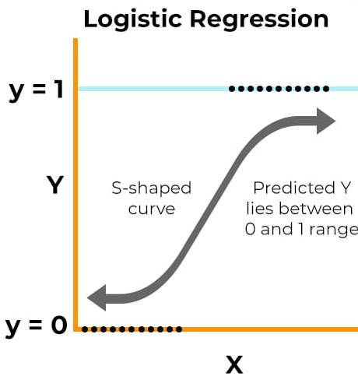
Logistic Regression
Logistic Regression is a statistical method used for binary classification tasks, where the output variable can take only two possible values, such as "yes" or "no".
It is a type of supervised learning algorithm that models the relationship between a set of input variables and a binary output variable.
Logistic Regression is a linear model, which means that it assumes a linear relationship between the input variables and the log odds of the output variable.

Slide 13
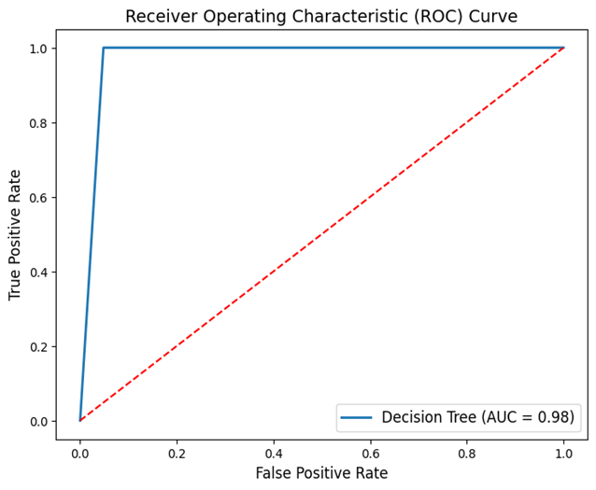
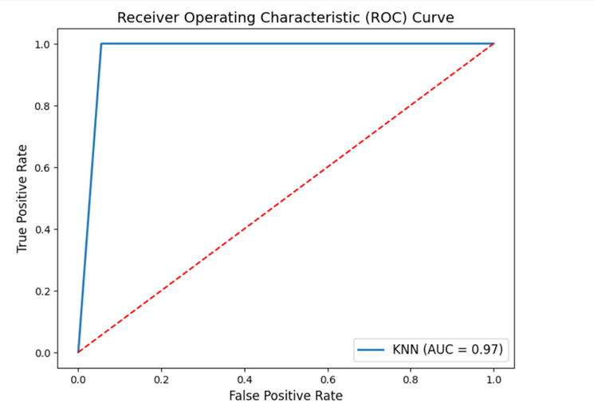
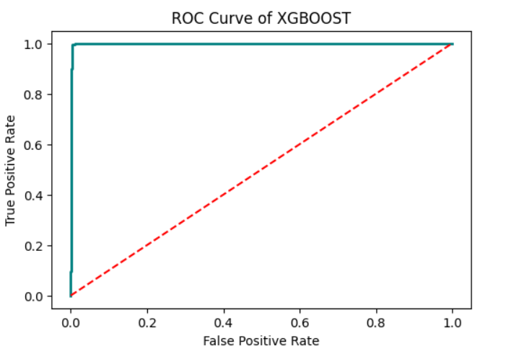
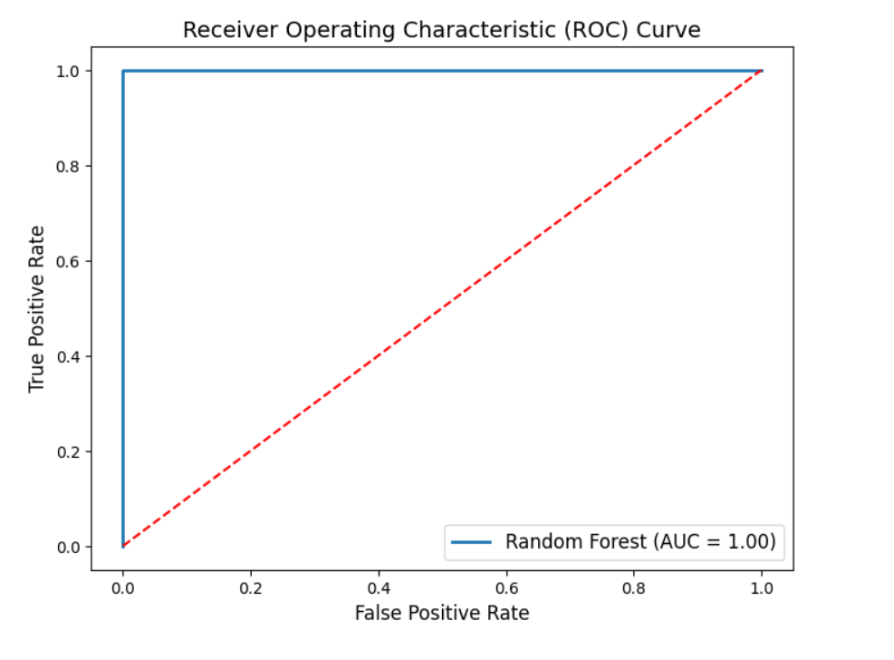
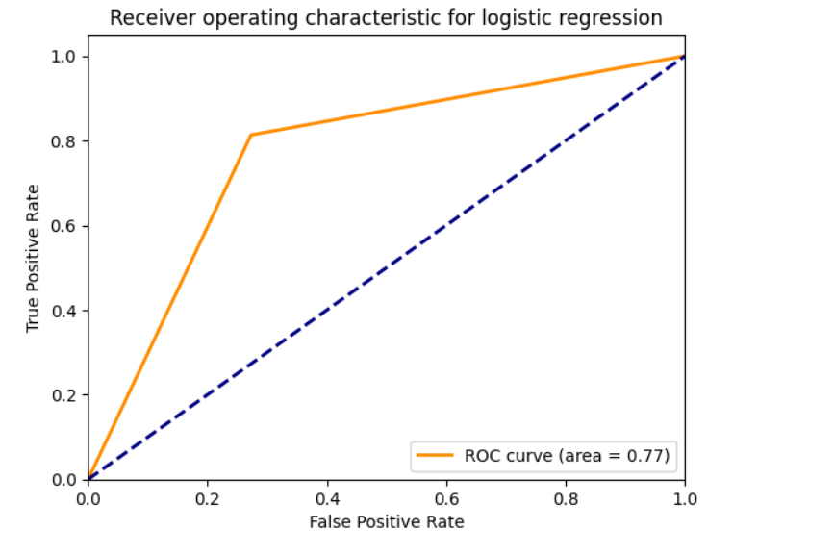
Receiver Operating characteristic curves

Slide 14
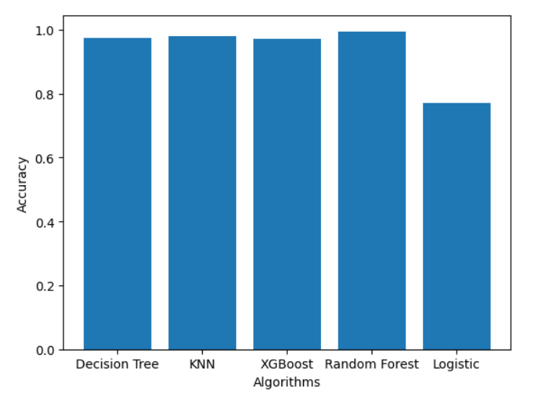
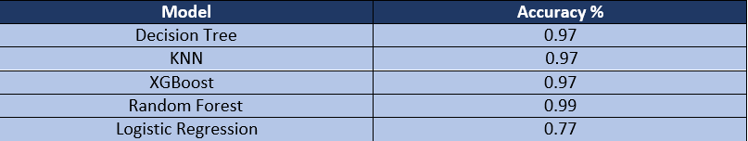
Accuracy comparison graph
The data shown above is an average of multiple test runs.
We see that the highest accuracy for the training dataset is Random Forest.
So we select the Random Forest model to predict the test dataset.

Slide 15
Limitations
Data availability and quality may affect the accuracy and generalizability of stroke prediction models.
Dynamic changes in risk factors over time pose challenges for static machine learning models.
Generalizability of models to different populations, demographics, or geographic regions may be limited.
Ethical considerations regarding data privacy, security, and informed consent arise when using sensitive patient data.

Slide 16
Future scope of improvements
Mobile apps incorporating brain stroke prediction models can help individuals monitor their risk for stroke and receive personalized recommendations for reducing their risk.
Integration of wearable devices and electronic health records can provide real-time monitoring and risk assessments for patients at high risk for stroke.
Natural language processing and chatbots can be used to gather patient information and provide personalized recommendations for reducing stroke risk.
Advances in AI and big data analysis can help identify patterns and risk factors associated with strokes more accurately.

Slide 17
Thank you

