Slide 1
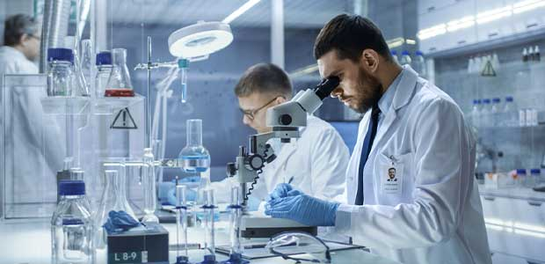
Laboratory safety
Safety is a MUST !

Slide 2

General principles
Working safely is your own responsibility.
Inform yourself on the safety risks of specific procedures.
If you feel uncertain, ask help from experienced lab members.
Keep the working space clean and organized.
Work with a well-organized lab journal and register your files.
Never work in a hurry.
Keep notice of your colleagues in the lab.
Know where the emergency exit and fire extinguishers are.

Slide 3
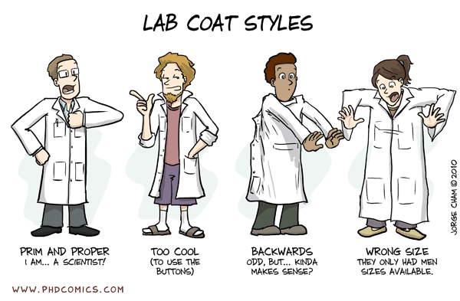
Personal Protective Equipment
In the Chemistry lab, always wear a Full Sleeve lab coat.
The lab coats should not leave the lab.
Wear gloves before handling chemicals.

Slide 4
Wear closed-toe shoes at all times in buildings where chemicals are stored or used.
Do not wear perforated shoes, sandals or cloth sneakers in laboratories. These shoes offer no barrier between you and chemical and physical hazards.
Foot Protection

Slide 5
Your eyes are precious.
Eye Protection
Wear Safety Googles all the time while doing the Experiments.
Tight fitting eye protection that completely covers the eyes, eye sockets and facial area surrounding the eyes. Provides protection from impact, dust and splashes.

Slide 6
Hand and Arm Protection
Chemical and liquid resistant gloves: When working with chemicals with a high acute toxicity, working with corrosive materials in high concentrations, handling chemicals for extended periods of time or immersing all or part of a hand into a chemical, the appropriate glove material should be selected, based on chemical compatibility.
While wearing gloves, be careful not to handle anything but the materials involved in the procedure. Touching equipment, phones, wastebaskets or other surfaces may cause contamination. Be aware of touching the face, hair, and clothing as well.
Before removing them, wash the outside of the glove. To avoid accidental skin exposure, remove the first glove by grasping the cuff and peeling the glove off the hand so that the glove is inside out. Repeat this process with the second hand, touching the inside of the glove cuff, rather than the outside. Wash hands immediately with soap and water.

Slide 7
Handling glassware
Never use broken glassware.
Remove broken glassware immediately.
If you connect tubes to glassware be aware of breaking/cutting danger. To avoid this wrap the part you handle with a sturdy towel.
Never put big forces on glass because it will break.
Never put pressure on glass because it could explode violently.
If you put pressure (column, nitrogen) always leave a way out to avoid overpressure.
If you handle reaction with develop pressure, leave the vessel open.

Slide 9
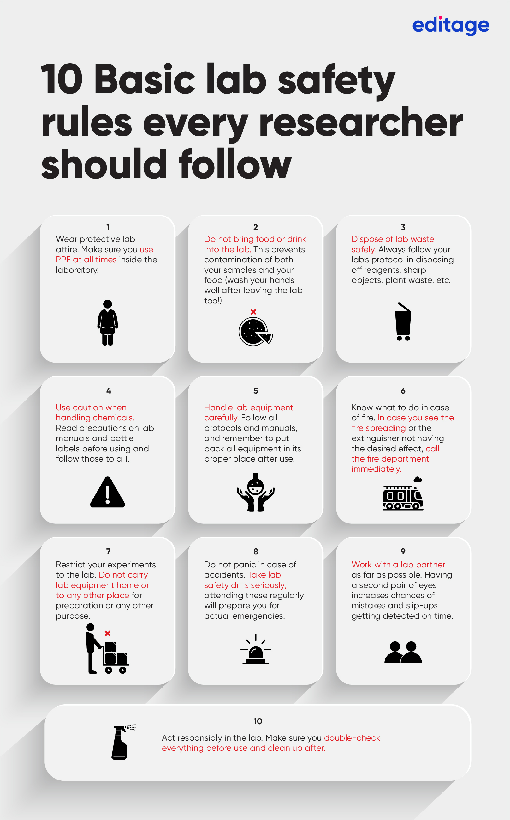

Slide 10
Know these signs

Slide 11
National Fire Protection Association (NFPA)

Slide 18
Safety and Emergency Equipments

Slide 19

Recommended Action in the event of Chemical Accident or Spill

Slide 23

Material Safety Data Sheet

Slide 38
How to use a burette:
The burette should be washed thoroughly before using.
When mounting the burette, make sure that it is clamped vertically and the tap is on your right side. It is then filled up to the zero mark and the nozzle is filled by opening the tap for two or three seconds.
The reading of the bottom level of the meniscus is taken. The tap is held by left hand (Thumb and fore-finger). The flask containing the solution is held in the right hand. During the titration, the solution is added slowly from the burette and the flask is whirled with right hand.
The burette after use should be emptied and washed thoroughly with water before leaving the lab.

Slide 39
How to use a standard measuring flask:
Standard flask is a narrow necked flask fitted with a glass stopper.
A weighed amount of the substance is usually transferred to it by using a funnel.
The funnel and its stems are washed down into the flask.
The funnel is removed and the substance is then dissolved by giving a rotating motion to the flask.
Water is then added to it till the lower water meniscus coincides with the mark on the standard flask.
The flask is then closed and shaken well till the solution gets a uniform concentration.

Slide 40
All apparatus should be extremely clean to start with. Test tubes, beakers can be cleaned with soap powder with a semi-micro brush. At the end of the day’s work, you must clean all the apparatus and return to the lab staff.
2. Droppers containing the reagents should not be allowed to touch on the sides of the test tube during addition. Reagent drops should be allowed to fall directly into the test tube without touching the sides; otherwise the reagent bottle will get contaminated.

Slide 41

Summary

