Slide 1
Lung cancer detection
Here is where our presentation begins

Slide 2
Team members
1- Amal Nader Sabry. Sec1
2- Ayatollah Abdel Hamid. Sec1
3- Aya Nasser. Sec1
4- Alaa Nasser. Sec1
5- Hikmat Reda. Sec2

Slide 3
Introduction:
Lung cancer is a significant health concern worldwide, with early detection playing a crucial role in improving patient outcomes. Artificial intelligence (AI) has emerged as a promising tool in the field of medical imaging, particularly in the detection and diagnosis of lung cancer.
The use of AI in lung cancer detection offers several advantages, including increased accuracy, efficiency, and consistency in identifying potential abnormalities. By leveraging convolutional neural networks (CNNs) and deep learning techniques, AI models can learn complex patterns and features within medical images, aiding in the early identification of lung cancer even in its earliest stages.

Slide 4
Table of contents
01
02
03
Data Preprocessing
Model Architecture
Dataset Acquisition
04
05
Training
Evaluation

Slide 5
Some of Libraries that used in the project:
1-TensorFlow : Deep learning frameworks for building and training CNN models.
2-Scikit-learn: For evaluating model performance and metrics calculation.
3-Matplotlib or Seaborn: For data visualization and analysis.

Slide 6
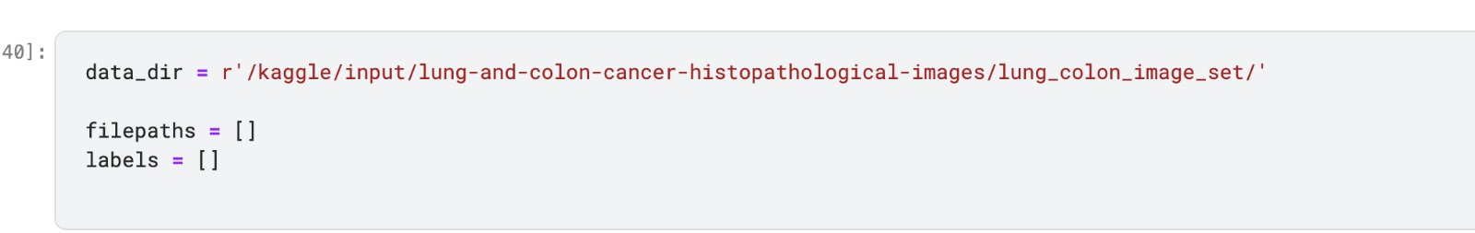
1-Dataset Acquisition:
Obtain a dataset of medical images containing lung scans, ideally labeled with information about whether each scan contains cancerous lesions or not.

Slide 7
2. Data Preprocessing:
Preprocess the images to ensure uniformity and compatibility with the CNN model. This may involve resizing the images, normalizing pixel values, and possibly augmenting the dataset to increase its size.

Slide 8
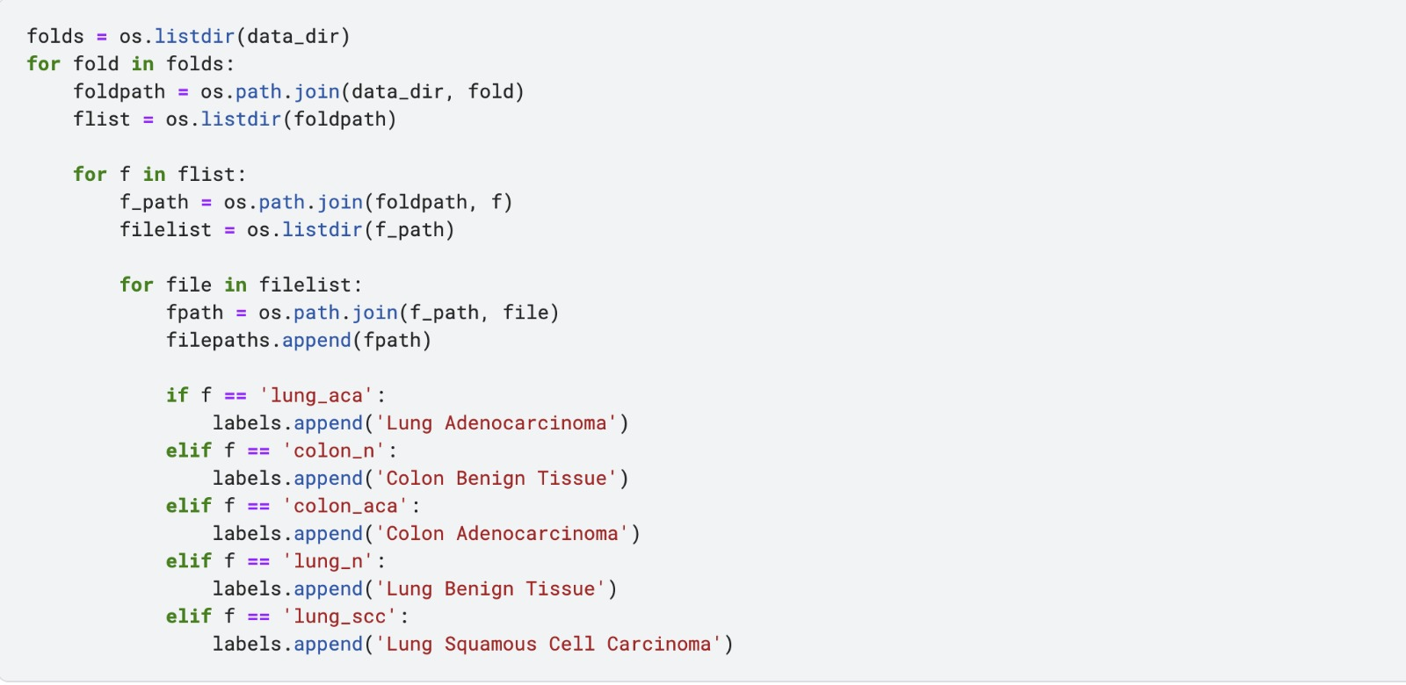

Slide 9
3. Model Architecture:
Design a CNN architecture suitable for lung cancer detection. Typically, this involves a series of input layers followed by hidden layers for feature extraction, followed by one or more fully connected layers for classification.

Slide 10
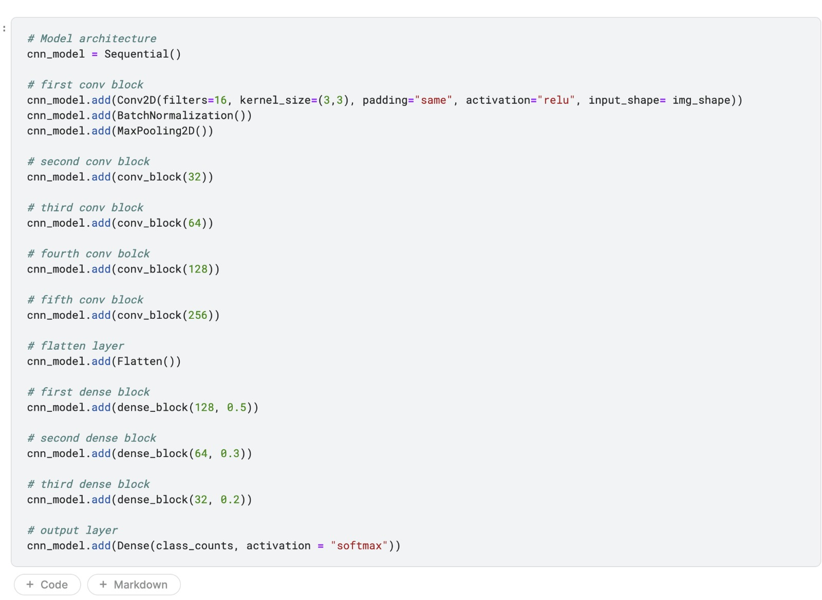

Slide 11
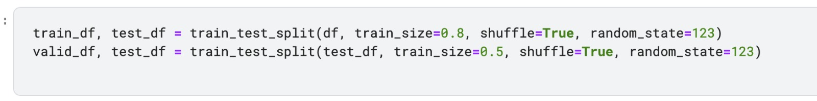
4. Training:
Split the dataset into training, validation, and test sets.
Train the CNN model on the training data using an appropriate optimization algorithm (Adam max) and loss function (categorical).
Validate the model's performance on the validation set .

Slide 12
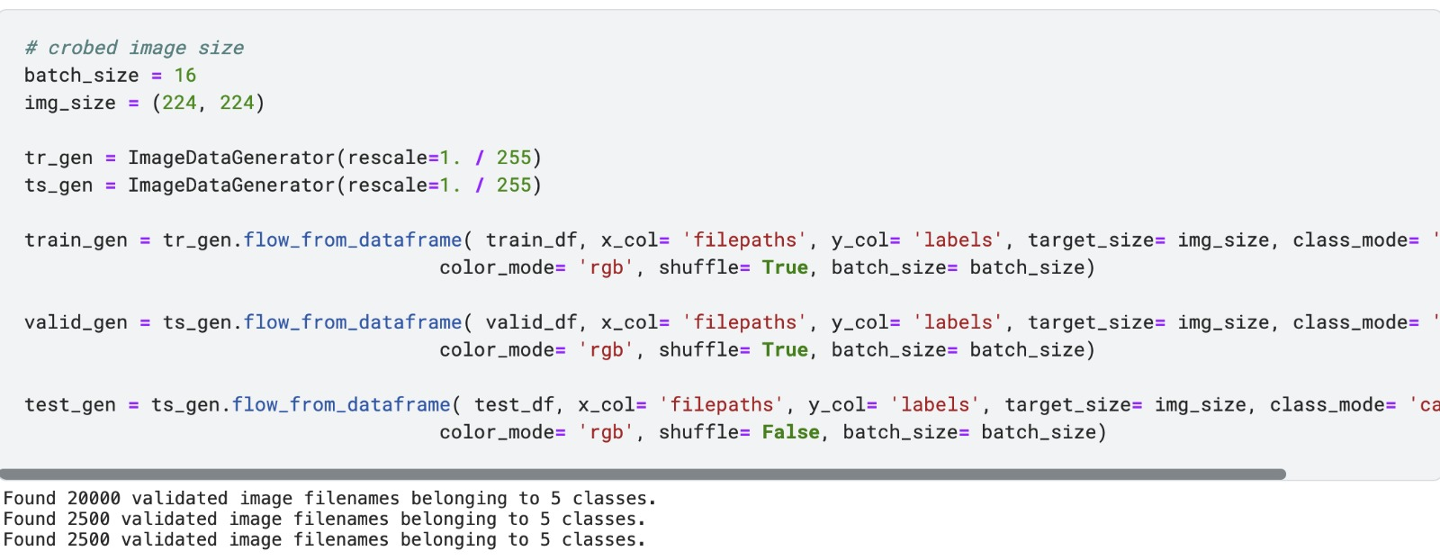
detect the number of validated images belonging to classes

Slide 13
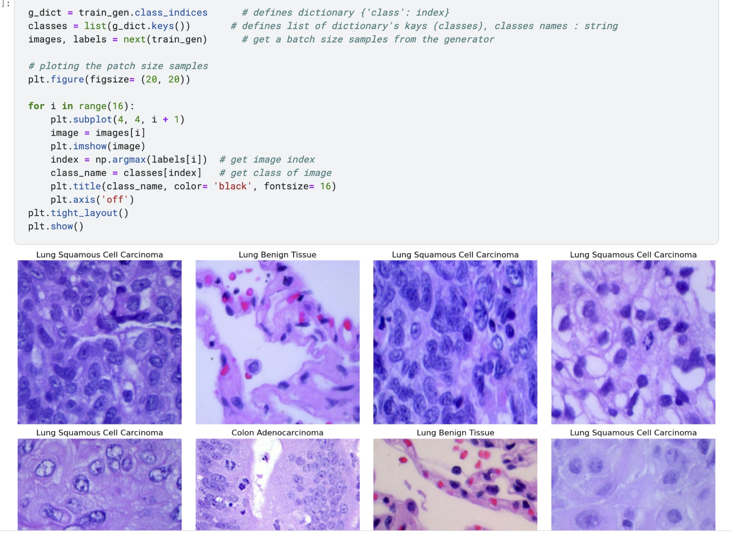

Slide 14
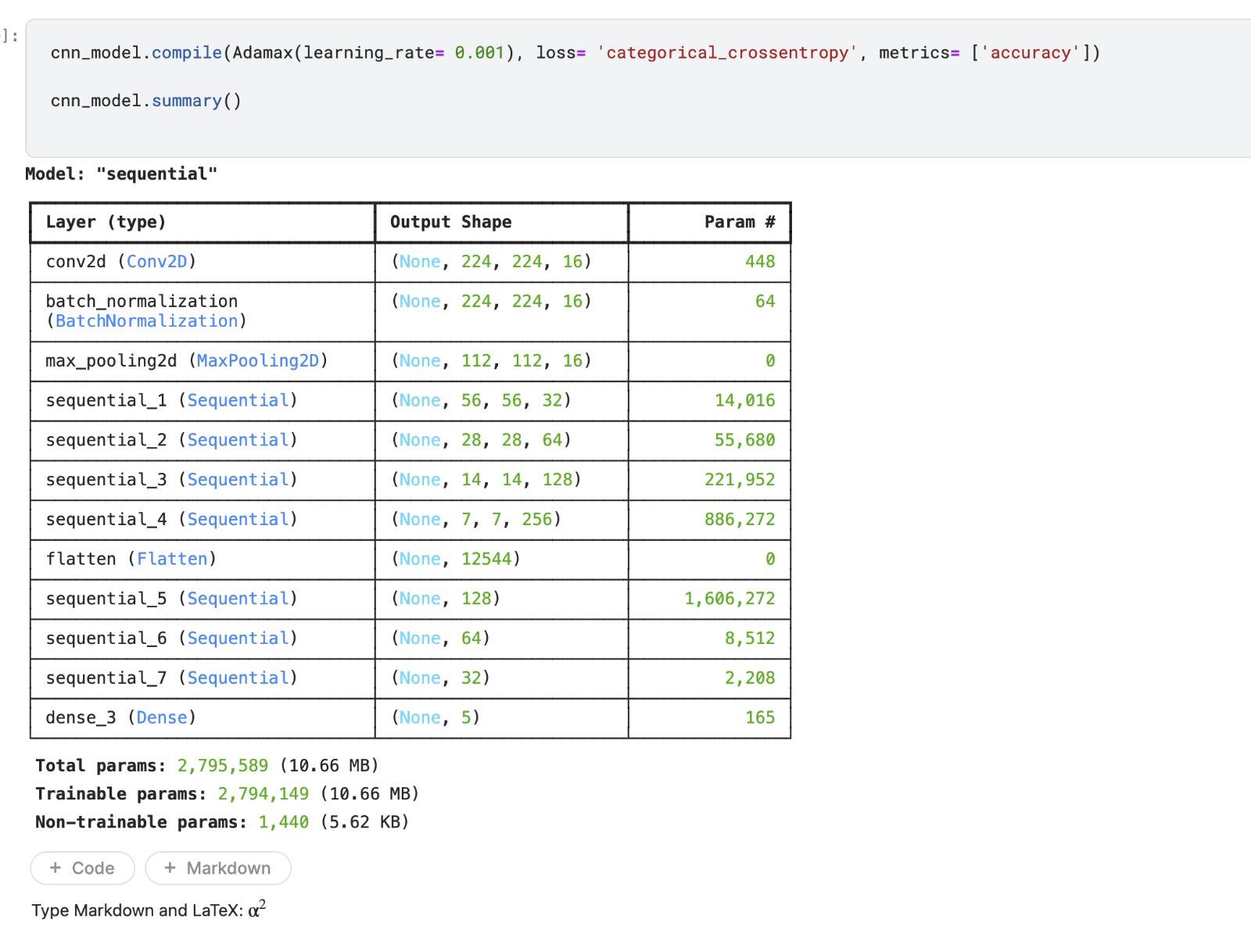

Slide 15
5. Evaluation:
Evaluate the trained model on the test set to assess its performance metrics such as accuracy, precision, recall, and F1-score.
Visualize the model's predictions and analyze any misclassifications to identify areas for improvement.

Slide 16
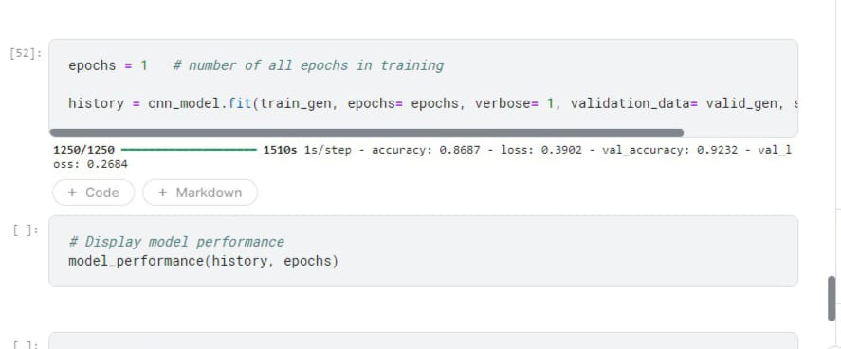

Slide 17
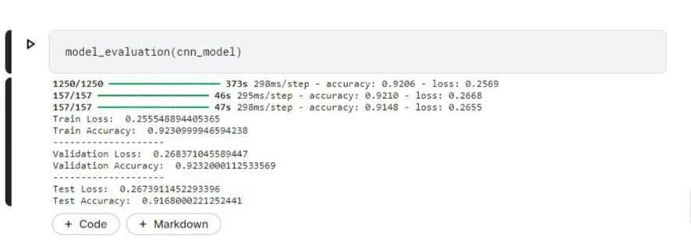

Slide 18
Thank you

