Slide 1

A-Rent

Slide 2
It is a website on the Internet for renting household items with the main goal of helping people and its name is A-Rent .
Concept :

Slide 3
Html5 , Css3 , JavaScript , Bootstrap , Laravel , MySQL
Technology:

Slide 4
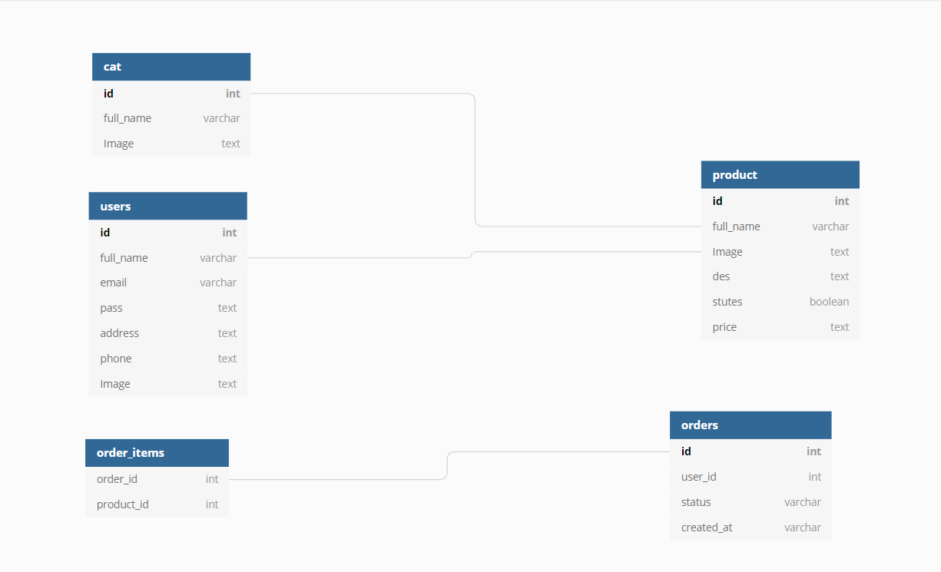
Database Diagram

Slide 5
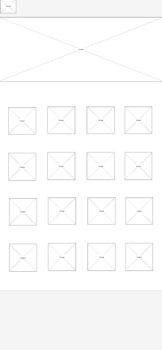
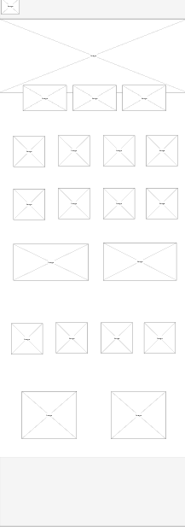
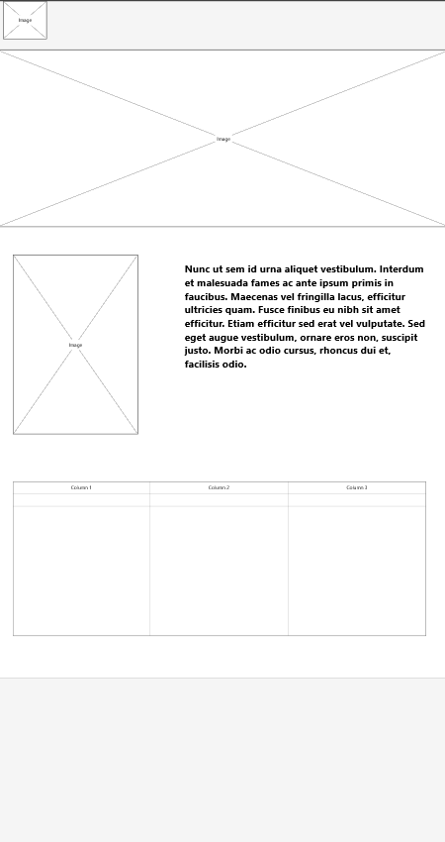
WireFrame

Slide 6
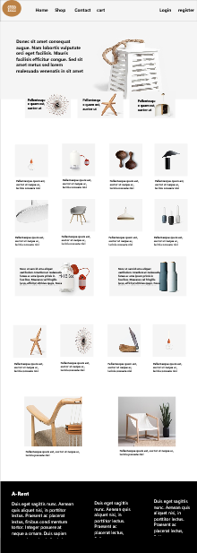
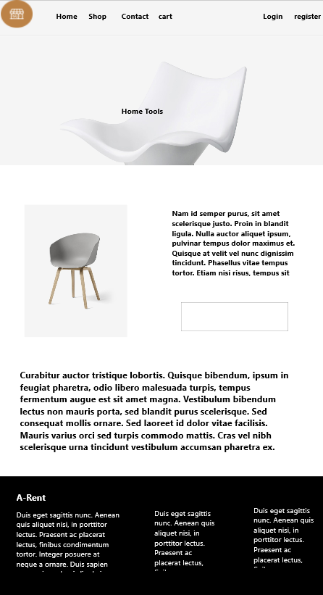
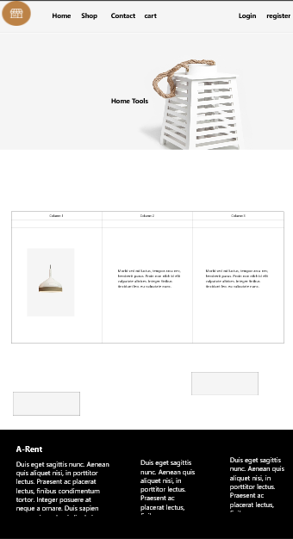
Mockup

Slide 7
Challenges:
The biggest challenge for me was working on a whole project on my own. Even my choice of idea considered it a challenge.
Another challenge I faced was organizing the time to get the best result.

Slide 8
Future additions:
Giving the user the powers to add the products he wants to rent.
I hope that the site becomes a place that helps others to get money from home by selling or renting tools

Slide 9
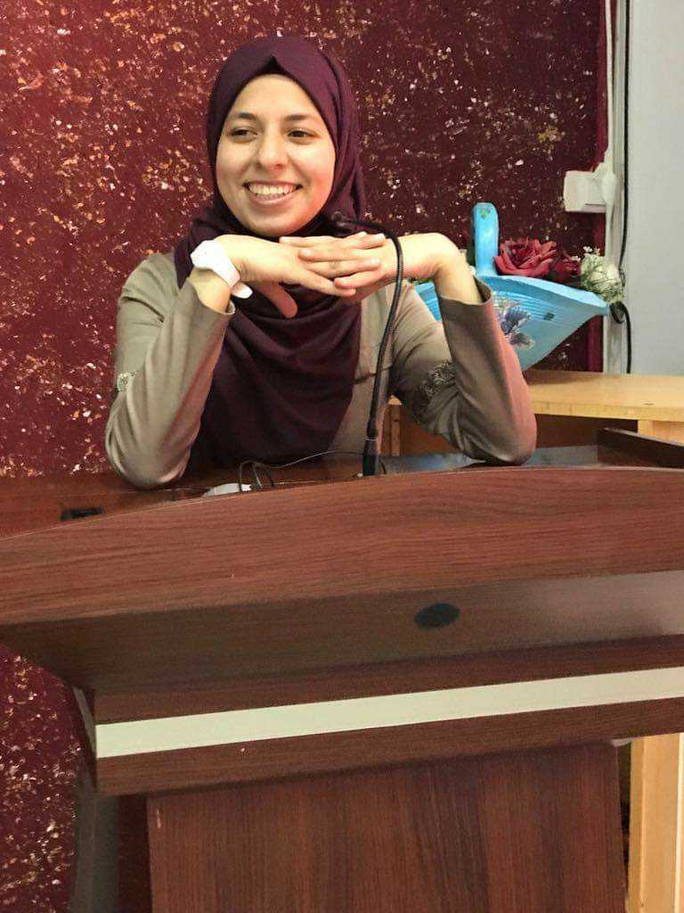
Thank You...The End
Created By :
Ayah Khawaldeh

