Slide 1
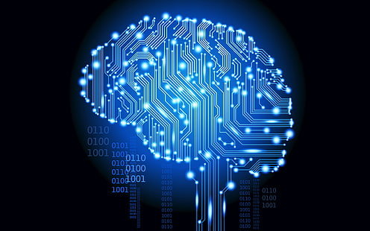
Transformers and Attention
Intro to BERT, GPT.
Ayah Khaldi

Slide 2
Agenda
Introduction of seq2seq
Encoder Decoder Architecture
Attention Mechanisms
Transformer
BERT And GPT
Exercise (Sentiment Analysis by BERT)

Slide 3
INTRODUCTION
seq2seq

Slide 4
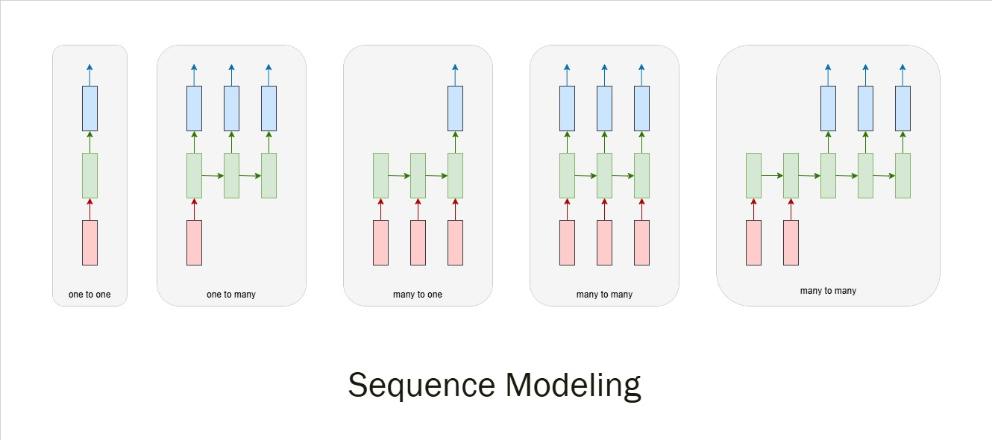
Sequence Modeling with RNNs

Slide 5
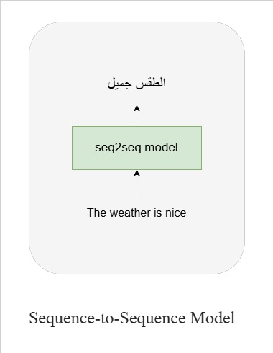
Sequence-to-Sequence model (Seq2Seq)
A type of neural network architecture widely used in machine learning.
used to transform one sequence into another.
Both the input and the output are treated as sequences of varying lengths.
Examples of seq2seq tasks:
Machine Translation
Text Summarization
Code Generation
ChatBots

Slide 6
Timeline of seq2seq
(2014) Encoder Decoder Architecture
(2017) Transformers
(2018) Transfer Learning
(2018) Large Language Models (LLMs)
(2015) Attention Mechanism
https://medium.com/@sachinsoni600517/the-epic-history-of-llms-journey-from-rnns-to-chatgpt-8b6c72b40f09

Slide 7
Encoder Decoder Architecture
seq2seq

Slide 8
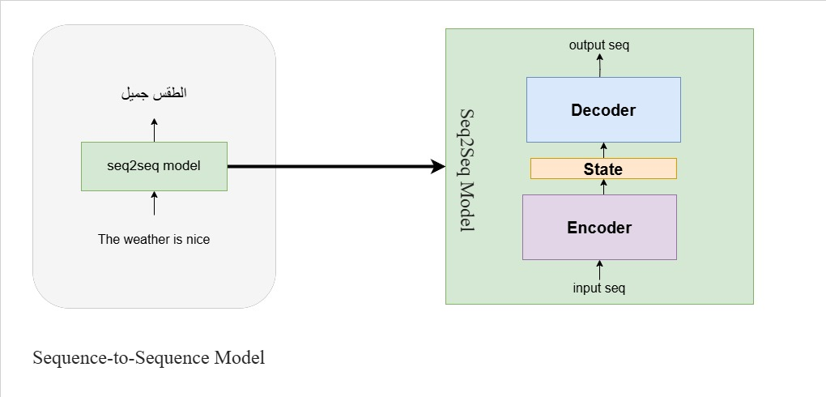
Encoder Decoder
composed of two parts:
Encoder: processes the input sequence and encodes it into a fixed-length context vector or series of hidden states.
Decoder: uses this encoded information (context vector) to generate the output sequence.
Both Encoder and Decoder are Recurrent Neural Networks (RNN) like LSTM and GRU.
The context vector is the final hidden state of the encoder that summarizes the information from the input sequence.

Slide 9
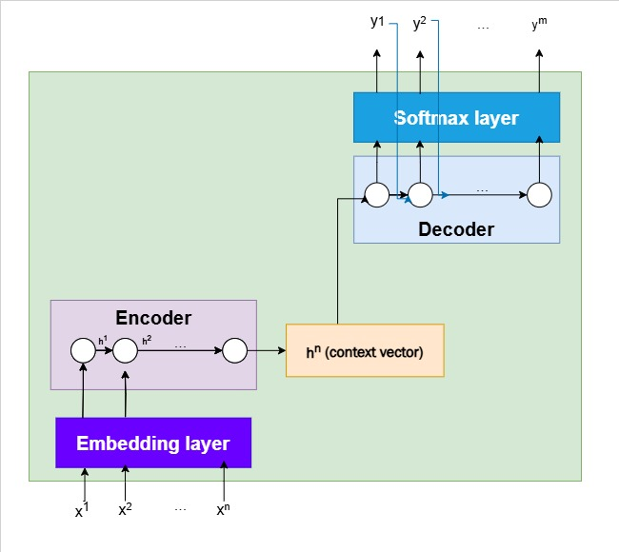
Encoder Decoder

Slide 10
ATTENTION MECHANISMS
seq2seq

Slide 11
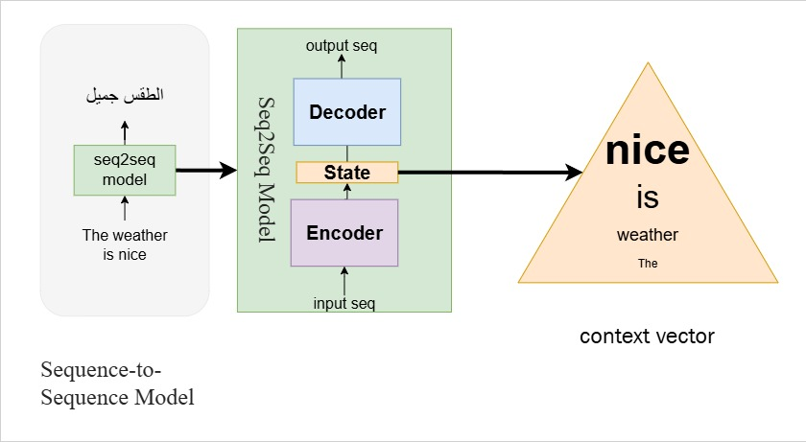
Attention Mechanisms - Why?
The Decoder is focusing on the final hidden state of the encoder (context vector), which making the last input the most important part.
But what's about the importance of the most biggening inputs?
And what if the encoder makes a bad context vector (bad state summary).
This problem is called bottleneck!

Slide 12
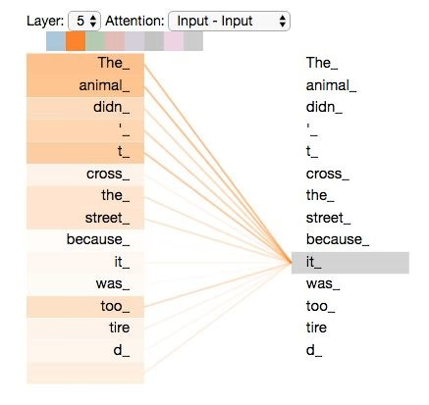
Attention Mechanisms - solution
Addresses the limitations of the encoder-decoder framework, especially in handling long sequences, and its impact on the accuracy and coherence of the output.
Allows the decoder to focus on different parts of the encoder’s output for each step of the decoder’s own outputs. Essentially, it computes a weight distribution (or attention scores) that determines the importance of each input element for each output.

Slide 13
Attention Mechanisms – How?
Include an attention mechanism in a seq2seq model by performing the following three steps:
1. comparison of Sequences and Calculation of Attention Scores:
At each time step during the decoding process, we will compare the decoder hidden state with all of the encoder hidden states.
2. Conversion of Attention Scores to Attention Distribution:
We then take the softmax of all these attention scores
3. Multiplying Attention Distribution with Encoder Hidden States to Get Attention Output
We then multiply each element of the attention distribution with its corresponding encoder hidden states and sum up all of these products to produce a single vector called the "attention output"

Slide 14
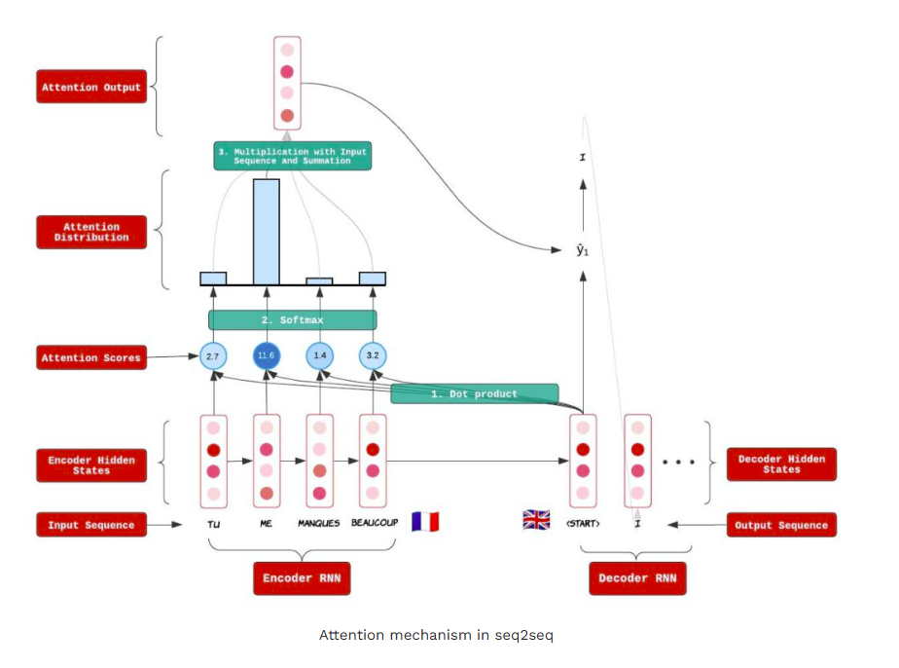
Attention Mechanisms - How?

Slide 15
Self Attention
Allows a model to focus on relevant parts of the input while processing a specific token, word, or element in the sequence.
Attention(Q, K, V) = softmax((Q * K^T) / sqrt(d_k)) * V
Q (Query): The token or word being processed.
K (Key): Other words in the sequence that the current word is compared against.
V (Value): The vector representation of the corresponding words.
d_k: Dimensionality of the keys, used for scaling to prevent large dot products.
https://dev.to/nareshnishad/understanding-self-attention-and-multi-head-attention-in-deep-learning-4jg4

Slide 16
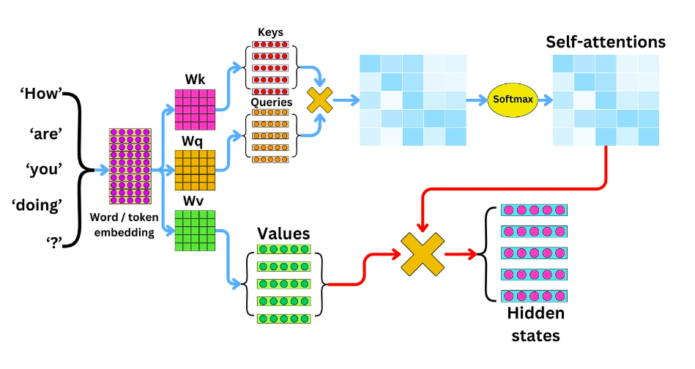
Self Attention
https://newsletter.theaiedge.io/p/understanding-the-self-attention

Slide 17
Multi-Head Attention
Splits the query, key, and value vectors into multiple smaller vectors and performs self-attention independently on each of them.
The use of multiple heads allows the model to focus on different semantic aspects of the input.
MultiHead(Q, K, V) = Concat(head_1, head_2, ..., head_h) * W_O
W_O: Output weight matrix.
https://dev.to/nareshnishad/understanding-self-attention-and-multi-head-attention-in-deep-learning-4jg4

Slide 18
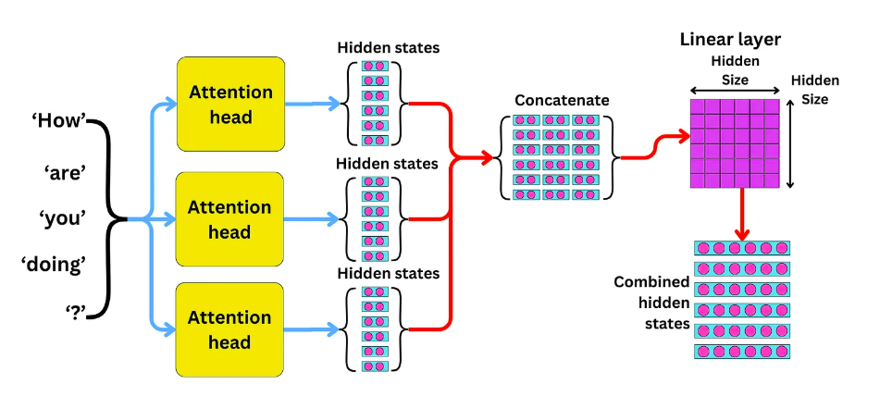
Multi-Head Attention
https://newsletter.theaiedge.io/p/the-multi-head-attention-mechanism

Slide 19
Transformer
seq2seq

Slide 20
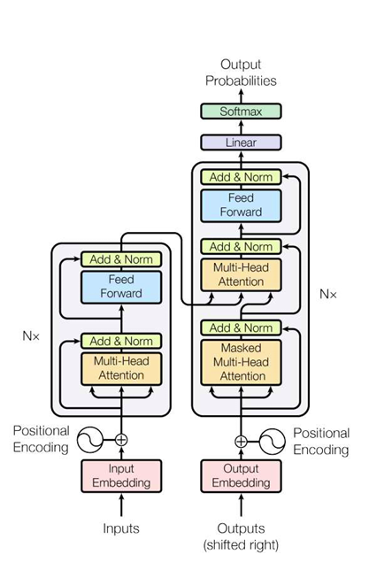
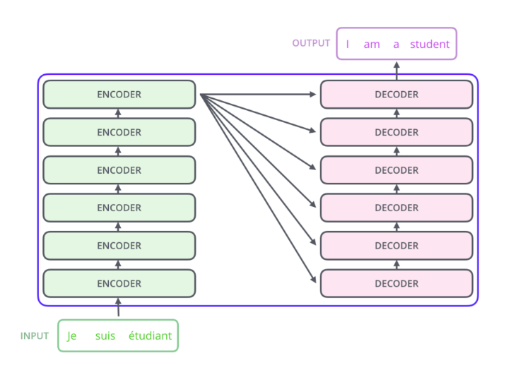
Transformers
https://hannibunny.github.io/mlbook/transformer/attention.html

Slide 21
Transformers
Introduced in "Attention Is All You Need“ paper (Vaswani et al., 2017).
The Transformer is a sequence model that forgoes traditional recurrent architectures in favor of a fully attention-based approach.
https://deeplearning.cs.cmu.edu/S24/document/slides/lec19.transformers.pdf?utm_source=chatgpt.com
Components:
Tokenization
Input Embeddings
Position Encodings
Query, Key, & Value
Multi-Head Attention
Feed Forward
Add & Norm
Masked Attention
Linear
Softmax
Encoder-Decoder Models

Slide 22
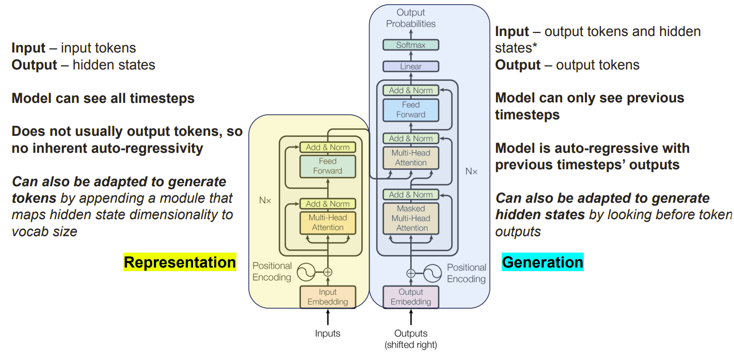
Transformers
https://hannibunny.github.io/mlbook/transformer/attention.html

Slide 23
BERT And GPT
seq2seq

Slide 24
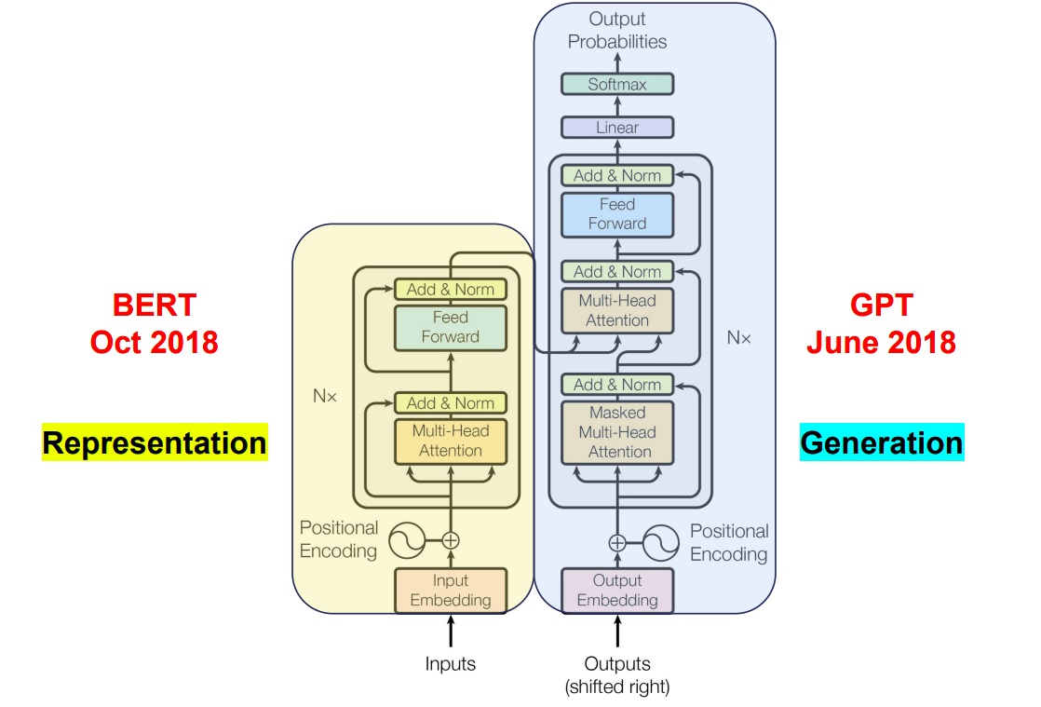
Encoder
Decoder

Slide 25
BERT
Bidirectional Encoder Representations Transformers
Introduced by Google in 2018.
Is a pre-trained model that uses only the encoder part of the Transformer.
Bidirectional Context: Processes text in both directions from left and right
to capture context.
Training Tasks:
Masked Language Modeling (MLM): Predicts randomly masked words in the sentence and trains the model to understand the word relationships and semantics.
Next Sentence Prediction (NSP): Trains the model to predict if one sentence follows another.

Slide 26
GPT
Generative Pre-trained Transformer
Introduced by OpenAI in 2018.
Is a pre-trained model that uses only the decoder part of the Transformer.
Autoregressive Generation: Generates text by predicting one word at a time
Training Tasks:
Predict the next token, given the previous tokens, using only left to right context.

Slide 27
Exercise
Sentiment Analysis by BERT

Slide 28
Sentiment Analysis by BERT
Fine-tune BERT for text classification Dataset: IMDB Movie Reviews (Sentiment Analysis)
Dataset:
IMDB Movie Reviews: https://huggingface.co/datasets/stanfordnlp/imdb
25K rows.
Text and label columns.
Binary classification.
Github link:
https://github.com/Ayah-khaldi99/Sentiment-Analysis

Slide 29
THANK YOU
Questions ?

