Slide 1
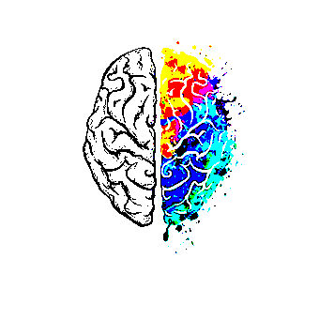
Special Needs Control System

Slide 2
Overview
This project is about a humanitarian service to develop a miniature wheelchair prototype that is controlled via the user’s brain waves data .

Slide 3
Motivation
This project is aimed towards quadriplegics, paraplegics, people involved in freak accidents that have left them without an extremity or any for that matter and people with motor conditions severe enough to impair movement of the extremities; it will give them an alternative way of controlling traditional wheelchairs

Slide 4

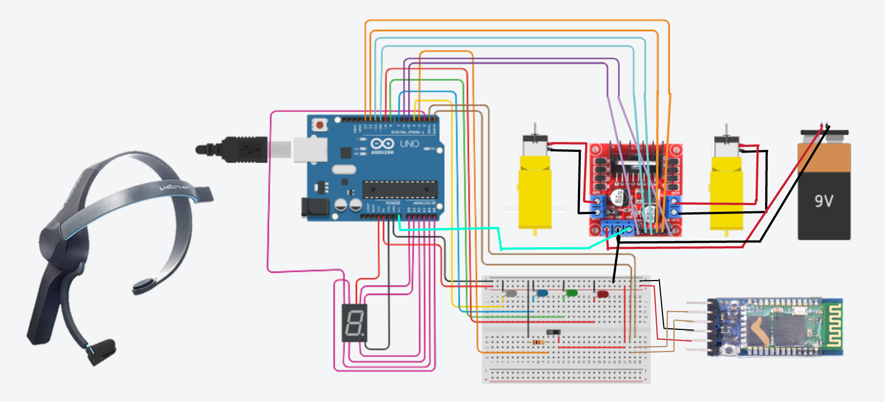
Hardware design

Slide 5
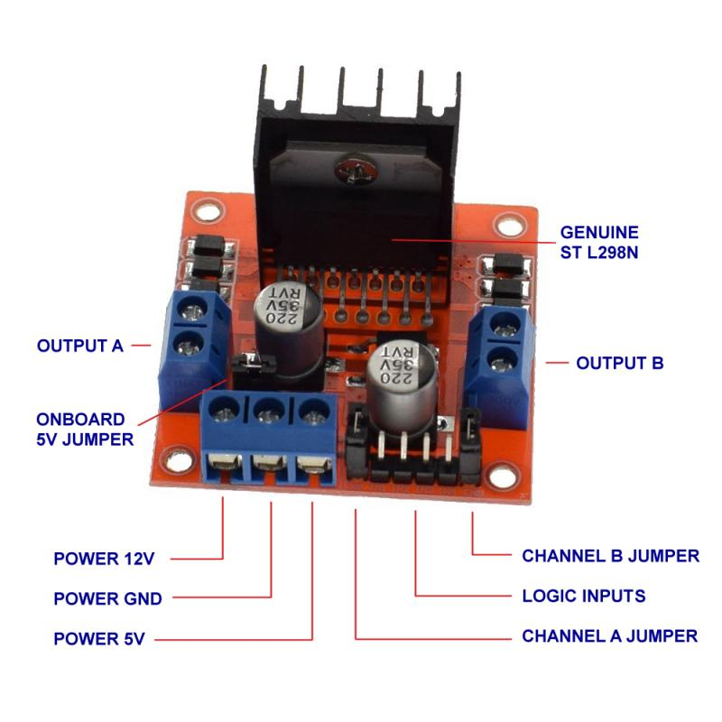
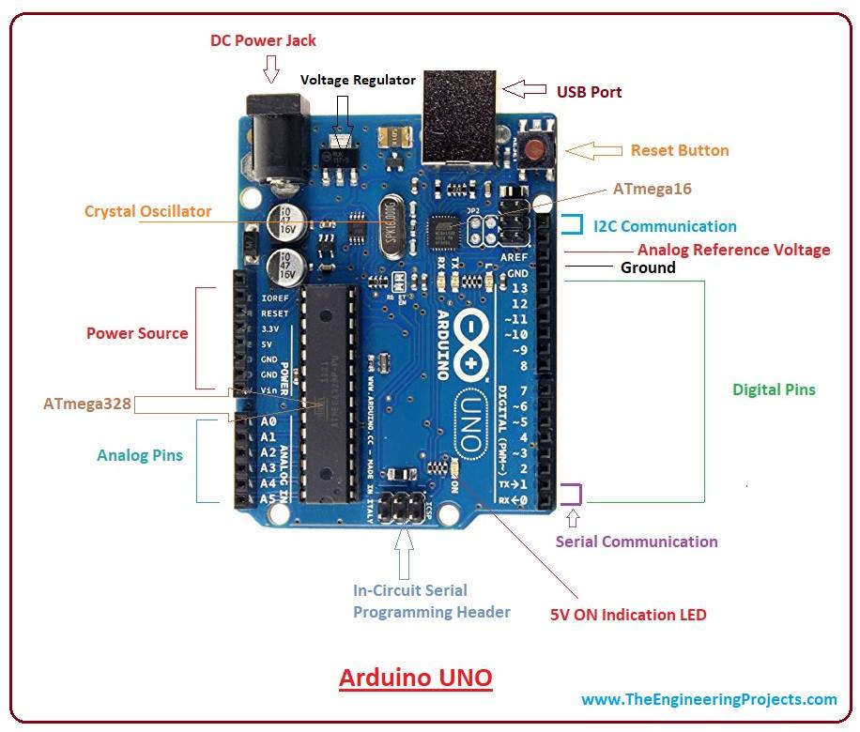
Arduino UNO
L298 Motor driver
This motor driver use two technique, PWM for control
the speed and H-Bridge for control the direction of motors.
the Arduino board will be the brain of the robot as it will be running the software that controls all other parts

Slide 6
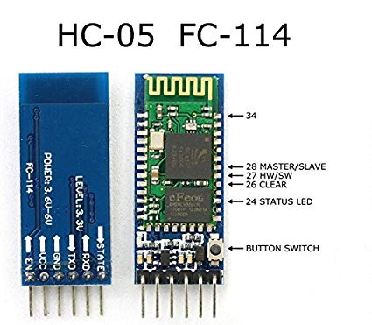
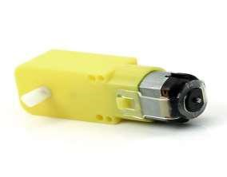
HC-05 Bluetooth
To receive data from NeuroSky to Arduino
DC Motor
Direct current motor is the machine which convert electrical energy into mechanical energy

Slide 7
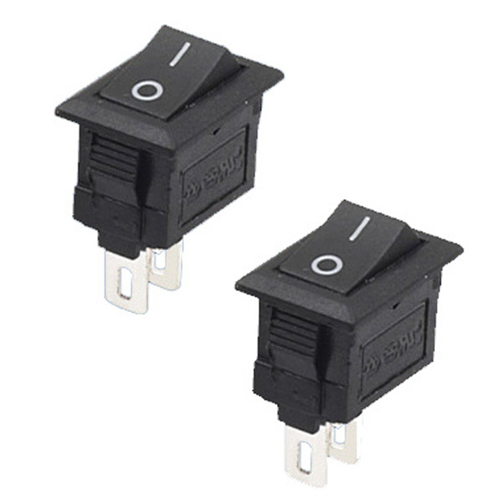
SWITCH
The first switch is used to connect the system to the power released by the battery in addition to protect the user in case of any problem in the system.
The second switch is used to maintain the current direction of the system if it wants to go in the same direction for a long time without having to receive packets during this period.

Slide 8
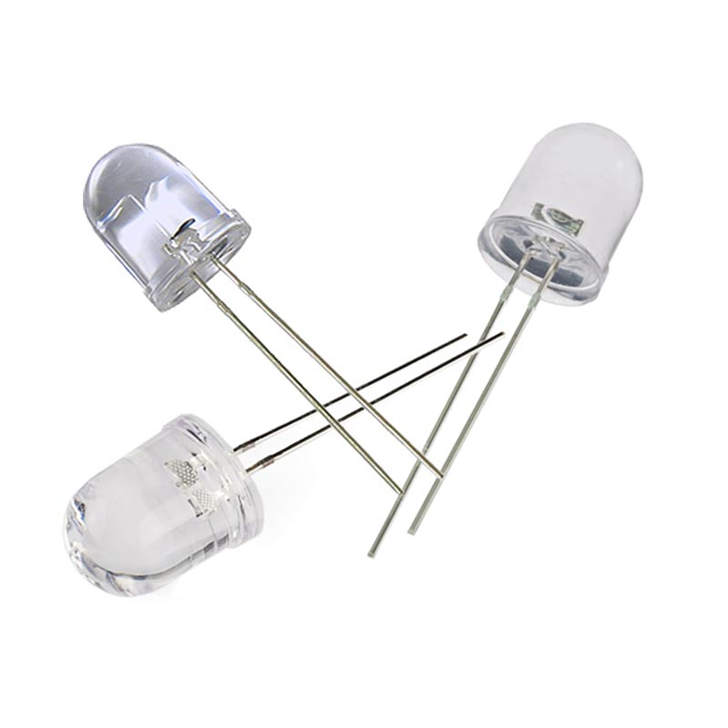
LED
It lights up at the first blink of the user to know the moment of the beginning of the count to determine.

Slide 9
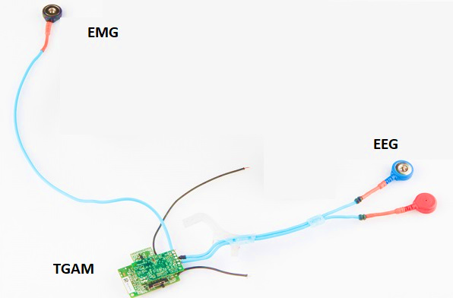
NeuroSky
EMG records the electrical movement of our muscles.
EEG records electrical activity of the brain.
ThinkGear senses the signals from the human brain, then filters out extraneous noise and electrical interference then converts to digital power.

Slide 10
ThinkGear Data Values
1. attention
Unsigned one-byte value refers to the level of concentration of the human and wandering thoughts, lack of focus, or anxiety may lower the attention meter levels.
2. Meditation
Unsigned one-byte value which indicates the level of a user's mental calmness or relaxation, its measure a person's mental levels, not physical levels.
3.Raw Value
Consists of two bytes, its value is a signed 16 bit integer, The first byte of the Value represents the high-order bits of the twos-compliment value, while the second byte represents the low-order bits.

Slide 11
EEG power signal
Brainwave Type | Frequency range | Mental states and conditions
Delta | 0.5Hz to 2.75Hz | waves deep, dreamless sleep, unconscious
Theta | 3.5Hz to 6.75Hz | Intuitive, creative, fantasy, imaginary, dream
Alpha | Low:7.5Hz to 9.25Hz High:10Hz to 11.75Hz | Appears when closing the eyes and relaxing and disappears when opening the eyes or alerting by any mechanism (thinking, calculating).
Beta | Low:12Hz to 15Hz Mid : 16Hz to 20Hz High: 20Hz to 30Hz | relaxed yet focused, integrated ,thinking ,alertness ,agitation
Gamma | Low:31Hz to 39.75 Hz Mid:41Hz to 49.75 Hz | Higher mental activity

Slide 12
thinkGear Packet structure
Packets are sent as an asynchronous serial stream of bytes :

Slide 13
Data Payload itself consists of a continuous series of Data Values, each contained in a series of bytes
called a DataRow. Each DataRow contains information about what the Data Value represents,

Slide 14
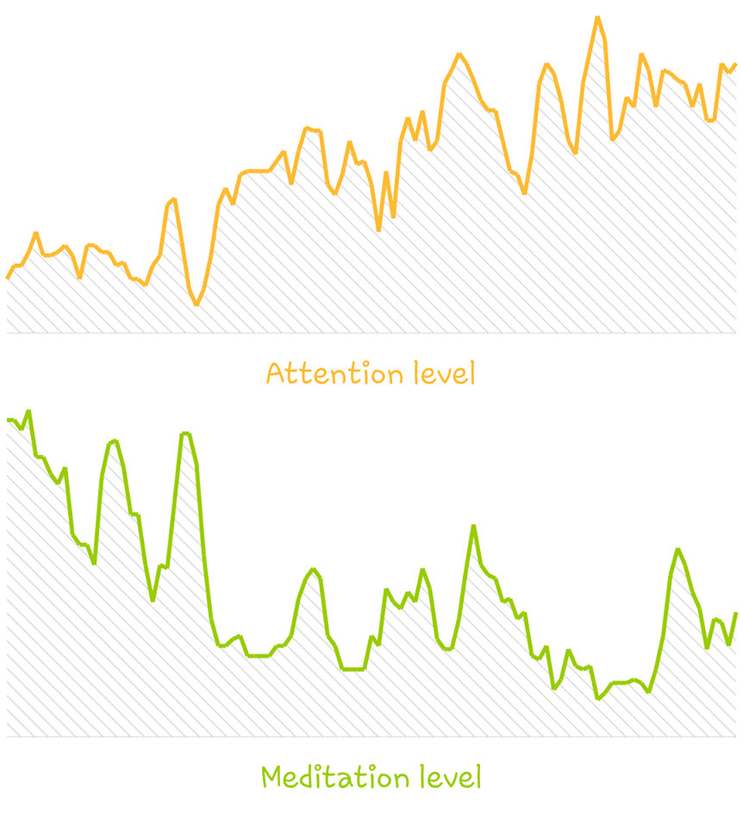
A test of the attention signal
A vision when the mind is fully concentrated.

Slide 15
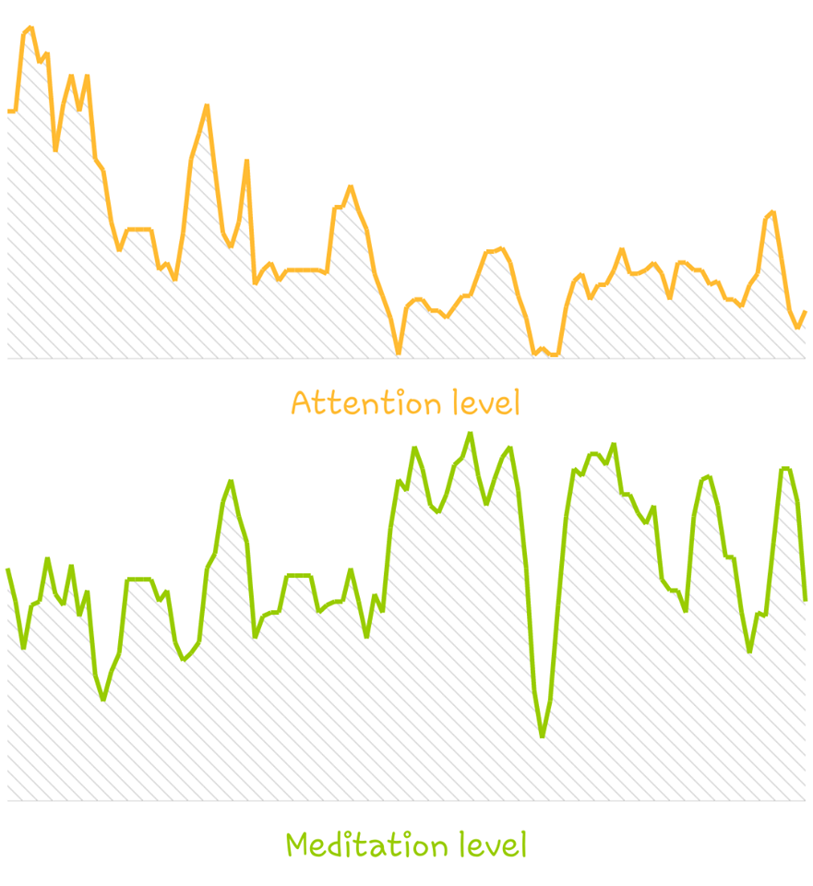
A test of the meditation signal
A vision when the mind is completely at rest.

Slide 16
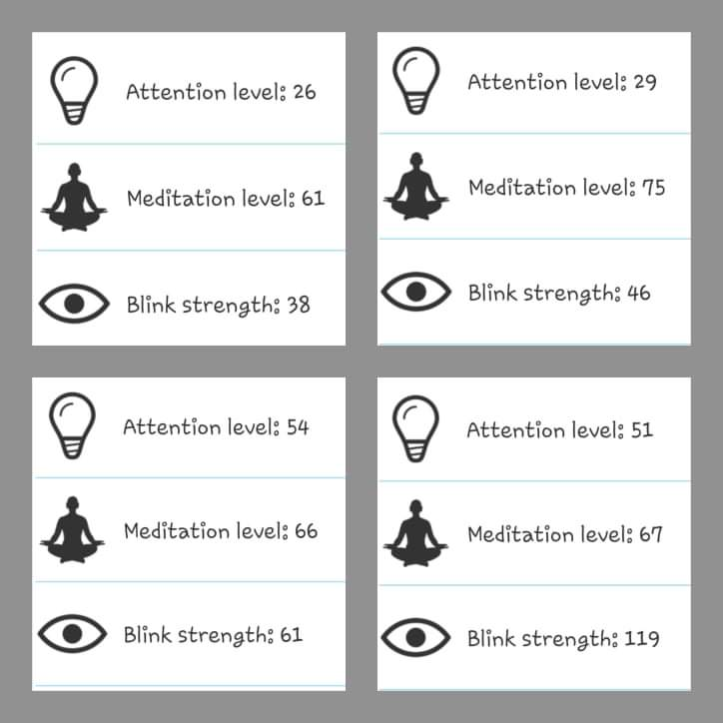
A test of the eye blinking signal
Blink strength indicates the speed of the blinking.
Faster blinking leads to higher value of blink strength.

Slide 17
The Neurosky signals
There are two types of signals that could be read from the neurosky device :
EEG signals
EMG signals

Slide 18
The EEG signals
Neurosky device can detect five brainwaves (signals) that are measured and reported originate from different parts of the brain, the signals are : Delta, Theta, Alpha, Low Beta, High Beta and Gamma, and a calculated value for attention and meditation.
There is another signal which is poor quality that ranges from 0 to 200
0 value means good quality
26 value means poor quality

Slide 19
The EMG signal

