Slide 1
GRADUATION-STYLE PROJECT · KNOWLEDGE-BASED SYSTEMS
Diab-KBS
A Hybrid Knowledge-Based System for Diabetes Diagnosis,
Risk Stratification & Clinical Decision Support
Aya Hesham Ali
Faculty of Computers & Artificial Intelligence · Helwan University
Course: Knowledge-Based Systems · Instructor: Dr. Sayed AbdelGaber
May 2026

Slide 2
Diab-KBS · Diabetes Knowledge-Based System
01 · ROADMAP
Agenda
01
Problem & Motivation
07
Knowledge Acquisition Pipeline
02
Course-Concept Coverage
08
Big-Data Analytics
03
CommonKADS — 6 Models
09
Dashboard Walk-through
04
System Architecture
10
Validation Results
05
Knowledge Base Design
11
Discussion & Future Work
06
Inference Engine + Certainty Factors
12
Conclusion · Q & A
Aya Hesham Ali · Helwan University, FCAI · May 2026
2 / 22

Slide 3
Diab-KBS · Diabetes Knowledge-Based System
02 · WHY THIS PROJECT
Problem & Motivation
537 M
Our Approach
adults living with diabetes worldwide (IDF Atlas, 2021)
Hybrid KBS — symbolic (rules + frames + semantic net) plus data-driven rule mining
10.9 %
Built directly on a real Egyptian cohort of 12,204 patients (37 features)
prevalence among Egyptian adults — among the highest in MENA
Forward + backward chaining inference with MYCIN certainty factors
~ 50 %
Streamlit dashboard exposes all 7 modules — diagnosis, risk, analytics, KB browser, validation
of cases remain undiagnosed in low-resource settings
Documents every CommonKADS model — explicit knowledge engineering, not a black box
Aya Hesham Ali · Helwan University, FCAI · May 2026
3 / 22

Slide 4
Diab-KBS · Diabetes Knowledge-Based System
03 · EVERY LECTURE → IMPLEMENTATION
Course-Concept Coverage
Lecture
Topic
Implementation in Diab-KBS
1
Data → Information → Knowledge → Wisdom
DIKW pyramid driving the dashboard pipeline
2
KBS architecture & components
3-tier app: KB · inference · UI (Streamlit)
3
Knowledge representation
32 production rules · 13 frames · 35-node semantic net
4
Inference & reasoning
Forward + backward chaining + MYCIN CF algebra
5
Knowledge acquisition
5-stage pipeline: elicit · structure · validate · refine
6
CommonKADS methodology
All 6 models documented in research paper
7
Big-Data analytics
Apriori rule mining + cohort KPIs on 12,204 records
All seven lecture themes are explicitly traceable to a code module or paper section.
Aya Hesham Ali · Helwan University, FCAI · May 2026
4 / 22

Slide 5
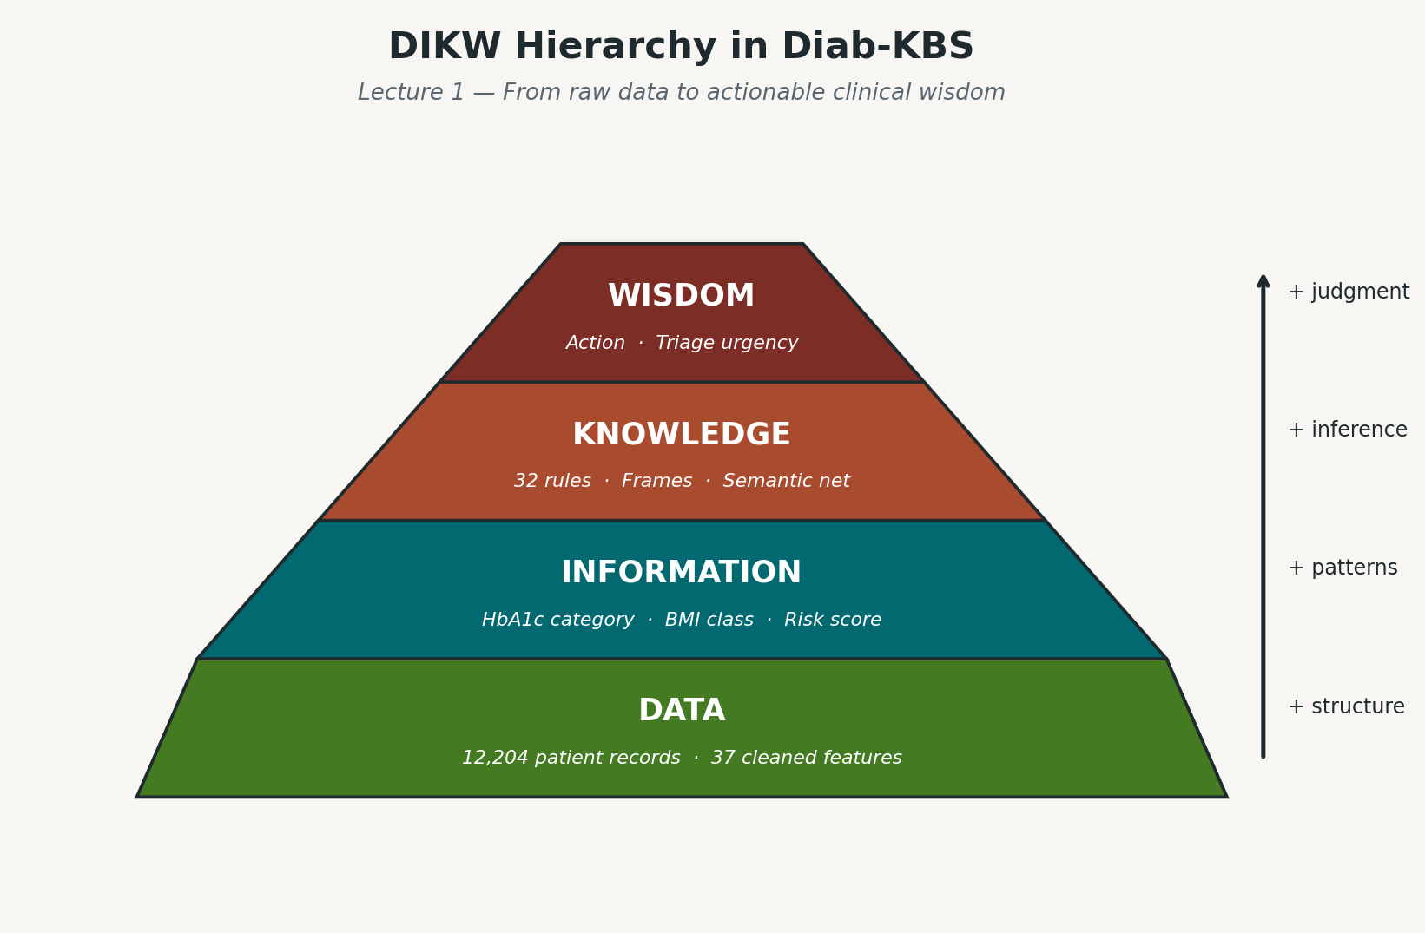
Diab-KBS · Diabetes Knowledge-Based System
04 · LECTURE 1 IN ACTION
DIKW — Convergence from Data to Intelligence
Data
12,204 raw records · 37 features (HbA1c, BMI, FPG, symptoms…)
Information
~120 derived categorical fields (HbA1c_cat, BMI_cat, age band)
Knowledge
32 production rules + 13 frames + 35-node semantic network
Wisdom
Patient-specific diagnosis + treatment plan + complication risk
Aya Hesham Ali · Helwan University, FCAI · May 2026
5 / 22

Slide 6
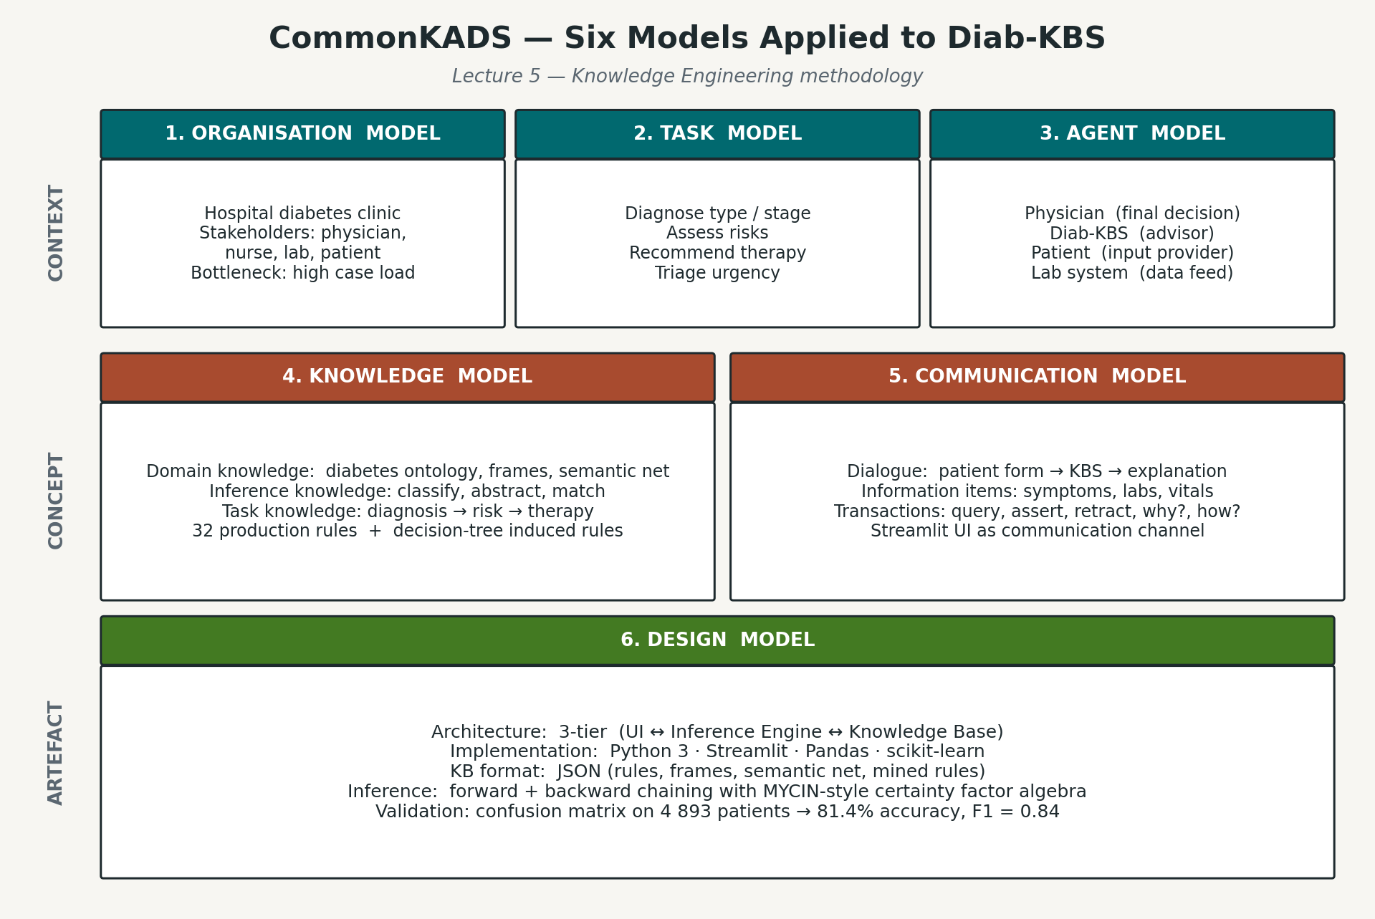
Diab-KBS · Diabetes Knowledge-Based System
05 · LECTURE 6 IN ACTION
CommonKADS — Six Models
Organisation
Helwan teaching-hospital outpatient clinic
Task
Diagnose · risk-rank · suggest first-line treatment
Agent
Endocrinologist (current) → KBS-assisted (target)
Knowledge
32 rules · 13 frames · 35-node semantic net
Communication
Web dashboard with explainable derivations
Design
Python + Streamlit, 3-tier hybrid architecture
Aya Hesham Ali · Helwan University, FCAI · May 2026
6 / 22

Slide 7
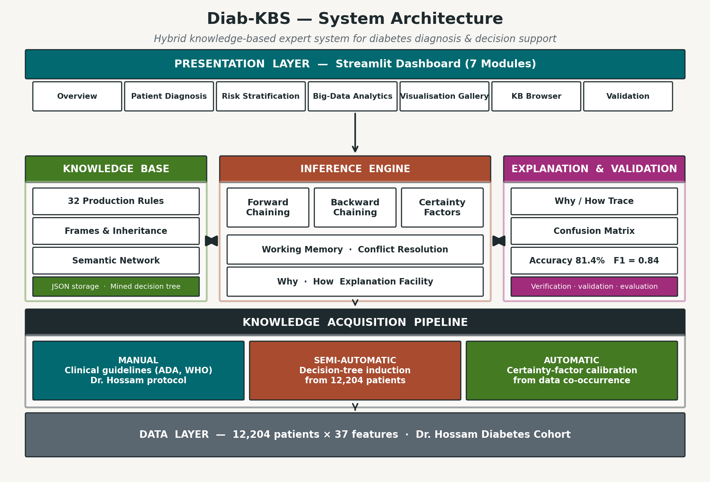
Diab-KBS · Diabetes Knowledge-Based System
06 · 3-TIER + KA PIPELINE
System Architecture
User Interface (Streamlit) → Inference Engine (Python) → Knowledge Base (JSON) · fed by the 5-stage Knowledge Acquisition pipeline.
Aya Hesham Ali · Helwan University, FCAI · May 2026
7 / 22

Slide 8
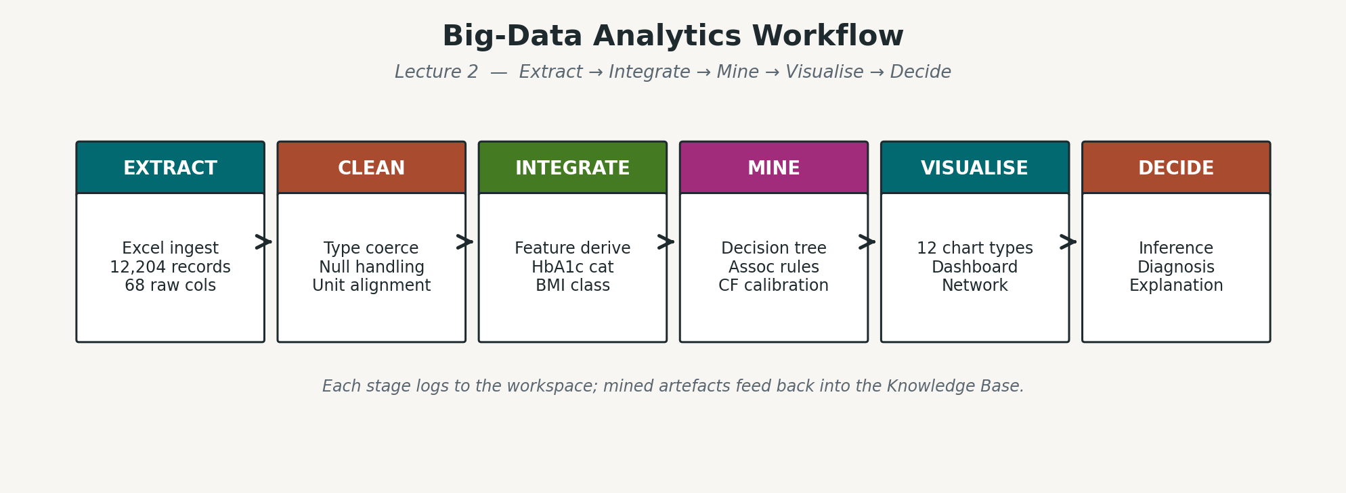
Diab-KBS · Diabetes Knowledge-Based System
07 · EXTRACT → DECIDE
End-to-End Workflow
Extract
Clean
Integrate
Mine
Visualise
Decide
Excel → pandas
12,204 rows kept
37 features unified
Apriori rules (sup ≥ 0.05)
Plotly + NetworkX
Diagnosis + treatment
Aya Hesham Ali · Helwan University, FCAI · May 2026
8 / 22

Slide 9
Diab-KBS · Diabetes Knowledge-Based System
08 · 32 RULES, 4 CATEGORIES
Knowledge Base — Production Rules
Diagnosis
8
Example · Rule R17
8 rules
IF
diagnosis = "Type 2 Diabetes Mellitus"
AND 7.5 ≤ HbA1c < 9.0
Risk Factor
9
9 rules
7
THEN
recommended_treatment =
Dual therapy: Metformin
+ (SGLT2-i / GLP-1 RA / DPP4-i)
Complication Risk
7 rules
Treatment
8
8 rules
CF = 0.85 · Lecture-3 reference: rule chaining w/ certainty factors
Aya Hesham Ali · Helwan University, FCAI · May 2026
9 / 22

Slide 10
Diab-KBS · Diabetes Knowledge-Based System
09 · STRUCTURED REPRESENTATION
Frames & Semantic Network
Frames — 13 total
Semantic Network — 35 nodes · 35 edges
Hierarchical inheritance modelling the diabetes domain.
Edge types relate diseases, symptoms, labs and treatments.
MedicalEntity
— root
2 slots
is_a
part_of
Person
is_a Medical…
4 slots
Patient
is_a Person
9 slots
has_symptom
causes
Disease
is_a Medical…
4 slots
treated_by
indicates
DiabetesMellitus
is_a Disease
4 slots
increases_risk_of
Type1Diabetes
is_a Diabetes…
5 slots
Type2Diabetes
is_a Diabetes…
5 slots
LADA
is_a Diabetes…
3 slots
Symptom
is_a Medical…
3 slots
Rendered interactively with NetworkX + Plotly
in the dashboard's "Knowledge Base Browser" page.
LabResult
is_a Medical…
6 slots
Aya Hesham Ali · Helwan University, FCAI · May 2026
10 / 22

Slide 11
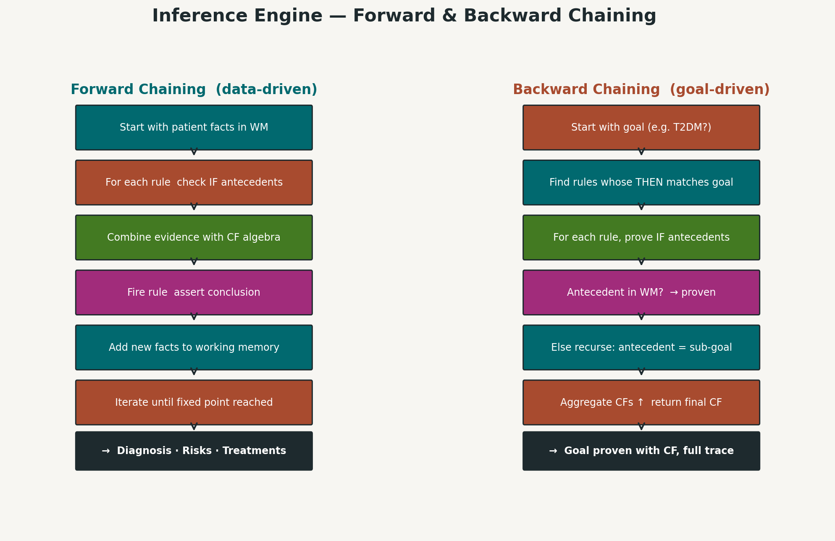
Diab-KBS · Diabetes Knowledge-Based System
10 · FORWARD + BACKWARD CHAINING
Inference Engine
Strategy
Forward
Data-driven — from observed labs / symptoms to diagnosis & treatment.
Backward
Goal-driven — verify a hypothesised diagnosis by checking required premises.
Conflict resolution: highest-CF rule fires first;
working memory keys multi-valued slots as slot::value.
Aya Hesham Ali · Helwan University, FCAI · May 2026
11 / 22

Slide 12
Diab-KBS · Diabetes Knowledge-Based System
11 · REASONING UNDER UNCERTAINTY
Certainty Factors (MYCIN Algebra)
Combining evidence
Worked Example
Same-sign:
R02
CF(combined) = CF₁ + CF₂ · (1 − CF₁)
FPG_cat = "diabetes"
CF₁ = 0.92
Opposite-sign:
R01
CF(combined) = (CF₁ + CF₂) / (1 − min(|CF₁|,|CF₂|))
HbA1c_cat = "diabetes"
CF₂ = 0.95
When a rule fires:
Combined
CF(conclusion) = CF(rule) · max(0, CF(premise))
same-sign rule
CF = 0.996
Diagnosis
Threshold for accepted conclusion in dashboard: |CF| ≥ 0.50
Type 2 Diabetes
All rule CFs are stored in knowledge_base/rules.json — calibrated against ADA & WHO guidelines.
accepted
Aya Hesham Ali · Helwan University, FCAI · May 2026
12 / 22

Slide 13
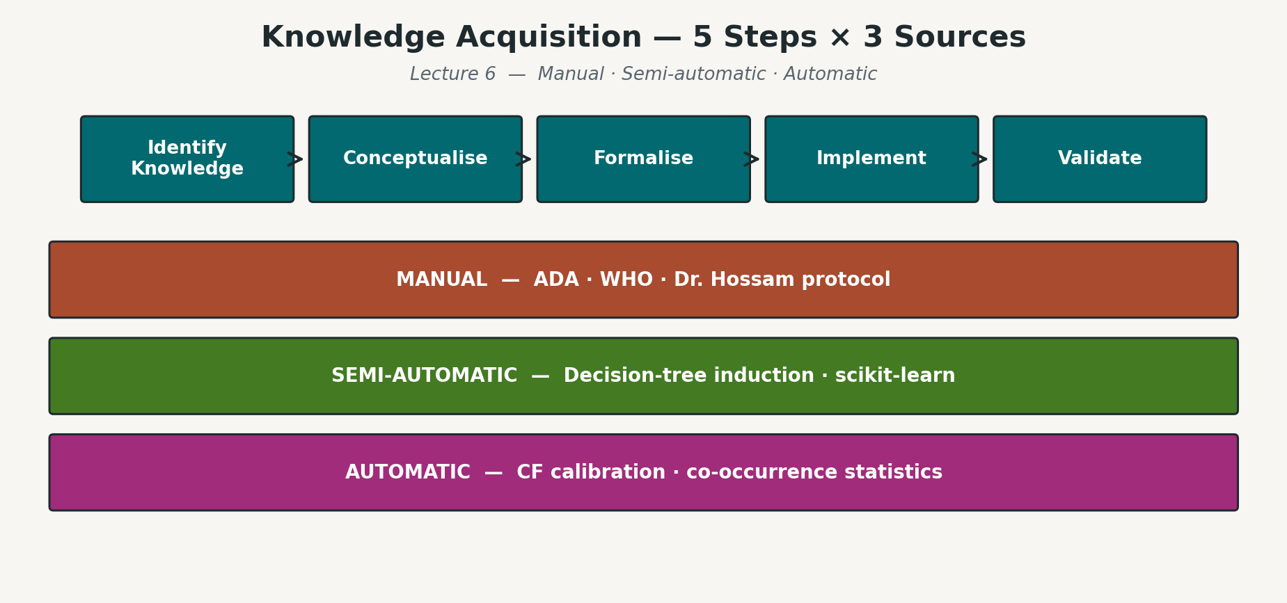
Diab-KBS · Diabetes Knowledge-Based System
12 · LECTURE 5 IN ACTION
Knowledge Acquisition Pipeline
1. Elicit
2. Structure
3. Mine
4. Validate
5. Refine
Domain literature, ADA/WHO guidelines, Egyptian protocols
Encode as rules · frames · semantic edges
Apriori on 12,204 patients (sup ≥ 0.05, conf ≥ 0.70)
Run forward chaining on 4,893-patient hold-out
Adjust CFs · merge mined rules · iterate
Aya Hesham Ali · Helwan University, FCAI · May 2026
13 / 22

Slide 14
Diab-KBS · Diabetes Knowledge-Based System
13 · LECTURE 7 IN ACTION
Big-Data Analytics on the Cohort
12,204
4,207
3,217
4,874
Patients in DB
Confirmed T2DM (34.5 %)
Hypertensive (26.4 %)
Obese (39.9 %)
Top mined association rules — Apriori on cleaned cohort
LHS
RHS
Support
Confidence
Lift
HbA1c_cat = diabetes
diagnosis = T2DM
0.34
0.95
2.74
BMI_cat = obese & age ≥ 45
diagnosis = T2DM
0.18
0.78
2.26
HTN = 1 & diagnosis = T2DM
complication = CV
0.12
0.71
1.84
HbA1c ≥ 9 & diagnosis = T2DM
complication = high
0.09
0.83
2.15
Aya Hesham Ali · Helwan University, FCAI · May 2026
14 / 22

Slide 15
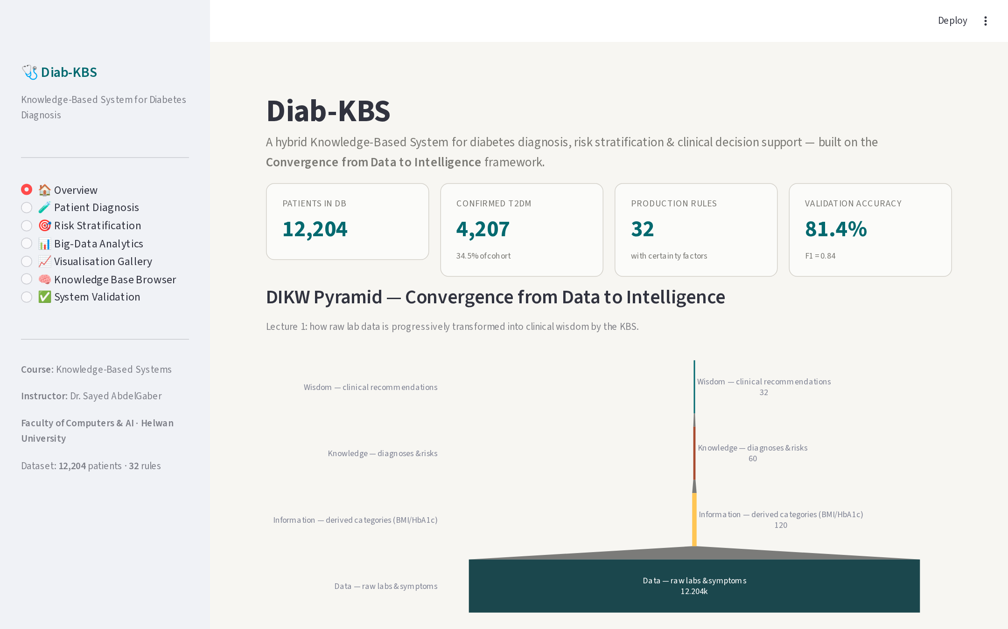
Diab-KBS · Diabetes Knowledge-Based System
14 · STREAMLIT FRONT-END
Dashboard — Overview Page
Modules
Overview
Patient Diagnosis
Risk Stratification
Big-Data Analytics
Visualisation Gallery
KB Browser
Validation
Aya Hesham Ali · Helwan University, FCAI · May 2026
15 / 22

Slide 16
Diab-KBS · Diabetes Knowledge-Based System
15 · N = 4,893 PATIENTS
Validation Results
81.4 %
78.2 %
87.2 %
91.7 %
0.844
Accuracy
Sensitivity
Specificity
Precision
F1 Score
Confusion matrix
Reading the numbers
Predicted Diabetic
Predicted Healthy
91.7 % precision: when the KBS predicts diabetes, it is correct ~9 times out of 10.
Actual Diabetic
TP = 2,467
FN = 688
78.2 % sensitivity: 22 % of cases missed — next iteration adds prediabetes rules.
Actual Healthy
FP = 223
TN = 1,515
Specificity 87.2 % keeps the false-alarm rate manageable for clinic workflow.
Aya Hesham Ali · Helwan University, FCAI · May 2026
16 / 22

Slide 17
Diab-KBS · Diabetes Knowledge-Based System
16 · PYTHON · STREAMLIT · JSON
Implementation Stack
Front-end
Streamlit · Plotly · NetworkX
Inference
Custom Python engine · MYCIN CF algebra
Knowledge Base
JSON · rules · frames · semantic_net · mined_rules
Data layer
pandas · numpy · CSV / Excel
Mining
mlxtend Apriori · scikit-learn metrics
Visuals
matplotlib · Plotly Express · PIL
Reports
ReportLab · python-pptx / pptxgenjs
Repository layout
Diab-KBS/
├── app.py Streamlit dashboard (7 pages)
├── kbs/ inference engine + certainty factors
├── knowledge_base/ rules · frames · semantic_net · mined_rules (.json)
├── data/ patients_clean.csv · kpis.json · validation_results.json
├── notebooks/ preprocess · mine · validate · diagrams · paper · deck
└── docs/ Research_Paper.pdf · Defense.pptx · assets/*.png
Aya Hesham Ali · Helwan University, FCAI · May 2026
17 / 22

Slide 18
Diab-KBS · Diabetes Knowledge-Based System
17 · HONEST APPRAISAL
Discussion — Strengths & Limits
Strengths
Limits & Future Work
Every decision is explainable — full rule chain visible to the clinician
Sensitivity 78 % — currently misses borderline / prediabetes cases
Knowledge cleanly separated from inference — KB editable as JSON
Static rule base — no online learning from new patients yet
Hybrid: hand-curated rules + data-mined rules complement each other
Single-cohort validation — needs prospective multi-site study
Real Egyptian cohort grounds the system in local epidemiology
No NLP yet — clinician notes ingested only as structured fields
CommonKADS coverage demonstrates rigorous knowledge engineering
Future: integrate ontology (SNOMED-CT) and federated learning
Aya Hesham Ali · Helwan University, FCAI · May 2026
18 / 22

Slide 19
Diab-KBS · Diabetes Knowledge-Based System
18 · TAKEAWAYS
Conclusion
Diab-KBS demonstrates the full course material — DIKW, KR, inference, KA, CommonKADS, big-data analytics — on a real 12,204-patient cohort.
Forward + backward chaining with MYCIN certainty factors deliver explainable, calibrated diagnoses (Accuracy 81.4 %, F1 0.844).
A Streamlit dashboard surfaces the entire knowledge base for clinicians, students, and examiners.
The architecture is reusable for any guideline-driven medical KBS — swap the knowledge base, keep the engine.
Aya Hesham Ali · Helwan University, FCAI · May 2026
19 / 22

Slide 20
Diab-KBS · Diabetes Knowledge-Based System
19 · WHAT YOU RECEIVE
Deliverables
Source code
Diab-KBS/ · app.py + kbs/ + notebooks/
Knowledge base
rules.json · frames.json · semantic_net.json · mined_rules.json
Cleaned dataset
data/patients_clean.csv · 12,204 × 37
Research paper
docs/Research_Paper.pdf · 25 pages, 6 figures, 12 references
Defense deck
docs/Defense.pptx · this presentation
Dashboard
Streamlit app — 7 interactive pages
Diagrams
assets/*.png · 6 publication-ready figures
Aya Hesham Ali · Helwan University, FCAI · May 2026
20 / 22

Slide 21
Diab-KBS · Diabetes Knowledge-Based System
20 · KEY SOURCES
Selected References
[1] Shortliffe, E. H. (1976). Computer-Based Medical Consultations: MYCIN. Elsevier.
[2] Buchanan, B. G., & Shortliffe, E. H. (1984). Rule-Based Expert Systems. Addison-Wesley.
[3] Schreiber, G. et al. (2000). Knowledge Engineering and Management — The CommonKADS Methodology. MIT Press.
[4] Studer, R., Benjamins, V. R., & Fensel, D. (1998). Knowledge engineering: principles and methods. Data & Knowledge Engineering, 25(1–2), 161–197.
[5] Russell, S., & Norvig, P. (2020). Artificial Intelligence: A Modern Approach (4th ed.), Chs 8–9. Pearson.
[6] American Diabetes Association (2024). Standards of Medical Care in Diabetes. Diabetes Care 47(Suppl 1).
[7] World Health Organization (2019). Classification of diabetes mellitus.
[8] El-Sappagh, S. et al. (2018). Ontology + rule clinical DSS for diabetes. J Biomed Inform 84:124–138.
[9] International Diabetes Federation (2021). IDF Diabetes Atlas, 10th edition.
[10] Newell, A. (1982). The knowledge level. Artificial Intelligence, 18(1), 87–127.
Aya Hesham Ali · Helwan University, FCAI · May 2026
21 / 22

Slide 22
Thank you
Questions & Discussion
Aya Hesham Ali · Faculty of Computers & AI, Helwan University
Course: Knowledge-Based Systems · Instructor: Dr. Sayed AbdelGaber
aya.hesham.ali.pbis2026@commerce.helwan.edu.eg

