Slide 1
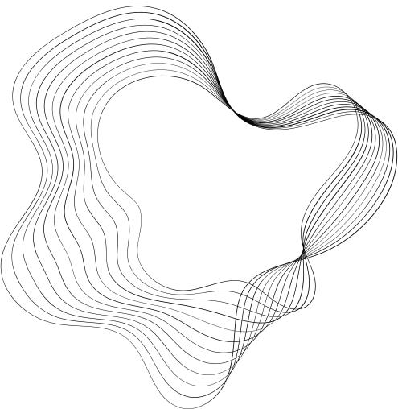

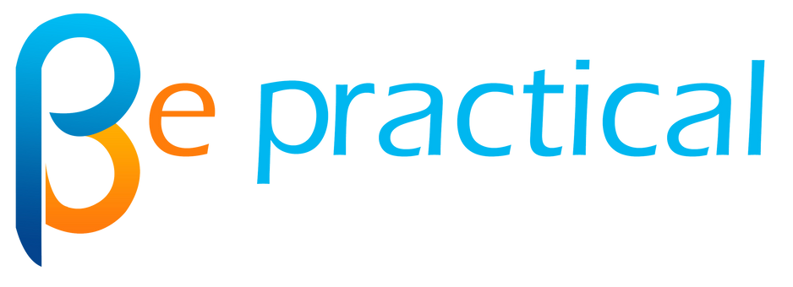
PRESENTATION ON
EVENTS
PRESENTED BY : AYAZ AHAMAD
GUIDE : JAVED SIR

Slide 2
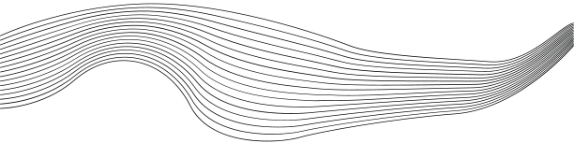
CONTENT
01
INTRODUCTION
02
WHAT IS EVENT?
03
USE OF EVENT
04
ANATOMY OF EVENT
05
TYPES OF EVENT
06
ADVANTAGES & DISSADVANTAGES
07
CONCLUSION

Slide 3
INTRODUCTION
In web development, events are like signals that tell your website when something happens. They could be when you click a button, type on your keyboard, move your mouse, or do other actions. These events make websites interactive. Just like pressing a remote control button changes what you see on TV, events change what you see and do on a website. By using events, website creators can make sure their websites respond and adapt to what you're doing, making your online experience more fun and engaging.

Slide 4

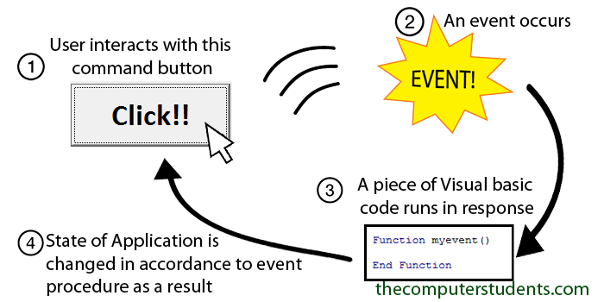
WHAT IS EVENT?
An event in programming is like a notification that tells the program when something happens, such as a button being clicked or a key being pressed. It's a way for the program to know what's going on and react accordingly.

Slide 5
USE OF EVENT
WHY?
Interactivity: Events enable user interactions with software, making applications responsive and allowing users to engage with interfaces naturally through actions like clicking buttons, typing, and scrolling.
Real-time Updates: Events help deliver real-time updates by triggering actions when new data arrives, ensuring that applications remain current without requiring manual refreshing.
Dynamic UI: With events, interfaces can change and adapt based on user actions, improving user experience by providing immediate feedback and dynamic content.
Efficient Asynchronous Programming: Events allow programming tasks to continue while waiting for certain actions, optimizing resource utilization and preventing blocking behaviour.
Enhanced User Experience: Events enable the creation of interactive features like animations, tooltips, and pop-ups, contributing to a more engaging and enjoyable user experience.
Error Handling: Events can be used to detect and handle errors, providing a structured way to manage unexpected situations.

Slide 6
USE OF EVENT
WHERE?
IoT (Internet of Things):
Sensor Data: Events process data from various sensors, like humidity or light sensors.
Remote Control: Events capture signals from remote devices like smartphones to control IoT devices.
Multimedia Applications:
Media Playback: Events control media playback, like play, pause, and volume adjustments.
Timed Events: Events trigger actions at specific times, such as animations synchronized with audio.
Form Validation:
Input Validation: Events validate user input in real-time, providing feedback on valid/invalid entries.
User Experience Enhancements:
Tooltips: Events trigger tooltips when hovering over elements for additional information.
Pop-ups: Events activate pop-ups for displaying detailed content or messages.
Web Development:
User Interfaces: Events power interactions like button clicks, form submissions, and input validations.
Animations: Events trigger animations and transitions for visual enhancements.
Navigation: Click events are used for navigating between different sections of a web page.

Slide 7
ANATOMY OF EVENT
Let's say you have a simple HTML webpage with a button element that triggers an event when clicked.
1. HTML Markup:
<!DOCTYPE html>
<html>
<head>
<title>Event Anatomy Example</title>
</head>
<body>
<button id="myButton">Click me</button>
<script src="script.js"></script>
</body>
</html>

Slide 8
ANATOMY OF EVENT
2. JavaScript (script.js):
// Step 1: Get a reference to the button element
const button = document.getElementById('myButton');
// Step 2: Define the event listener function
function handleClick(event) {
alert('Button clicked!');
}
// Step 3: Attach the event listener to the button
button.addEventListener('click', handleClick);

Slide 9
ANATOMY OF EVENT
Event Target:
The event target is the HTML element to which you attach the event listener. In this case, the target is the <button> element with the ID "myButton".
Event Type:
The event type specifies what kind of interaction or occurrence you want to listen for. In this case, you are interested in the "click" event, which occurs when the button is clicked.
Callback Function:
The callback function is the JavaScript code that you want to run when the event happens. In this example, the handleClick function is the callback function. It's a function you define to respond to the "click" event.
Event Listener:
An event listener is a piece of JavaScript code that "listens" for a specific event on a particular element and then executes the associated callback function when that event occurs. In the code, button.addEventListener('click', handleClick); is attaching an event listener to the "click" event of the button element. This means that when the button is clicked, the handleClick function will be executed.

Slide 10
ANATOMY OF EVENT
Event Object:
When the event occurs (in this case, when the button is clicked), the browser automatically creates an event object. This object contains information about the event and is passed to the callback function you specified. In the handleClick function, the parameter event represents this event object.
Properties of the Event Object:
type: Indicates the type of event that occurred (e.g., "click", "keydown").
target: References the DOM element on which the event was triggered.
currentTarget: References the element currently handling the event (can differ in the case of event propagation).
clientX and clientY: Store the coordinates of the mouse pointer when the event occurred (useful for mouse-related events).
keyCode: Contains the key code of the pressed key (useful for keyboard-related events).

Slide 11
ANATOMY OF EVENT
Event Object:
Suppose you want to display the coordinates of the mouse pointer when a button is clicked. Here's how you can do that using the event object:
const button = document.getElementById('myButton');
function handleClick(event) {
const x = event.clientX;
const y = event.clientY;
alert(`Mouse coordinates: X=${x}, Y=${y}`);
}
button.addEventListener('click', handleClick);

Slide 12
ANATOMY OF EVENT
Event Object:
Methods of the Event Object:
In addition to properties, the event object also provides methods to control and interact with the event:
preventDefault(): Prevents the default behavior associated with the event. For instance, calling this method on a click event prevents a link from navigating to a new page.
stopPropagation(): Prevents the event from bubbling up or capturing down the DOM tree during event propagation.
EX: Suppose you want to prevent a link from navigating when clicked. You can use the preventDefault() method:
const link = document.getElementById('myLink');
function handleLinkClick(event) {
event.preventDefault();
alert('Link click prevented!');
}
link.addEventListener('click', handleLinkClick);

Slide 13
ANATOMY OF EVENT
Removing Event Listeners:
Sometimes, you might need to remove an event listener from an element. You can do this using the ‘removeEventListener’ method. However, the function you pass to ‘removeEventListener’ must be the exact same function you used to add the listener in the first place. This can lead to issues if you're using anonymous functions as event listeners.
const button = document.getElementById('myButton');
function handleClick() {
alert('Button clicked!');
}
button.addEventListener('click', handleClick);
// Later, you can remove the event listener like this:
button.removeEventListener('click', handleClick);

Slide 14
ANATOMY OF EVENT
Event Propagation:
Events in the DOM follow a propagation flow: capturing phase, target phase, and bubbling phase. During the capturing phase, the event descends from the root to the target element. Then, during the bubbling phase, it ascends from the target back to the root. You can control which phase the event listener responds to by using the addEventListener method's third parameter: useCapture.
const parent = document.getElementById('parent');
const child = document.getElementById('child');
function handleCapture() {
console.log('Capture phase: Parent');
}
function handleBubble() {
console.log('Bubble phase: Child');
}
parent.addEventListener('click', handleCapture, true); // Use capture phase
child.addEventListener('click', handleBubble, false); // Use bubbling phase

Slide 15
ANATOMY OF EVENT
Event Delegation:
Event delegation is a technique where you attach a single event listener to a common ancestor of multiple elements instead of attaching individual listeners to each element. This is useful for improving performance when dealing with a large number of elements.
<ul id="myList">
<li>Item 1</li>
<li>Item 2</li>
<li>Item 3</li>
</ul>
<script>
const list = document.getElementById('myList');
function handleItemClick(event) {
if (event.target.tagName === 'LI') {
console.log(`Clicked on ${event.target.textContent}`);
}
}
list.addEventListener('click', handleItemClick);
</script>

Slide 16

TYPES OF EVENTS
01
02
03
04
05
06
07
08
Mouse Events
Keyboard Events
Form Events
Focus Events
Window Events
Media Events
Touch Events
Custom Events

Slide 17
1. Click Event
A "click" event occurs when a user clicks an element, like a button or a link.
<button id="myButton">Click me</button>
<script>
const button = document.getElementById('myButton');
button.addEventListener('click', function() {
alert('Button clicked!');
});
</script>

Slide 18
2. Keydown Event
A "keydown" event occurs when a user presses a key on the keyboard.
<input type="text" id="myInput">
<script>
const input = document.getElementById('myInput');
input.addEventListener('keydown', function(event) {
console.log(`Key pressed: ${event.key}`);
});
</script>

Slide 19
3. Mouseover Event
A "mouseover" event occurs when the mouse cursor enters an element.
<div id="myDiv" style="width: 100px; height: 100px; background-color: blue;"></div>
<script>
const div = document.getElementById('myDiv');
div.addEventListener('mouseover', function() {
div.style.backgroundColor = 'red';
});
</script>

Slide 20
4. Mouseout Event
A "mouseout" event occurs when the mouse cursor leaves an element.
<div id="myDiv" style="width: 100px; height: 100px; background-color: blue;"></div>
<script>
const div = document.getElementById('myDiv');
div.addEventListener('mouseout', function() {
div.style.backgroundColor = 'blue';
});
</script>

Slide 21
5. Submit Event
A "submit" event occurs when a form is submitted, usually triggered by clicking a submit button.
<form id="myForm">
<input type="text" name="username" placeholder="Username">
<button type="submit">Submit</button>
</form>
<script>
const form = document.getElementById('myForm');
form.addEventListener('submit', function(event) {
event.preventDefault();
const formData = new FormData(form);
console.log('Form submitted with data:', formData);
});
</script>

Slide 22
6. Load Event
A "load" event occurs when a web page or an image finishes loading.
<img id="myImage" src="image.jpg">
<script>
const image = document.getElementById('myImage');
image.addEventListener('load', function() {
console.log('Image loaded');
});
</script>

Slide 23
TYPES OF EVENT
1. Mouse Events:
click: Occurs when a mouse button is clicked on an element.
dblclick: Occurs when a mouse button is double-clicked on an element.
mousedown: Occurs when a mouse button is pressed down on an element.
mouseup: Occurs when a mouse button is released on an element.
mousemove: Occurs when the mouse cursor moves over an element.
mouseover: Occurs when the mouse cursor enters an element.
mouseout: Occurs when the mouse cursor leaves an element.
2. Keyboard Events:
keydown: Occurs when a key on the keyboard is pressed down.
keyup: Occurs when a key on the keyboard is released.
keypress: Occurs when a key that produces a character value is pressed down.
3. Form Events:
submit: Occurs when a form is submitted.
reset: Occurs when a form is reset.
input: Occurs when the value of an input element changes.
change: Occurs when the value of a form element (like a select dropdown) changes.

Slide 24
TYPES OF EVENT
4. Focus Events:
focus: Occurs when an element receives focus (e.g., clicked or tabbed into).
blur: Occurs when an element loses focus.
5. Window Events:
load: Occurs when a web page or an external resource finishes loading.
unload: Occurs when a page is about to be unloaded (not well-supported).
resize: Occurs when the browser window is resized.
scroll: Occurs when scrolling within an element.
6. Media Events:
play: Occurs when media playback begins.
pause: Occurs when media playback is paused.
ended: Occurs when media playback has ended.
7. Drag and Drop Events:
dragstart: Occurs when an element is dragged.
drag: Occurs when an element is being dragged.
dragend: Occurs when an element has been dropped.

Slide 25
TYPES OF EVENT
8. Touch Events:
touchstart: Occurs when a touch point is placed on the touch surface.
touchmove: Occurs when a touch point is moved along the touch surface.
touchend: Occurs when a touch point is removed from the touch surface.
9. Transition and Animation Events:
transitionend: Occurs when a CSS transition ends.
animationstart: Occurs when a CSS animation starts.
animationiteration: Occurs when a CSS animation repeats.
animationend: Occurs when a CSS animation ends.
10. Custom Events:
You can also create and dispatch your own custom events using the ‘CustomEvent’ constructor

Slide 26
ADVANTAGES OF EVENTS
Interactivity: Events enable users to interact with applications, making interfaces responsive and engaging by responding to clicks, keystrokes, and other actions.
User Experience: By responding promptly to user actions, events enhance the overall user experience, making applications feel intuitive and fluid.
Real-Time Updates: Events allow applications to receive and respond to real-time data changes, providing users with up-to-date information without manual refreshing.
Asynchronous Programming: Events support asynchronous programming, enabling tasks to continue while waiting for certain events, improving application performance.
Modularity: Using events, you can modularize code by separating concerns into event handlers, leading to cleaner and more maintainable codebases.
Extensibility: Event-driven architectures facilitate the addition of new features by simply attaching event listeners to existing or new elements.
Customization: Events enable developers to tailor application behavior based on user interactions, adapting to individual preferences.

Slide 27
DISSADVANTAGES OF EVENTS
Tight Coupling: Overuse of events can lead to tight coupling between components, making the application harder to refactor and maintain.
Performance Impact: Overuse of frequent events (e.g., mousemove) can impact application performance, especially on resource-constrained devices.
Unpredictable User Behavior: Relying heavily on events might not handle all user interactions or scenarios, leading to unexpected outcomes.
Lack of Context: In cases where events are fired outside user interaction (e.g., data updates), the user context might be lost.
Accessibility Concerns: Relying solely on events can pose accessibility challenges for users with disabilities who rely on assistive technologies.
Synchronization Issues: Synchronizing events across multiple components can be challenging, potentially leading to race conditions.
Event Collisions: Multiple event listeners on the same element might conflict, causing unintended behavior.
Debugging Complexity: Complex interactions involving multiple events can be challenging to debug and reproduce consistently.

Slide 28
CONCLUSION
In conclusion, events are the heartbeat of interactive programming. They empower developers to design dynamic and engaging applications that respond to user actions, system changes, and external stimuli. By providing triggers for code execution, events breathe life into user interfaces, allowing seamless interactions, real-time updates, and personalized experiences.
A well-structured event-driven approach can result in applications that captivate users, offer efficient interactions, and adapt gracefully to the evolving needs of modern software development.

Slide 29
THANK YOU

