Slide 1
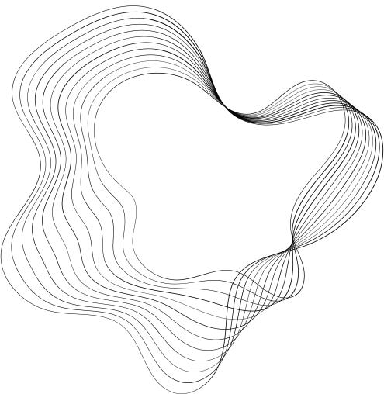


PRESENTATION ON
FUNCTION'S
PRESENTED BY :AYAZ AHAMAD
GUIDE:JAVED SIR

Slide 2

CONTENT
01
INTRODUCTION
02
WHAT IS FUNCTION?
03
USE OF FUNCTIONS
04
ANATOMY OF FUNCTION
05
TYPES OF FUNCTION
06
WAYS TO WRITE THE FUNCTION
07
CONCLUSION

Slide 3
INTRODUCTION
Welcome to our presentation on "Understanding Functions in Programming." In the world of coding, functions serve as essential tools that contribute to well-organized and reusable code. Today, we'll delve into the significance of functions and how they act as the fundamental building blocks in crafting efficient and effective software solutions. Let's explore how functions streamline complex tasks, enhance code readability, and contribute to the overall success of our programming endeavors.

Slide 4

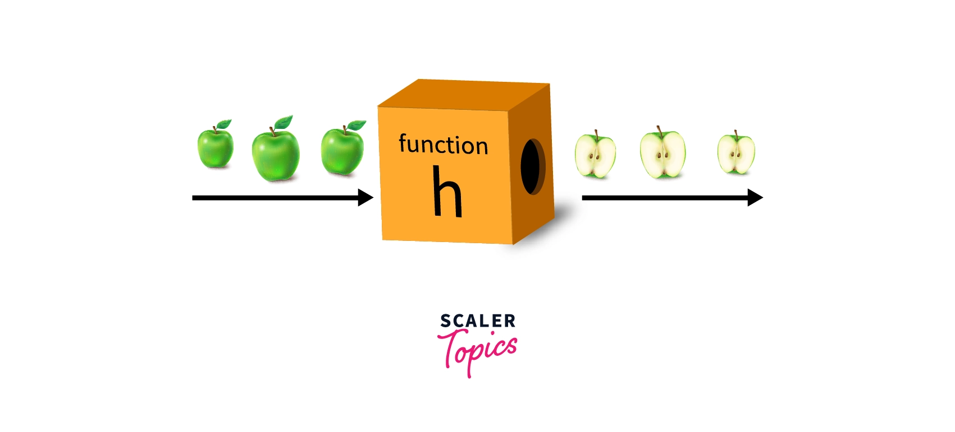
WHAT IS FUNCTION?
Functions are a fundamental blocks in programming, They allow you to group a set of instructions together and give them a name, making your code more organized, modular, and reusable.
Think of functions like recipes: you define a set of steps to perform a specific task, and you can reuse that recipe whenever you want to achieve that task again.

Slide 5
USE OF FUNCTION
WHY?
Modularity and Reusability: Functions allow you to break down your code into smaller, more manageable pieces. You can write a function to perform a specific task, and then reuse that function wherever you need that task to be performed again. This modular approach makes your codebase cleaner and more maintainable.
Readability: Using functions enhances the readability of your code. Functions are named according to their purpose, making it easier for you and other developers to understand what a particular piece of code does.
Debugging and Testing: Functions create clear boundaries for testing and debugging. You can isolate and test individual functions without affecting the rest of the codebase. This targeted testing simplifies the process of identifying and fixing issues.
Scoping: Functions create their own scope. Variables declared within a function are local to that function, preventing unintended interference with variables in other parts of your code.
Event Handling: Functions are essential for event handling in web development. You attach functions to events (like clicks or keypresses), allowing your code to respond to user interactions.

Slide 6
USE OF FUNCTION
WHERE?
Validation and Form Handling: Functions can validate user inputs, such as checking if an email address is valid or if a password meets certain criteria. They are also used to handle form submissions and perform necessary actions.
Mathematical Calculations: JavaScript functions are used for performing calculations, such as addition, subtraction, multiplication, and more.
Object-Oriented Programming: Functions can be used as methods within objects to define behaviors associated with those objects.
Encapsulation of Logic: Functions allow you to encapsulate complex logic, making your codebase more modular and understandable.
Time-Based Operations: Functions like setTimeout and setInterval execute code after a certain delay or at regular intervals, respectively.
Event Handling: Functions are used to handle user interactions like clicks, keyboard input, and form submissions. When an event occurs, a specified function is executed, allowing you to respond to user actions.

Slide 7
ANATOMY OF FUNCTION
1. Function Declaration:
A function begins with the function keyword, followed by the function's name (identifier). This is how you give a name to your function, making it callable later in your code.
function greet(name) {
console.log(`Hello, ${name}!`);
}
2. Parameters:
Parameters are placeholders for values that the function expects to receive when it's called. They act as variables within the function, representing the inputs it will work with.
function add(a, b) {
return a + b;
}

Slide 8
ANATOMY OF FUNCTION
3. Function Body:
The function body is enclosed within curly braces {}. It contains the instructions that the function will execute when called. This is where you define the actual behavior of the function.
function multiply(x, y) {
return x * y;
}
4. Return Statement:
Functions can produce a result using the return statement. This is the value that the function "returns" back to the caller. If there's no return statement, the function returns undefined.
function subtract(a, b) {
return a - b;
}

Slide 9
ANATOMY OF FUNCTION
5. Function Call:
To execute a function and make it perform its defined actions, you call it by using its name followed by parentheses. You can also pass arguments to the function's parameters.
greet("Alice"); // Output: "Hello, Alice!"
const result = add(3, 5); // result will be 8
6. Parameters vs. Arguments:
Parameters are the placeholders in the function definition,
while arguments are the actual values you pass to the function when you call it.
function fullName(firstName, lastName) {
return `${firstName} ${lastName}`;
}
const completeName = fullName("John", "Doe");
// completeName will be "John Doe"

Slide 10

TYPES OF FUNCTION
01
02
03
04
FUNCTION WITH NO ARGUMENT AND NO RETURN VALUE
FUNCTION WITH ARGUMENT AND NO RETURN VALUE
FUNCTION WITH NO ARGUMENT AND WITH RETURN VALUE
FUNCTION WITH ARGUMENT AND WITH RETURN VALUE

Slide 11
1) DEFAULT FUNCTION (NO PARAMETER, NO RETURN VALUE)
This type of function performs a task without taking any inputs or returning any results.
// Function definition
function greet() {
console.log("Hello, there!");
}
// Calling the function
greet(); // Output: "Hello, there!"

Slide 12
2) WITHOUT PARAMETER, WITH RETURN VALUE
This type of function doesn't take any inputs but returns a value after performing a task.
function addFunction(){
let firstNumber = 10, secondNumber = 20, sum;
sum = firstNumber + secondNumber;
return sum;
}
document.write(`<strong>Without Parameter, with Return value :
${addFunction()}</strong>`);

Slide 13
3) WITH PARAMETER, WITHOUT RETURN VALUE
This type of function takes inputs (parameters) and performs a task without returning any value.
// Function definition
function sayHello(name) {
console.log(`Hello, ${name}!`);
}
// Calling the function
sayHello("Alice"); // Output: "Hello, Alice!"

Slide 14
4) WITH PARAMETER, WITH RETURN VALUE
This type of function takes inputs, performs a task, and then returns a value.
// Function definition
function add(a, b) {
return a + b;
}
// Calling the function
const sum = add(3, 5);
console.log(`Sum: ${sum}`); // Output: "Sum: 8"

Slide 15
TYPES OF FUNCTIONS IN JS
(METHODS TO WRITE THE FUNCTION'S)
1. NAMED FUNCTION :
Named functions in JavaScript are functions that have a specified name identifier when they are defined. These names are used to reference the functions in your code.
Named functions can be defined using the function keyword followed by the function name, parameters, and function body.
// Named function definition
function greet(name) {
console.log(`Hello, ${name}!`);
}
// Calling the function
greet("Alice"); // Output: "Hello, Alice!"
greet("Bob"); // Output: "Hello, Bob!"

Slide 16
TYPES OF FUNCTIONS IN JS
(METHODS TO WRITE THE FUNCTION'S)
2. ANONYMOUS FUNCTION :
An anonymous function is a function without name. It's often used as a callback function or assigned to a variable.
They are commonly used in scenario where you need to pass a function as an argument to another function.
const multiply = function(a, b) {
return a * b;
};
console.log(multiply(3, 4)); // Output: 12

Slide 17
TYPES OF FUNCTIONS IN JS
(METHODS TO WRITE THE FUNCTION'S)
3. ARROW FUNCTION :
An arrow function in JavaScript is a more concise way to define functions, introduced in ES6 (ECMAScript 2015).
Arrow functions offer a shorter syntax compared to traditional function expressions. They are often used for shorter functions, especially when working with callbacks and higher-order functions.
// Traditional function expression
const multiply = function(a, b) {
return a * b;
};
// Arrow function equivalent
const multiplyArrow = (a, b) => a * b;
console.log(multiply(3, 4)); // Output: 12
console.log(multiplyArrow(3, 4)); // Output: 12

Slide 18
TYPES OF FUNCTIONS IN JS
(METHODS TO WRITE THE FUNCTION'S)
4. CALLBACK FUNCTION :
A callback function in JavaScript is a function that is passed as an argument to another function and is executed later, after the completion of a certain task or event. Callback functions are commonly used for asynchronous operations, handling events, and achieving modularity in code.
function fetchData(callback) {
setTimeout(function() {
const data = "Fetched data";
callback(data);
}, 1000);
}
function processData(data) {
console.log("Received:", data);
}
fetchData(processData); // Output: Received: Fetched data

Slide 19
TYPES OF FUNCTIONS IN JS
(METHODS TO WRITE THE FUNCTION'S)
5. Immediately Invoked Function Expressions (IIFE):
IIFE functions are defined and executed immediately after creation.
(function() {
console.log("IIFE executed");
})();
// Output: IIFE executed

Slide 20
TYPES OF FUNCTIONS IN JS
(METHODS TO WRITE THE FUNCTION'S)
6. Higher-Order Functions:
A higher-order function in JavaScript is a function that takes one or more functions as arguments, returns a function as its result, or both.
// Higher-order function that performs an operation using a callback
function calculate(a, b, operation) {
return operation(a, b);
}
// Callback function for addition
function add(x, y) {
return x + y;
}
// Using the calculate function with the add callback
const sum = calculate(5, 3, add); // Output: 8
console.log("Sum:", sum);

Slide 21
TYPES OF FUNCTIONS IN JS
(METHODS TO WRITE THE FUNCTION'S)
7. Generator Functions:
A generator function in JavaScript is a special type of function that can be paused and resumed during its execution, allowing you to generate a sequence of values lazily over time.
It's defined using the function* syntax and uses the yield keyword to produce values while maintaining its own state.
This is particularly useful when dealing with asynchronous operations, infinite sequences, or scenarios where you want more control over the flow of execution.
function* numberGenerator() {
yield 1;
yield 2;
yield 3;
}
const generator = numberGenerator();
console.log(generator.next().value); // Output: 1
console.log(generator.next().value); // Output: 2
console.log(generator.next().value); // Output: 3
console.log(generator.next().value); // Output: undefined (no more yields)

Slide 22
QUESTION'S
What is a function in JavaScript?
Explain the difference between a function declaration and a function expression.
What are the benefits of using functions in JavaScript?
How do you define a function in JavaScript?
How do you return a value from a function in JavaScript?
What is the scope of a variable declared inside a function?
What is a higher-order function?
What are arrow functions in JavaScript?

Slide 23
CONCLUSION
In summary, functions serve as the building blocks of JavaScript, enabling the creation of organized, modular, and reusable code.
They allow developers to encapsulate logic, handle asynchronous tasks, and respond to events. By understanding and utilizing functions effectively, developers can craft more efficient, flexible, and maintainable applications.

Slide 24
THANK YOU

