Slide 1

My RSS News
Your News when you decide
Ayako.D, Elodie.B, Guillaume.P

Slide 2

Introduction
Are you tired to search the latest news on internet? To waste your time to find the right web page?
We have the solution! My RSS News!
You access to our user interface and you choose to receive the latest news directly by email.
We take care of everything: content retrieving of RSS to the email sending.

Slide 3
Agenda
What is RSS ?
RSS Recovery
User Interface
Email Sending

Slide 4

I. What is RSS ?

Slide 5

What is RSS?
Rich Site Summary
Changing web content
Syndicated content
XML format
Publish frequently updated information

Slide 6
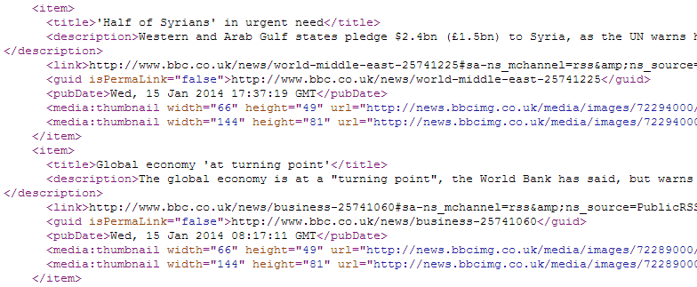
What does RSS look like ?
XML Format

Slide 7
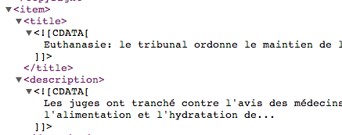
What is CDATA ?
Stands for Character DATA
It behaves similarly to a comment, but it is still part of the document

Slide 8
Workflow
Recovery of RSS
User Interface
Send email?
No
Yes
Send by email the contents of the text file
End

Slide 9
II. RSS Recovery

Slide 10
Feeds Recovery
RSS Choice :
url_flux1
url_flux2
Function showTitleAndDescriptionOfURL2 () :
url_flux2 content recovery
Save as : titleAndDescriptionOfURL2.txt
Function showTitleAndDescriptionOfURL1 () :
url_flux1 content recovery
Function filterCDATA() :
Erase some terms :
<![CDATA[ ]]> in url_flux2
Update of :
titleAndDescriptionOfURL2.txt
Function fusionRSS1andRSS2 () :
Fusion of both results
Save as :
fusionRSS1andRSS2.txt
Function deleteSpaceBeforeLine () :
Refine text
Save as :
yourRSSNews.txt

Slide 11
Curl
Make request to a server like http
GET method
-s | silent mode : don’t show progress meter

Slide 12
Grep
Filter
\{...\} | Repetition
\{Example\} | Repetition of Example (exactly)
\{Example,\} | Repetition of Example (minima)
\{Example 1 Example2\} | Repetition of Example1 to Example2
s | substrat : delete found terms
g | global : do it on each line

Slide 13
Sed
Work line by line (flow mode)
-e | specify a simple command, between quotes (double or simple) to avoid some terms which can be interpreted by shell

Slide 14
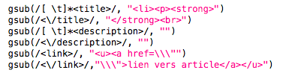
Why don’t use awk ?
Awk would be the best choice
Cut piece by piece title and description
Permit to make a better style with html tag (using gsub)
Save in a .htm file
However more difficult to use than grep and sed
Example of what we could do :

Slide 15
III. User Interface

Slide 16
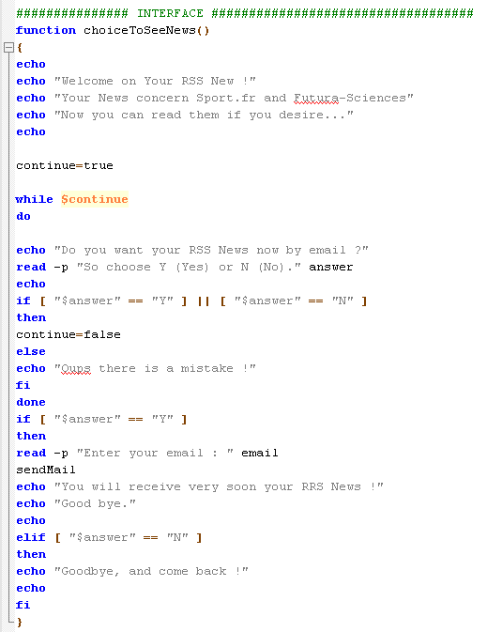
User Interface
Function choiceToSeeNews () :
Send RSS News by email?
No
Other
Yes
Enter the adress email :
$email
Function sendMail ()
End

Slide 17
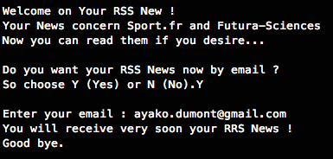
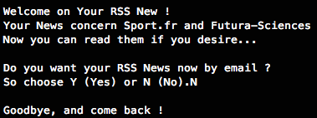
User Interface : example

Slide 18
IV. Email Sending

Slide 19

Email sending
Function in the user interface
Recovery text file : RSS information
Sending email with the contents of the text file via an SMTP server
User Interface :
If the user wants to receive the mail ($answer = yes)
=> Entering the email : $email
Function sendMail () :
Recovery of yourRSSNews.txt
Send the Mail at the mail adress : $email

Slide 20

SMTP Server - envisaged solutions
Two envisaged solutions : Emacs and OpenShift server
SMTP server : "Simple Mail Transfer Protocol."
Communication protocol used to transfer electronic mail to mail servers.
OpenShift server :
- OpenShift connection via the terminal
- Sending email directly from the command line
unpratical : email delivery is not automatic in the script

Slide 21


SMTP Server - envisaged solutions
Send an email with Emacs via Gmail
Configuration : “.emacs” file creation
Command line : emacs -nw
C-x m
Error sending mail : canceled solution
;;use the default agent with SMTP
(setq send-mail-function 'smtpmail-send-it)
;; send mails via smtp.gmail.com.
(setq smtpmail-smtp-server "smtp.gmail.com")
;; to specify the port used by 587 for TLS required by Gmail
(setq smtpmail-smtp-service 587)
;; use starttls, by specifying the server, port, private key and certificate, nil = null
(setq smtpmail-starttls-credentials '(("smtp.gmail.com" 587 nil nil)))
;; authentication password and login
(setq smtpmail-auth-credentials '(("smtp.gmail.com" 587 "adress@gmail.com" "password")))

Slide 22

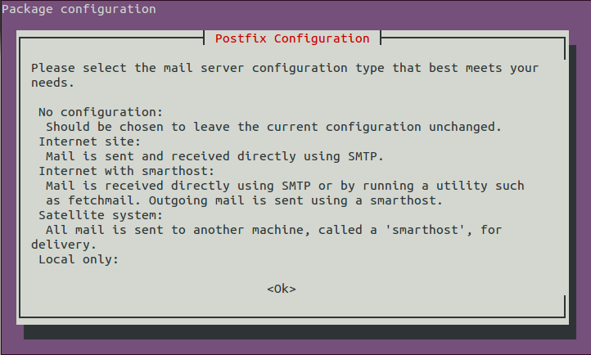
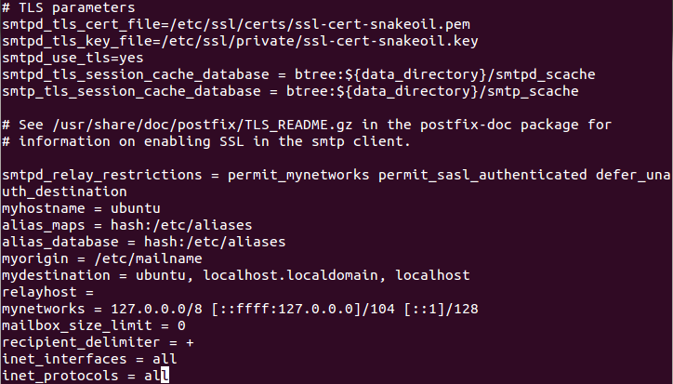
SMTP Server - chosen solution
SMTP server used : Postfix :
Mail transfer agent (MTA)
Installation and configuration :
apt-get install postfix
dpkg-reconfigure postfix
vi /etc/postfix/main.cf

Slide 23

SMTP Server - chosen solution
Script ssh :
Command line :

Slide 24
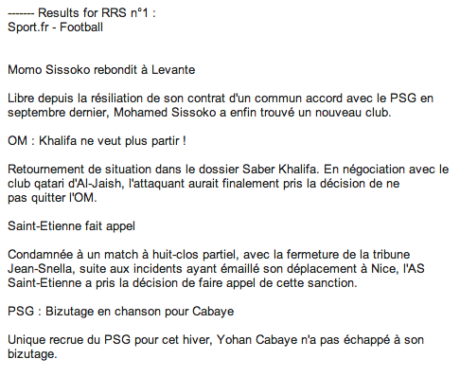
What you’ll receive…

Slide 25

Thank you !
We sincerely hope that you’ll enjoy My RSS News

