Slide 1
Some applications on arduino
Controlling led using push Button using if /switch statement
The led will be on if the button is pushed .
The led will be off if the button is released .

Slide 2
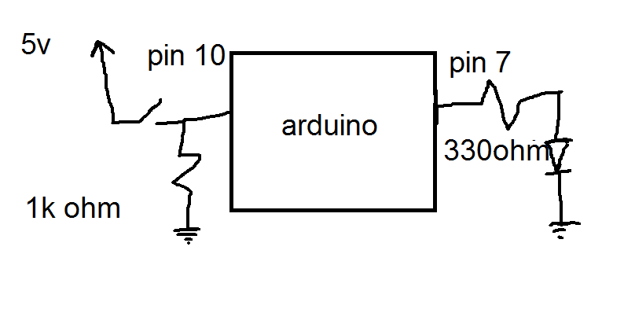
schematic of the circuit

Slide 3
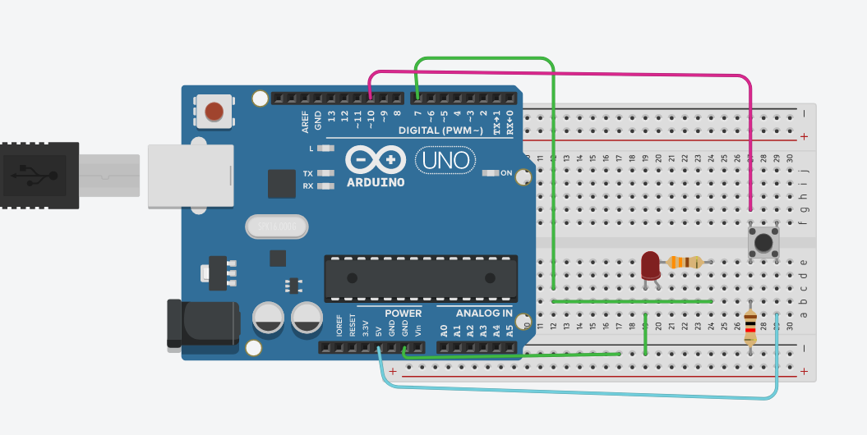
Design

Slide 4
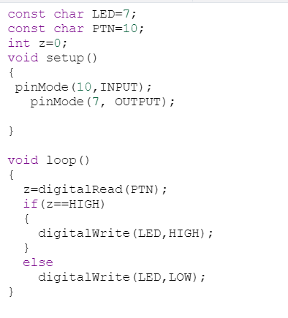
If statement code

Slide 5
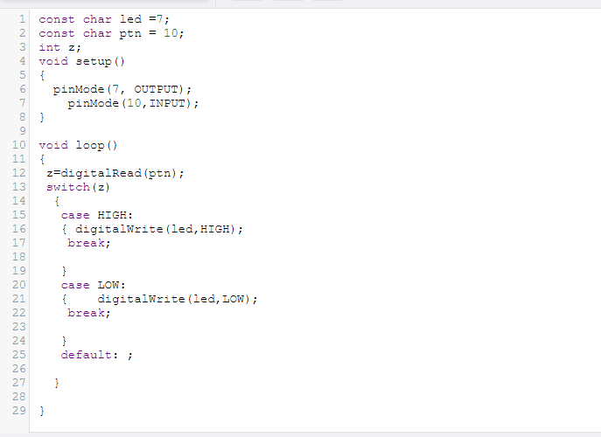
Switch statement code

