Slide 1
Finding Architecture of MLP
Ayan Gupta

Slide 2
        Definition Of Neural Network
        A neural network is a massively parallel distributed processor made up of simple processing units ,which has a natural propensity for storing experiential knowledge and making it available for use .

Slide 3
Neural Networks
Ultimate goal of Neural Net is to imitate a human brain.
But human brain is too complex to understand.
How can we incorporate these newfound insights of human brain into an ANN?

Slide 4
Why do we require a neural network?
Modern computers can compute much faster than a human being. But is it capable enough to solve such problems which are very easily solved a human being. For e. g.
Matching patterns
Identifying images or classifying images
Classifying surfaces and walk accordingly

Slide 5
Way out?
      To solve such problems we need to create an artificial brain which will work like a computer i.e. we need to put intelligence into machines.

Slide 6
  A human being becomes intelligent by learning process and experience. Then only a human being is able to solve basic problems like:
  Matching patterns
  Identifying images
  Doing basic jobs which are fed into its brain
  walking carefully in a tiles floor
  carefully handling items of glass
  i.e. all kinds of classifying jobs.

Slide 7
      Likewise we try to do the same thing in a Neural Network.
      At first we create a structure which resembles that of a human brain containing “neurons” and “synapses”.
      A neuron resembles to a ‘perceptron’ and synapse to a straight line bearing a ‘synaptic weight’ connecting two neurons.
      Then we get a graph like structure which can be represented through a computer program -------
      This graph like structure is commonly termed as
      Multi layer Perceptrons

Slide 8
Input layer hidden layer output layer
x₀=1
h₀=1
h₁
y
x₁
x₂
h₂

Slide 9
This project basically is divided into 3 parts:
Training the data sets (the most important)
Validating the data sets
Finally test the data sets and hence find the final error of the architecture

Slide 10
Training
As human being learns best through training, we also train a neural network so that it learns and gains information.
At first start with an initial weights (information) then go on updating the weights vectors by vectors.
Do it for all the training vectors.
Continue doing it until all the training vectors converges.
The final weights obtained is the final information obtained.
This method of training is called ‘online’ training method where each vector is trained until errors for all the training vectors goes beyond a predetermined threshold value.

Slide 11
Validation
After the data set gets trained, a different subset of the original data set is taken in random order
It is then put under the architecture formed and the error is observed
If the error in the training is very close (i.e. their difference is very low) the it is ok , otherwise a node in the hidden layer is increased again the network is retrained
Again it is tested for validation and again a node in the hidden layer is increased if the errors are not close enough.
When it validates correctly then that architecture becomes the final architecture.

Slide 12
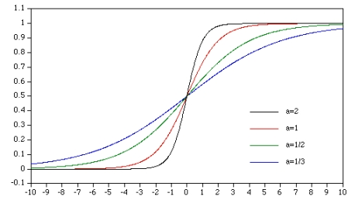
Some important things to remember
Determine the threshold value carefully, it sometimes over learns the network and validation may not be proper (online method)
The vectors or the points are randomized before they are introduced to the network
Activation function should be chosen correctly – so that it is within a range of 0 & 1 and it can be represented in a computer program
Here sigmoid function has been used - f (x) = 1/(1+e^{-ax}); a=1(const)

Slide 13
Test
Finally the architecture is tested using the test set (another subset of the given data set
The error in the test set serves as the misclassification rate . For e.g. if the error in the test set is 0.09876 then misclassification rate is 9.87% i.e.9.87% of total points are misclassified.

Slide 14
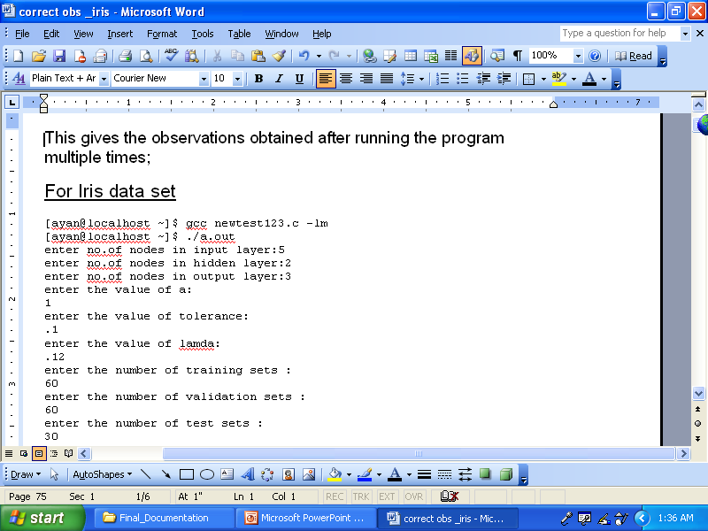

Slide 15
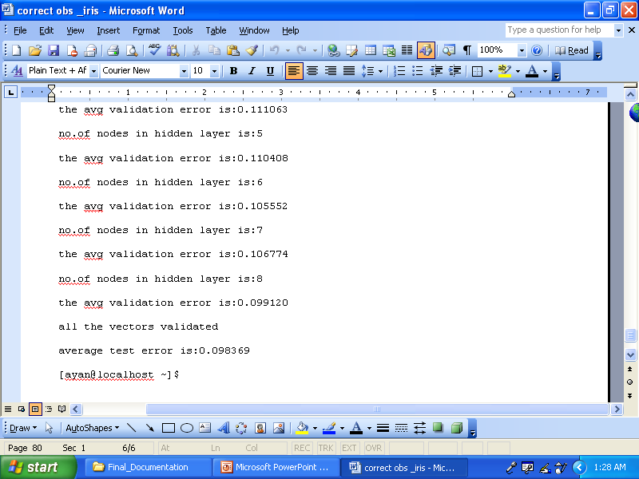

Slide 16
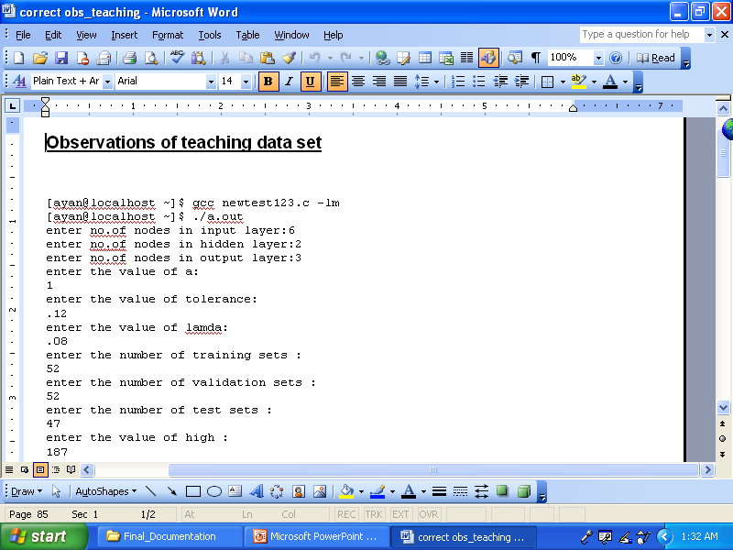

Slide 17
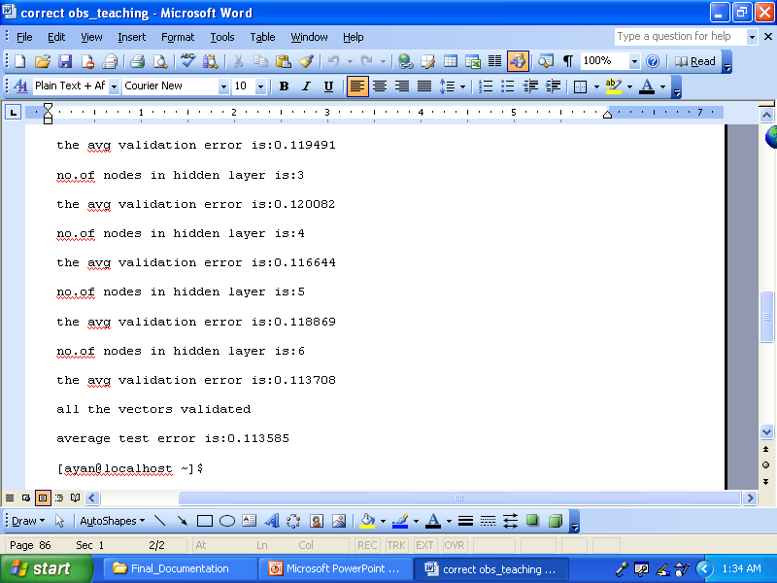

Slide 18
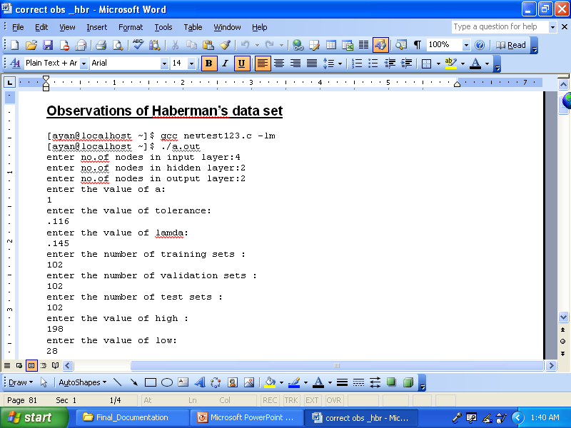

Slide 19
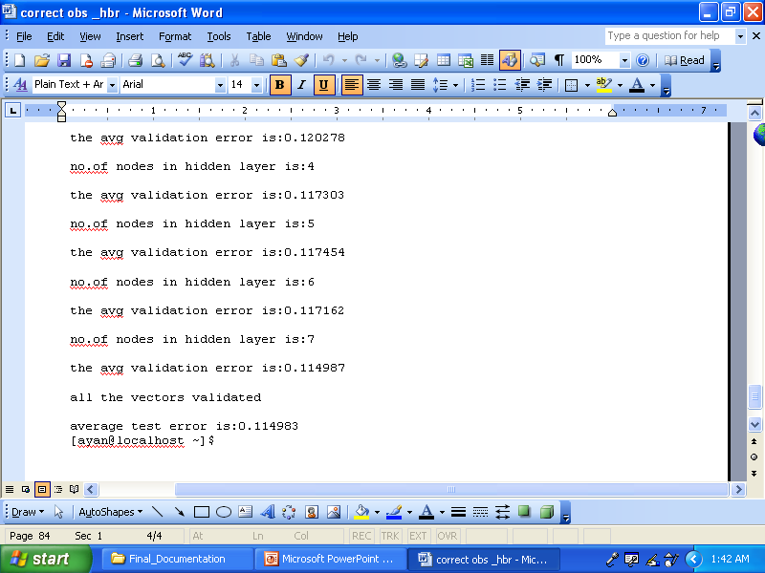

Slide 20
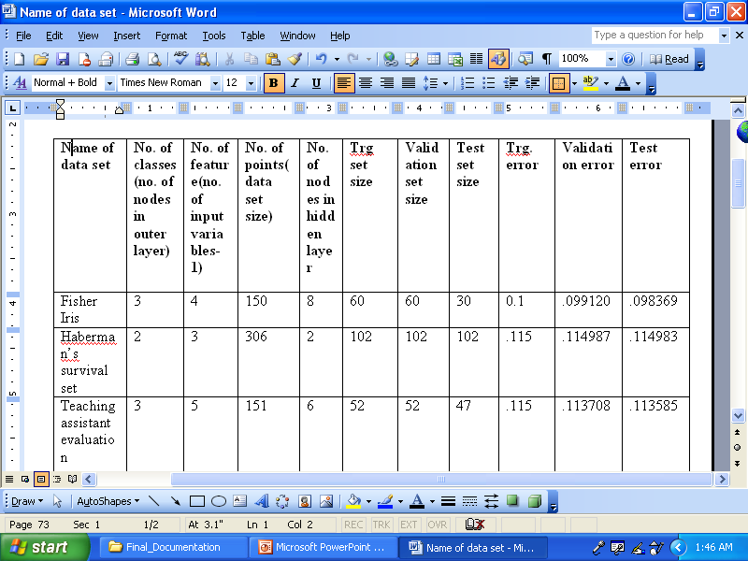

Slide 21
Technological Specifications
Platform used:
Linux (Ubuntu ver 9.10)
Software Used:
gcc compiler(in built in linux)
no extra s/w used.

Slide 22
Future prospects
This project can be extended to solve any classification jobs.
classifying voice of different persons from a sample of mixture of voices.
similarly classifying different images
classifying different finger prints

Slide 23
Acknowledgement
Prof. C. A. Murthy, MIU, Indian Statistical Institute, Kolkata.
(external guide)
Dr. Goutam Saha, HoD (IT & CSE), Govt.College Of Engg. And Leather Technology, Kolkata.
(internal guide)
Mrs. Srirupa Dasgupta, Faculty, Dept. (IT & CSE) , Govt. College Of Engg. And Leather Technology, Kolkata.
Besides the persons mentioned above I am also thankful to my parents for their utmost support.
Ayan Gupta.

Slide 24
Thank You ,
Ayan Gupta
IT 4th year,
Roll-14,
Govt. College Of Engg. And Leather Technology,
Kolkata
Batch-(2007-11)

