Slide 1
Modeling & Performance Analysis of RF Satellite
Downlink
Project demonstration
Group No: 07
Group Member’s ID: 1706013|1706016|1706029|1706032
Course No: EEE 310

Slide 2
Summary
This project shows a model of a satellite link, using the blocks from the Communication ToolboxTM in Simulink. It models some impairments of the communication link and then optionally corrects the impairments imposed.
The model consists of a Satellite Downlink Transmitter, Downlink Path, and Ground Station Downlink Receiver. The performance of the satellite system using 16 QAM digital modulation technique is analyzed and investigated which is a spectrally more efficient digital modulation scheme.
We analyzed performance of the satellite link by observing Bit Error rate. We varied antenna diameter, carrier frequency and altitude of the satellite to see the variations in BER.

Slide 3
Work Flow
Binary Bit Generation
16- QAM Modulation
Up-sampling
Transmission Antenna
Free Space Path
Receiver Binary Bit
Impairment Handling
Down-sampling
Receiver Antenna
16- QAM Demodulation

Slide 4
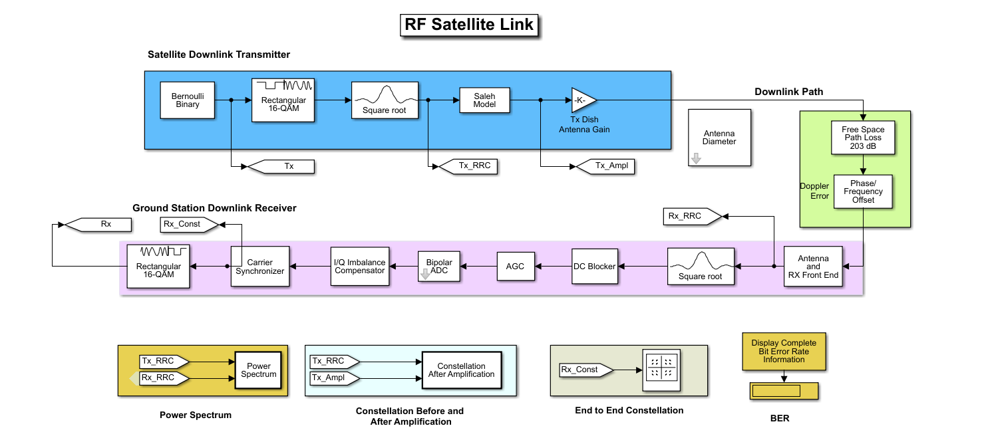
satellite down-link Simulink model

Slide 5
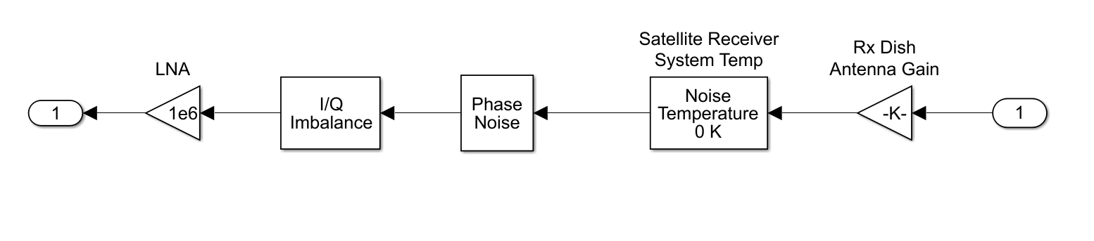
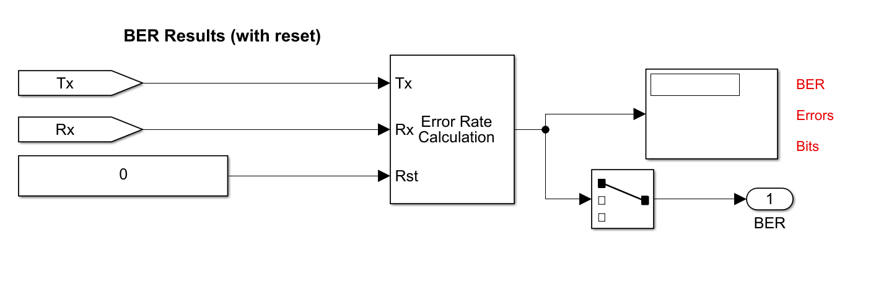
Internal Subsystems
Fig: Receiver Antenna and RX Front End
Fig : Bit Error Rate Calculation Block

Slide 6
Satellite Downlink Transmitter
- Bernoulli Binary Generator
-Rectangular QAM Modulator Baseband
- Raised Cosine Transmit Filter
- Saleh Model for memory nonlinearity
- Antenna Gain
Ground Station Downlink Receiver
- Antenna Gain
- Thermal and Phase noise
- IQ imbalance
- Low noise amplifier
- Raised Cosine Receive Filter
- DC blocker
- AGC block
- IQ imbalance compensator
- Carrier Synchronizer
- Demodulator
Downlink Path
-Free space path loss
-Doppler Error(Phase/Frequency offset)

Slide 7
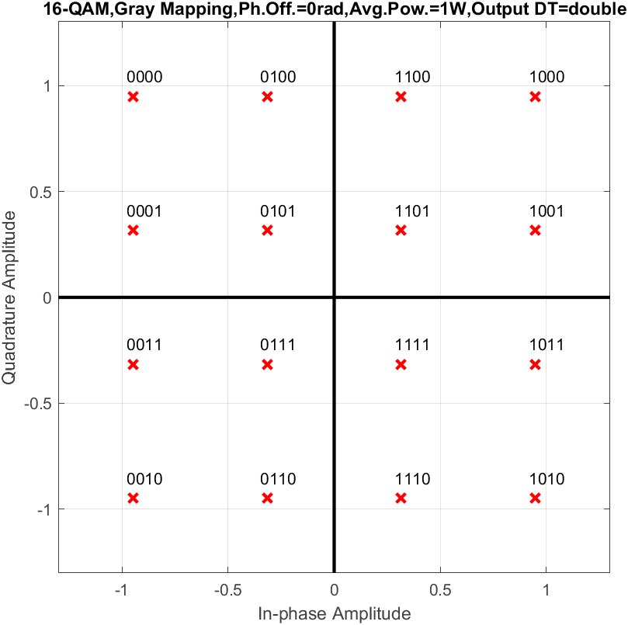

Modulation Scheme 16-QAM
In our model we used “16-QAM” scheme. To execute it “Rectangular QAM” Simulink block is used at both transmission(modulation) and receiving(demodulation) end. The Rectangular QAM Baseband block works using M-ary quadrature amplitude modulation with a constellation on a rectangular lattice.
Fig: Simulink block for 16- QAM
Here, the M-ary number is set to 16 to execute 16- QAM scheme.
Constellation Diagram of 16 QAM

Slide 8


Memoryless Nonlinearity Saleh model
Memory-less nonlinear impairments occur due to signal amplification in the radio frequency (RF) transmitter or receiver. For nonlinearity modeling method Saleh model is used.
The Saleh model is an empirical model for memory-less nonlinearity of the power amplifier. The gain and saturation level of the model are specified by the values of the parameters α and β which are positive and real numbers.
The AM/AM parameters, α_{AMAM} and β_{AMAM}, are used to compute the amplitude distortion of the input signal by using
The AM/PM parameters, α_{AMPM} and β_{AMPM}, are used to compute the phase distortion of the input signal by using
The parameter values (AM/AM, AM/PM, Input scaling and Output scaling) are set according to our satellite model requirements.

Slide 9
Gain at Downlink Transmitter and Receiver
The antenna gain is parameterized by the antenna diameter. We created a mask to take the antenna diameter as user input. This input is used to measure antenna gain. The Gain block multiplies the input by a constant value (gain). The input and the gain can each be a scalar, vector, or matrix.
We specify the value of gain in the Gain parameter as a variable “TxGain” for the transmitter and “RxGain” for the receiver.
Gain = sqrt(neff)*pi*antDiam*(frequency * 1e6)/3e8;
where, neff= 0.55; ( middle of the road efficiency)

Slide 10
Impairments
Reduces amplitude of the signal based on altitude and frequency
Doppler Error
Causes frequency and phase shift
Thermal and Phase noise
Represents effective temperature of the system
IQ imbalance
Introduces DC offset, amplitude imbalance, or phase imbalance to the signal
Free Space path loss
Introduced fluctuations in the phase of a waveform.

Slide 11
Impairments Correction
DC Blocker
Compensates DC offsets.
AGC
Adaptively adjusts its gain to achieve a constant signal level at the output.
IQ Imbalance Compensator
Mitigates the effects of an amplitude and phase imbalance between the in-phase and quadrature components of a modulated signal.
Carrier Synchronizer
Compensates for carrier frequency and phase offsets

Slide 12
Observation 1
We tried to show the BER(bit error rate) variations for the change in antenna diameter which eventually changes the gain of the antenna.
At two different configuration of frequency offset – 0Hz and 2Hz
System Parameters | Values
Altitude | 35600Km
Carrier Frequency | 4000MHz
Total Bits | 4e+6
Simulation run time | 40 seconds

Slide 16
So, we can see that with the increase in antenna diameter (and eventually antenna gain). At first the bit error decreased and then after a certain limit it became increasing in both different frequency offsets.

Slide 17
Observation 2:
BER vs Altitude graph at 4GHz carrier frequency.
With the increase in altitude loss increases and gain decreases. So bit error rate increases with decrease in gain.

Slide 18
Observation 3
BER vs Carrier Frequency

Slide 20
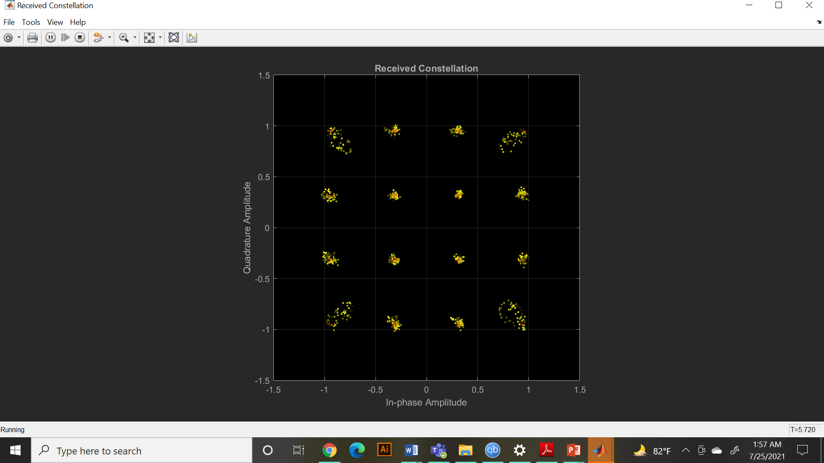
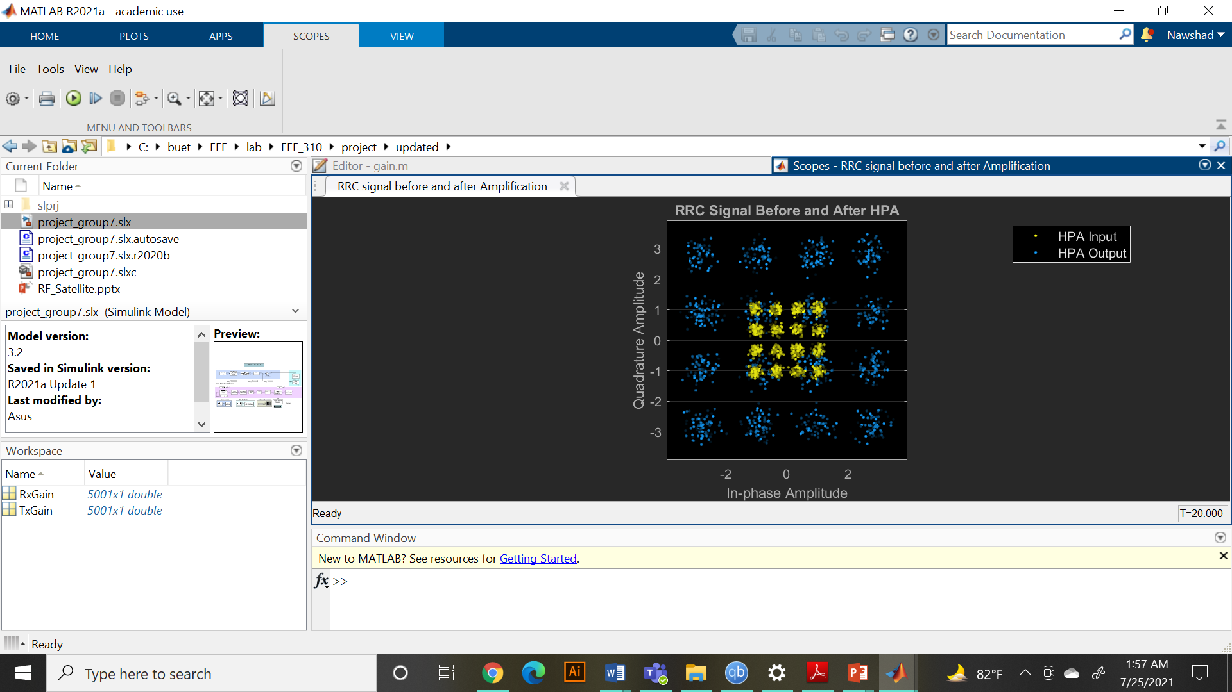
Constellation Diagrams
(Altitude=35600Km, Carrier Frequency=4000MHz)
Fig: End to End Constellation
Fig: Constellation before and after amplification

Slide 21
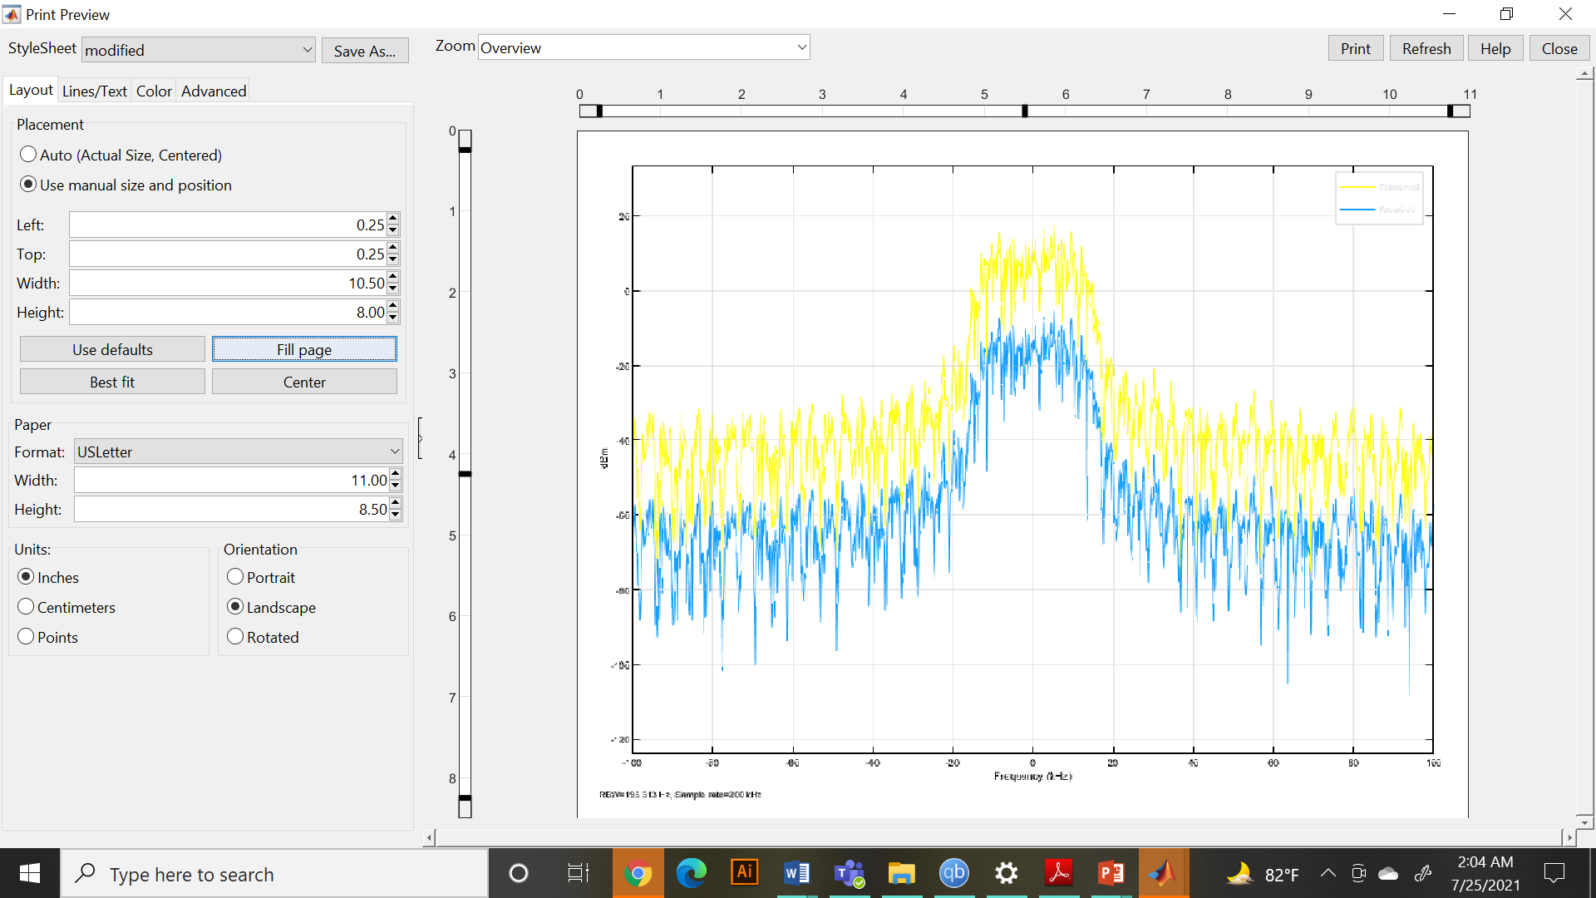
Power Spectrum of Input and Output Signal

Slide 22
Conclusion
To conclude, we simulated a satellite downlink channel with impairments and their remedies. We showcased the resulted BER values for different antenna diameters. We understand that the effect of noise is the main issue regarding BER. That’s why increasing gain not always leads to a better BER.
Other impairment handlings - IQ imbalance compensation, carrier frequency synchronization, AGC, DC Blocking were used to mitigate the impairments.
This simulation can be a projection of a real-life satellite downlink channel.

Slide 23

Thank You!

