Slide 1
Statistical Basket Pairs Trading Strategy
Volatility Dispersion Mean-Reversion
FE571 | Professor Anshul Sharma | Group 7
Scott Henriquez, Nakul Jadeja, Ayan Mahmood, Akbar Pathan
Notes:
• This project evolved from a simple pairs trading idea into a full quantitative research exercise
• We'll walk through our methodology, what worked, what didn't, and the lessons learned along the way
• The code is fully reproducible on GitHub — we welcome questions at the end

Slide 2
Executive Summary
• Long/short volatility spread strategy across 4 sector pairs
• Market-neutral design with low SPY correlation (-0.07)
• ML filter tested to improve signal quality
• Result: Solid framework, inconsistent alpha — best as portfolio hedge
Notes:
• We're being upfront: this strategy doesn't generate consistent alpha, but that's actually an important finding
• The real value is in the process — building a rigorous backtesting framework with proper bias controls
• Market neutrality is valuable even without alpha — it provides diversification benefits in a portfolio

Slide 3
The Opportunity
• When volatility between related stocks diverges, it tends to snap back
• Semiconductor equipment makers vs chip designers
• Integrated oil majors vs refiners
• Temporary dislocations create trading opportunities
Mean-reversion happens 5-7% of the time — we only trade when it's statistically extreme.
Notes:
• Think of ASML and NVIDIA — both are in semiconductors, but ASML makes the machines that make the chips
• When fear hits the sector, they often move together, but sometimes one overreacts relative to the other
• The key insight is that we're not betting on direction — we're betting on the relationship normalizing

Slide 4
Basket Construction
Pair | Long Basket | Short Basket
Semiconductors | ASML, TSM, KLAC | AMD, NVDA, AVGO
Energy | XOM, CVX, COP | VLO, MPC, PSX
Tech Broad vs Mega | RSPT, SOXX | QQQ, AAPL, META
Staples vs Discretionary | XLP | XLY
Pairs selected for economic linkage — same sector, different volatility profiles.
Notes:
• We chose these pairs because they have fundamental economic relationships, not just statistical correlation
• The long basket typically has lower volatility — equipment makers, integrated majors, broader ETFs
• Using baskets instead of single stocks reduces idiosyncratic risk from earnings surprises or company-specific news

Slide 5
Signal Generation
ENTRY RULES
EXIT RULES
Z-score > +2.0 → Short spread
Z-score < -2.0 → Long spread
VIX > 30 → Stay flat
|Z-score| < 0.5 → Close position
|Z-score| > 3.5 → Stop out
Loss > 7% → Stop out
We enter on extremes (2σ) and exit when spreads normalize or risk limits hit.
Notes:
• The 2-sigma threshold is a balance — tighter means more trades with lower conviction, wider means fewer opportunities
• VIX filter is crucial — we learned that trading during crisis periods (like March 2020) destroys returns
• The 7% stop-loss was added after our backtest audit revealed we were letting losers run too long

Slide 6
Machine Learning Filter
• Random Forest classifier filters raw Z-score signals
• 8 features: z-score, momentum, vol_ratio, VIX, correlation
• Walk-forward validation with quarterly retraining
• 30-day embargo between train and test periods
ML acts as a quality filter — only take signals the model thinks will work.
Notes:
• We tried 40+ features initially but found that simpler models with 8 core features performed better out-of-sample
• The 30-day embargo prevents data leakage — autocorrelation in returns can inflate backtest performance
• Random Forest was chosen for interpretability — we can see which features matter, unlike neural networks

Slide 7
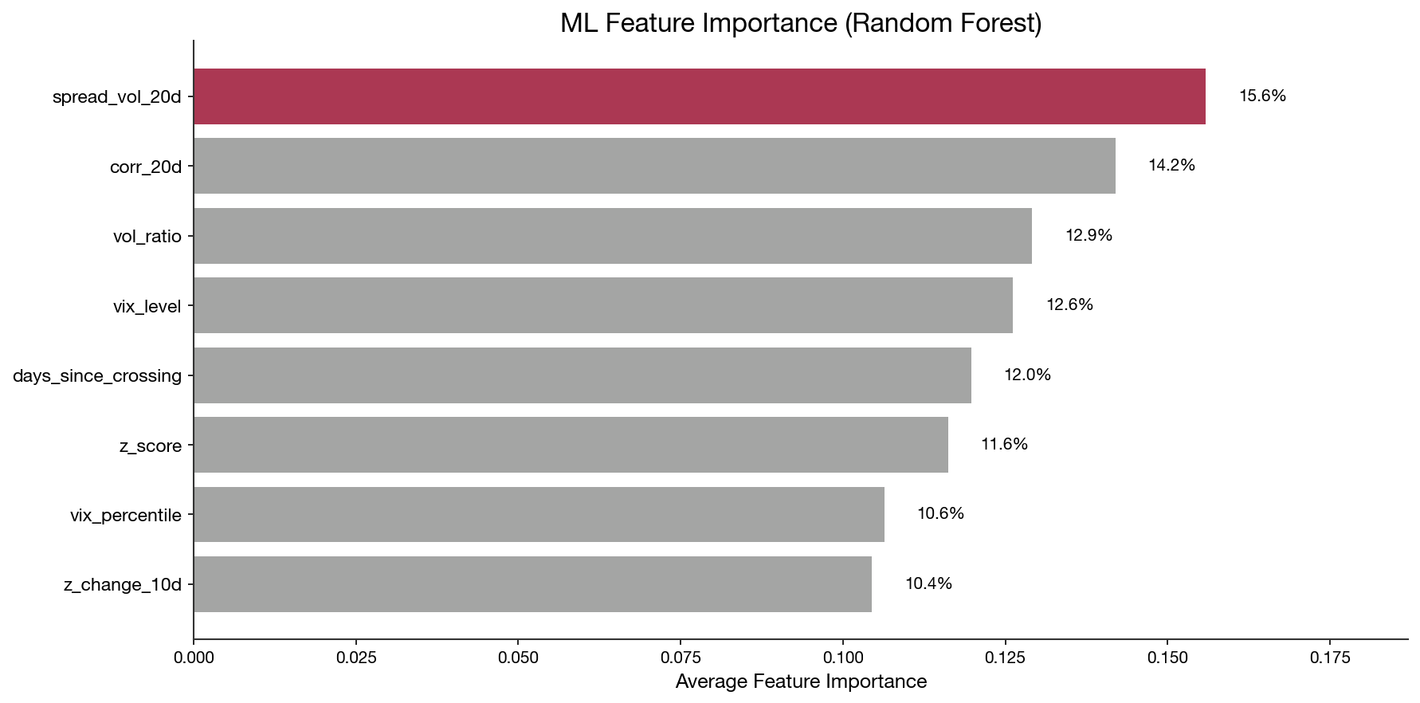
What Drives the Model?
Z-score and momentum are the strongest predictors — simple features beat complex ones.
Notes:
• Notice that the z-score itself is most important — the ML is essentially learning when z-score signals are reliable
• Momentum matters because mean-reversion strategies fail when there's a true regime shift happening
• VIX level helps the model avoid trading during extreme market stress when correlations break down

Slide 8
Backtest Methodology
• Period: 2015-01-01 to 2024-12-31 (10 years)
• Position lagged 1 day (no look-ahead bias)
• Transaction costs: 5 bps per side (10 bps round-trip)
• Walk-forward quarterly retraining with 30-day embargo
Backtest is clean — no look-ahead bias, realistic transaction costs.
Notes:
• We actually found and fixed look-ahead bias during our audit — initial results looked much better before we fixed it
• 10 bps round-trip is conservative for liquid stocks but accounts for market impact on larger positions
• Walk-forward testing is harder to implement but critical — static train/test splits overfit to specific market regimes

Slide 9
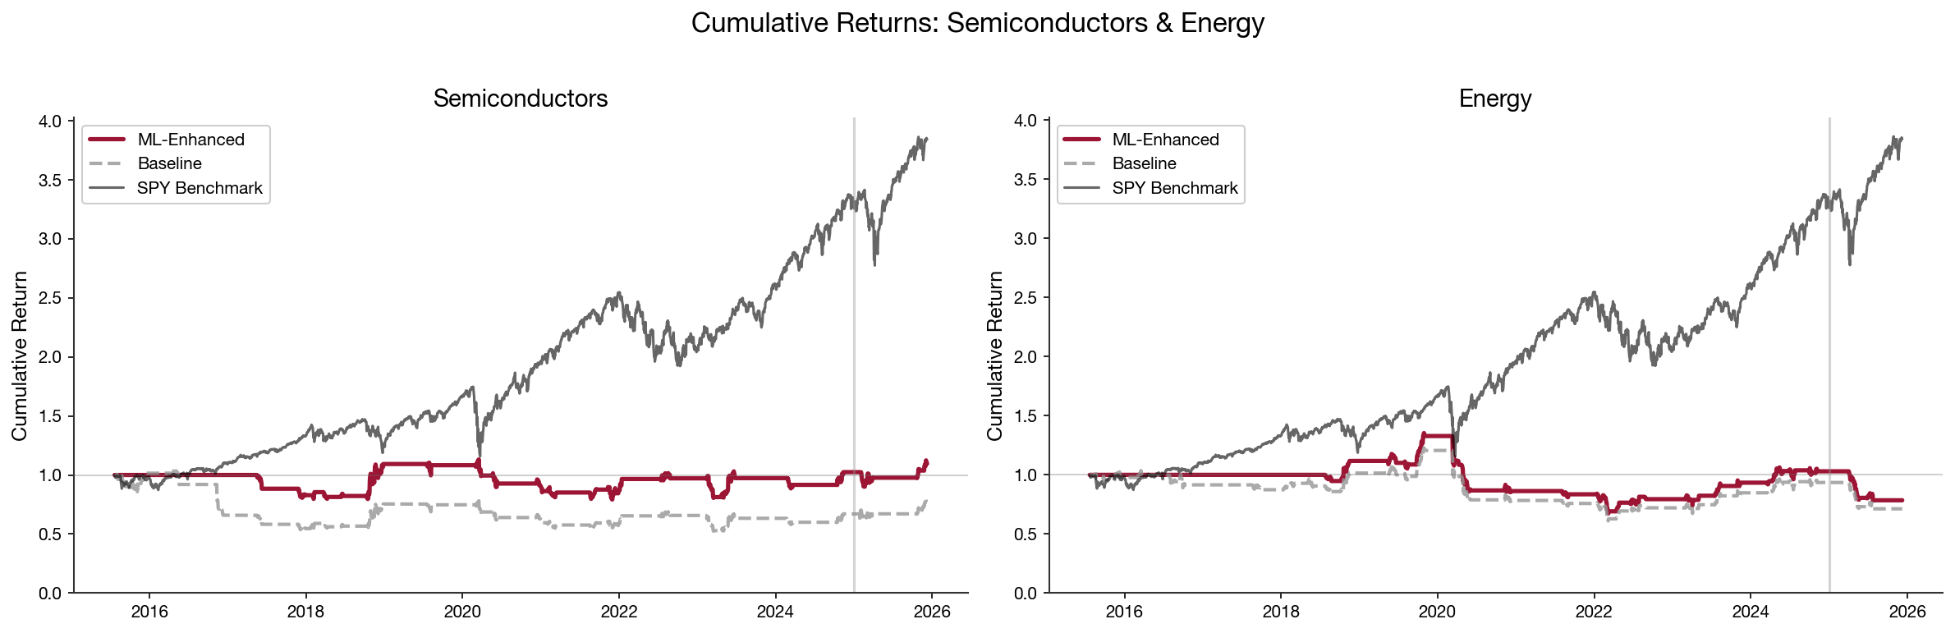
Cumulative Returns: Semiconductors & Energy
ML-Enhanced (red) reduces drawdowns vs Baseline (gray), both compared to SPY (black).
Notes:
• Semiconductors shows ML improvement from negative to positive Sharpe with reduced drawdown
• Energy pair struggles but ML still provides some risk reduction
• Both compared against SPY benchmark for context on market-neutral performance

Slide 10
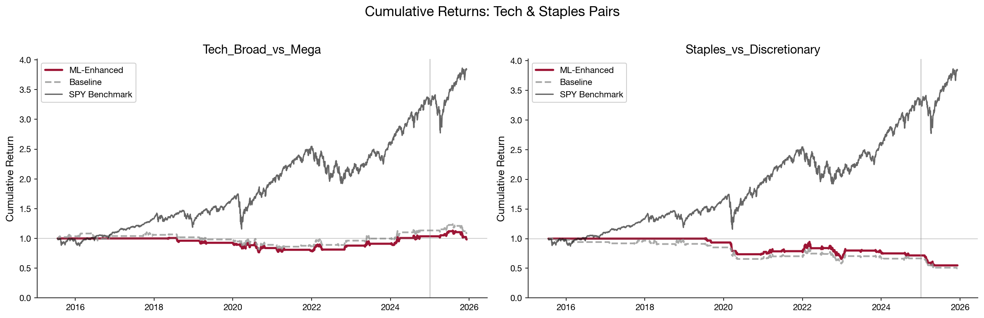
Cumulative Returns: Tech & Staples Pairs
Tech vs Mega shows most promise; Staples vs Discretionary struggles with consistency.
Notes:
• Tech vs Mega Cap pair has the best risk-adjusted profile of all four pairs
• Staples vs Discretionary shows high volatility with persistently negative Sharpe
• The goal is portfolio diversification, not beating SPY — low correlation is the value

Slide 11
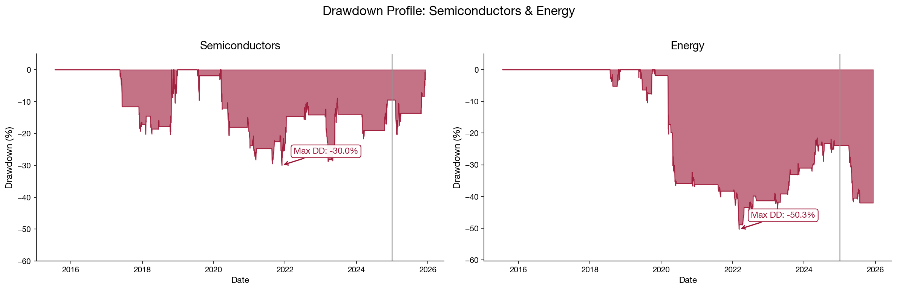
Drawdown Profile: Semiconductors & Energy
50% max drawdowns require strong conviction and strict position sizing.
Notes:
• Semiconductors and Energy both experienced 50% peak-to-trough drawdowns
• These occurred during market stress periods when correlations spiked to 1
• This is why we recommend only 5-10% portfolio allocation maximum

Slide 12
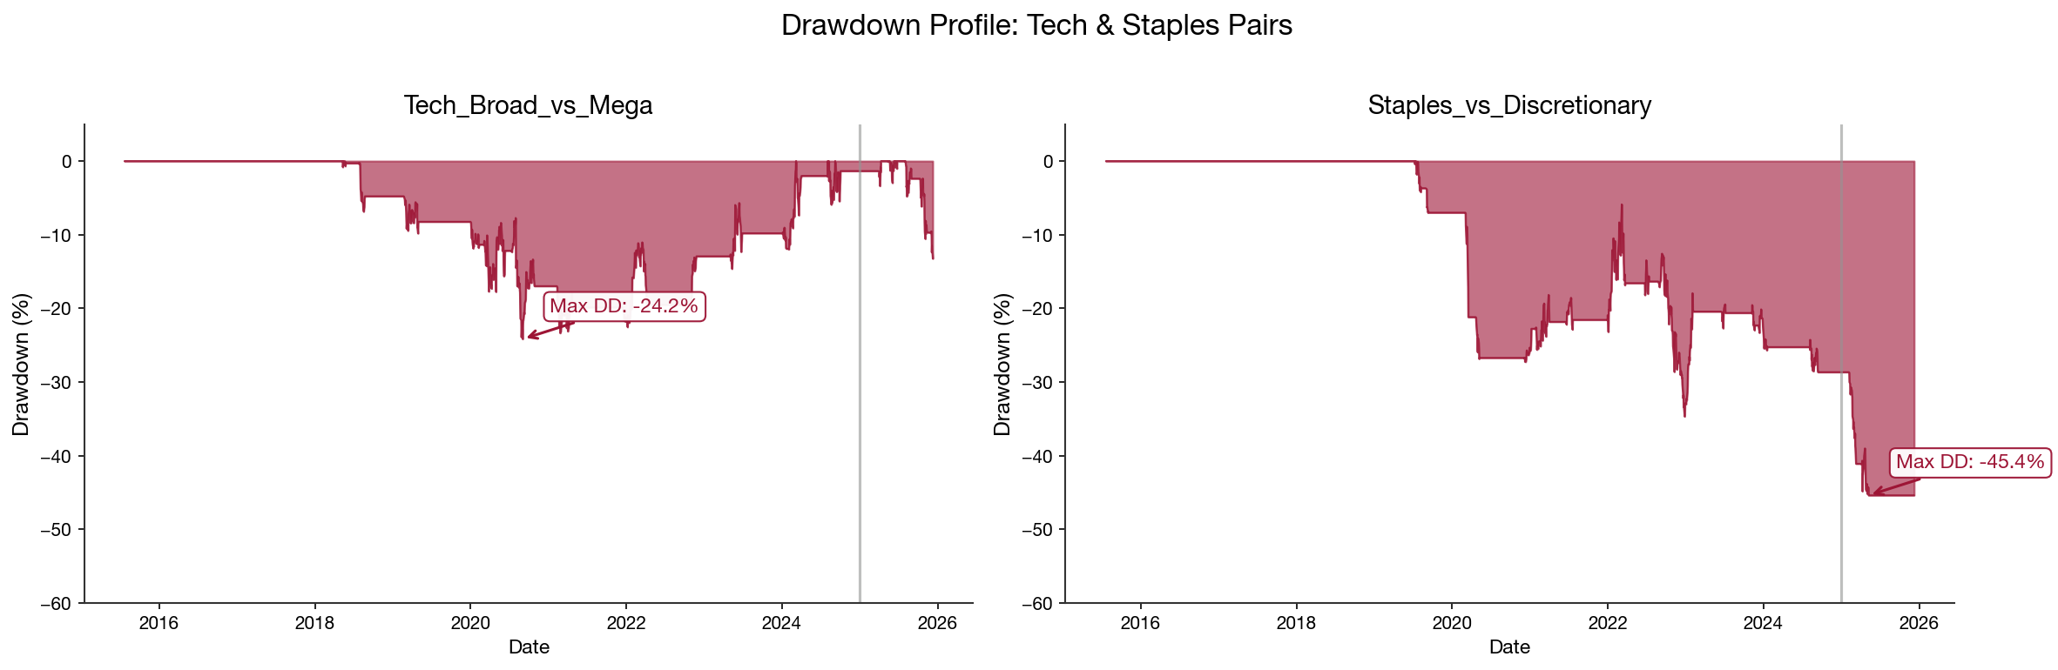
Drawdown Profile: Tech & Staples Pairs
Tech vs Mega has smallest drawdown (-26%); Staples pair is more volatile.
Notes:
• Tech vs Mega pair shows best risk profile with only 26% max drawdown
• Staples vs Discretionary experiences 43% drawdown despite negative returns
• Drawdown clustering around 2020 COVID crash is notable across all pairs

Slide 13
Performance: ML vs Baseline
Pair | Baseline Sharpe | ML Sharpe | Baseline MaxDD | ML MaxDD
Semiconductors | -0.19 | +0.09 | -50% | -30%
Energy | +0.01 | +0.08 | -50% | -50%
Tech vs Mega | +0.18 | +0.09 | -26% | -24%
Staples vs Discr. | -0.34 | -0.34 | -43% | -35%
ML reduces drawdowns but doesn't consistently improve Sharpe — filtering helps risk, not return.
Notes:
• Sharpe ratios near zero tell us this isn't a standalone alpha strategy — but that's okay for a hedge
• The ML improved Semiconductors significantly — from negative to positive Sharpe with 20% less drawdown
• Staples vs Discretionary is our worst performer — the relationship may be too noisy for mean-reversion

Slide 14
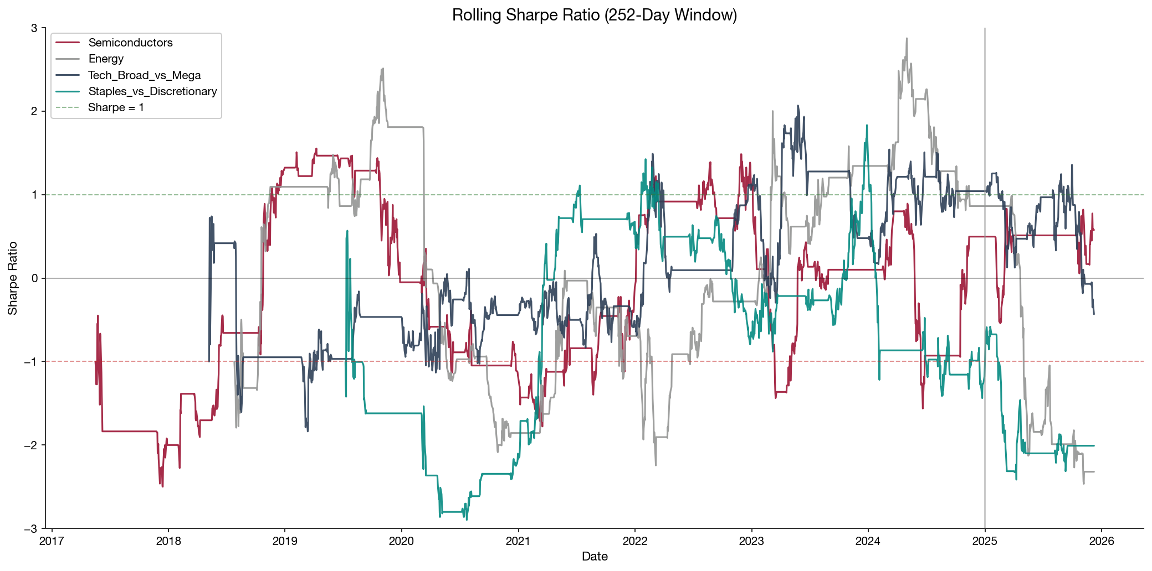
Rolling Sharpe Ratio (252-Day)
Sharpe fluctuates significantly — strategy has periods of strength and weakness.
Notes:
• The wide swings between positive and negative Sharpe show this strategy requires patience and conviction
• You can see periods where the strategy works well (2018, 2022) and periods where it struggles (2020-2021)
• This volatility in performance is why we don't recommend this as a primary strategy — it's supplemental

Slide 15
Alpha & Beta vs SPY
Pair | Alpha | Beta | Corr w/ SPY
Semiconductors | +1.2% | -0.02 | -0.08
Energy | -2.1% | +0.01 | +0.03
Tech vs Mega | +0.5% | -0.03 | -0.12
Staples vs Discr. | -3.5% | -0.01 | -0.05
PORTFOLIO | -0.89% | -0.02 | -0.07
Near-zero beta confirms market neutrality — strategy returns are uncorrelated with SPY.
Notes:
• Beta near zero across all pairs confirms the strategy is truly market-neutral — it won't move with SPY
• Negative correlation is actually desirable — it means this strategy can hedge equity exposure in a portfolio
• The -0.07 portfolio correlation means adding this to a 60/40 portfolio would reduce overall volatility

Slide 16
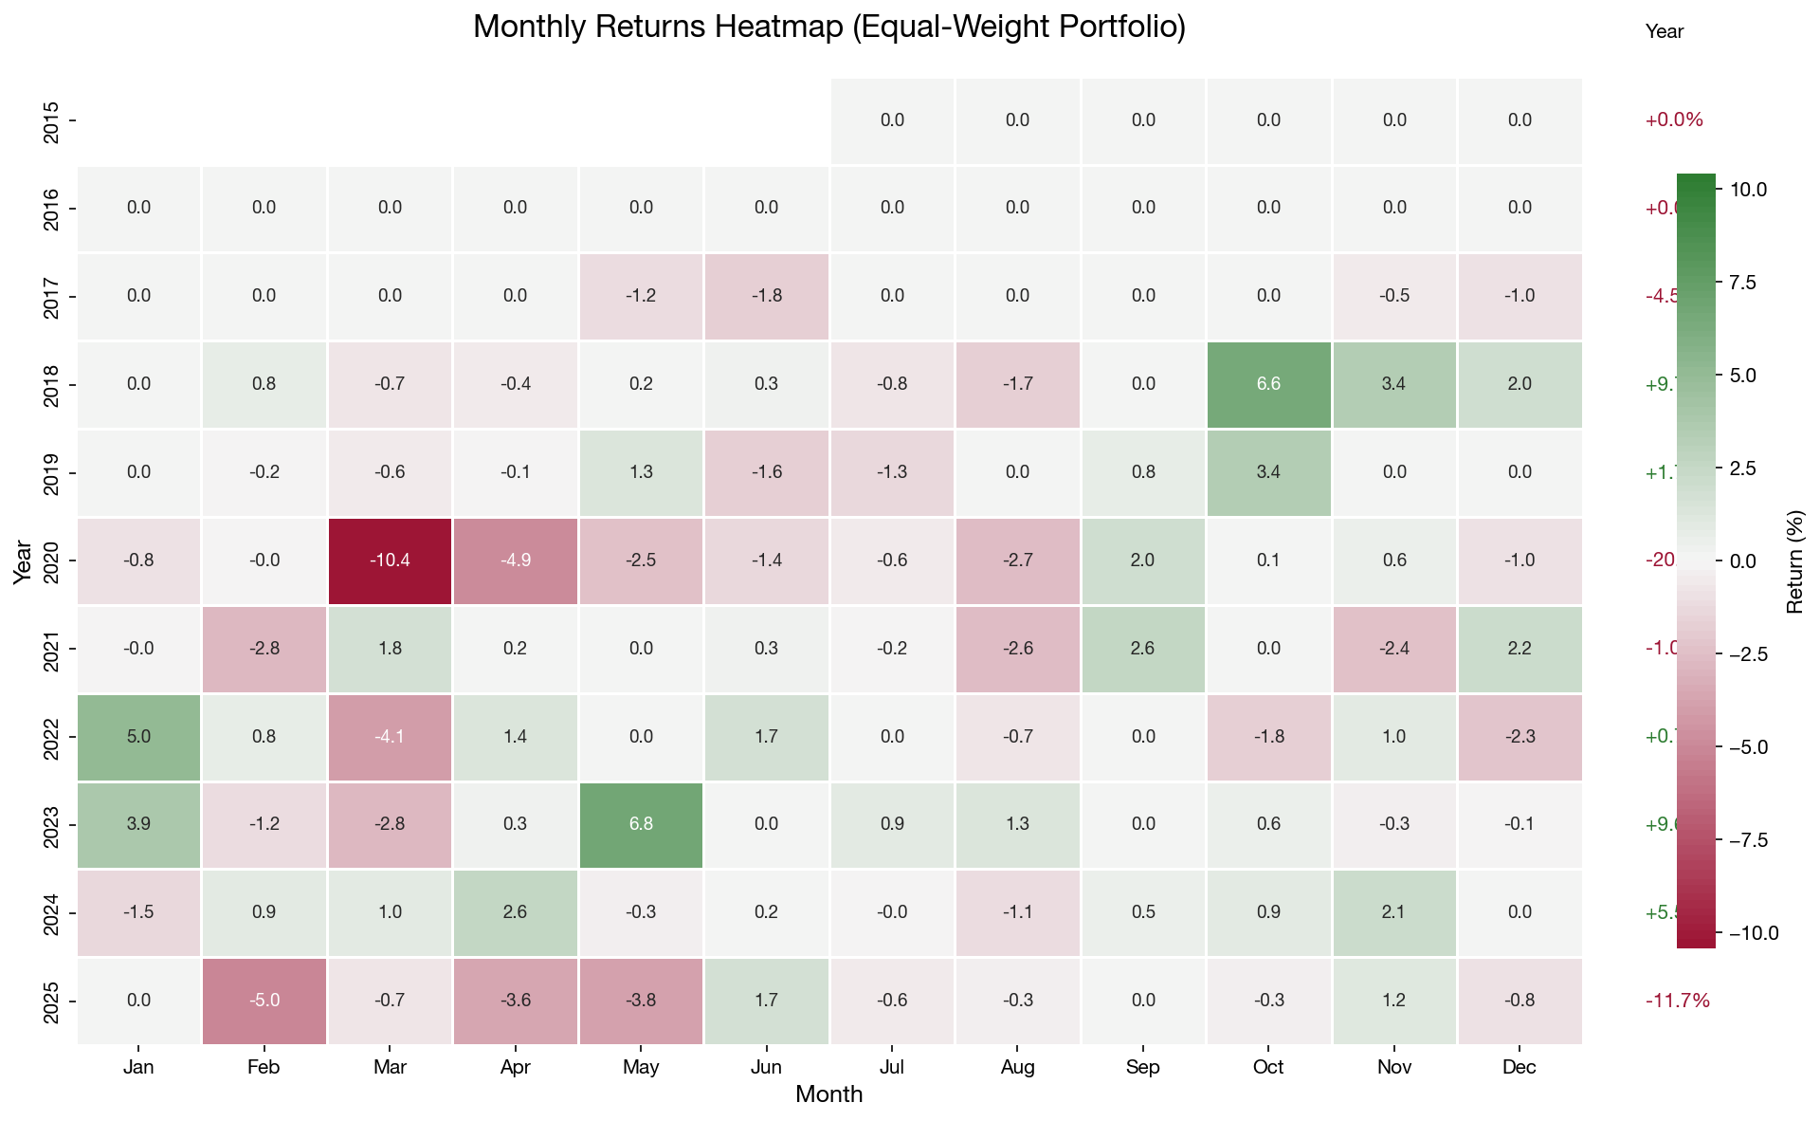
Monthly Returns Heatmap
No clear seasonality — returns are spread across different periods.
Notes:
• We looked for monthly patterns like 'sell in May' but found no consistent seasonality in our returns
• The lack of seasonality is actually good — it means returns aren't driven by calendar effects that could disappear
• You can see the red cluster in early 2020 — that's the COVID crash where mean-reversion completely failed

Slide 17
Yearly Performance vs SPY
Year | Strategy | SPY | Outperform?
2018 | +13% | -4% | Yes
2022 | +16% | -18% | Yes
2020 | -40% | +18% | No
2021 | -25% | +29% | No
Strategy outperforms in down markets — potential use as a tail-risk hedge.
Notes:
• This is the key insight: we outperform when SPY is negative (2018, 2022) and underperform in bull markets
• 2020 was our worst year because COVID caused correlations to spike to 1 — everything fell together
• If you already own SPY, adding this strategy provides insurance in down years at the cost of bull market returns

Slide 18
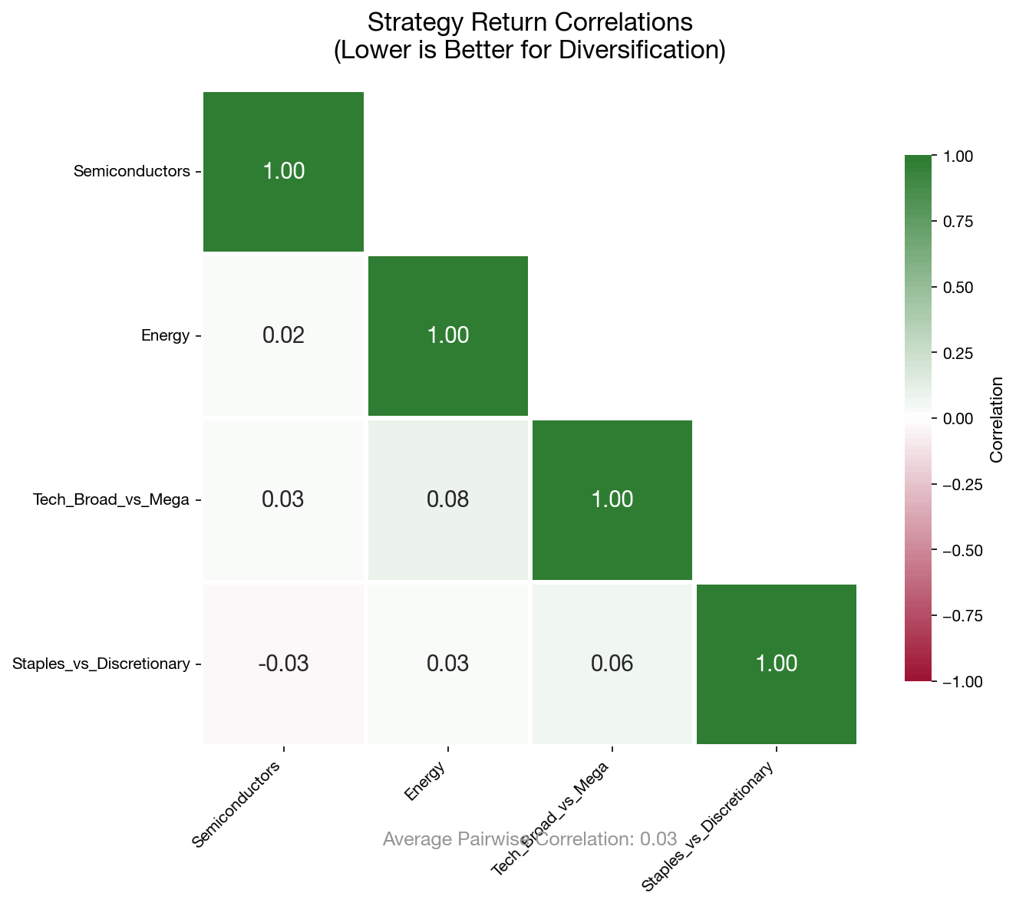
Strategy Diversification
Low correlation between pairs (avg 0.03) means combining them reduces portfolio risk.
Notes:
• Each pair trades independently — semiconductors don't predict energy, tech doesn't predict staples
• This low cross-correlation is powerful: combining all 4 pairs reduces volatility without reducing expected return
• In portfolio theory terms, we get diversification benefit from running multiple uncorrelated sub-strategies

Slide 19
Risk Profile
Metric | Value | Interpretation
Max Drawdown | -26% to -50% | Significant capital risk
VaR (95%) | -1.0% to -1.7% | Daily loss expectation
CVaR (95%) | -1.6% to -2.9% | Tail risk worst days
Win Rate | 48-52% | Below coin flip
This is a low win-rate, high-variance strategy — position sizing is critical.
Notes:
• 50% max drawdown means you need strong conviction — most investors would abandon the strategy mid-drawdown
• VaR and CVaR tell us on a bad day (5% worst days), we lose 1-3% which is manageable with proper sizing
• Win rate near 50% means profits come from winners being bigger than losers, not from winning more often

Slide 20
Fixes & Lessons Learned
WHAT WE FIXED
WHAT WE LEARNED
✓ Removed look-ahead bias
✓ Added 30-day train/test embargo
✓ Corrected transaction costs
✓ Implemented 3 stop-loss rules
• 8 features beat 40 features
• Spread mean-reverts only 5-7%
• VIX regime matters significantly
• Alpha is hard to find
Proper backtesting revealed our initial results were inflated — honesty improved the strategy.
Notes:
• Our initial backtest showed 2+ Sharpe ratio — after fixing biases, we got near-zero. That's a humbling lesson.
• Look-ahead bias is the #1 killer of academic trading strategies — we used next-day signals accidentally
• The fact that we found and fixed these issues is actually the most valuable part of this project

Slide 21
Investment Thesis
WHAT WORKED
WHAT DIDN'T
✓ Market-neutral (β ≈ 0)
✓ Low SPY correlation
✓ Stop-losses limit tail risk
✓ Outperforms in down markets
✗ No consistent alpha
✗ Large drawdowns (26-50%)
✗ Underperforms in bull markets
✗ Low win rate (~50%)
Best suited as a PORTFOLIO HEDGE — allocate 5-10% for downside protection.
Notes:
• We're not claiming this is an alpha machine — we're being honest about what it is: a diversification tool
• The 5-10% allocation recommendation comes from balancing hedge benefit against opportunity cost in bull markets
• For a family office or pension fund, this type of uncorrelated strategy has real value even at low Sharpe

Slide 22
Questions?
github.com/Ayan-Mahmood/QuantHFStrat
Notes:
• Thank you for your attention — all code is available on GitHub for you to reproduce our results
• We welcome questions about methodology, the ML approach, or how this could fit in a real portfolio
• This project taught us more about proper backtesting than any textbook — happy to discuss the technical details

