Slide 1

Guest House Management System
RA1911003010808
RA1911003010793
RA1911003010792

Slide 2
The project intends to provide a solution to implement the Guest House Management System, using a database and web pages to interact with the database.

Slide 3
Tools Used
PostgreSQL 10.15
pgAdmin 4.30
(GUI)

Slide 4
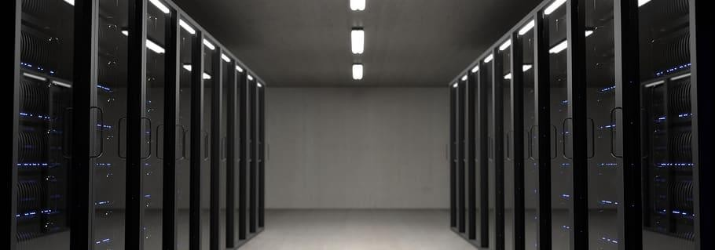
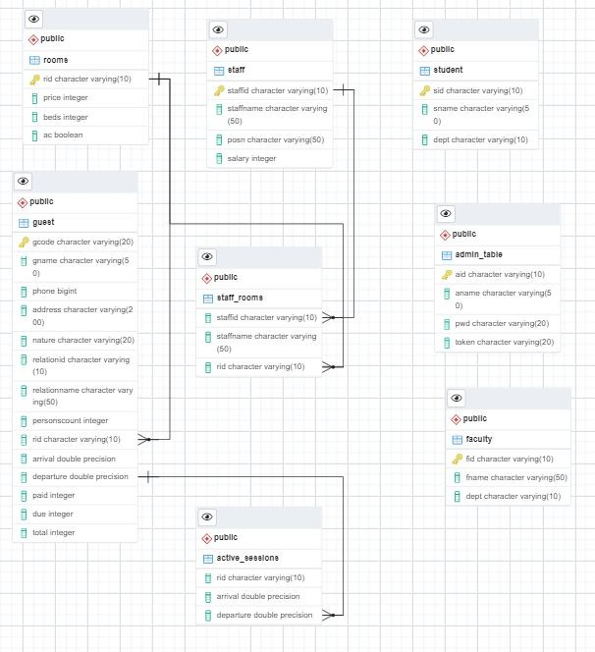
SCHEMA DIAGRAM

Slide 5

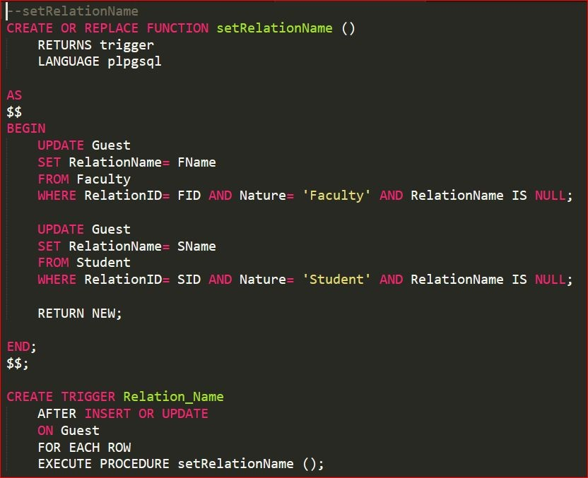
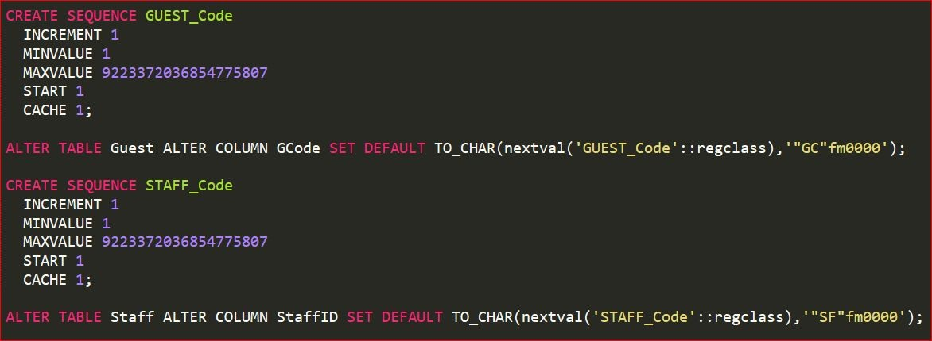
A sequence is a user deﬁned schema bound object that generates a sequence of numeric values.
Sequences are frequently used in many databases because many applications require each row in a table to contain a unique value and sequences provides an easy way to generate them.
A trigger is a stored procedure in database which automatically invokes whenever a special event in the database occurs. For example, a trigger can be invoked when a row is inserted into a speciﬁed table or when certain table columns are being updated.

Slide 6
FRONTEND

Slide 7
Tools Used
HTML
Describing the structure of the information in a webpage
C++
Deals with elements color, font, layout, etc
REACTJS
Allows developers to create large web applications which changes data without reloading

Slide 8
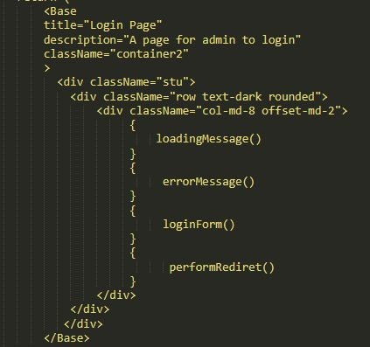
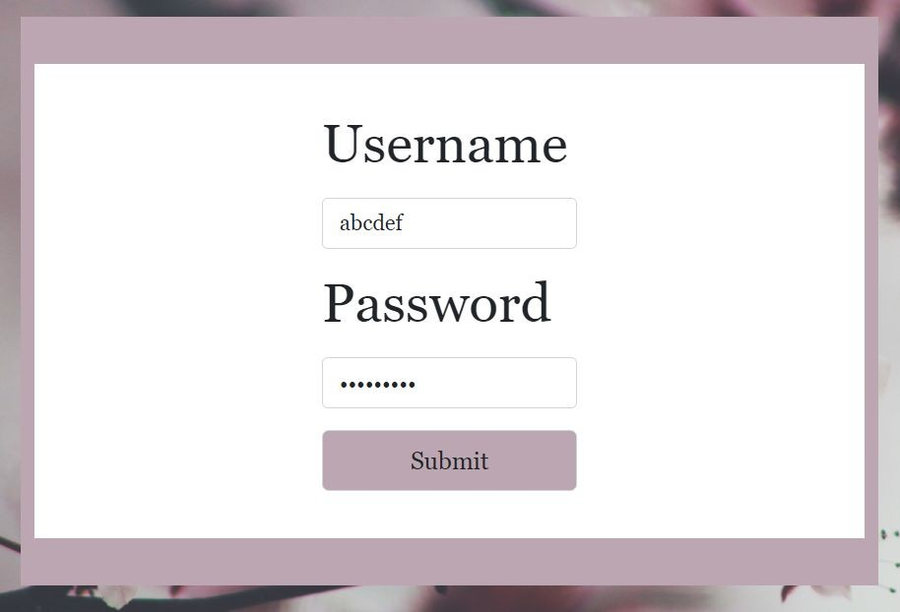
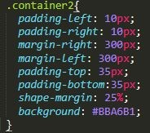
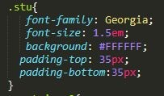
Form and its corresponding HTML and CSS codes

Slide 9
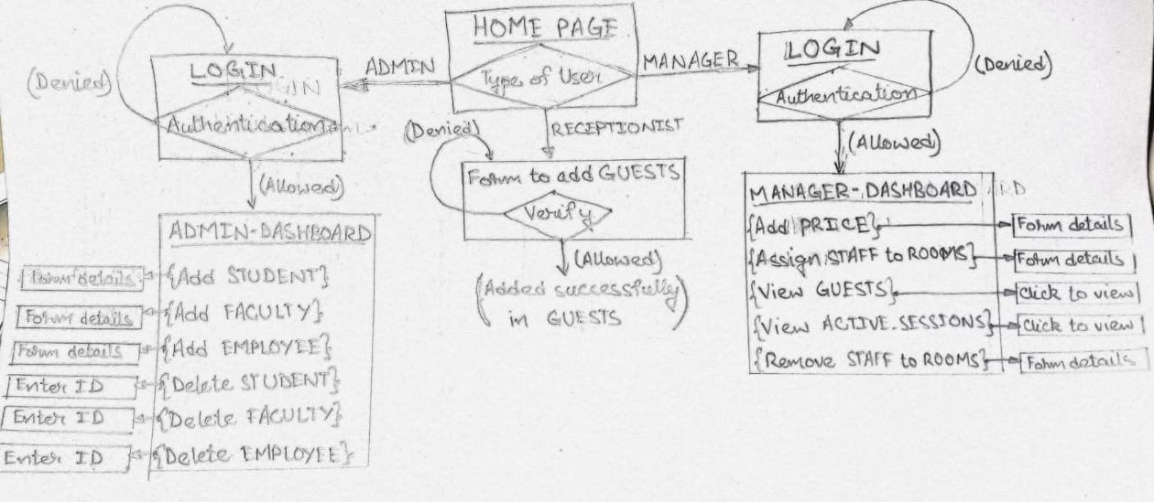
SITE MAPS & ACTIONS

Slide 10


